Slide 1
heatmaps
File created on: 2/23/20 1:58:50 PM EST

Slide 2
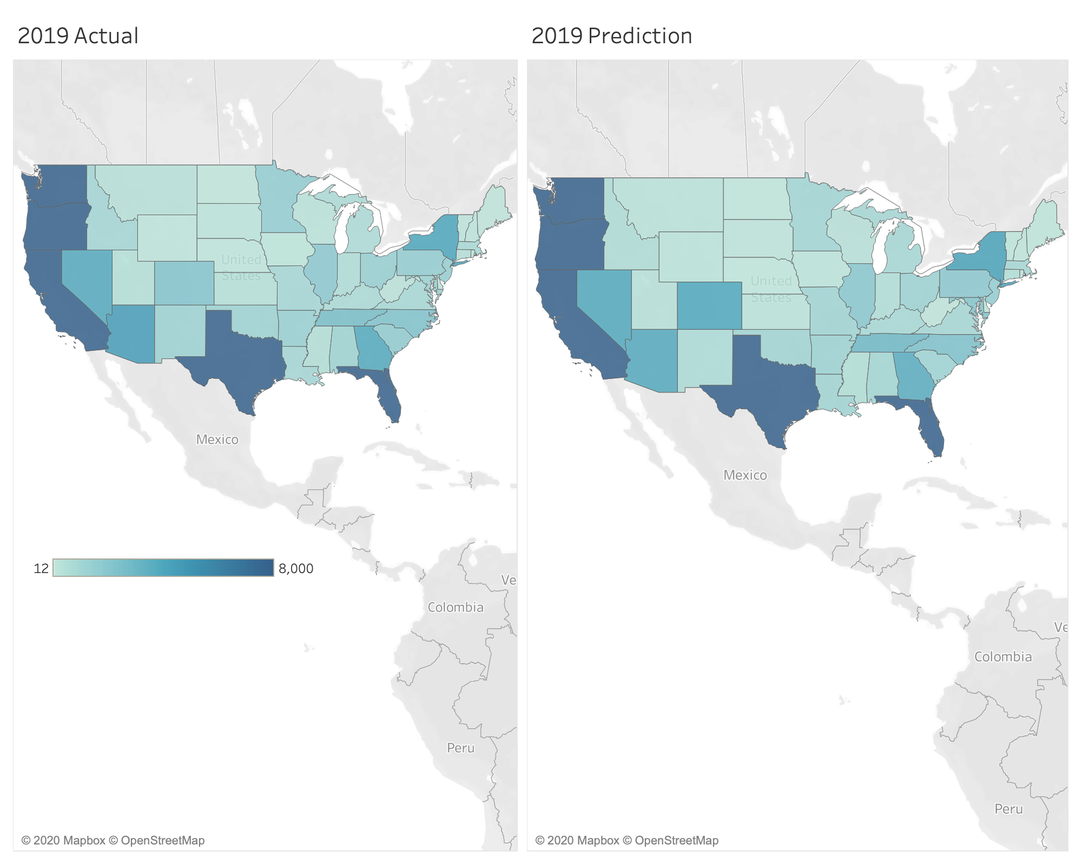

Slide 3
