Slide 1

BREAKING CRYPTO WITHOUT
BREAKING YOUR BRAIN
portcullis
Graham Sutherland – Penetration Tester

Slide 2

WHO AM I?
Graham Sutherland
@gsuberland on Twitter
Pentester for Portcullis Computer Security, London
Ex-developer (mainly .NET, Delphi, PHP)
Started out in security research on my own – no formal training or education in the field
Love reverse engineering (Windows binaries / network protocols / hardware gear)
Learnt crypto because it's interesting!

Slide 3

CORPORATE INFORMATION

Slide 4
CONTENT/TOPICS
Talk background
Rules
Notation for dummies
Basic crypto concepts
Types of crypto, and attacks on them
Techniques for identification
A few demos
Wrap-up
Goal: Learn crypto in the next hour

Slide 5
WHAT'S COVERED?
What crypto is covered in this talk?
  One-time pad
  Stream ciphers
  Block ciphers
  Padding
  Cipher modes
  Malleability

Slide 6
WHAT'S NOT COVERED?
What is not covered by this talk?
  Classical crypto, e.g. Caesar cipher
  Elementary ciphers, e.g. substitution
  Asymmetric crypto*
  Key exchange, e.g. Diffie-Hellman
  Public key infrastructure
  Hash functions / HMAC
  TPM / DRM
  Monstrously large protocols such as SSL/TLS

Slide 7
THE PROBLEM
Sometimes, when I check my work email, I'll find a message that says "Talk Announcement: Vertex-based Elliptic Cryptography on N-way Bojangle Spaces." I'll look at the abstract for the talk, and it will say something like this: "It is well-known that five-way secret sharing has been illegal since the Protestant Reformation [Luther1517]. However, using recent advances in polynomial-time Bojangle projections, we demonstrate how a set of peers who are frenemies can exchange up to five snide remarks that are robust to Bojangle-chosen plaintext attacks." I feel like these emails start in the middle of a tragic but unlikely-to-be-interesting opera. Why, exactly, have we been thrust into an elliptical world? Who, exactly, is Bojangle, and why do we care about the text that he chooses? If we care about him because he has abducted our families, can I at least exchange messages with those family members, and if so, do those messages have to be snide?
(source: This World of Ours - James Mickens)

Slide 8
WHY IS CRYPTO HARD?
Mathematics: statistics, probability theorem, finite fields, discrete log problem, semiprime factoring problem, etc.
Notation: weird hieroglyphs, unintuitive concepts, not always hegemony between styles in papers
Community: lots of internal knowledge within the field, but not much of it being shared in an easy-to-digest format
Punishing: bad things happen when you get it wrong, lots of little subtle holes that can be missed

Slide 9
BUT WHY IS CRYPTO HARD?
It doesn't have to be as hard as people make out
It doesn't have to be full of crazy hieroglyphs
We can explain our notation clearly, ahead of time
It doesn't have to rely upon pure maths*
We can describe things. We can draw diagrams. We don't have to be exclusionary of people that don't have a mathematics degree, or that aren't familiar with the so-called “standard” notations.
Learning crypto is easier than learning to code.

Slide 10
THE RULES
Five important rules of crypto.
Respect them: it's the law!

Slide 11
RULE 0x00
Custom ciphers are the devil.

Slide 12
RULE 0x01
If your cipher needs to be secret, it's not a cipher.

Slide 13
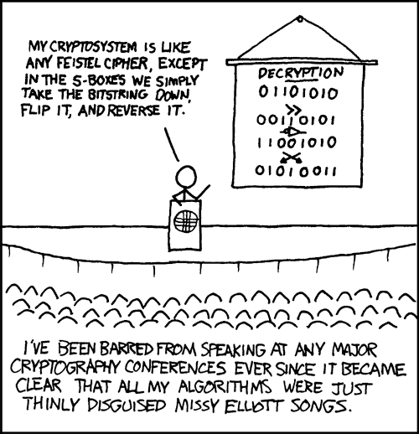
RULE 0x02
Know what you're doing.

Slide 14
RULE 0x03
It's easy to write a cipher you can't break yourself. It's hard to write a cipher nobody can break.

Slide 15
RULE 0x04
Peer review everything.
Don't trust yourself, or me.

Slide 16
BASIC LOGIC NOTATION
Inputs are A, B, C, etc.
Output is usually Q.
Arbitrary (i.e. “any”) values are referred to as X.
Two forms of equality:
  A normal = symbol is used just as you would expect to see it in ordinary maths.
  The ≡ symbol means an identity, which is a way of saying “this always holds true”.

Slide 17
BASIC CRYPTO NOTATION
M is the message, also known as the plaintext
C is the ciphertext (encrypted data)
k is a key, which is a secret
E(M,k) is an encryption operation, i.e. encrypt message M using the key k. The output of this operation is C.
D(C,k) is a decryption operation. The output of this operation is M.
When referring to bits or bytes of a value, we use subscript. For example, m₀ is the first element in M.

Slide 18
XOR IS IMPORTANT
The XOR operation has interesting properties.
For a start, it's reversible:
  0 xor 1 = 1
  1 xor 1 = 0
Its outputs also don't tell us anything about the state of individual inputs. For any value of Q, the chance of A being 0 is 50%, and the chance of A being 1 is also 50%. Same goes for B.
Number of 1s and 0s in input/output columns equal, so no skew is introduced by the operation.

Slide 19
XOR EXPLAINED
We use the ⊕ symbol to refer to XOR.
A ⊕ B = Q
X ⊕ X ≡ 0
X ⊕ 0 ≡ X
A ⊕ B ⊕ B = A
A ⊕ B ⊕ A = B
Note that equal pairs give 0, non-equal pairs give 1
A | B | Q
0 | 0 | 0
0 | 1 | 1
1 | 0 | 1
1 | 1 | 0

Slide 20
ONE TIME PAD
OTP is a perfect cipher. It cannot be broken if implemented correctly.
Defined as C = M ⊕ k
  k must be the same length as M
  k must be perfectly random
  k must always remain unknown to attackers
  You can only use k once, for one message
This is unbreakable due to the properties of xor.
There is no way to verify a “correct” decryption – all keys produce a result of some sort.

Slide 21
ONE TIME POINTLESS
First problem: creating a perfectly random key is almost impossible – there are very few true sources of random data in the world.
Second problem: key distribution is difficult – you need to securely agree upon a new key for every message.
Third problem: the key must NEVER EVER be discovered by an attacker.
If you had a way of doing this, why not just send the message over this super secure exchange channel?

Slide 22
TWO TIME PAD
Same mechanism as OTP, except the key is re-used.
C_{a} = M_{a} ⊕ k, and C_{b} = M_{b} ⊕ k
If we know C_{a} and C_{b} then we can xor them together.
C_{a} ⊕ C_{b} = M_{a} ⊕ k ⊕ M_{b} ⊕ k
Remember that X ⊕ X ≡ 0, so the two k values cancel each other out, giving us C_{a} ⊕ C_{b} = M_{a} ⊕ M_{b}
Knowing M_{a} ⊕ M_{b} doesn't sound useful at first, but it actually tells us which bits of the two messages are equal.

Slide 23
DEMO 0x01

Slide 24
KNOWN PLAINTEXT ATTACKS
We can further the previous attack if we know some or all of one of the plaintexts.
Since we know that M_{a} ⊕ M_{b} reveals which bits are equal and which are not equal, we can deduce the value of one if we know the other.
This is actually just xor again! So we xor M_{a} ⊕ M_{b} with our known value (bits from either M_{a} or M_{b}) and recover the other plaintext.
More formally: M_{a} ⊕ M_{b} ⊕ M_{a} = M_{b}
Known plaintext attacks are made easier due to structured data – even if we don't know values, we can guess.

Slide 25
MAKING OTP USEFUL
Would be better if we only need a small key
  No longer have the “just send plaintext” issue
  Key distribution is easier
  Easier to make high quality random keys
Key stretching – turn a fixed length key into a large amount of key material.
Random number generator – seeded by the key.

Slide 26
RANDOM NUMBERS
A random number generator (RNG) produces a sequence of digits that are statistically unpredictable.
Regular RNGs such as libc's rand() and PHP's mt_rand() are not suitable! Needs to be cryptographically strong.
In order to really be random, an RNG requires a “seed” value that is unpredictable. This sets up the internal state of the RNG.
If your seed is a key, you can use the output data as a source of OTP-like key data.
This construction is called a stream cipher.

Slide 27
STREAM CIPHERS
A stream cipher can be defined as C = G(k) ⊕ M, where G is a random number generator seeded by a secret value k.
  Step 1: Load the key into the RNG
  Step 2: Generate a random byte
  Step 3: Xor the next byte of plaintext with the random byte
  Step 4: Write the result to the ciphertext stream
  Step 5: Repeat from step 2 until we run out of plaintext.
Decryption involves loading the same key into the same RNG algorithm, and xor'ing the ciphertext bytes with the produced values.
The numbers produced by the RNG are called the key stream.
This construction is as strong as the quality of the RNG and the randomness of k. A perfect RNG and perfectly random k means a perfect cipher.
Can theoretically encrypt an infinite amount of data using only a small key.

Slide 28
BREAKING STREAM CIPHERS
The fundamental security of a stream cipher comes from its RNG. Break the RNG, break the cipher.
Usually we're looking for statistical skews.
For example, if we know that the RNG has a 70% statistical skew towards zeroes for the first 64 bits of output, we can guess that 70% of the time that c₀ will be equal to m₀. Same goes for c₁, c₂, c₃, … c₆₃.
The most useful attack in many cases is a predictor.
A predictor is an algorithm that can guess output values of an RNG with a measurably higher probability than 0.5 (i.e. better than a random guess).
Formally: P( F(g₀,g₁,...,g_{n}) = g_{n+1} ) > 0.5 + δ for a predictor F.
“Given all previous outputs, I can guess the next output correctly significantly more than half of the time.”

Slide 29
EASIER WAY
As a pentester you will probably never need to create a predictor for a stream cipher.
Bad cryptography usually comes down to two classes: bad custom crypto, and bad custom implementations.
The bad custom crypto is usually trivial, and will very likely not require you to do anything fancy to break it.
The bad implementations don't require you to break the cipher – you just break the way they used it.
The list of potential implementation problems is massive, and people usually get something wrong.
One example of this is forgetting that the same RNG with the same seed (key) will produce the same values every time...

Slide 30
THE KEY RE-USE PROBLEM
If we re-use the same key for two or more messages, the RNG produces the same sequence again.
Xor two ciphertexts together and you get the xor of the two plaintexts, just like we showed in the demo.
Key re-use is BAD! Can break your entire scheme.
But key re-use is useful, e.g. if you want to derive the key from a password, then want to repeatedly encrypt data.
Solution is an initialisation vector or nonce value.

Slide 31
INITIALISATION VECTORS
An IV is used to ensure uniqueness.
Loaded in as a parameter, like the key, e.g. G(k,IV).
The same key and same IV will produce the same output every single time.
The same key with different IVs will produce different results each time. This patches the key re-use hole.
IVs must never be re-used; they must be unique.
IVs should be random (in some cases no randomness is required – in this case it is called a nonce, i.e. number-used-once)
IVs do not always have to be secret.
You can use the same key as many times as you like, as long as you use a different IV for each message.

Slide 32
IV RE-USE
If an IV is re-used on the same key, an attacker that captures ciphertexts can decrypt them via known plaintext attacks, or chosen plaintext attacks.
If you have a short IV and a lot of messages, you might end up exhausting all possible values of the IV, resulting in re-use.
This can be forced by an attacker if they have a way of repeatedly causing messages to be sent, using a new IV each time.

Slide 33
BIRTHDAY PARADOX
The hardest thing to get your head around in this entire presentation!
Essentially states that the probability of two people sharing the same birthday from a randomly selected crowd is deceptively high.
In fact, there's a 99.9% chance that there will be a shared birthday with a crowd size of 75 people, and a 50% chance with a group of just 23.
Relies upon diminishing possibilities – as you add more people, more birthdays are taken up, making the chance of picking someone with a non-taken birthday gets lower.
First person in the group has a chance of 365/365, second has a chance of 364/365, third is 363/365, etc. down to 1/365.
This works out to be very interesting in cryptography, because we can show that we don't need as many samples to get a collision.

Slide 34
IV RE-USE IN WEP
Wired Equivalent Privacy (WEP) is infamously broken.
Relies upon the RC4 stream cipher, with a 24-bit IV.
24-bit IV means that 2²⁴ (16.7 million) messages can be sent using a key before the IV is guaranteed to repeat. This isn't a lot on a busy network.
Using the birthday paradox we can show that, for randomly selected 24-bit IVs, the probability of having a collision reaches 95% after only 10,000 messages.
Due to deficiencies in the protocol, it's possible to inject packets and force these messages to be generated very quickly.
Once we have a collision, we can use known plaintext to recover the keystream, then other messages, just like before.

Slide 35
FIXING THE IV PROBLEM
Bigger IVs = more resistance to birthday paradox.
Incremental IVs, where the first half is random and the second half is incremented. This may not be ideal due to related key attacks – it depends on your cipher.
Generate IVs in a way that ensures no collisions, e.g. a randomised sequence.
Key cycling (also known as temporal keys), i.e. change the key when we have sent a number of messages. A root key is used to exchange temporal keys. This is secure when implemented properly.

Slide 36
ANOTHER WAY
Stream ciphers are not the only way – there are also block ciphers.
Block ciphers take chunks of plaintext called blocks, transform them in some way, then output them as ciphertext.
Unlike stream ciphers, ciphertext and plaintext bits don't necessarily occupy the same position as each other.
Famous block ciphers are AES, Serpent, Twofish, DES

Slide 37
BLOCK CIPHER OPERATION
Two functions are defined:
  E(M,k) is an encryption transform
  D(C,k) is a decryption transform
Each input block M is a fixed length, e.g. 128 bits.
Encrypt the first block: C₀ = E(M₀, k)
Encrypt the second block: C₁ = E(M₁, k)
Decrypt the first block: M₀ = D(C₀, k)
Decrypt the second block: M₁ = D(C₁, k)
Notice that in this simple construction it is possible to encrypt and decrypt in parallel, or in a random access fashion.

Slide 38
DIFFUSION & CONFUSION
Block ciphers use two core concepts to produce a cryptographically strong result: diffusion & confusion.
Diffusion refers to the random spreading and shuffling of information. Think of this like an anagram – it's harder to make sense of OBCNA than BACON.
Confusion refers to the modification of values in order to obscure their values. For example, I might type one key to the right on a QWERTY keyboard and get NSVPM instead of BACON.
Using both of these concepts together, repeatedly, can produce a strong cipher.

Slide 39
MESSAGE PADDING
Not every real message will be a multiple of the block size – most people want to be able to encrypt arbitrary length messages!
We solve this with a padding scheme, which essentially bulks up the message until it is the right length.
Common padding scheme is PKCS#7, which says that the value of each added byte should be the number of bytes that are added.
So 0F 02 00 A5 might be padded to 0F 02 00 A5 04 04 04 04 if the block size was 64-bit.
Other padding schemes are ANSI X.923 (pad zeroes with count byte at end), ISO 10126 (pad random bytes with count byte at end), ISO/IEC 7816-4 (pad 0x80 plus following zeroes), null padding (just add null bytes – sometimes used for ASCII)

Slide 40
MODES OF OPERATION
Block ciphers can be configured in modes.
The simplest mode is Electronic Code Book (ECB) which operates as we showed before – transformation of each block is done independently.
Other modes include CBC, CFB, OFB, CTR, XTS.

Slide 41
ECB IS BROKEN
It would be nice if ECB was secure for encrypting most messages, but it isn't.
Encrypting more than one block with the same key can lead to problems. This restricts what we can do with it.
Data patterns are not obscured!

Slide 42

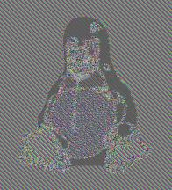
THE PROOF
Plaintext
ECB encrypted
Source: images created in GIMP by Larry Ewing (lewing@isc.tamu.edu)

Slide 43
DEMO 0x02

Slide 44
SOLVING THE ECB PROBLEM
Identical plaintexts = identical ciphertexts, when same key is used.
How did we solve the problem for stream ciphers?
Again the solution is IVs, but this time the IV isn't consumed by the cipher (block transform) itself.
We use a different mode.

Slide 45
INTRODUCING CBC
Cipher Block Chaining
Very common mode of operation for block ciphers.
Xors each plaintext block with the previous ciphertext block, before passing to transform.
First block doesn't have a previous block...
This is where an IV comes in. The IV is the size of one block and ends up delivering the same security properties as we saw in the stream cipher.
Formally: C_{n} = E(M_{n} ⊕ C_{n-1}, k), replacing C_{n-1} with IV for block 0.

Slide 46
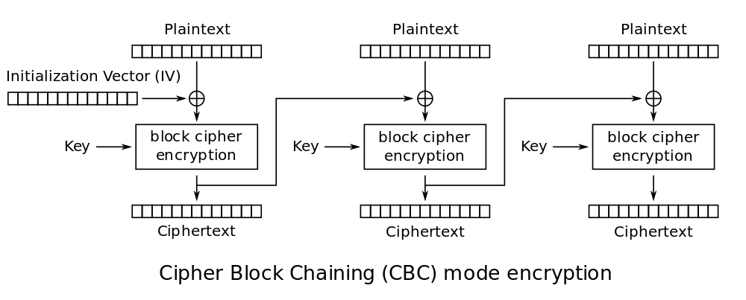
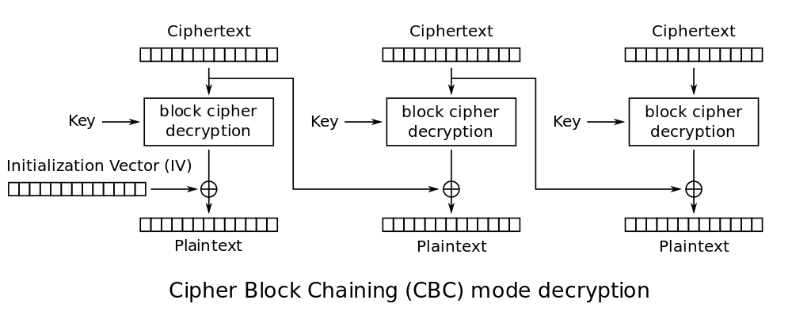
CBC DIAGRAM

Slide 47
PROBLEMS WITH CBC
No parallel encryption / decryption
Random access reads but no random access writes without re-encrypting all subsequent blocks
Block malleability (with caveats)... we'll get to this
No inbuilt authenticity or authentication
Issues with padding (oracle attacks)
Issues with compression (oracle attacks)
Some of these issues are not unique to CBC.

Slide 48
MALLEABLE CIPHERS
Malleable ciphers allow for plaintext to be altered in some meaningful way by tweaking the ciphertext, without knowing the key
In a stream cipher, one need only xor the ciphertext with something and the plaintext will get xor'ed too: C ⊕ K = M, therefore C ⊕ X ⊕ K = M ⊕ X
This is VERY dangerous in known plaintext attacks: we can tweak the ciphertext of any plaintext we know.
This is also useful for doing side-channel attacks on error handling, where we tweak an unknown value (with known position) and check the error produced.

Slide 49
MALLEABILITY IN CBC
CBC is an interesting case. A normal block cipher that is not malleable in ECB mode will be in CBC.
Remember that the plaintext of each block is xor'ed with the ciphertext of the previous block.
So if we xor a ciphertext block with some value, that block is destroyed, whilst the previous block's plaintext gets xor'ed with that value.
C_{n} = E(M_{n} ⊕ C_{n-1}, k)
M_{n} = D(C_{n} , k) ⊕ C_{n-1}
If we xor C_{n-1} with a value X, decryption looks like this:
D(C_{n} , k) ⊕ [C_{n-1} ⊕ X] = M_{n} ⊕ X.

Slide 50
SURELY THIS DOESN'T WORK?
It certainly does!
Anyone heard of LUKS?
Found to be vulnerable to this attack.
Possible to find non-critical blocks of data adjacent to critical blocks, tweak the non-critical block (it gets trashed) such that the critical block is xor'ed.
Result: can modify kernel or other files on disk if you know where they are, without knowing the password.
Serious derp.

Slide 51
SOLUTION TO MALLEABILITY
Authenticity checking
  Cryptographic hash in MAC construction
  Mode with in-built authenticity, e.g. EAX
Integrity-check plaintext
  MAC on plaintext
  But what if we just change the MAC?
  Not a strong solution.
Non-malleable mode (XEX, XTS or similar)

Slide 52
OTHER ATTACKS
Error side-channel attacks
Padding oracle attacks
Compression oracle attacks (CRIME)
Hash collisions on integrity checks
Related key attacks
Unidentified cascade interactions

Slide 53
IDENTIFYING CIPHERS
In general, we want to look for the way ciphertext reacts to changes in plaintext.
Look for obvious patterns, repeating blocks, etc.
Look for header data that might give things away, e.g. block size (or IV size – usually the same!), key size, etc.
Does a single bit input change alter a single bit of output? Does it alter a fixed block? Does it change everything after it? Or does it just change everything?
Is the data significantly smaller than the input? May be compressed – look for signs of this.
Match block sizes to potential ciphers.

Slide 54
PUTTING IT ALL TOGETHER
Use the block size / IV size / key size to build a list of potential ciphers, if you know them.
Use the ciphertext change behaviour to guess whether it's a block or stream cipher, and guess the mode of operation.
Use tools such as PEiD's KryptoAnalyser plugin, or other crypto finder tools / plugins.
Look at patents that apply to the software / hardware.
FCC ID database is great for hardware products.
General reverse engineering work will be required.

Slide 55
THE BOTTOM LINE
Crypto is hard to get right – there are lots of hidden issues and caveats.
Major applications and systems have been found to be flawed because people made untrue assumptions.
Breaking systems that use strong ciphers such as AES becomes easy when those ciphers are used incorrectly.
In many cases you can identify what type of crypto is in use by just looking at how it behaves.
If you're implementing crypto, stick to tried-and-tested ciphers in approved constructions, and get your design peer reviewed!
You don't need to understand the math inside ciphers to break crypto.
It should not be so difficult to get into the field of crypto!

Slide 56
RECOMMENDED READING
Disclaimer: Recommendation are not necessarily an endorsement by Portcullis; just my opinion here!
Cryptography Engineering: Design Principles and Practical Applications by Niels Ferguson, Bruce Schneier, Tadayoshi Kohno
Applied Cryptography by Bruce Schneier
Coursera Stanford Cryptography Course

Slide 57

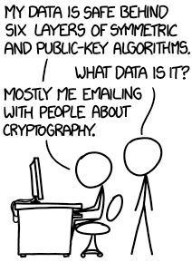
END OF PRESENTATION
Presentation by: Graham Sutherland
Title within Portcullis: Penetration Tester
Personal Twitter: @gsuberland
Email: gcs@portcullis-security.com
Telephone: +44 (0)20 8868 0098

