Slide 1

Attacking and defending Flash Applications

Slide 2
Flash Security
  I’ll talk about;
    RIA, Web 2.0 and Security
    What is Crossdomain.xml? Why does it exist?
    Only problem about Flash : XSS
    XSS and Impact of XSS Attacks
    Attack Surface of Flash Applications
      Global Parameters
      External Resources
    Same-origin Policy and Flash Embedding
    High Security Required Applications and Flash
  Not going to talk about these, at least not today;
    Server-side Flash Security
    Attacking users via Flash
    Flash Vulnerabilities
Notes:
Zamanim kisitli oldundan bir cok konuyu hizli sekilde gececegim. Dolayisiya XSS gibi konularin detaylarina inmeden size bilgi vermeye calisacagim.

Slide 3
RIA, Web 2.0 and Security
  Complexity is the worst enemy of security
  Every new component in the browser is a new threat
  AJAX, Silverlight, AIR, Flash, Java, Myspace Upload ActiveX etc. All of these are potential security problems.
  Every new technology comes with new style of development and it takes time to have secure “best practices”.
Notes:
Zamanim kisitli oldundan bir cok konuyu hizli sekilde gececegim. Dolayisiya XSS gibi konularin detaylarina inmeden size bilgi vermeye calisacagim.

Slide 4
Crossdomain.xml & Same-Origin Policy
  Same-Origin Policy
    Why Cross-domain access is a bad thing?
      Examples...
    Cookie, XMLHTTP Requests, Javascript etc.
    Flash and Crossdomain.xml

Slide 5
A Quite Naïve Crossdomain.xml File
<cross-domain-policy>
<allow-access-from domain="*" secure="false"/>
</cross-domain-policy>

Slide 6
Demo
Stealing information via Flash by exploiting Crossdomain.xml trust.
http://examplebank.com
http://attacker.com/

Slide 7
XSS Tunnelling?
Tunnelling HTTP tarffic through XSS channels. Allows to bypassing IP Restrictions, VPN, basic auth etc.

Slide 8
Attack Surface of Flash
  Global Parameters
  Flashvars
  Querystring
  LoadVars
  Configuration Files
  Dynamically loaded Flash Animations

Slide 9
Global Parameter Modification
  Who are these global parameters?
    _root.
    _global.
    _level0.

Slide 10
Flash Embedding
  Limit Flash file’s access by setting Allowscriptaccess attribute to “noaccess” while embedding an external Flash animation.

Slide 11
getURL()
  getURL problems
  getURL(“javascript:alert(1)”)

Slide 12
HTML Text Area
  If HTML enabled in the textareas and if the data loaded up dynamically
  http://example.com/XSS/riaac3.swf?_Ghtml=<img%20src="javascript:alert(1)//.jpg">

Slide 13
LoadClip, xml.load
  Are external resources secure? Hardly coded or configuration files coming from a secure place?
  You should check for configuration location and should not this from the user input.

Slide 14
Flash usage in highly security required systems
  Why it can be a problem?
  Increased attack surface

Slide 15
Sum it up!
  You should limit Flash’s JavaScript access while embedding external Flash files.

Slide 16
Sum it Up!
  Loaded configurations should be coming from trusted domains,
  Loaded external resources should be coming from trusted domains.

Slide 17
Sum it Up!
  When you are using Htmltext be sure that loaded data is sanitised and encoded.

Slide 18
References, Resources and Tools
  Flashsec Wiki
  OWASP – Finding Vulnerabilities in Flash Applications
  SWFIntruder
  Flare and similar decompilers

Slide 19
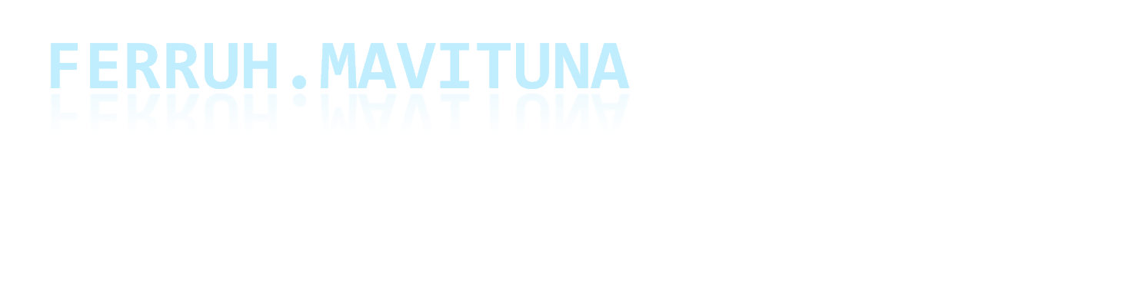
Thanks...

