Slide 1
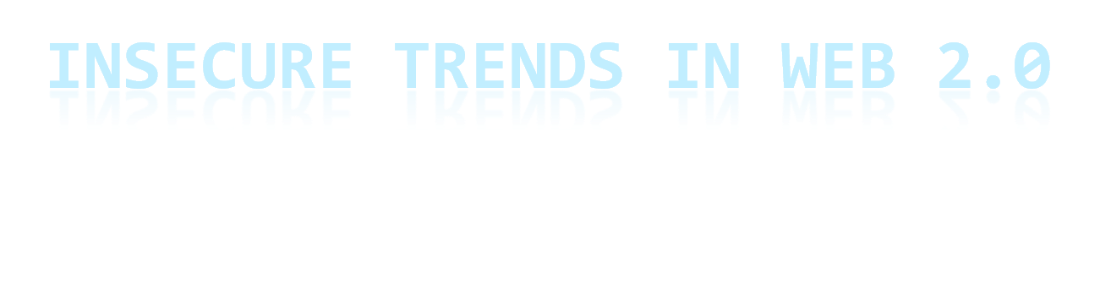
Insecure Trends in Web 2.0 Applications

Slide 2
It’s all about Web 2.0
It’s in everywhere
This is the new way
Second dot com craziness, and it’s not going to burst this time...

Slide 3
Web 2.0 Trends
Usability
Simplicity
Sociability
Integration
Outsourcing

Slide 4
Usability & Simplicity
Instead of
KISS - Keep It Simple & Stupid
it should be
KISSS - Keep It Simple, Stupid & Secure

Slide 5
Just “Stupid”
Changing password without requiring the current one
Guilty:
  Twitter
Impact:
  Permanent account hijacking

Slide 6
Just “Stupid” – Password pls.
“Give me your hotmail password so I can send spam to your contact list”
Guilty:
  Bebo, Facebook, Diigo ve tüm diğer sosyal hoppalık içeren Web 2.0 uygulamaları
What’s next? Websites will request password of our online bank? (Wait! It’s already done! – mint.com)

Slide 7
Just “Stupid” – remember me
“Remember Me” functionality
Guilty:
  Everyone!
Impact:
  Increasing the success possibility of Cross-site Scripting and similar session hijacking attacks.

Slide 8
Just “Stupid” – send it away
Resetting passwords without requiring an extra information other than an e-mail
Guilty:
  Everyone!
Impact:
  If victim’s e-mail compromised than all of his or her identity will be gone within minutes.

Slide 9
Just “Stupid” – password1
Limiting password length, not allowing user to choose secure passwords.
Guilty:
  A Lot!
Impact:
  Forcing user to be insecure! Really poor interpretation of KISS.

Slide 10
Sociability
Kevin Mitnick gotta love Web 2.0 !

Slide 11
Social Attractions – Where were you last night?
Too much personal information online.
Guilty:
  Linkedin, youtube, twitter, facebook, blogs, the crazy guy who shot your photo and posted to flickr, “transparent” company blogs etc.
Impact:
  Easier social engineering attacks...

Slide 12
Integration – Get this API and hack me
Overpowered APIs, Facebook widgets, RSS madness!
Guilty:
  Facebook, Feedburner.
Impact:
  Using API functionality to hack the website who provides the API.
Notes:
Social engineering was some kind of an art but now it's bloody easy. If you are trying to learn more information about someone such "what colour of undies she's wearing" or "what's her birthday" or "who's her boyfriend" or "where was she last night" or "in which company she's working as personal assistant" just visit her profile in Facebook, myspace, bebo, read her twitter messages, learn her taste of music by checking out her last.fm profile. Don't stop there learn what she reads from librarything and what she eats from another social website, and see her resume in LinkedIn. Finally don't forget her blog where she writes every little totally useless information about her daily life. Funny enough you'll figure pretty soon her e-mail password is her dog's name.
Couple of years we were talking about how "out-of-office" replies leaks information, now we are talking about massive information leakage about everything. All empoyees blog about stuff, companies being "open" and "transparent". That's Web 2.0 for you where your birthday is publicly available in 15 different social websites and your company's new and super project's first draft already released in one of your developer's blog.

Slide 13
Outsourcing
Too much external component usage
Guilty:
  Blogosphere, video embedding, flash embedding, widgets, stats, external javascripts... All new websites.
Impact:
  Increased attack surface, To able to make one website secure you have to secure 10 websites.
Notes:
Social engineering was some kind of an art but now it's bloody easy. If you are trying to learn more information about someone such "what colour of undies she's wearing" or "what's her birthday" or "who's her boyfriend" or "where was she last night" or "in which company she's working as personal assistant" just visit her profile in Facebook, myspace, bebo, read her twitter messages, learn her taste of music by checking out her last.fm profile. Don't stop there learn what she reads from librarything and what she eats from another social website, and see her resume in LinkedIn. Finally don't forget her blog where she writes every little totally useless information about her daily life. Funny enough you'll figure pretty soon her e-mail password is her dog's name.
Couple of years we were talking about how "out-of-office" replies leaks information, now we are talking about massive information leakage about everything. All empoyees blog about stuff, companies being "open" and "transparent". That's Web 2.0 for you where your birthday is publicly available in 15 different social websites and your company's new and super project's first draft already released in one of your developer's blog.

Slide 14
SSL ?
What happened to SSL?
Guilty:
  Gmail (after 4 years they fixed), and lots, lots of other Web 2.0 applications.
Impact:
  Isn’t it obvious?
Notes:
Social engineering was some kind of an art but now it's bloody easy. If you are trying to learn more information about someone such "what colour of undies she's wearing" or "what's her birthday" or "who's her boyfriend" or "where was she last night" or "in which company she's working as personal assistant" just visit her profile in Facebook, myspace, bebo, read her twitter messages, learn her taste of music by checking out her last.fm profile. Don't stop there learn what she reads from librarything and what she eats from another social website, and see her resume in LinkedIn. Finally don't forget her blog where she writes every little totally useless information about her daily life. Funny enough you'll figure pretty soon her e-mail password is her dog's name.
Couple of years we were talking about how "out-of-office" replies leaks information, now we are talking about massive information leakage about everything. All empoyees blog about stuff, companies being "open" and "transparent". That's Web 2.0 for you where your birthday is publicly available in 15 different social websites and your company's new and super project's first draft already released in one of your developer's blog.

Slide 15
Did you say “Best Practice”?
Agile Programming,
Shorter Dead-lines,
Fast development means more money,
Lack of defined best practices about new technologies

Slide 16
Security doesn’t sell
MS Vista proved it!
Unfortunately,
Web 2.0 is not an exception

Slide 17
Web 2.0 Followers
Every single day new Web 2.0 startups are launching all over the world and they do follow all these bad practices, because big guys are doing them.

Slide 18
Security...
First make it secure, then make it Web 2.0

Slide 19
Questions and Discussion
@fmavituna finished his talk, and waiting some question from the audience. (*)
*not so obscure twitter joke

Slide 20

Thanks...

