Slide 1
DNA Analyzer

Slide 2
Introduction
DNA analyzer tool helps to parse the various log files from DNAC , Collect the Database content based on application usage , Perform the compliance verification against postgres database, Generate Compliance report, SDA Audit Report and Telemetry data report. Also it Helps to find the known issues based on the Error messages and Symptoms.
Its just not collecting the data, Also, It determines the inconsistency in postgres database content.
Target Audience
Escalation Engineer
TAC Engineer
Partner Engineer

Slide 3
Why do we need this Tool ?
Reduce the overall troubleshooting time more than half.
Avoid Back and Forth email to collect the data from customer DNAC.
Analyze the log and Identify the root cause.
Engineer no need to go over 1000s of lines in log file to look for error messages.
Make TAC Engineer life easy to collect the data from Database table.
Identify the stale Data from database and report it correctly.
Easy way to apply the workaround for Known Issues.
TAC can find the Error and Look at Topic/ CDETS and find the workaround.
Reduce BEMS incoming.

Slide 4
What does the tool offer ?
Log Analyzer
Database data collection / Stale Deduction /Compliance Report.
Generates SDA Audit Report
Generates Telemetry Report
Search the defect using Error message
Applying workaround for Known Issues.

Slide 5
How it benefit for everyone?
TAC and BU Engineer
No need to go 1000s of line of various log file.
Database content is available in handy just to verify based on error message
Reports Stale data , Helps to apply workaround.
Audit and Telemetry data helps to understand the deployment and usage.
TAC
No need to worry for what data needs to collect from postgres.
No need to worry for how to connect postgres , how to write and sql query and how to collect data.
Avoid multiple back and forth email conversation just for collecting some table content and based on one output BU will ask to collect some other table data.
No need to worry what needs to check from the collected RCA or logfile.
Just Simple Calculation (One SR / BEMS)
TAC will open BEMS with RCA.
BU Engineer will pick the BEMS , Download the RCA , Look at the error message. ( 1 day)
Based on log message BU will ask to collect some table data, TAC needs to find customer availability, schedule a Webex. ( 2 Day)
During Webex TAC will collect required data. (1 Day)
BU will get back the data and may ask for another set of data based on first data collection ( same process assume 2 days)
Bu will suggest some workaround , Assume modify or delete some entries. (Another Webex and perform operation 2 days)

Slide 6
How it benefit for everyone?
Just Simple Calculation (One SR / BEMS) (Contind …)
Number of days taken for resolve a SR / BEMS : ~ 8 days. (Lets assume average 5 Days).
How many BEMS opened per week : ~5 BEMS.
Number of Hours spent : 5 days * 5 BEMS * 8 Hours = 200 Hours i.e 5 Man days / Week.
How this tool helps to reduce
TAC will collect all required data in day 1 before open a BEMS.
So No front and forth email communication.
Bu engineer will come to the resolution next day.
So Average Resolution time will be reduced from 5 days to 2 days.
Its not just reducing the time, We have all the data in handy, we can right away file CDETS with all required details.
Development team will not ask any further data or RCA location to analyze further.
TAC or BU can provide more detail for quick resolution.
Quick resolution of CFD CDETS is Increase customer sentiment and Product Quality.

Slide 7
How to run/use the Script ?
DNAC Cyclops Patch-4 Onwards
DNA Analyzer tool will be part of DNAC Product.
Steps to Run,
1. SSH Login to DNAC using maglev user.
2. Run following command to get the sda-helper container id
docker ps | grep k8s_sda-helper-service_sda-helper-service | awk '{print $1}'
$ docker ps | grep k8s_sda-helper-service_sda-helper-service | awk '{print $1}' a80059e79588
3. Take the ID from above command output and run following command by replacing <dockerID>
$ docker cp <dockerID>:/opt/maglev/services/sda-helper-service/7.3.263.62640/dev-resources/dna-analyzer .
$ docker cp a80059e79588:/opt/maglev/services/sda-helper-service/7.3.263.62640/dev-resources/dna-analyzer .
4. Now you will have "dna-analyzer" directory created in the folder which will have the script.
5. You can run script by changing the directory and run the commands.
cd dna-analyzer
python ./DNA_Analyzer

Slide 8
How to run/use the Script ?
Previous Versions of DNAC
To Download
This script needs to be downloaded onto Cisco DNA Center.
First ssh to DNAC.
ssh -p2222 maglev@<dnacIP>
The next step is to get the script onto Cisco DNA Center.
There are three ways of doing this, depending on access from DNAC to the internet
Option 1. git clone direct
If you have access to the internet from DNAC, can clone the repository (containing the executable)
git clone https://github.com/CiscoDevNet/DNA_Analyzer
Option 2. git clone via proxy
If DNAC needs a proxy to get to the internet, you will need to provide a proxy for git command. NOTE: please do not set a permanent environment variable as this will stop you from accessing some DNAC commands like maglev.
The example below uses an inline environment variable, just for the git command. Make sure to put in the correct proxy url (including port)
https_proxy=https://<your proxy> git clone https://github.com/CiscoDevNet/DNA_Analyzer
Option 3. Isolated environment.
You will need to clone (using method 1 or 2) to an intermediate machine and copy to DNAC, using scp.
Remember to use port 2222 with the -P option to scp.
scp -P 2222 ./dna_analyzer maglev@<mydnac>:
To get the latest version
We are adding new features quite often. If you have downloaded an older version, it is very easy to get the latest. Provided you used option #1 or #2, you can simply change directory into the dna-analyzer directory and use git pull, instead of git clone.
You might need to provide proxy as in option #2.
$ cd ./dna_analyzer $ git pull

Slide 9
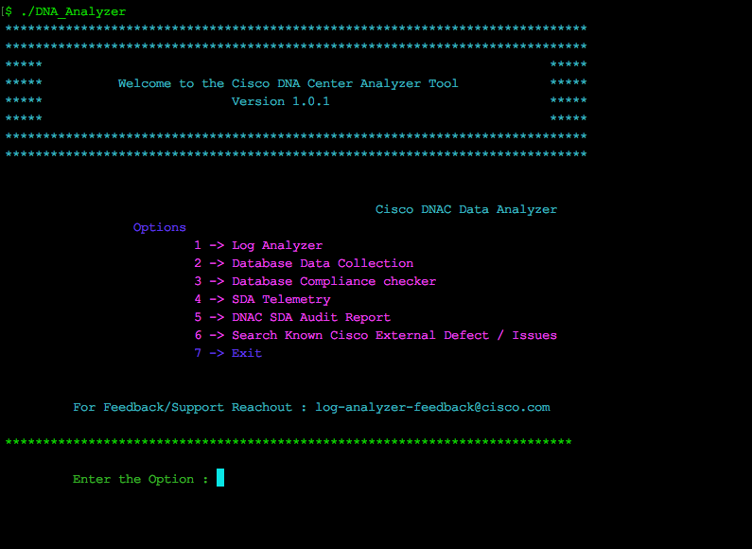
How to run/use the Script ?

Slide 10
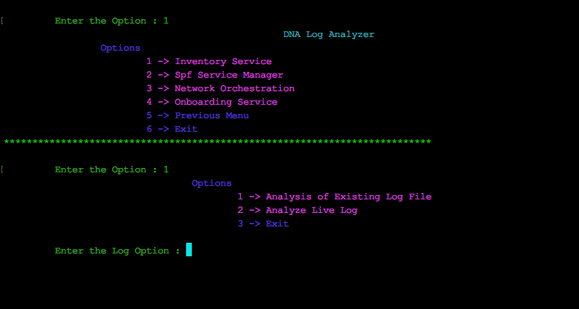
Log Analyzer
Pick the Option 1 for Log Analysis

Slide 11
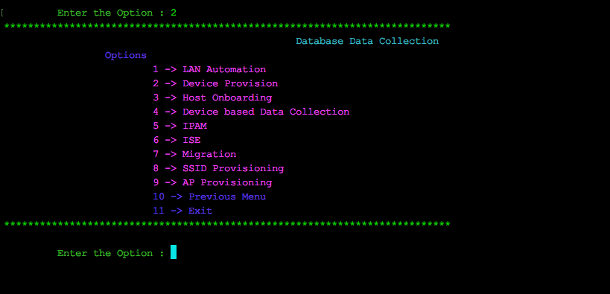
Database Data Collection
Pick the Respective APP to collect the data (Example for LAN Automation select option 1)

Slide 12
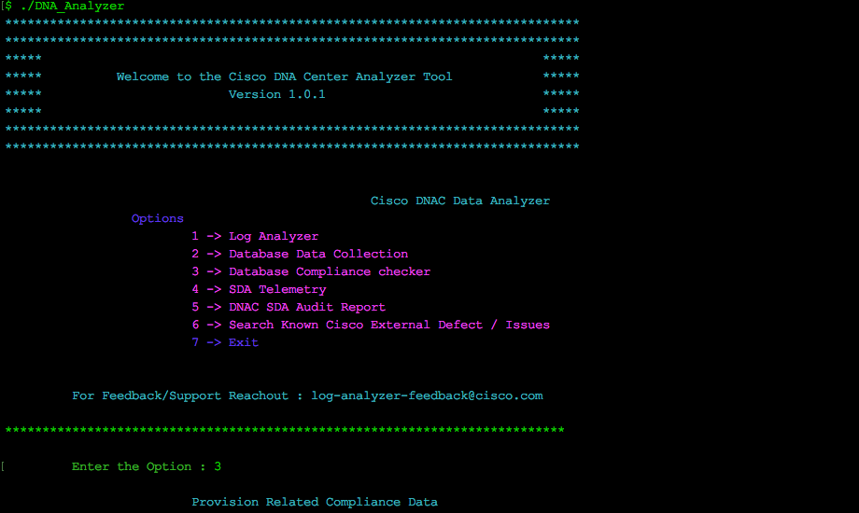
Database Compliance Checker

Slide 13
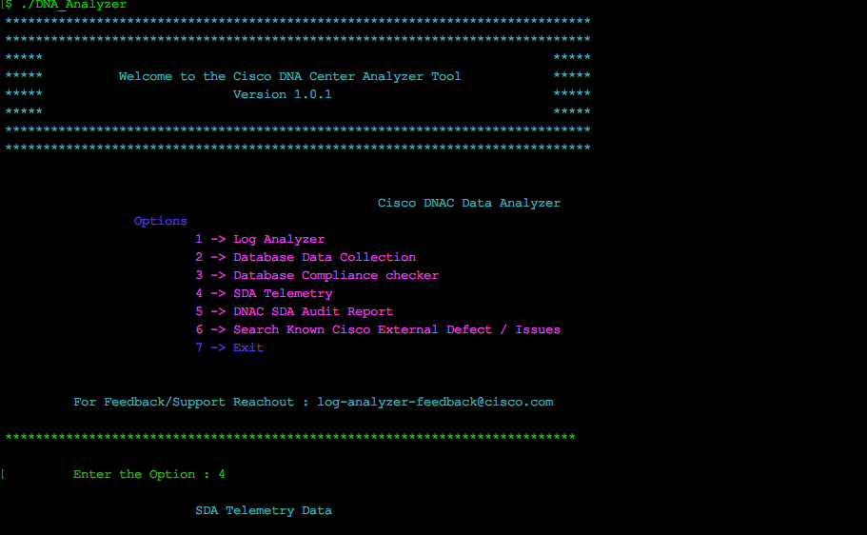
SDA Telemetry

Slide 14
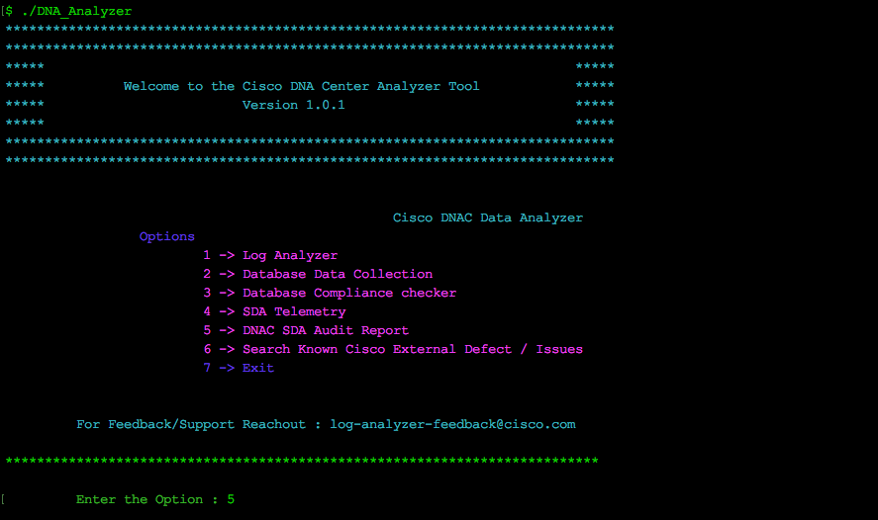
SDA Audit Report

Slide 15
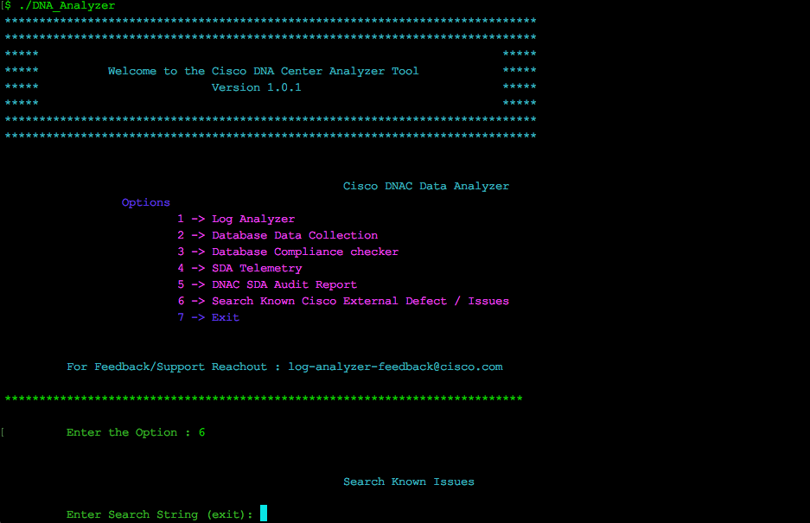
Search Known Issues
Pick the Appropriate Option and Provide the Error message in Search String, this will list down possible error messages.

Slide 16
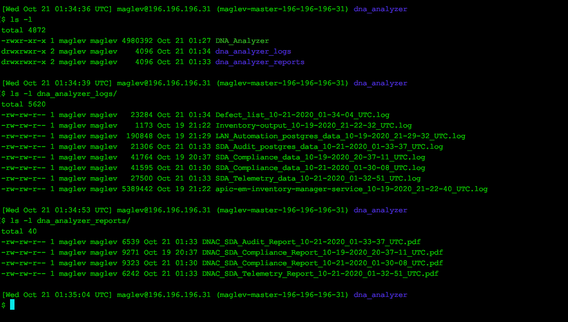
Script Output
Each option will create separate Log file.
Script output will be logged in console as well as Log file in the same location where the script resides.
Upload the script output into Case Note in order to further investigation from BU.

Slide 17
Want to Contribute Tool Development / Enhancement ?
Download and install pyCharm community Edison
https://www.jetbrains.com/pycharm/download
Download existing code from GitLab repository
https://gitlab-sjc.cisco.com/enataraj/dna-analyzer
Start Enhance the script and Review with team before commit into GitLab.

Slide 18
Enhancement
Enhancements on going for Parsing various logs
Script development for IP Pool Deletion use case.
Miscellaneous script for quickly running and collecting data from database.
Miscellaneous script for finding specific string existence across postgres tables.
Script for validating the database before taking the backup.
Limitations
Some script Needs to copy and Run into DNAC Cluster
Example Database Data Collector script needs to Run into DNAC Cluster.
Some scripts required Third Party library or package.
Example DNAC Health check script depending on
pxssh, EOF, TIMEOUT from pexpect
Reference :
https://techzone.cisco.com/t5/SD-Access-Software-Defined/SDA-DNA-Log-Analyzer-Tool/ta-p/1452522#toc-hId-1841674328

