Slide 1

Intro to Git and github
Presenting: Dr. aaron Hamachi
Lab: Alexander Stevenson, Adrian Iliesiu, aaron hamachi

Slide 2

Starting with: a True story
Coding on work laptop ready to teach a class in an hour
Working just fine!
This Photo by Unknown Author is licensed under CC BY-NC

Slide 3
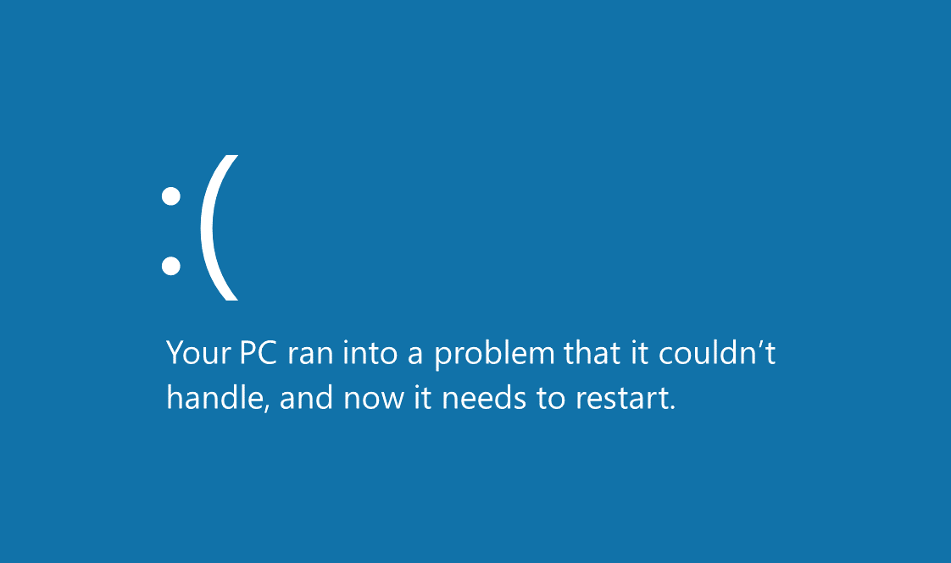
Starting with: a True story
This Photo by Unknown Author is licensed under CC BY-SA

Slide 4
Starting with: a True story
…and all of my code was on this laptop

Slide 5



Starting with: a True story
This Photo by Unknown Author is licensed under CC BY-SA
This Photo by Unknown Author is licensed under CC BY

Slide 6

Starting with: a True story
…no problem!
This Photo by Unknown Author is licensed under CC BY-SA

Slide 7

Starting with: a True story
This Photo by Unknown Author is licensed under CC BY

Slide 8
Agenda
What is Git?
Getting familiar with the Cisco DevNet Learning Lab environment
Hands-on lab
Call to Action

Slide 9

What is git?

Slide 10
Git
Git manages files on your computer so that when you make changes, you can compare old and new versions of files. This aspect of file management is called Version Control.
GitHub also enables you to coordinate work with others on new versions of files.
Now would be a good time to login or create your github.com account (it’s free).

Slide 11
Git
Understand what problems Version Control Systems help us solve.
Learn and practice your first Git workflows.
Clone our sample code in the browser development environment.
Create a "safe place" for you to make and commit your changes.
Learn how to incrementally save your code changes.

Slide 12
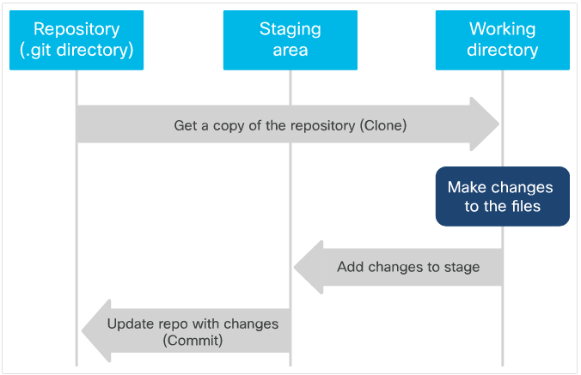
Git
Git is organized by 3 states and 3 stages
The three stages are:
Repository (the .git directory)
Working directory
Staging area
The three states are:
Committed
Modified
Staged

Slide 13
Git
Git has two types of repositories: local and remote.
A local repository is stored on the file system of a client machine, which is the same one on which the git commands are being executed.
A remote repository is stored somewhere other than the client machine, usually a server or repository hosting service (github).
After the local repository is cloned from the remote repository or the remote repository is created from the local repository, the two repositories are independent of each other until the content changes are applied to the other branch through a manual Git command execution.

Slide 14
Git
Full Directory/File structure
Remote Branch: Main
(github)
Change 1
Change 2
Change 1
Change 2
You make
Some changes
locally
Change 3
Change 4
git push origin main
Local Branch: Main
(git)
Change 3
Change 4

Slide 15
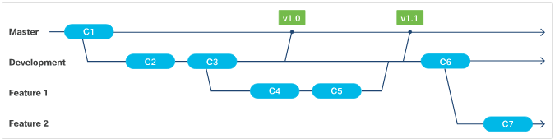
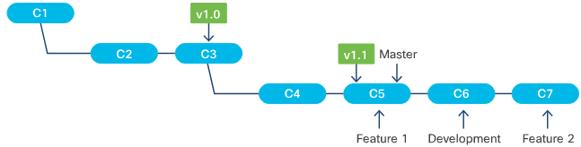
Git
Branching enables users to work on code independently without affecting the main code in the repository. When a repository is created, the code is automatically put on a branch called Main.
Branches can be local or remote, and they can be deleted and have their own history, staging area, and working directory.
When a user goes from one branch to another, the code in their working directory and the files in the staging area change accordingly, but the repository (.git) directories remain unchanged.

Slide 16
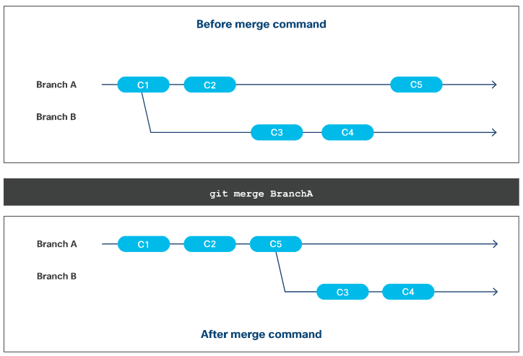
Git
Merging Branches
Branches diverge from one another when they are modified after they are created.
When Git merges the branch, it takes the changes/commits from the source branch and applies it to the target branch.
During a merge, only the target branch is modified.
The source branch is untouched and remains the same.

Slide 17
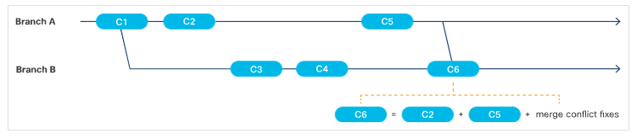
Git
Fast-Forward Merge
A fast-forward merge is when the Git algorithm is able to apply the changes/commits from the source branch(es) to the target branch automatically and without any conflicts.
Merge Conflicts
A merge conflict is when Git is not able to perform a fast-forward merge because it does not know how to automatically apply the changes from the branches together for the file(s).

Slide 18
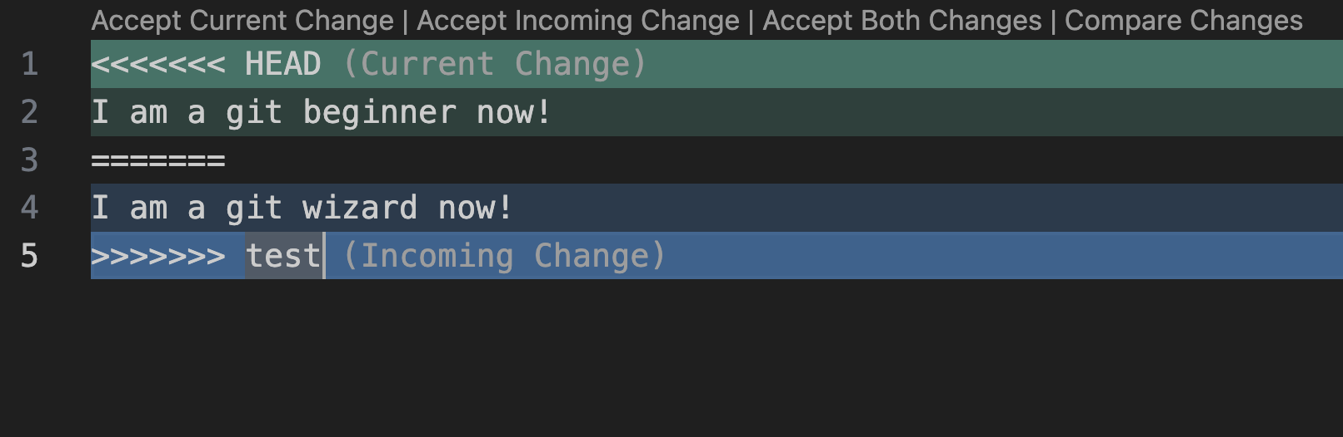
Git Merge conflicts
Don’t panic!
Click either Accept Current Change, or Accept Incoming Change
Or manually fix if the “Accept” buttons are not available -- example:
Manually delete line 1, 3, 4, and 5 to accept Current
Delete lines 1, 2, 3, and 5 to accept Incoming

Slide 19
Git
Connect your Git instance with GitHub
GitHub Desktop (AIO GUI)
Authenticating methods (CLI):
Personal Access Token (easiest)
SSH Key
Fine-Grained Token (Beta)
(demo?)

Slide 20
Git
Personal Access Token:
Go to GitHub.com and click your avatar > settings
On the left, go to Developer Settings
Click Personal access tokens > Tokens (classic) > Generate new token
Make a note, set an expiration, and select repo under Scopes
At the bottom: Generate token
Copy the token and use as your password when prompted
Vault the token (put it in a safe place)…i.e. NOT your public GitHub repo ☺
Demo?

Slide 21
Getting familiar with the Cisco DevNet Learning Lab environment

Slide 22
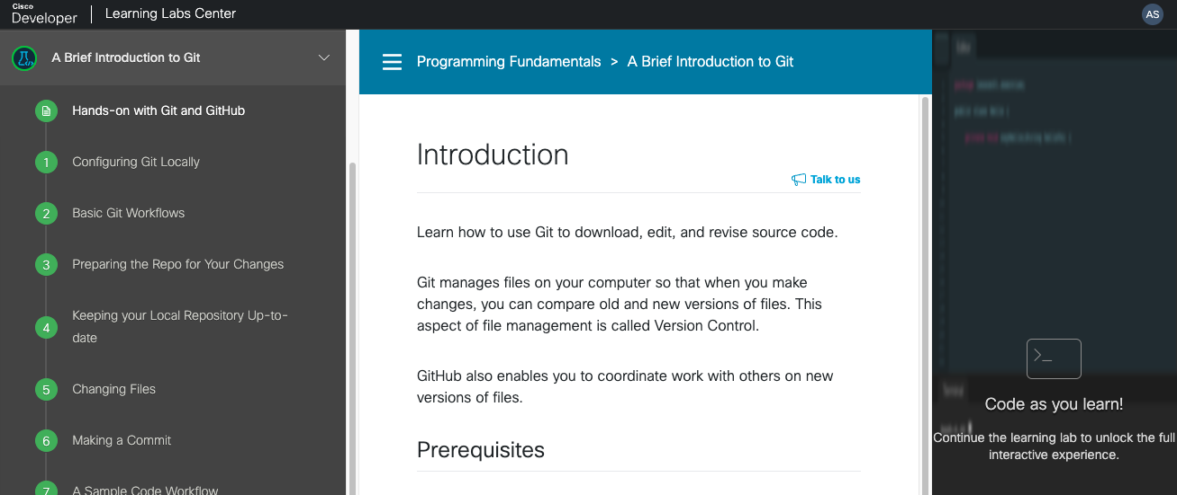
Table of Contents Instructions Code IDE
Main parts of Learning Lab environment

Slide 23
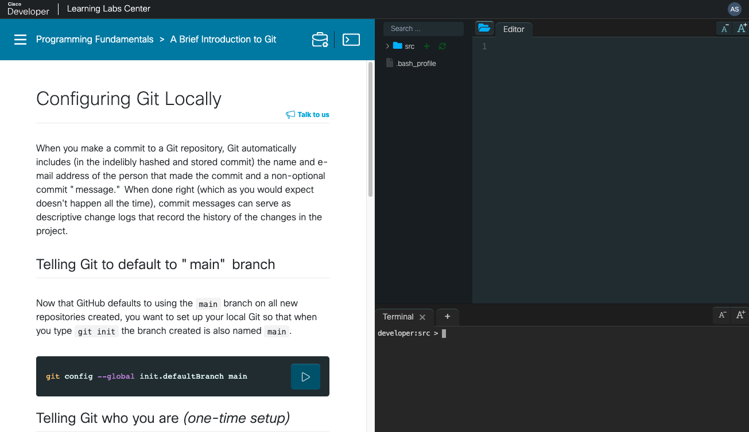
Lab walk-through File System and Editor Interactive terminal

Slide 24
Hands-on lab
A brief introduction to git

Slide 25
A brief introduction to git
https://developer.cisco.com/learning/labs/dne-git-basic-workflows/hands-on-with-git-and-github/

Slide 26
Call to action

Slide 27
Call to action Git-related Learning Labs
1
Git Branching
Learn the basics of Git branching https://learngitbranching.js.org

Slide 28
Thank you

