Slide 1

Intro to Git and github
Dr. aaron hamachi

Slide 2

Starting with: a True story
Coding on work laptop ready to teach a class in an hour
Working just fine!
This Photo by Unknown Author is licensed under CC BY-NC

Slide 3
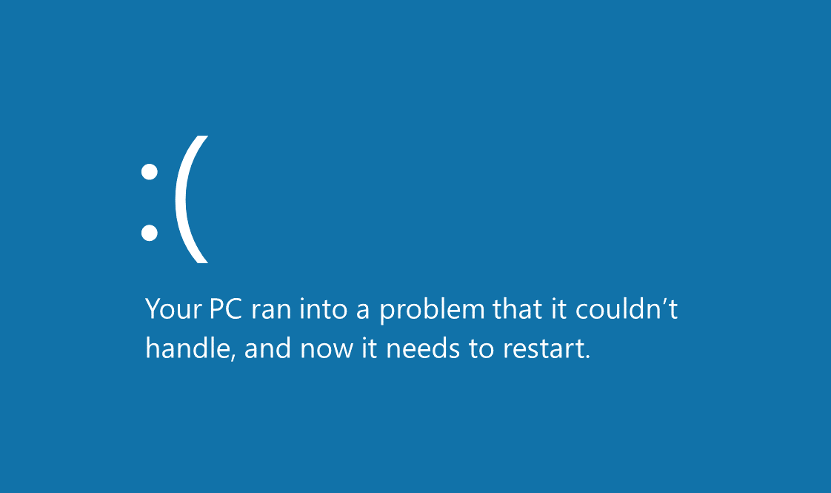
Starting with: a True story
This Photo by Unknown Author is licensed under CC BY-SA

Slide 4
Starting with: a True story
…and all of my code was on this laptop

Slide 5



Starting with: a True story
This Photo by Unknown Author is licensed under CC BY-SA
This Photo by Unknown Author is licensed under CC BY

Slide 6

Starting with: a True story
…no problem!
This Photo by Unknown Author is licensed under CC BY-SA

Slide 7

Starting with: a True story
This Photo by Unknown Author is licensed under CC BY

Slide 8
Agenda
What is Git?
Getting familiar with the Cisco DevNet Learning Lab environment
Hands-on lab
Call to Action

Slide 9

What is git?

Slide 10
Git
Git manages files on your computer so that when you make changes, you can compare old and new versions of files. This aspect of file management is called Version Control.
GitHub also enables you to coordinate work with others on new versions of files.

Slide 11
Git
Understand what problems Version Control Systems help us solve.
Learn and practice your first Git workflows.
Clone our sample code in the browser development environment.
Create a "safe place" for you to make and commit your changes.
Learn how to incrementally save your code changes.

Slide 12
Getting familiar with the Cisco DevNet Learning Lab environment

Slide 13
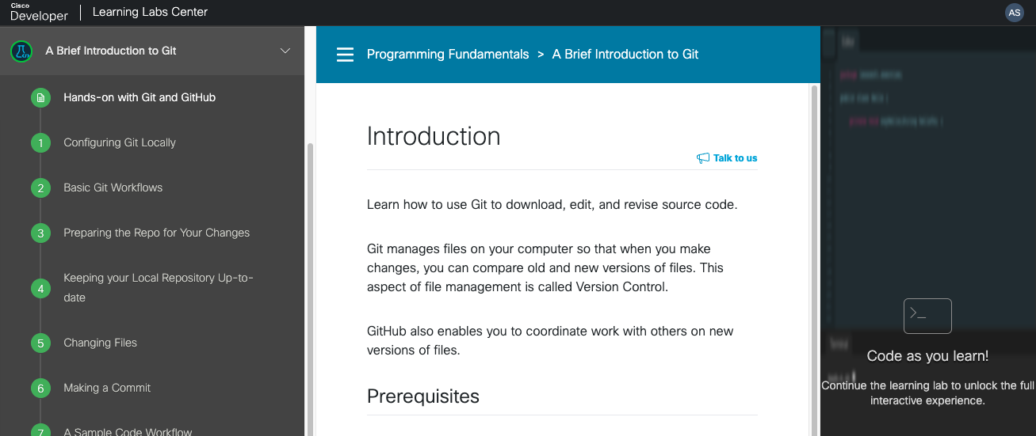
Table of Contents Instructions Code IDE
Main parts of Learning Lab environment

Slide 14
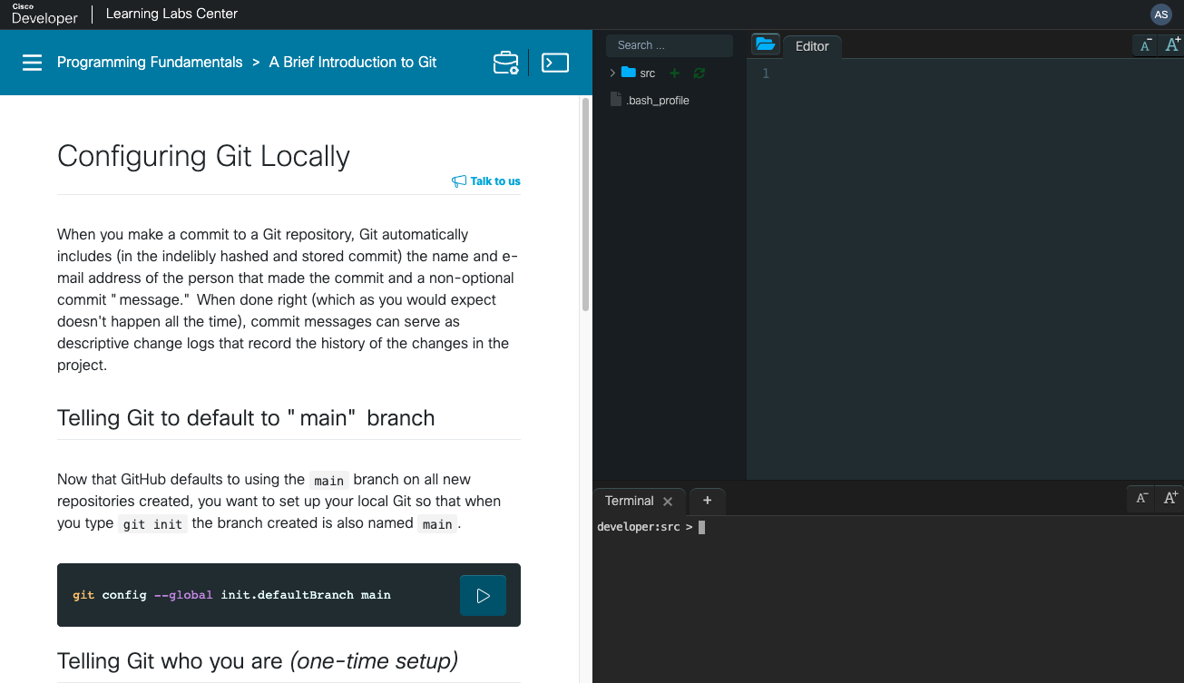
Lab walk-through File System and Editor Interactive terminal

Slide 15
Hands-on lab
A brief introduction to git

Slide 16
A brief introduction to git
https://developer.cisco.com/learning/labs/dne-git-basic-workflows/hands-on-with-git-and-github/

Slide 17
Call to action

Slide 18
Call to action Git-related Learning Labs
1
2
3
Introduction to Version Control Systems
Learn how to use Git for version control including configuration, commits, and differences.
Git Branching
Learn the basics of Git branching so that you can diverge from the main code base.
Using Git with servers
Learn how to use Git with servers to share your work with others.

Slide 19
Thank you

Slide 21
Section Header

Slide 22
Section Header

Slide 25
Section Header

Slide 28
Section Header

