Slide 1
{Call} http://HOST/
{Click} ACI
show_prodcut(“aci”)
show_feature(“aci”, “show”, “device”)
show_feature(“aci”, “show”, “device”)

Slide 2
cw-tnav
cw-snav
cw-feature-page
cw-page_title
cw-page cw-page-[pn]-[fn]-[sn]
cw-view-[UUID]
Panel
cw-view-[UUID]
cw-view-[UUID]
cw-view-[UUID]
cw-page cw-page-[pn]-[fn]-[sn]

Slide 3
http://ciscowebkit
PRODUCT-A PRODUCT-B PRODUCT-C
Product Name List Space
“Dashboard” View
Dashboard
Product

Slide 4
http://ciscowebkit/dashboard
PRODUCT-A PRODUCT-B PRODUCT-C
Product Name List Space
“Dashboard” View
Dashboard
Product

Slide 5
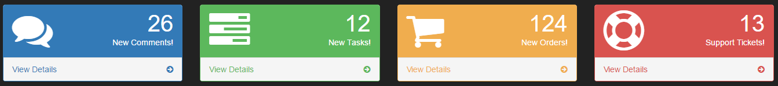
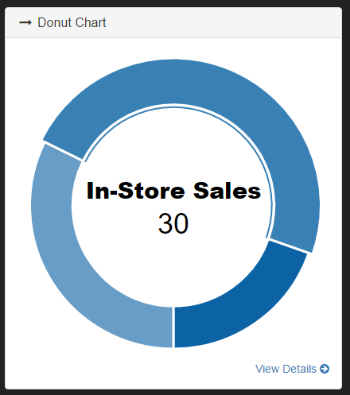
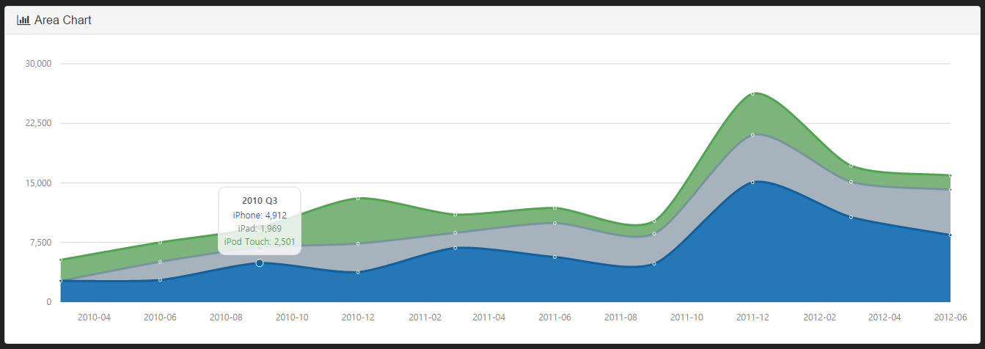
http://ciscowebkit/dashboard
PRODUCT-A PRODUCT-B PRODUCT-C
Dashboard
Statistics Overview
SAMPLE VIEW

Slide 6
http://ciscowebkit/aci
PRODUCT-A PRODUCT-B PRODUCT-C
Product Name List Space
Overview
Feature
Name
List
Space
Feature View
Feature Title Space
Overview
Single Feature
Drop Feature
“Overview” View
Setting
Feature
Default Focus
Default Feature

Slide 7
http://ciscowebkit/aci/overview
PRODUCT-A PRODUCT-B PRODUCT-C
Product Name List Space
Overview
Feature
Name
List
Space
Feature View
Feature Title Space
Overview
Single Feature
Drop Feature
“Overview” View
Setting
Focus

Slide 8
http://ciscowebkit/aci/singlefeature
PRODUCT-A PRODUCT-B PRODUCT-C
Product Name List Space
Overview
Feature
Name
List
Space
Feature View
Feature Title Space
Single Feature
Single Feature
Single Feature Description
Drop Feature
“Single Feature” View
Setting
Focus

Slide 9
http://ciscowebkit/aci/dropfeature/subfeature1
PRODUCT-A PRODUCT-B PRODUCT-C
Product Name List Space
Overview
Feature
Name
List
Space
Feature View
Feature Title Space
Sub Feature 1
Single Feature
Sub Feature 1 Description
Drop Feature
“Sub Feature 1” View
Sub Feature 1
Dropdown
Sub Feature 2
Focus
Setting
Sub-Feature

Slide 10
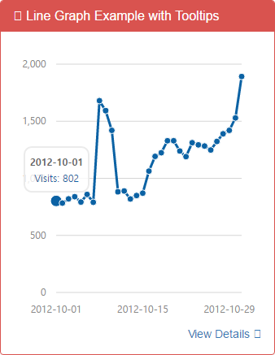
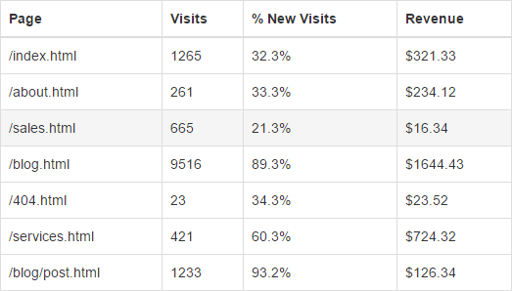
http://ciscowebkit/aci/dropfeature/subfeature1
PRODUCT-A PRODUCT-B PRODUCT-C
Overview
Sub Feature 1
Single Feature
Sub Feature 1 Description
Drop Feature
Sub Feature 1
Sub Feature 2
Setting
SAMPLE VIEW

Slide 11
Type | System | View (str.replace '-' to ' ') | URL (str.lower())
Single Feature on "Feature_Name.py" | class Single_Feature_Name(Feature): | Feature Name | /product_name/feature_name/
Sub Feature on "Feature_Name.py" | class Sub_Feature_Name(Feature): | Sub Feature Name | /product_name/feature_name/sub_feature_name/
Default Feature on "__init__.py" | class Sample_OV(Overview): | Overview | /product_name/ & /product_name/overview/
 | class Sample_SET(Setting): | Setting | /product_name/setting/
Path Architecture |  |  |  |  |  |  | Description
ROOT |  |  |  |  |  |  | Project Root
 | ciscowebkit |  |  |  |  |  | ciscowebkit 코드 패키지 Root 디렉토리
 |  | templates |  |  |  |  | HTML 템플릿 디렉토리
 |  | resource |  |  |  |  | 정적 요소 (css, js, img, font) 디렉토리
 |  | common |  |  |  |  | 플랫폼 서비스 라이브러리
 |  | dashboard |  |  |  |  | Dashboard 어플리케이션
 |  | product |  |  |  |  | Add-on 어플리케이션 Root 디렉토리
 |  |  | __init__.py |  |  |  | Product 어플리케이션 정의 파일
 |  |  |  | PRODUCT_ORDER = ['Product_A', 'Product_B', 'Product_C'] |  |  | Product 어플리케이션 View 순서
 |  |  | Product_A |  |  |  | "Product A" 어플리케이션 Root 디렉토리
 |  |  |  | feature |  |  | "Product A" 어플리케이션 Feature 서비스 디렉토리
 |  |  |  |  | __init__.py |  | "Product A" 어플리케이션 Feature 정의 파일
 |  |  |  |  |  | FEATURE_ORDER = ['Feature_A', 'Feature_B/Impl_SubFeature_A', 'Feature_B/Impl_SubFeature_B'] | "Product A" 어플리케이션 Feature 서비스 View 순서
 |  |  |  |  |  | class Impl_Overview(Overview): | "Product A" 어플리케이션 "Overview" Feature 서비스 구현
 |  |  |  |  |  | class Impl_Setting(Setting): | "Product A" 어플리케이션 "Setting" Feature 서비스 구현
 |  |  |  |  | Feature_A.py |  | "Product A" 어플리케이션 "Feature_A" 서비스 파일
 |  |  |  |  |  | class Impl_Feature_A(Feature): | "Product A" 어플리케이션 "Feature_A" Single Feature 서비스 구현
 |  |  |  |  | Feature_B.py |  | "Product A" 어플리케이션 "Feature_B" 서비스 파일
 |  |  |  |  |  | class Impl_SubFeature_A(Feature): | "Product A" 어플리케이션 "Impl_SubFeature_A" Sub Feature 서비스 구현
 |  |  |  |  |  | class Impl_SubFeature_B(Feature): | "Product A" 어플리케이션 "Impl_SubFeature_B" Sub Feature 서비스 구현
 |  |  |  | widget.py |  |  | "Product A" Dashboard Widget 파일
 |  |  |  |  | class Impl_Widget_A(Widget): |  | "Product A" 어플리케이션 "Impl_Widget_A" Widget 구현
 |  |  |  |  | class Impl_Widget_B(Widget): |  | "Product A" 어플리케이션 "Impl_Widget_B" Widget 구현
 |  |  | Product_B |  |  |  | "Product B" 어플리케이션 Root 디렉토리
 |  |  | Product_C |  |  |  | "Product C" 어플리케이션 Root 디렉토리

