Slide 1
At launch
Bi-directional Reflecting Loop
Custom Panel
(In-Room Controls = widgets)
Custom Panel
(In-Room Controls = widgets)
xapi.command (' …Widget SetValue'
xapi.command (' …Widget SetValue'
xapi.event.on (‘… Widget Action’
2. Update Widgets
Controller
(Node.js script, Macro external system…)
Controller
(Node.js script, Macro external system…)
1. Read configuration
xapi.config.on()
xapi.config.get()
xapi.config.set()
Device’s State
(status, configuration)
Device’s State
(status, configuration)

Slide 2
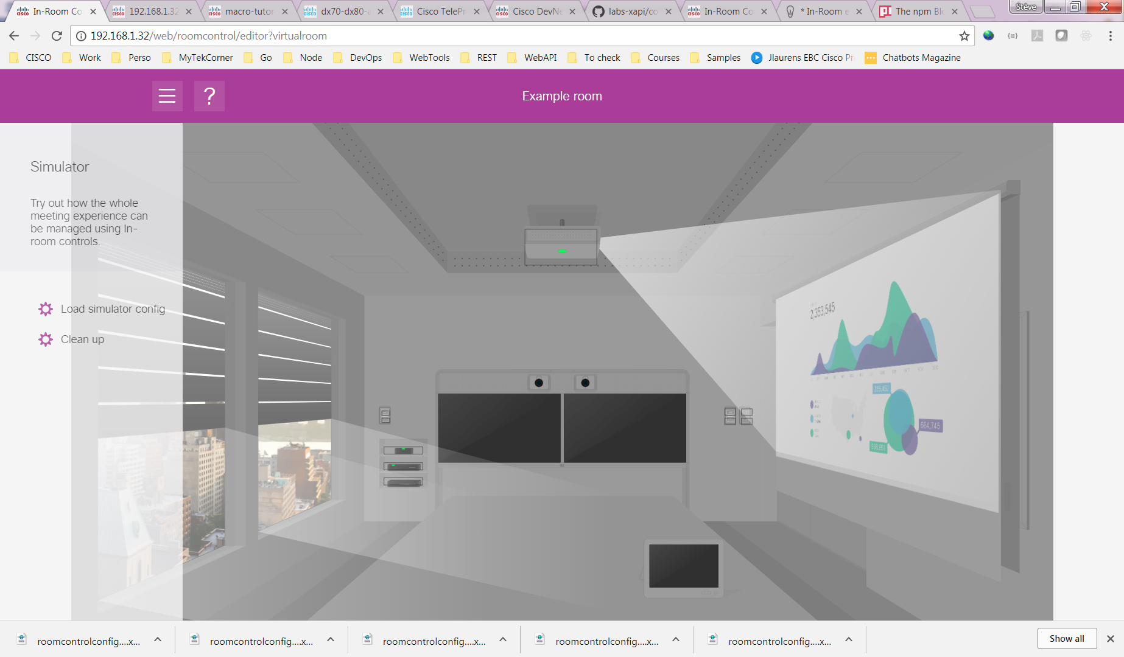

Slide 3
