Slide 1
LAB Network

Slide 2
Project OverView
Network Topology Discovery by CDP
Network Visualization
Traffic Schedule base on Destination by TE+StaticRoute
Traffic Schedule by base on Source+Destination+Protocol by TE+ABR

Slide 3
Traffic Schedul – TE+StaticRoute
TE2
TE1
Set static route to server2 nexthop to TE2

Slide 4
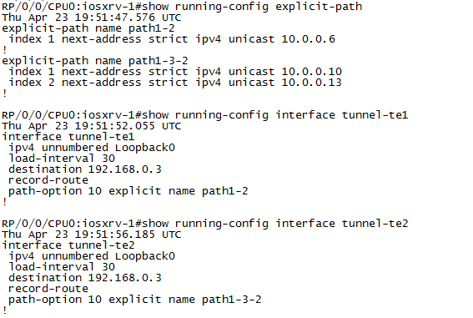
Traffic Schedul – TE+StaticRoute
TE Config by CLI

Slide 5

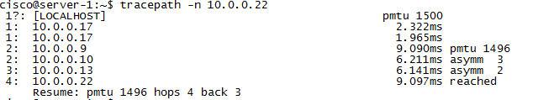
Traffic Schedul – TE+StaticRoute
Before adjust ：
After adjust ：

Slide 6
Traffic Schedul – TE+ABR
TE2
TE1
UDP…
TCP…

