Slide 1

SDN Enabling Visualized Network-Aware Path Selection
SEVEN-APS : Contributed by TEAM7
TEAM7:
穆琙博 Mu Yubo： CAICT
徐安民 Xu Anmin：TSINGHUA UNIVERSITY
陈研 Chen Yan: CTBRI

Slide 2
TEAM7’s GOAL:
Manage a network with 7 nodes
7 (Nodes)
=3(Cisco IOSV)+2(IOSXRV)+2(Servers)
Routers are ruled by a SDN Controller, which is based on OpenDayLight, our southbound API is NETCONF/YANG
Notes:
Topics
Criteria
Rules
Judges

Slide 3
TEAM7’s Features
Link protection / Passive mode
Path programmable / Active mode
Introduction of middleware / decoupling, scalable, heterogeneous network convergence
Notes:
Topics
Criteria
Rules
Judges

Slide 4
TEAM7’s Functions:
Display the map of topology of the full Networks
Keep aware of the changing of the network topology through CDP protocol information collection
Manual path selection with action taken on graphical user interface.
Auto path selection implemented when topology of the network changed as pre-setting
Notes:
Creativity
Usefulness
Presentation
UI
Integration with current network
Code Quality
Documentation
Test approaches
Runability/testability (ease of use/judgment)
Open source?
Topics
Criteria
Rules
Judges

Slide 5
TEAM7’s DESIGN
Polling/Command/
Rest Api
PC1/Client
GUI/D3 JavaScript
PC2/Server
Middleware/Python
Polling/Explain/
RestConf
VM/Server
OpenDayLight
Message/Filter
NetConf/YANG
VM Routers
--------------------
Cisco VIRL
CDP Protocol/Status
Notes:
Topics
Criteria
Rules
Judges

Slide 6


Q: What TEAM7’s Topology looks like?

Slide 7
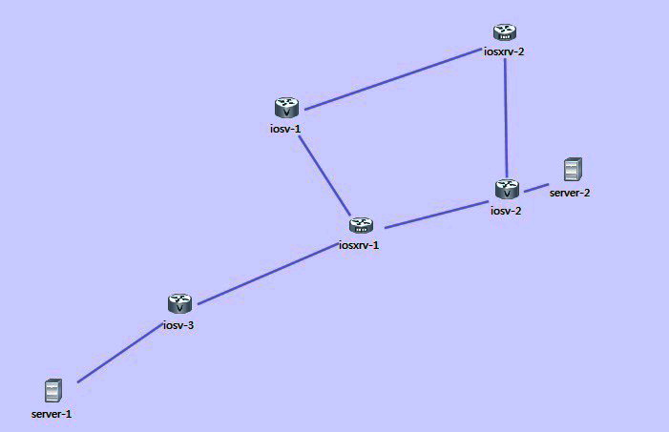
TEAM7’s Topology
IOSV x 3
IOSXRV x 2
Server x 2
IOSXRV is Controlled by APP via ODL

Slide 8
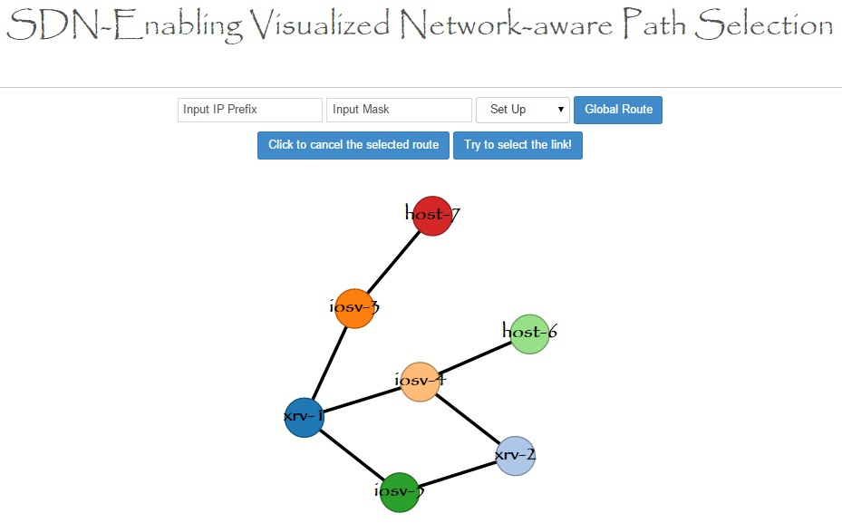
TEAM7’s APP GUI -Full Map

Slide 9
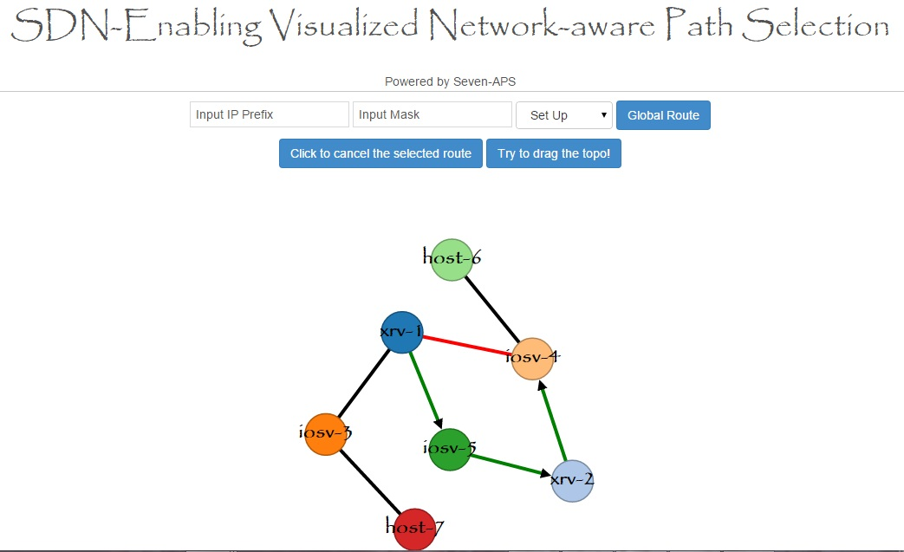
TEAM7’s APP GUI –Path Selection

Slide 10
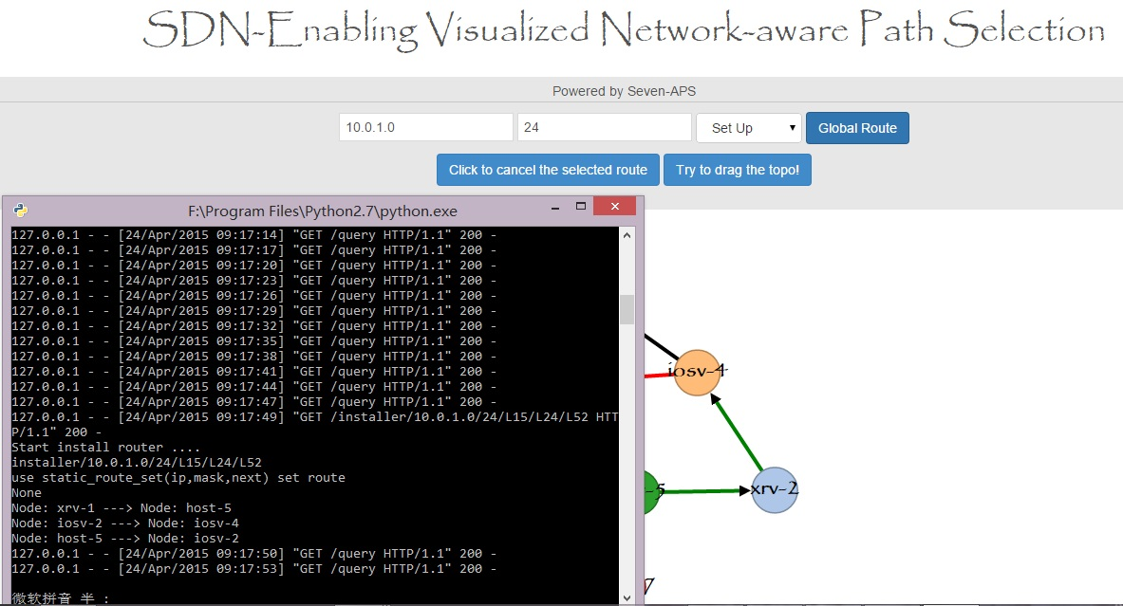
TEAM7’s APP GUI –Send Config Message

Slide 11
TEAM7’s Future Work
Including L2 SPF algorithm module into enlarged network management based on ODL SDN controller
Congestion control
?

Slide 12
MANY THANKS TO YOU,
7 Masters (Gurus) !
Raghu, Giles, Nathan, Ben, Ken, Chuck, Paul

