Slide 1
Towards easiness
Duang, ODL~
2015/04/24

Slide 2
Outline
3
Introduction
1
2
Architecture
3
Implementation
3
4
Summary

Slide 3
Introduction
Who we are?
  Qian.Li from SOHU
  Chenghui.Wu from THU
  Kansheng.Dong from CMCC
What we want to do?
  Simplify network configuration
  Simplify network management
What we did?
  Topology visualization
  Network element management
  optimum route calculation

Slide 4
Outline
3
Introduction
1
2
Architecture
3
Implementation
3
4
Summary

Slide 5

Architecture
Towards easiness
UI
REST API
Towards
easiness
ODL
Route
calculation
Topology
Manager
…
L2
Switch
Mysql
Statistic
Manager
…
Topology
Manager
NE Manager
Service Abstraction Layer (SAL)
ODL
Mininet
OpenFlow13
REST API
Function call

Slide 6
Outline
3
Introduction
1
2
Architecture
3
Implementation
3
4
Summary

Slide 7
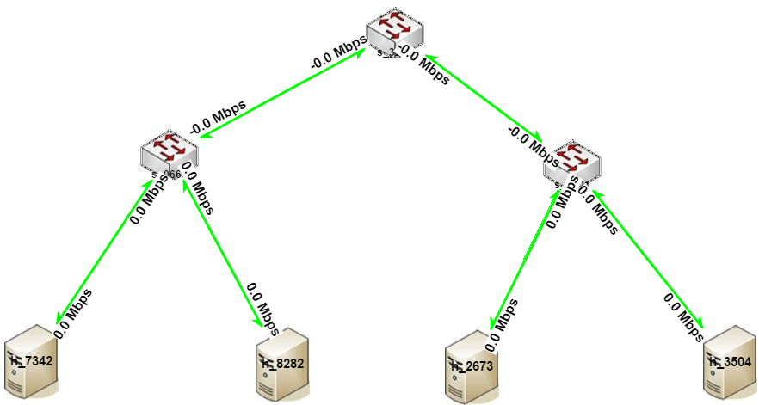
Topology Manager
Retrieve topology data and render it.
Retrieve statistic data and display it on the link.

Slide 8
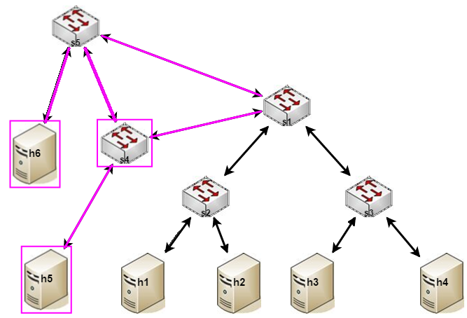
Network Element Manager
Add or remove switch
Add or remove host
Add or remove link

Slide 9
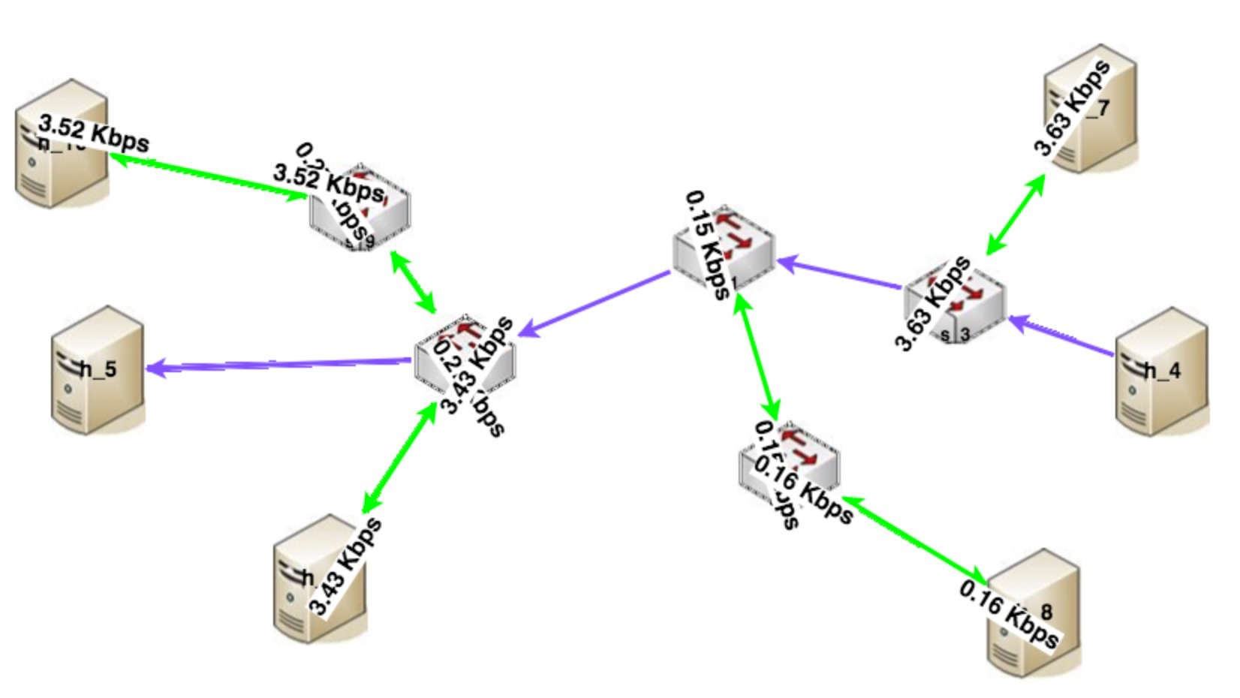
optimum route calculation
Calculate optimum route based on link loading and cost
Render and highlight the route

Slide 10
Outline
3
Introduction
1
2
Architecture
3
Implementation
3
4
Summary

Slide 11
Summary
With incorporation of Bootcamp learning, we realized an app based on ODL, which tries to easy the configuration and management of network.
For the app, it realizes topology visualization plus link loading, and supports optimum route calculation. Besides, it supports network element management functionalities, ex. add/remove switch, host or link.
2 api docs, 1 operational doc and 1 introduction slides generated.
We used black-box testing to verify it.

Slide 12

Any
Questions

