Slide 1
NARS
network as router service
Team 4：Gao Kai(THU)，Zhang Yu(BAIDU)，Wang Yingbin(ALI)

Slide 2
Agenda
1、Background
2、Concept
3、Uses Case
4、Design
5、Plan
6、Current
7、Future
8、Demo
9、Q&A

Slide 3
Background
Requirements
user define subnet
user define route
Problems
config complicated
address conflict
users effect each other

Slide 4




Concept
vNet
vNet
vRouter
vPort
Route
x.x.x.x/x -> vPort
vport
vRouter

Slide 5
Uses Case
vNet
vNet
USER1
USER2
vport1
vport1
vport6
vport2
vport6
vport2
vRouter
vport3
vRouter
vport3
vport5
vport5
vport4
vport4
Route:
10.11.0.0/16 -> vport1
10.12.0.0/16 -> vport2
10.13.0.0/16 -> vport3
Route:
10.11.0.0/16 -> vport1
10.12.0.0/16 -> vport2
10.13.0.0/16 -> vport3
10.14.0.0/16 -> vport4

Slide 6
Design-Arch
UI：shell、web…
App layer
APP
path
topolopy
vrouter
vport
user
route
RESTCONF
control plane
ODL
vRouter Service
abs layer
vRouter Yang Model
CDP
VRF
VLAN
INTERFACE
ROUTE
phy layer
physical device
data plane

Slide 7
Design-API
cisco-devnet@Cisco-DevNet-DevTools:~/wyb/vrouter_project$ sh client/api_direct.sh
Common Usage: --action $action
Action Usage:
init
create_vourter: --user $user --vrouter $name
destroy_vourter: --user $user --vrouter $name
list_vourter: --user $user
bind_vport: --user $user --vrouter $name --vport $name
unbind_vport: --user $user --vrouter $name --vport $name
list_vport: --user $user
add_route: --user $user --vrouter $name --dest $dest --mask $mask --vport $name
delete_route: --user $user --vrouter $name --dest $dest --mask $mask
list_route: --user $user --vrouter $name

Slide 8
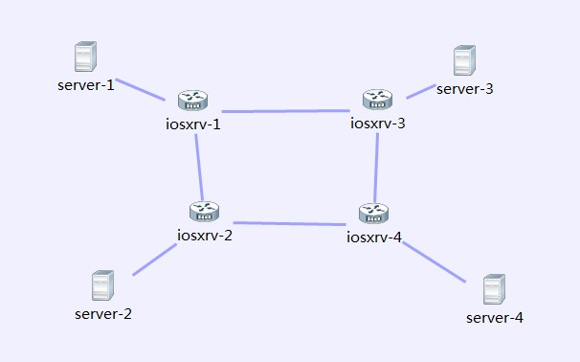
Design-bind vport to vrouter
do bind vport API
create vrf
get topology
6.config vrf&ip
create vlan&config ip
3.config vlan&ip
2.create vrf
1.create vrf
get vrouer other vport
5.config vlan&ip
config server if vrf&ip
4.create vrf
get cur vport to other vport path

Slide 9
Schedule
方案预研（迭代一）√
测试环境搭建
交换机手动配置，验证方案可行性
RESECONF测试（迭代二）√
RESTCONF手动配置，验证方案可行性
基础功能（迭代三）√
环境搭建
Python app
vRouter、ROUTE、vPort API and logical
topo、Path compute logical
CDP/ROUTE/VRF/VLAN/INTERFACE/ROUTE adapter
core code test
ODL MD-SAL
vRouter Yang model design
Demo
高级功能（迭代四）
UI
as service

Slide 10





Future
vNet
Internet
USER
FW/WAF/LB…
vport1
vport6
vport2
vRouter
vport3
Phy connect
Server
Server
vport5
172.16.21.11
172.16.21.12
172.16.21.0/24
vport4
Gateway
Route:
10.11.0.0/16 -> vport1
10.12.0.0/16 -> vport2
10.13.0.0/16 -> vport3
10.14.0.0/16 -> vport4
Server
Server
172.16.22.13
172.16.22.14
172.16.22.0/24
User data center

Slide 11
Demo
netops：
1、init
wyb1 user：
1、create：vrouter1
2、bind：server1(vport1)、server4(vport4)
3、add：10.11.0.0/16->vport1
4、add：10.12.0.0/16->vport4
5、ping check、netcat check
wyb1
wyb2
wyb2 user
1、create：vrouter2
2、bind：server2(vport2)、server3(vport3)
3、add：10.11.0.0/16->vport2
4、add：10.12.0.0/16->vport3
5、ping check、netcat check

Slide 12
Q&A

Slide 13
thanks

