Slide 1
Group 6
Group Members:
LiJie (Qihoo 360 Technology Co. Ltd.)
GuDongBo (UESTC)
SunGuoYou (USTC)

Slide 2
Hackathoon Project: SDL Loadbalancer
What we have done
An simple ODL internal application
An external application written in the Django framework

Slide 3
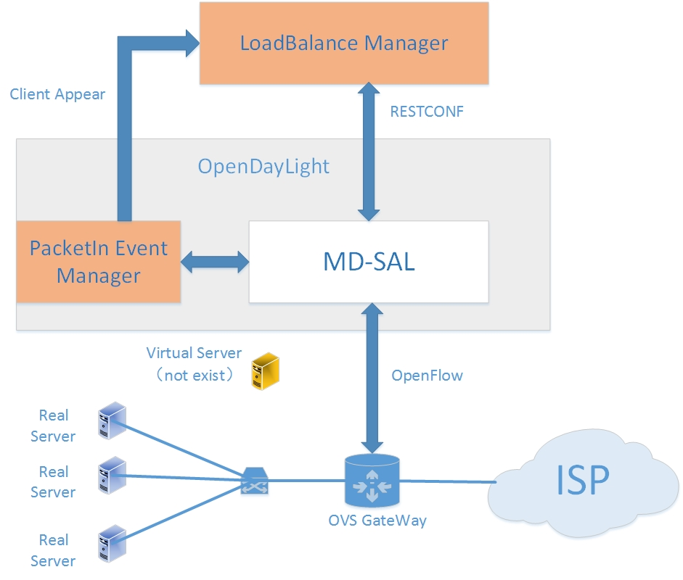
Architecture
Interaction between external application and
Internal application
External application call the odl northbound api to manage the flow on the gateway device
Internal application will packetin the packet that sent to the virtual ip and port and just post the information to the external application

Slide 4
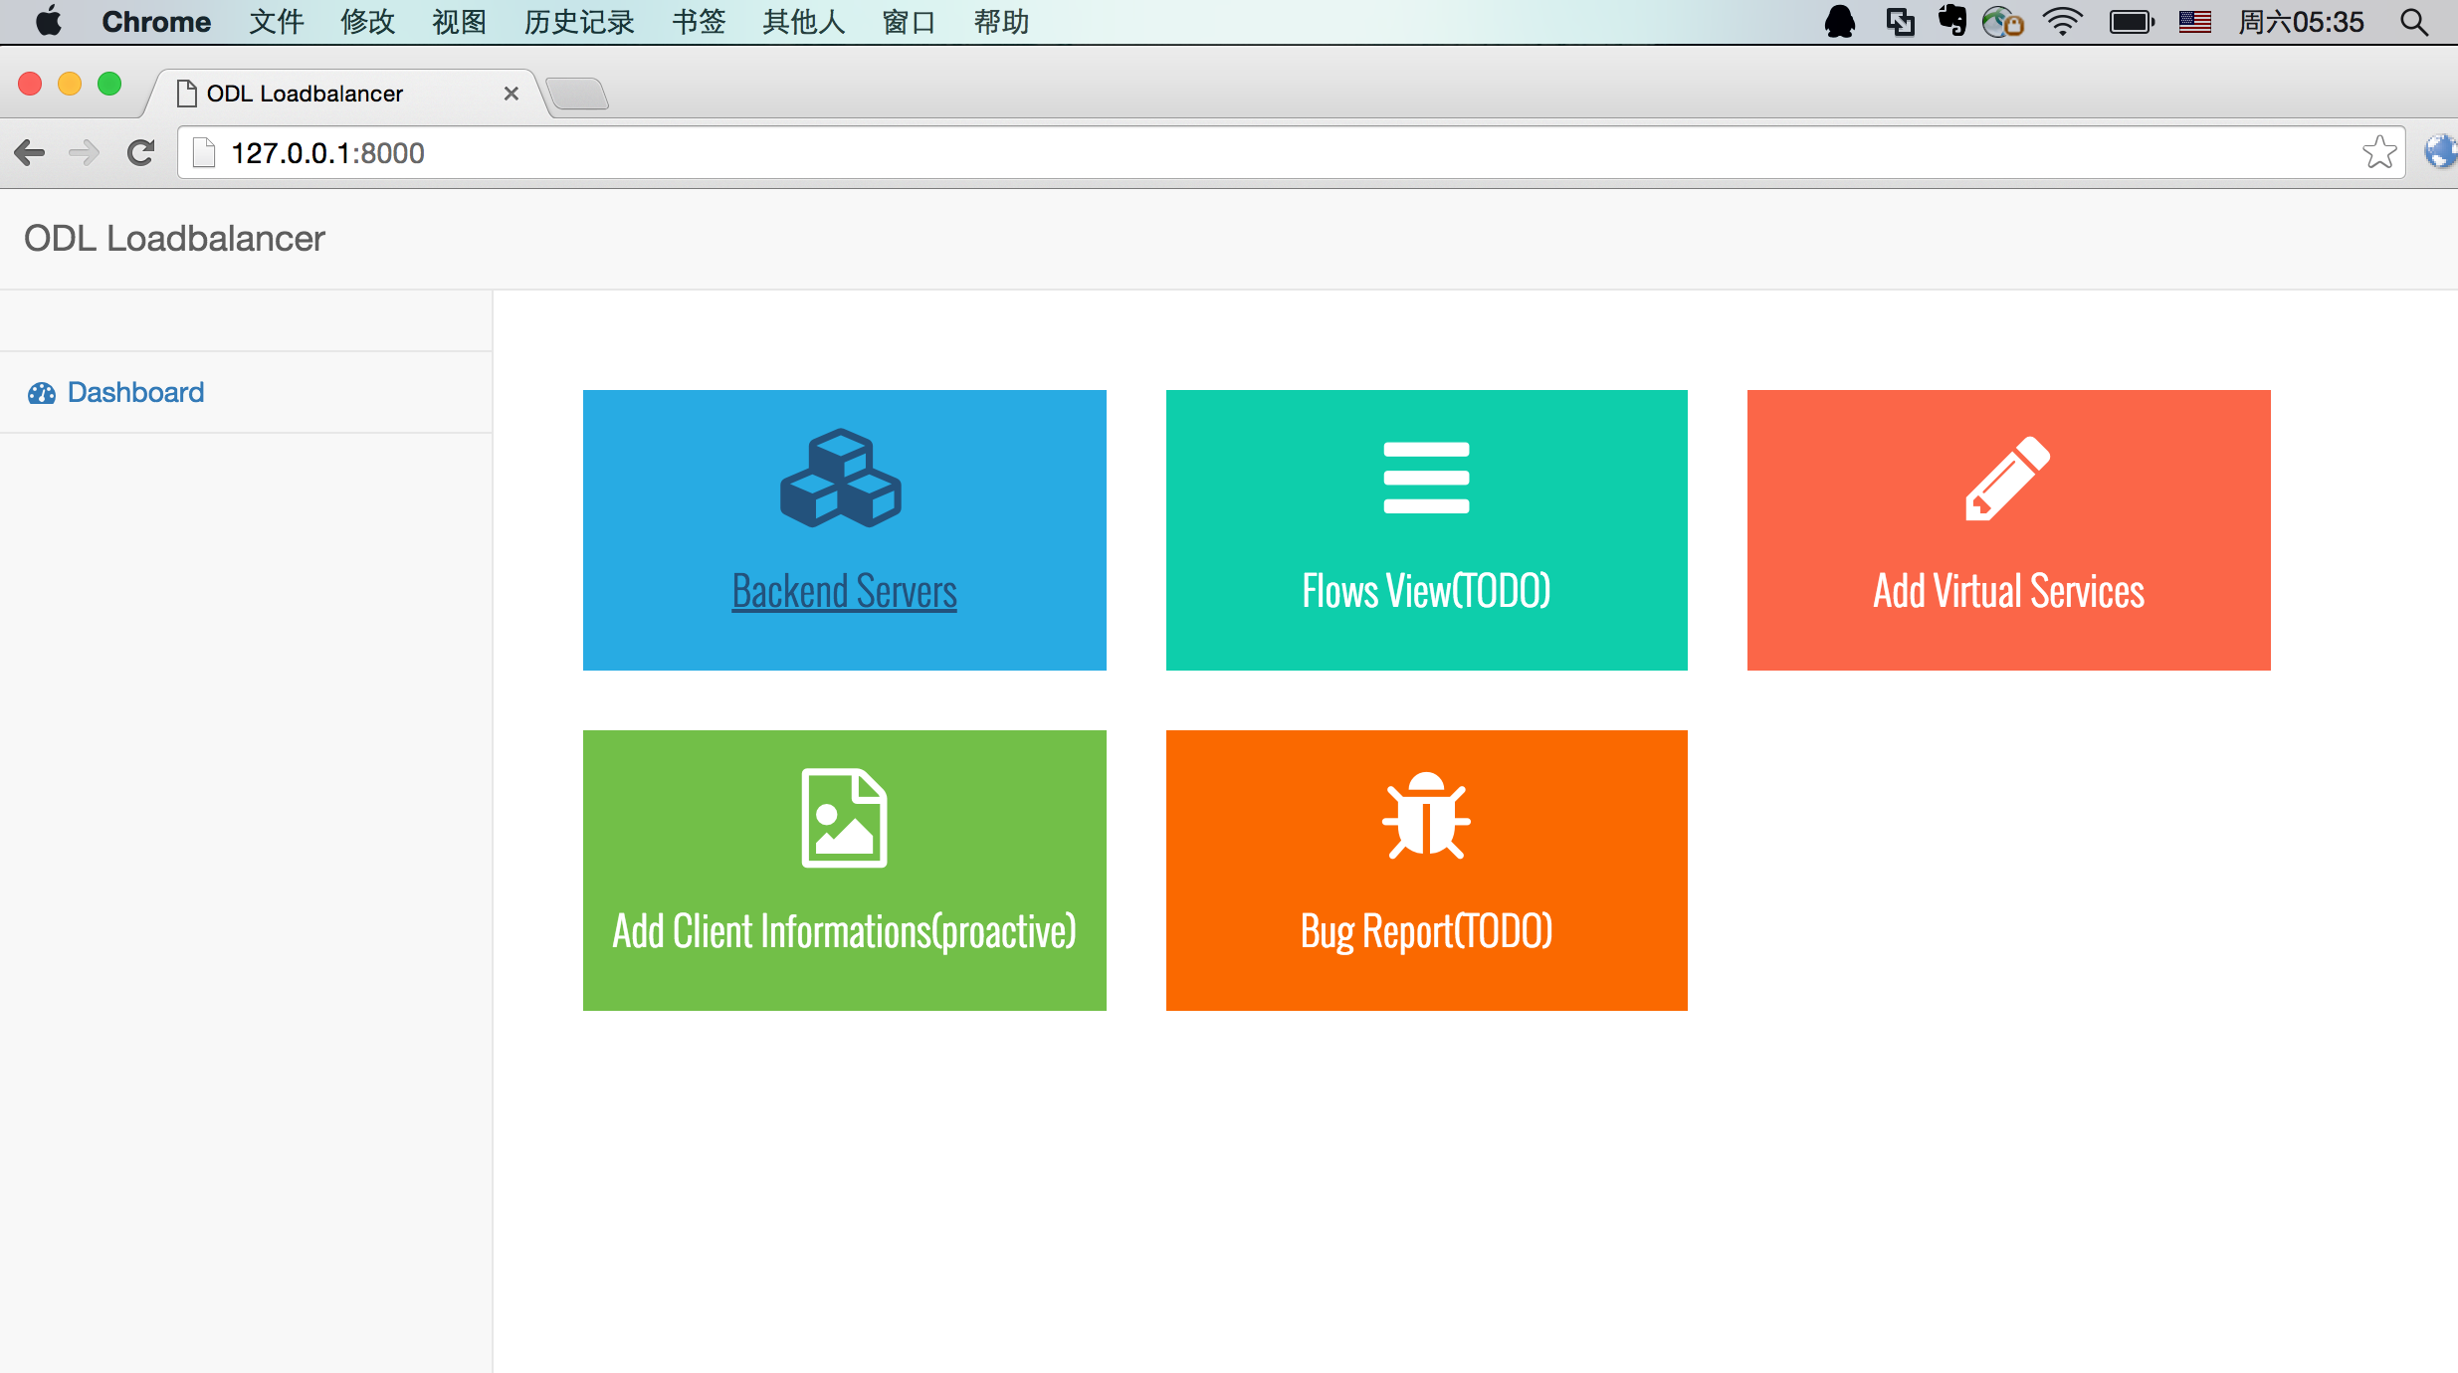
Enternal Application Dashboard

Slide 5
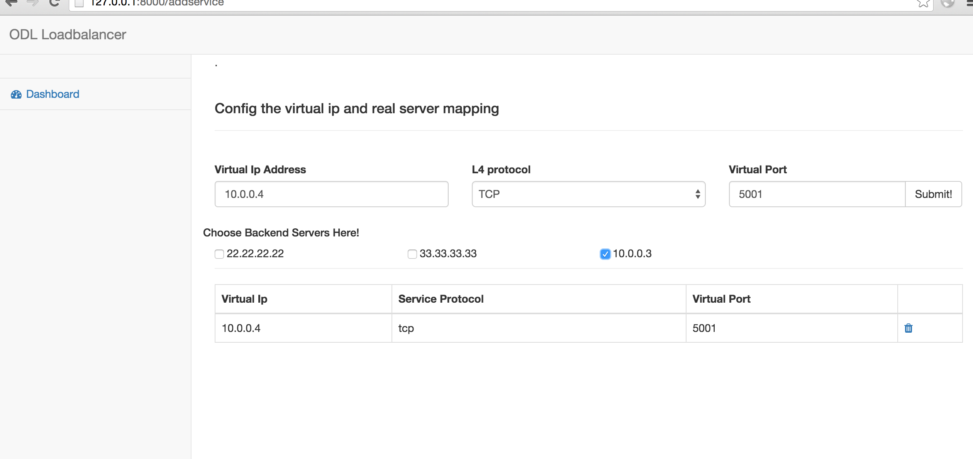
Workflow
Step1: define a virtural service
After defining the virtual service
External will call odl api to add initial flow

Slide 6
Workflow
When a client send data to the virtual service, internal app send information to the external application
The external app will choose a real server from pool and add flow for this client
The after coming packets will match this flow with priority 60 rather than the initial flow whose priority is 50
After idle_timeout is reached, the flow will be deleted automaticly, when the client request the same service, it may get a new backend to server it.

Slide 7
Thanks

