Slide 1
BGP-PCEP Tutorial
ODL Summit, Seattle - Sept 2016
Ajay Chhabria
Ajay Lele
Kevin Wang
Brocade
Giles Heron
Cisco

Slide 2
Agenda
Setup Creation
BGP
BGP IPv4/IPv6 Routes
BGP-LS
Application Peer
OpenConfig
PCEP
PCE initiated LSPs
PCC initiated LSPs (Delegation)
Bandwidth Update
Segment Routing
BMP
Flowspec

Slide 3
Pre-requisites
Basic understanding of BGP and PCEP protocols
Familiarity with ODL
Resources
Laptop with sufficient resources to create VM

Slide 4
Setup Creation

Slide 5



Lab Network Diagram
SFC
SEA
POR
AS: 65504
SJC
MIN
Controller
KCY
LAX
SAN

Slide 6
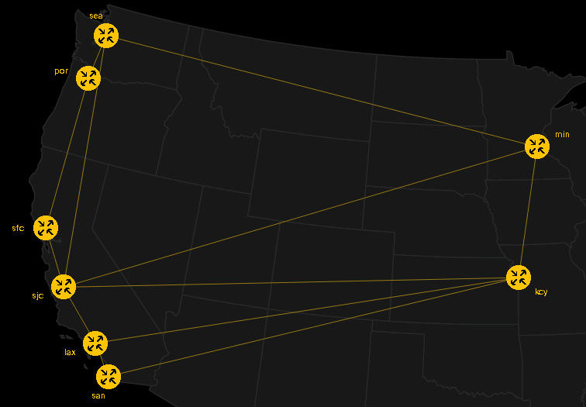
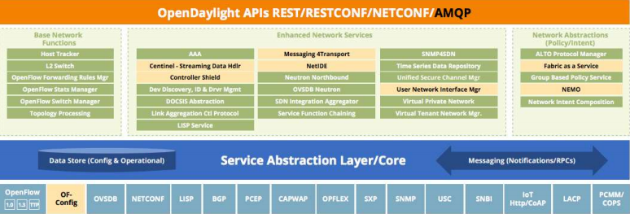

Setup Components
Conference Center
Cisco dCloud
VIRL Network Simulation
OpenDaylight Controller
Anyconnect VPN
Controller VM
OpenDaylight Lab

Slide 7
Controller VM
Three options for creating Controller VM
Use preconfigured VM from USB stick
(login: odlsummit/odlsummit)
Use Vagrant to launch preconfigured VM
(login: vagrant/vagrant)
Use any vanilla VM and configure manually
Use ODL setup scripts for configuration https://github.com/kevinxw/opendaylight-setup
Install OpenDaylight Controller
Initialize Controller
Connect to dCloud session using Anyconnect VPN

Slide 8
Network Simulation
Simulated network will be run in Cisco dCloud using VIRL
For today sessions will be pre-launched and run from Giles’ account.
Register and login to dCloud https://dcloud.cisco.com/
Search for “OpenDaylight Boron with Apps with 8 Nodes”
Schedule and launch lab session

Slide 9
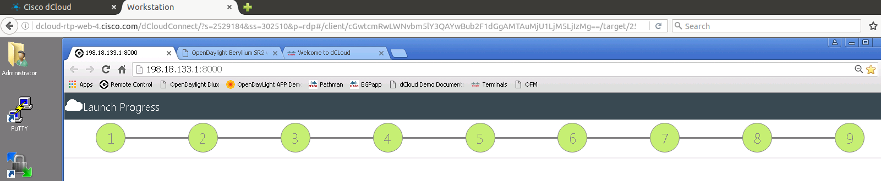
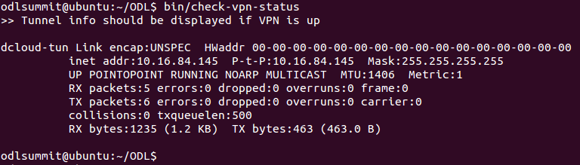
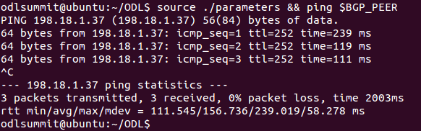
Setup Verification
Controller VM configured and ODL process running
dCloud Lab status page shows all steps completed and in green
Ping from Controller VM to SJC router successful

Slide 10
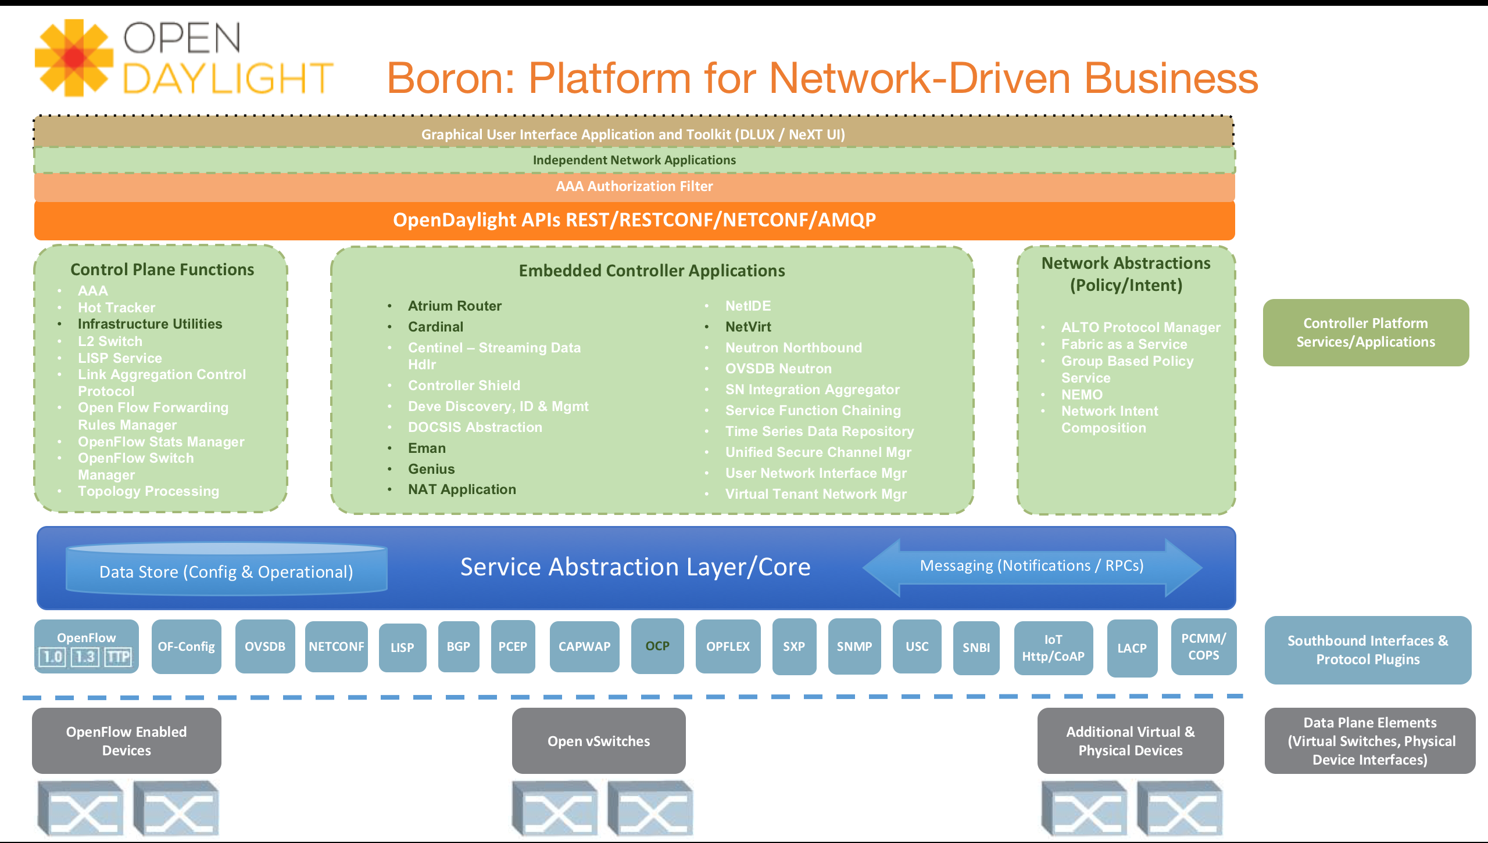
ODL BGP/PCEP Plugins

Slide 11

ODL BGP/PCEP Overview
App
RESTCONF
Topology
MPLS LSPs via PCEP
PCE-P
BGP
Route Reflector
Link-State, IPv4, IPv6, Labelled Unicast, IPVPN, EVPN and Flowspec routes
BGP
Edge
OSPF
Edge
BGP
PCE-P
OSPF
BGP
Edge
OSPF
OSPF
Core
OSPF
BGP
Edge
Core
OSPF
OSPF
Edge
PCE-P
BGP
BGP
OSPF
Route Reflector
OSPF

Slide 12
BGP/PCEP Topologies
Link-State
IPv4
IPv6
PCE-P
BGP-LS
OSPF
OSPF
OSPF
OSPF
OSPF
OSPF
BGP
RR
BGP
BGP

Slide 13
BGP

Slide 14
Overview
Exterior Gateway Protocol, used to exchange routing information between Autonomous Systems
Explicit connection establishment between peers (EBGP, IBGP, RR)
No periodic routing updates; sent only when information changes
MP-BGP enables supports for multiple address families
One or more attributes associated with prefixes; policies are applied on these attributes
Message Type | Description
OPEN | Exchange of options & capabilities
KEEPALIVE | Heartbeat message, Dead peer detection
UPDATE | Transfer routing information
NOTIFICATION | Inform about exception conditions
ROUTE-REFRESH | Request peer to re-send routing information

Slide 15
Standards Supported
RFC4271 - A Border Gateway Protocol 4 (BGP-4)
RFC4456 - BGP Route Reflection: An Alternative to Full Mesh Internal BGP (IBGP)
RFC1997 - BGP Communities Attribute
RFC4360 - BGP Extended Communities Attribute
RFC4486 - Subcodes for BGP Cease Notification Message
RFC5492 - Capabilities Advertisement with BGP-4
RFC5004 - Avoid BGP Best Path Transitions from One External to Another
RFC6286 - Autonomous-System-Wide Unique BGP Identifier for BGP-4
RFC6793 - BGP Support for Four-Octet Autonomous System (AS) Number Space
RFC7311 - The Accumulated IGP Metric Attribute for BGP
RFC5668 - 4-Octet AS Specific BGP Extended Community
draft-ietf-idr-link-bandwidth - BGP Link Bandwidth Extended Community
draft-ietf-idr-bgp-extended-messages - Extended Message support for BGP

Slide 16
Standards Supported
RFC4760 - Multiprotocol Extensions for BGP-4
RFC2545 - Use of BGP-4 Multiprotocol Extensions for IPv6 Inter-Domain Routing
RFC7752 - North-Bound Distribution of Link-State and TE Information using BGP
draft-gredler-idr-bgp-ls-segment-routing-ext - BGP Link-State extensions for Segment Routing
draft-ietf-idr-bgpls-segment-routing-epe - Segment Routing Egress Peer Engineering BGP-LS Extensions
RFC5575 - Dissemination of Flow Specification Rules
RFC7674 - Clarification of the Flowspec Redirect Extended Community
draft-ietf-idr-flow-spec-v6 - Dissemination of Flow Specification Rules for IPv6
draft-ietf-idr-flowspec-redirect-ip - BGP Flow-Spec Redirect to IP Action
RFC3107 - Carrying Label Information in BGP-4
draft-ietf-idr-bgp-prefix-sid - Segment Routing Prefix SID extensions for BGP
RFC4364 - BGP/MPLS IP Virtual Private Networks (VPNs)
RFC4659 - BGP-MPLS IP Virtual Private Network (VPN) Extension for IPv6 VPN
RFC7432 - BGP MPLS-Based Ethernet VPN
draft-ietf-bess-evpn-overlay - A Network Virtualization Overlay Solution using EVPN
draft-ietf-bess-evpn-vpws - VPWS support in EVPN
RFC7911 - Advertisement of Multiple Paths in BGP
RFC2918 - Route Refresh Capability for BGP-4

Slide 17
Processing of Routes
External App
RESTCONF
Adj-RIB-In
Import
Policy
Effective-RIB-In
App-RIB
Adj-RIB-In
Effective-RIB-In
Adj-RIB-In
Effective-RIB-In
Decision
Process
Import
Policy
IPv4/IPv6 Reachability Topology
BGP Peer 1
Loc-RIB
Topology
Exporter
Export
Policy
Linkstate
Topology
Adj-RIB-Out
Adj-RIB-Out
Adj-RIB-Out
BGP Peer 2
ODL BGP Speaker

Slide 18
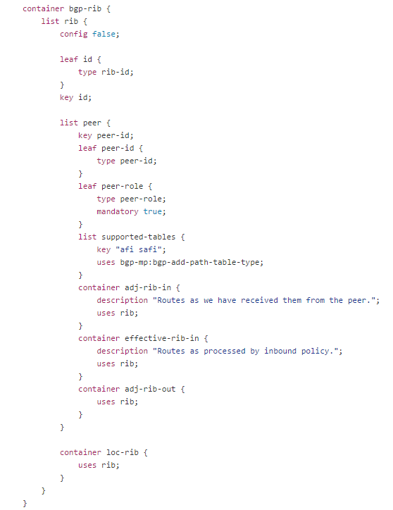
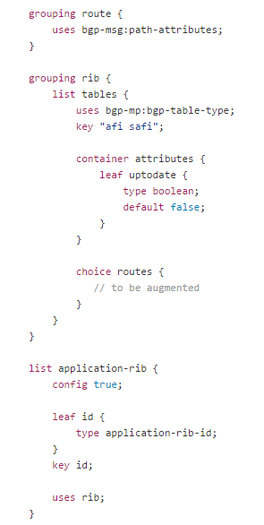
BGP RIB Model
List of RIBs, indexed by an ID
Note: config → false
BGP path attributes
List of tables, indexed by AFI-SAFI
List of peers, indexed by peer-ID
Peer role: ebgp, ibgp, or rr-client
Definition of route, augmented by each address-family model
Adj-RIB-In
Effective-RIB-In
Special application RIB, used for route injection
Note: config → true
Adj-RIB-Out
Loc-RIB – common to all peers
bgp-rib.yang

Slide 19
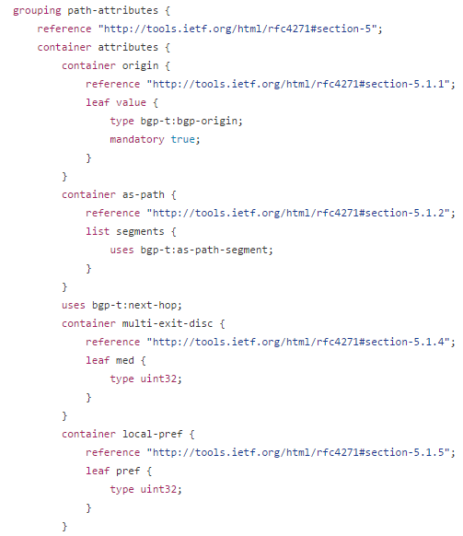
BGP Path Attributes
ORIGIN path-attribute
AS-PATH path-attribute
NEXT-HOP path-attribute
LOCAL-PREF path-attribute
bgp-message.yang

Slide 20
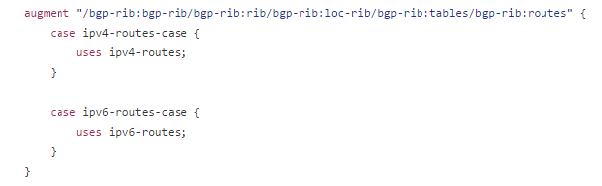
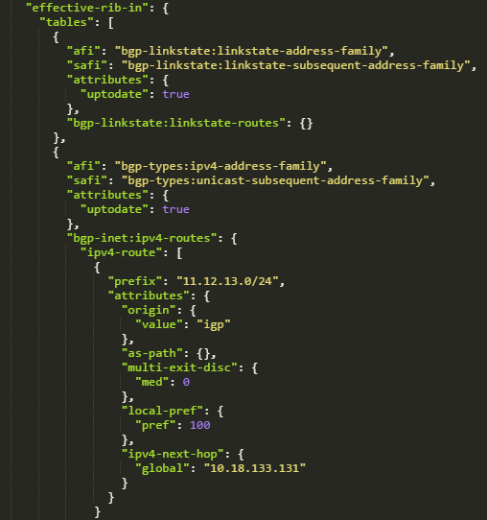
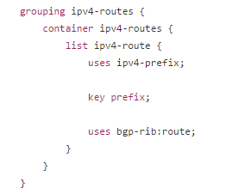
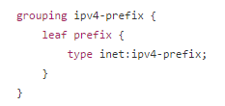
BGP Internet Routes
Augmentation on top of bgp-rib:routes for IPv4 routes
List of IPv4 routes, indexed
by IPv4 prefix
bgp-inet.yang

Slide 21
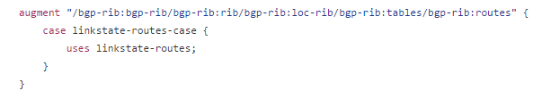
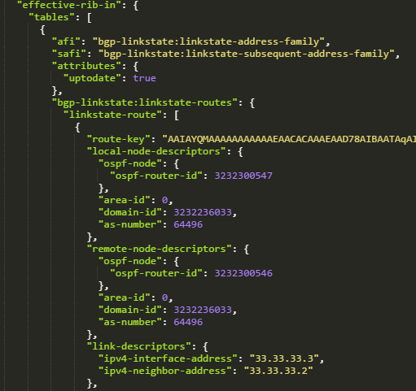

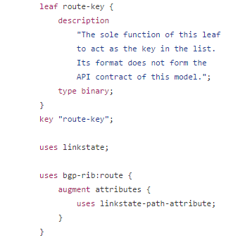
BGP Linkstate Routes
Augmentation on top of bgp-rib:routes for Linkstate routes
List of Linkstate routes, indexed by an opaque route-key
bgp-linkstate.yang

Slide 22
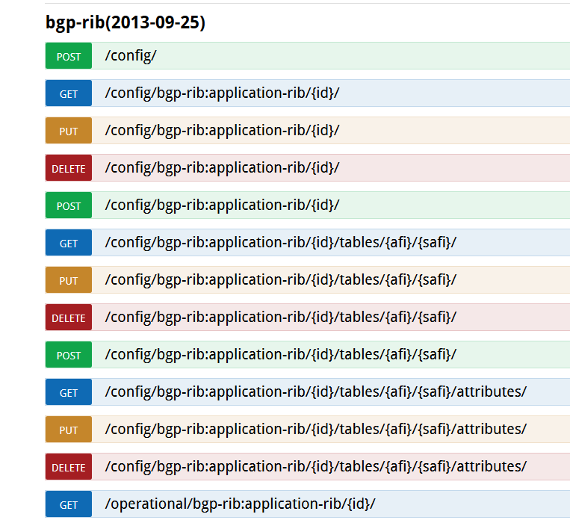
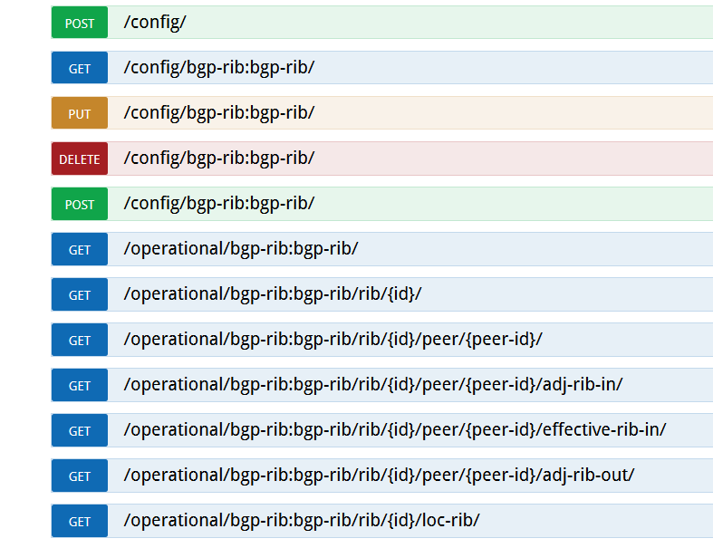
BGP RIB RESTCONF Endpoints

Slide 23
BGP-LS Topology Exporter

Slide 24
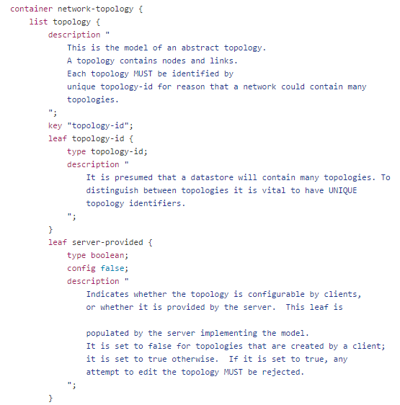
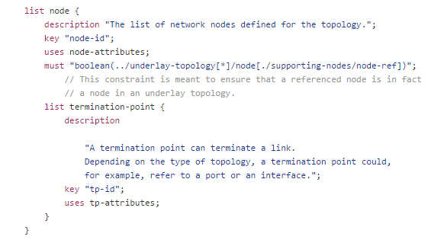
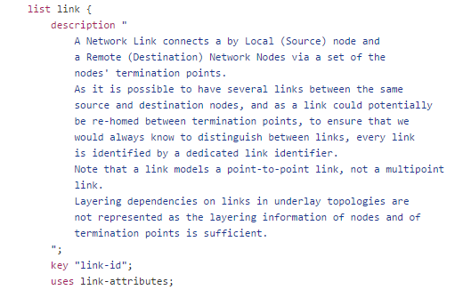
Base Network Topology Model
List of nodes
List of topologies
Attributes associated with node
List of termination-points on the node
Attributes associated with TP
List of links between nodes
Attributes associated with link
network-topology.yang

Slide 25
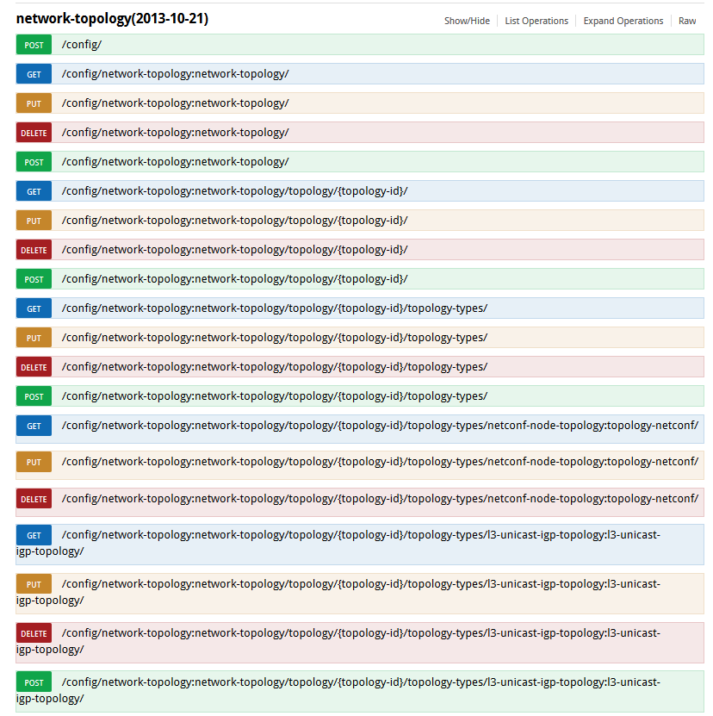
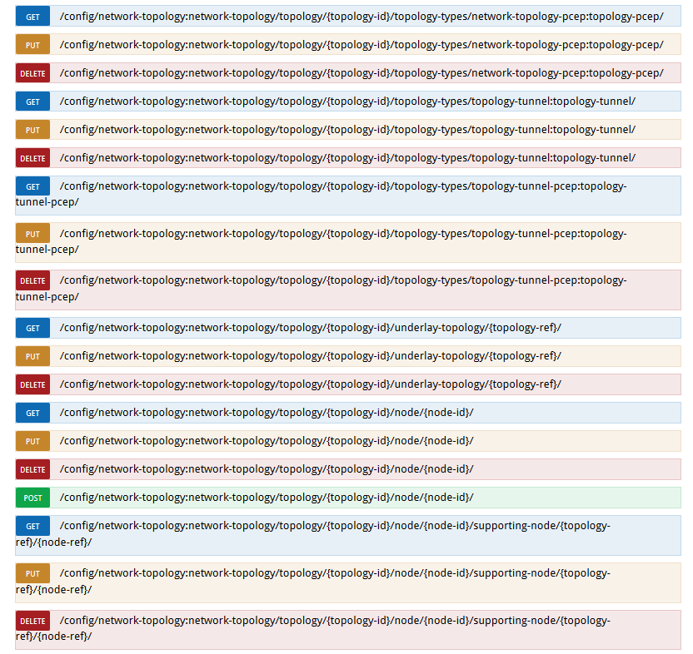
Network Topology RESTCONF Endpoints

Slide 26
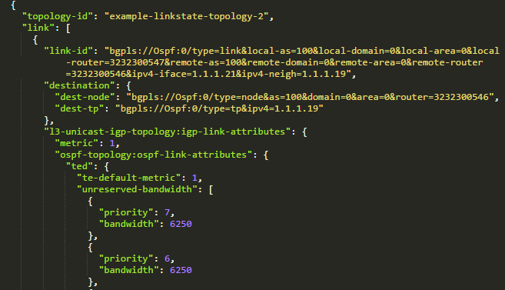
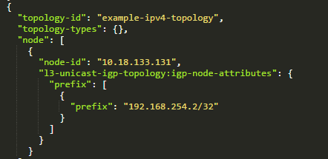
BGP Topologies
Linkstate Topology
IPv4 Reachability Topology
Node = Next hop IP address, augmented with igp-node-attributes containing list of prefixes that have this next-hop
No TP or Link information
Node = IGP (OSPF) Router
TP = Interfaces on Router
Link = Link between Routers

Slide 27
Installation
To be execute from Karaf console (can be enabled to run on startup)
feature:install odl-bgpcep-bgp-all (or install selectively)
Set logging level as desired
log:set DEBUG org.opendaylight.bgpcep.bgp
log:set DEBUG org.opendaylight.protocol.bgp

Slide 28
Configuration
Three ways to configure
Edit CSS config files (e.g. 41-bgp-example.xml)
Use Netconf controller-config mount point
Leads to creation of uber currentconfig CSS file
Use OpenConfig API
Limited support in Be, recommended method in Bo+
Configuration steps
Configure BGP RIB instance
Configure one or more BGP peers
Configure Application RIB (optional)
Tweak other settings e.g. BGP port, capabilities advertised (optional)

Slide 29
Troubleshooting
Initialization
Is ODL BGP speaker listening on port TCP/1790?
Shell: sudo netstat -natp | grep 1790
Is ODL process running?
Shell: ps -ef | grep karaf
Is BGP feature deployed?
Karaf console: feature:list -i | grep bgp
Check karaf.log file for initialization errors
Connectivity
Is the BGP connection between ODL and peer established?
Shell: sudo netstat -natp | grep 179
Is ODL BGP speaker running on TCP/179 or is port 1790 fwded to 179?
Shell: sudo iptables -t nat -L -n
Is ODL BGP speaker and/or BGP peer able to reach each other?
Shell: ping <peer-ip-address>
Is ODL BGP speaker and/or BGP peer able to connect to each other on BGP port?
Shell: telnet <peer-ip-address> <bgp-port>

Slide 30
Troubleshooting
Configuration
Does the BGP connection flap?
Shell: sudo netstat -natp | grep 179
Output shows different port numbers when run few minutes apart
Are BGP speakers configured with correct peer address
E.g. Check contents of 41-bgp-example.xml config file
Are BGP speakers configured with correct AS numbers
E.g. mis-matching AS number for IBGP connection
Do BGP speakers have mis-matching capabilities
E.g. ODL supports 4-octet AS numbers only
E.g. Both speakers should support the same address-families
Check karaf.log file for negotiation errors

Slide 31
Troubleshooting
Loc-RIB or Topology do not have expected entries
Trace the entries in the sequence they are processed
Adj-RIB-In → Effective-RIB-In → Loc-RIB → Adj-RIB-Out
App-RIB → Loc-RIB → Adj-RIB-Out
Adj-RIB-In → Effective-RIB-In → Loc-RIB → example-linkstate-topology
Use packet sniffer e.g. Wireshark to capture BGP traffic between peers and analyze it

Slide 32
PCEP

Slide 33
Overview
Message Type | Description
Open & Keepalive | Instantiate and maintain sessions
PCReq | Path Computation request
PCRep | Reply to path computation request
PCNtf | Notification message of a specific event
PCErr | Message sent upon the occurrence of protocol error
Communication protocol for
exchange of MPLS Traffic Engineering
(TE) information between PCE and PCC
Defined by RFC 5440
Stateful extension to enable
synchronization of LSP state
between PCC and PCE
LSP management can happen in two ways
PCE initiated
LSP is created and controlled by PCE
PCC initiated
LSP is created by PCC which may then delegate it to PCE
PCE can update it only if control is delegated by PCC

Slide 34
Standards Supported
RFC5440 - Path Computation Element (PCE) Communication Protocol (PCEP)
RFC5541 - Encoding of Objective Functions in the Path Computation Element Communication Protocol (PCEP)
RFC5455 - Diffserv-Aware Class-Type Object for the Path Computation Element Communication Protocol
RFC5521 - Extensions to the Path Computation Element Communication Protocol (PCEP) for Route Exclusions
RFC5557 - Path Computation Element Communication Protocol (PCEP) Requirements and Protocol Extensions in Support of Global Concurrent Optimization
RFC5886 - A Set of Monitoring Tools for Path Computation Element (PCE)-Based Architecture
draft-ietf-pce-pceps - Secure Transport for PCEP
Stateful extensions to the Path Computation Element Protocol, December 2013
draft-ietf-pce-stateful-pce-07 - PCEP Extensions for Stateful PCE
draft-ietf-pce-pce-initiated-lsp-00 - PCEP Extensions for PCE-initiated LSP Setup in a Stateful PCE Model
Segment routing extension to the Path Computation Element Protocol, October 2014
draft-ietf-pce-segment-routing-01 - PCEP Extension for segment routing
draft-ietf-pce-lsp-setup-type-01 - PCEP Extension for path setup type
draft-ietf-pce-stateful-sync-optimizations-03 - Optimizations of Label Switched Path State Synchronization Procedures for a Stateful PCE
draft-sivabalan-pce-binding-label-sid-00 - Carrying Binding Label/Segment-ID in PCE-based Networks

Slide 35
BGP-LS and PCE-P
Harvest Network Intelligence
Program for Optimized Experience
BGP-LS
PCE-P

Slide 36
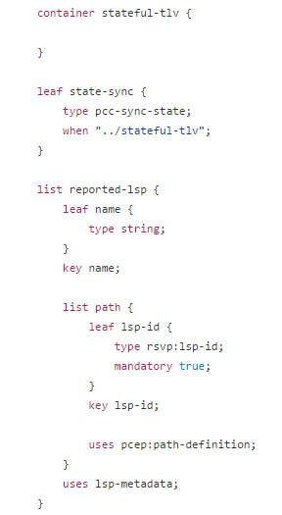
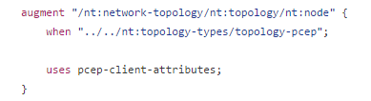
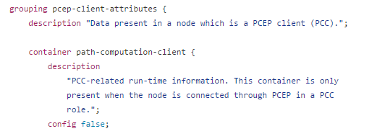
PCEP Topology Model
Augmentation on top of network-topology:node for PCC information
PCC information comprises of list of LSPs with associated details
network-topology-pcep.yang

Slide 37
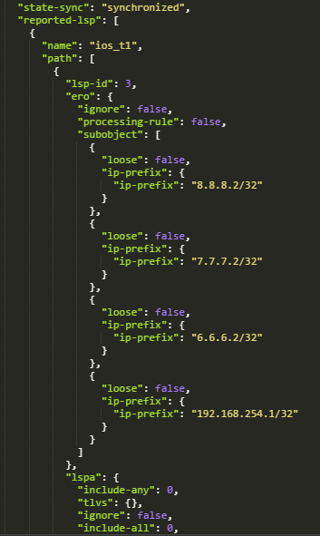
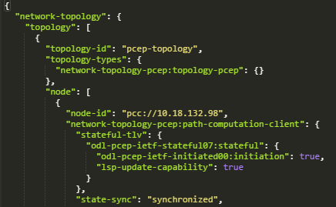
PCEP Topology
Node = Path Computation Client (PCC), augmented with pcep-client-attributes
No TP or Link information

Slide 38
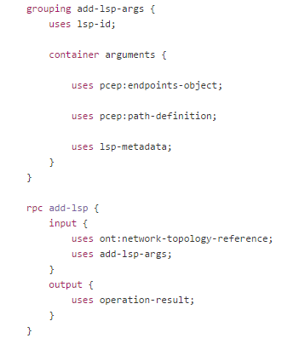
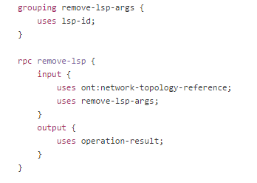
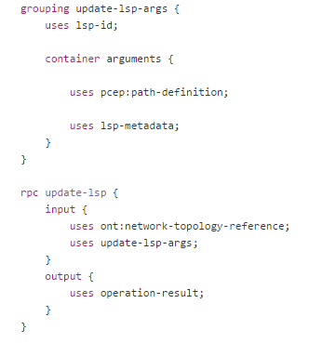
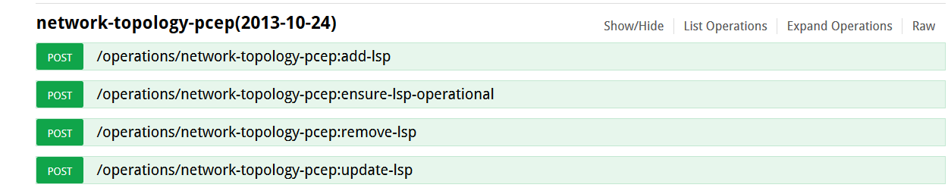
PCEP RPCs
RPCs for creation and removal of LSP – used by PCE initiated LSP use-case
RPC for updating LSP – in addition to PCE initiated, used by PCC initiated LSP + delegation use-case

Slide 39
Installation
To be execute from Karaf console (can be enabled to run on startup)
feature:install odl-bgpcep-pcep-all (or install selectively)
Set logging level as desired
log:set DEBUG org.opendaylight.bgpcep.pcep
log:set DEBUG org.opendaylight.protocol.pcep

Slide 40
Configuration
Two ways to configure
Edit CSS config files (e.g. 39-pcep-provider.xml)
Use Netconf controller-config mount point
Leads to creation of uber currentconfig CSS file
No OpenConfig model available
Configuration steps
No special configuration required
Tweak default config params e.g. PCEP topology name (optional)

Slide 41
Troubleshooting
Initialization
Is ODL PCE listening on port TCP/4189?
Shell: sudo netstat -natp | grep 4189
Is ODL process running?
Shell: ps -ef | grep karaf
Is PCEP feature deployed?
Karaf console: feature:list -i | grep pcep
Check karaf.log file for initialization errors
Connectivity
Is the PCEP connection between ODL PCE and PCC established?
Shell: sudo netstat -natp | grep 4189
Is PCC able to reach ODL PCE?
Shell: ping <peer-ip-address>
Is PCC able to connect to ODL PCE on PCEP port?
Shell: telnet <odl-ip-address> <pcep-port>

Slide 42
Troubleshooting
Configuration
Does the PCEP connection flap?
Shell: sudo netstat -natp | grep 4189
Output shows different port numbers when run few minutes apart
Is PCC configured with correct ODL PCE address and source address?
E.g. Check PCC running-config
Check karaf.log file for negotiation errors
Does PCC show up in ODL PCE PCEP Topology?
Check LSP delegation config on PCC (PCC initiated)
Is LSP state operationally UP?
Check path provided in EROs
Check if PCC is configured currently e.g. MPLS-TE / RSVP config
Use packet sniffer e.g. Wireshark to capture PCEP traffic between PCC & PCE and analyze it

Slide 43
BMP

Slide 44
BMP (BGP Monitoring Protocol)
RFC 7854
Enables access to peer’s Adj-RIB-In and Effective-RIB-In
You can get a LOT of prefixes
App
RESTCONF
BMP
BGP
BMP
RR
BGP
BGP

Slide 45
Installation and Configuration
To be execute from Karaf console (can be enabled to run on startup)
feature:install odl-bgpcep-bmp
Two ways to configure
Edit CSS config files (e.g. 42-bmp-example.xml)
Use Netconf controller-config mount point
Leads to creation of uber currentconfig CSS file
No OpenConfig model available
Configuration steps
No special configuration required
Tweak default config params e.g. BMP port (optional)

Slide 46
Flowspec

Slide 47
Setting “Flows” (FlowSpec)
RFC 5575
Similar to OpenFlow but uses BGP to distribute match/action rules
Matches:
Source / Destination IP prefix
IP Protocol
Source / Destination TCP/UDP port
ICMP Type / Code
TCP Flags
Packet Length
DSCP Field
Fragment (DF, IsF, FF, LF)
Actions:
Rate limit
Traffic sampling
Redirection
Traffic marking (DSCP)
And more... (optional)

Slide 48
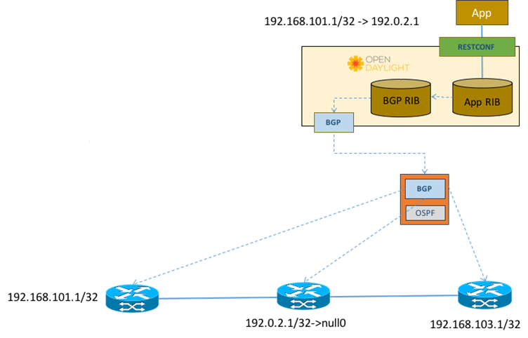
DDoS Mitigation using uRPF and IPv4/IPv6
Point 192.0.2.1/32 to null on all nodes
Turn on uRPF
Advertise routes with next-hop of
192.0.2.1 to discard

Slide 49
Installation and Configuration
To be execute from Karaf console (can be enabled to run on startup)
feature:install odl-bgpcep-bgp-flowspec (installed from odl-bgpcep-bgp-all)
No special configuration required

Slide 50
Thanks

