Slide 1
CloudUX Introduction
UCSDirector based Customized Self-Service Portal
Cisco System Korea
Mar. 2017
Hyung-Soo Kim(hyungsok@ciscocom)

Slide 2
What is CloudUX ?
Open Source Cloud Self-Service Portal
Target user is end-service user not IT addmin
The code is hosted on https://github.com/CiscoKorea/cloudux.git
It has dependencies on UCSDirector and vCenter
Python Django framework is used as webframework
It can be customized easily with extra requirements from customers & partners
CloudUX supports multi-language with built-in Korean & English

Slide 3
CloudUX screen capture

Slide 4
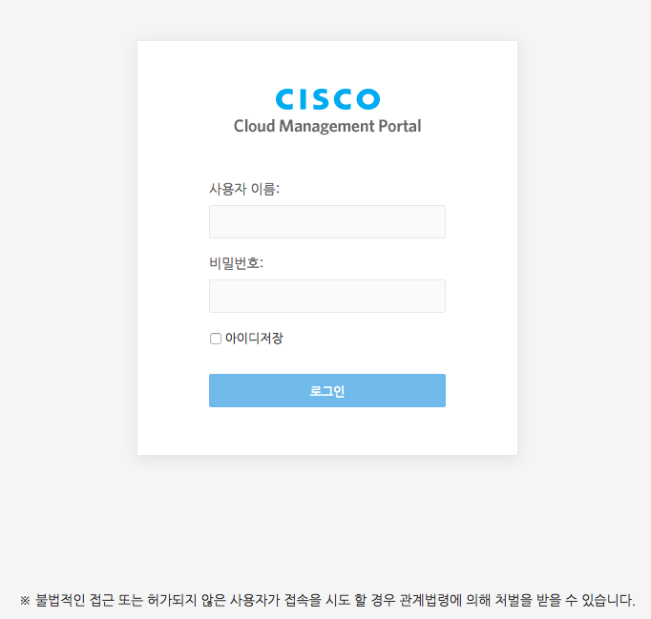
Main Login
Actual user validation is occurred at UCSDirector
No need to add users for service.

Slide 5
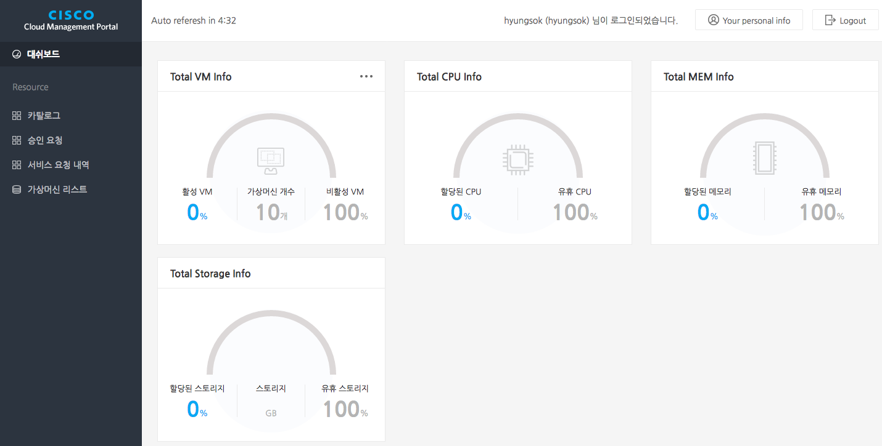
Dashboard – summary for allocated res
All allocated virtual resources are shown here by Group(Tenant)
Group(Tenant) is same meaning of group of UCSDirector

Slide 6
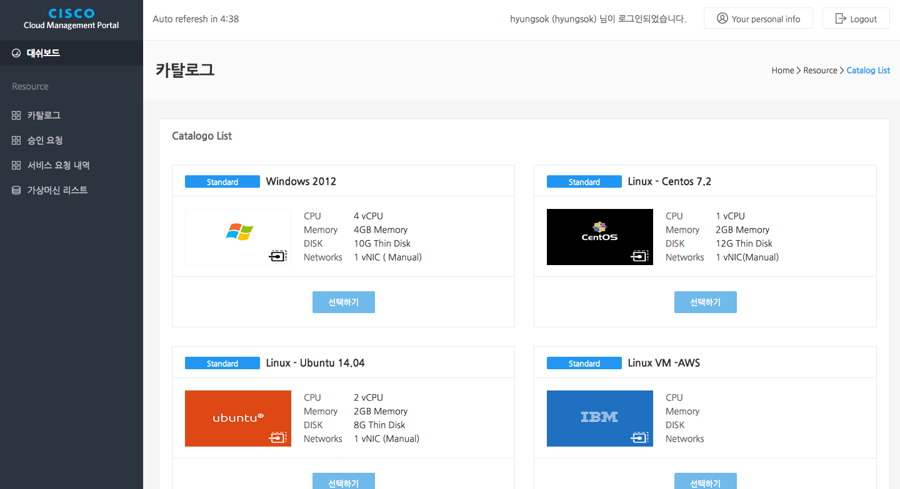
Catalog – Only for standard type
CloudUX show all catalogs registered at UCSDirector
List only standard(VM creation) type catalogs

Slide 7
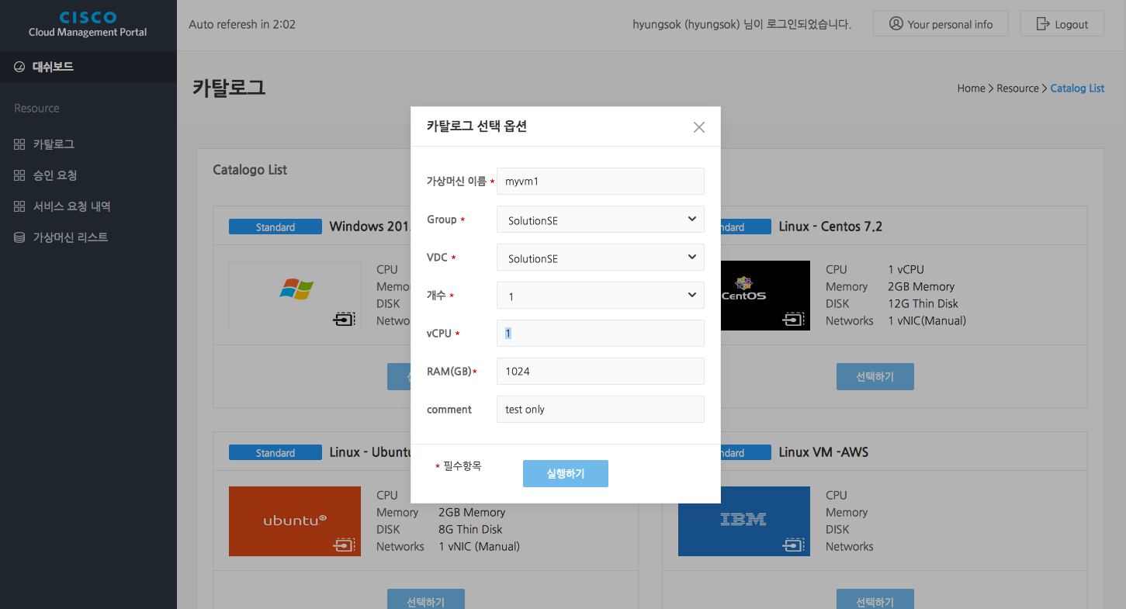
Ordering catalog – Creation VM
Before valid ordering catalog following are required
UCSD Group creation
Creation a vDC for the group (recommend same name)
Define & register compute/storage/network policy to the vDC
Images can be updated(or added) on catalog menu at UCSDirector

Slide 8
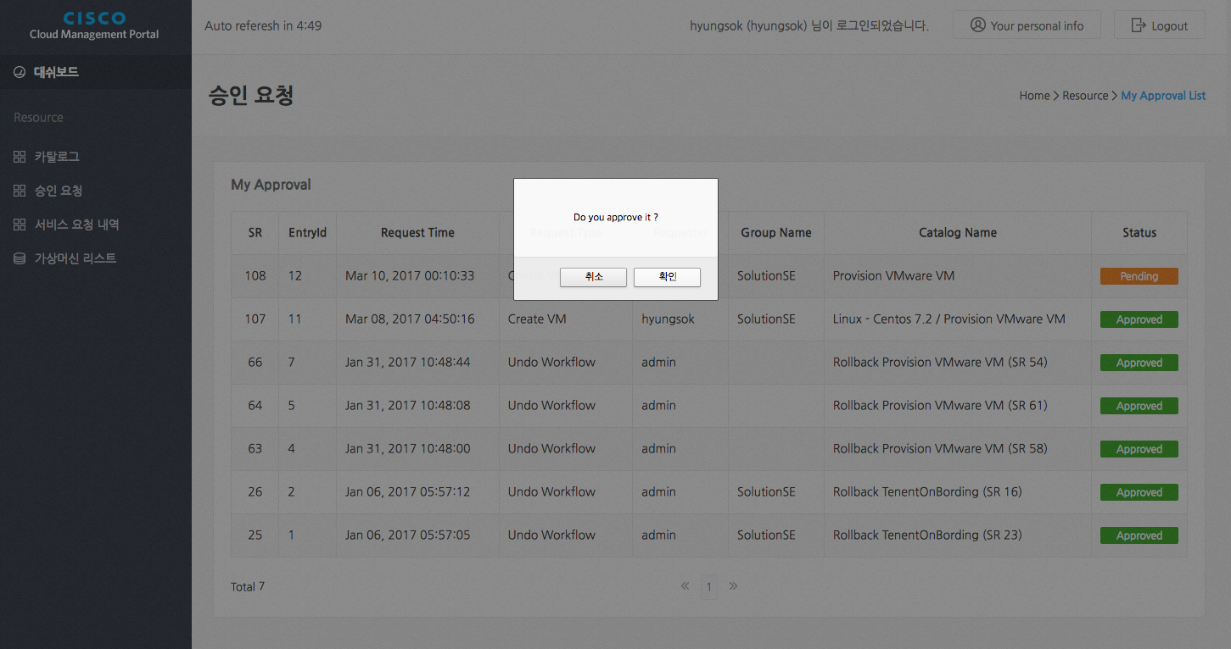
Approval Request List
Almost of company needs approval process
A manager who can approve the request at CloudUX
vDC has 1st,2nd approval process

Slide 9
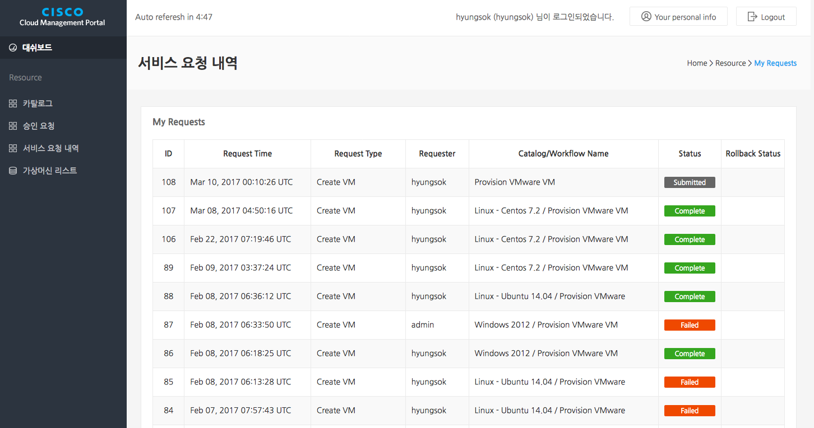
Service Request List
List all requests by member of Group(Tenant)
VM provisioning request
VM provisioning rollback request

Slide 10
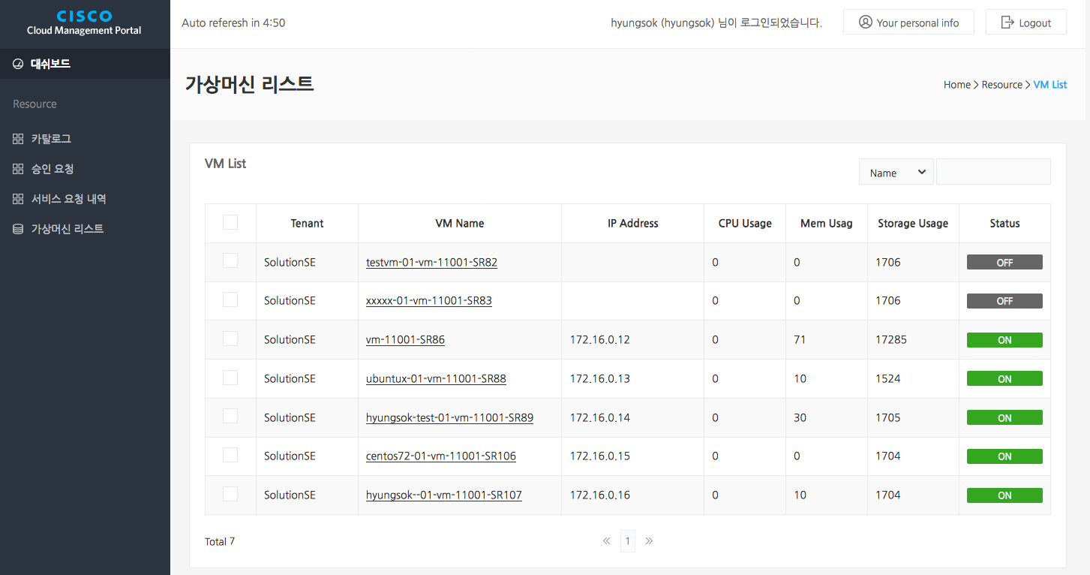
VM List
All virtual machines owned by Group(Tenant)
Remote Console with VMWare VMRC
VM Action includes power on/off
CPU, Memory, Disk usage data
from vCenter

Slide 11
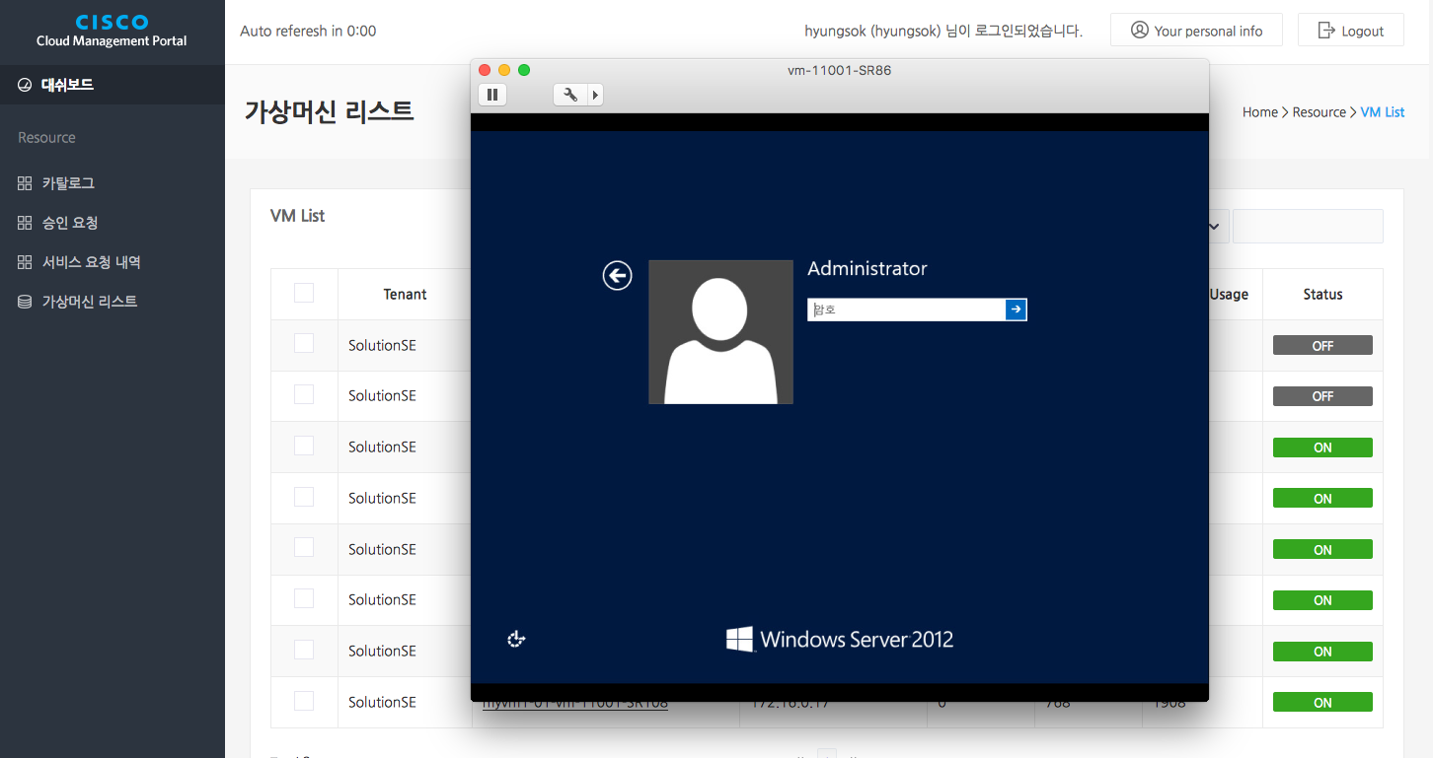
Launching VMRC
VMWare VMRC installation required
Console access with VMRC

Slide 12
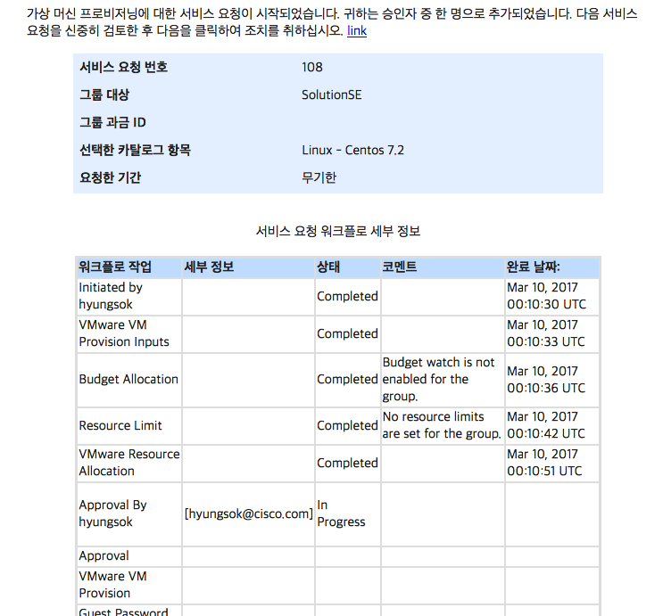
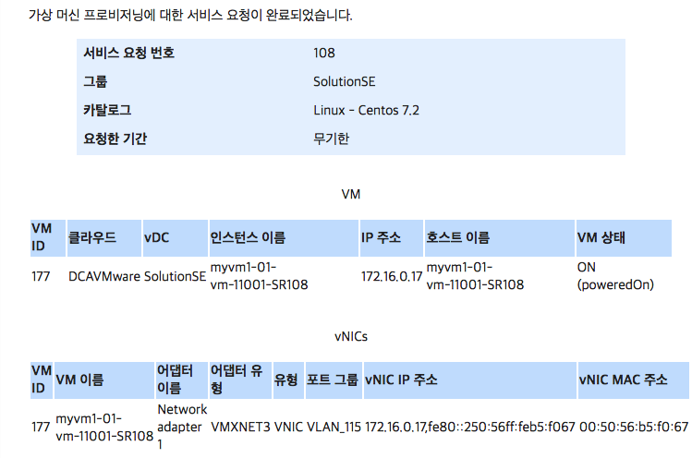
Notification with Email
Email templates can be customized with HTML5/CSS
Approval requests
Service completion

Slide 13
CloudUX Installation Guide

Slide 14
CloudUX Installation Guide
Single VM required for minimum
CentOS 7.x recommended, 2 vCPU, 2G Memory, 10GB Disk ( less then 100 users)
Github hosts all codes and installation guide
https://github.com/CiscoKorea/cloudux branch selfserviceportal
Ansible playbook for installation
Requirements for installation
UCSDirector IP address and admin REST API KEY
vCenter Information IP address, account & password for admin
Update variables before call ansible playbook

Slide 15
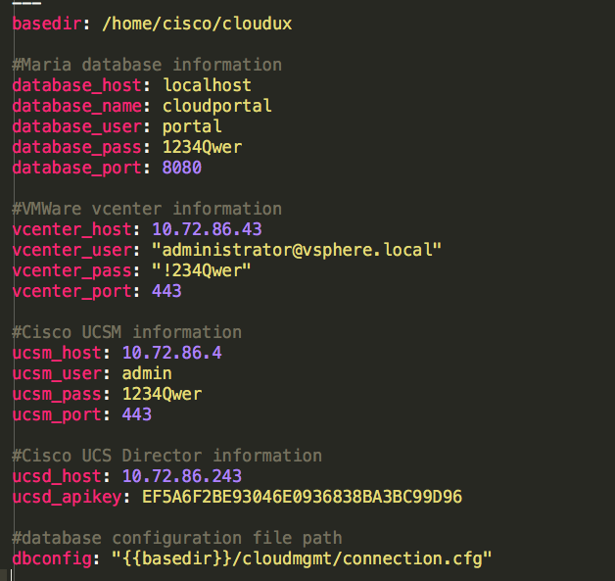
Ansible variables
Located
>cd cloudux
> vi ansible/playbook/roles/portal/var/main.yml
Database information
VMWare vCenter information
No use of UCSM for self-service portal
UCSDirector information

