Slide 1
Space Block – Roll the Block
Fábio Cunha Morais - up202008052
Francisco Miguel Alcobia Maia Prada - up202004646
Guilherme Soares Sequeira - up202004648

Slide 2
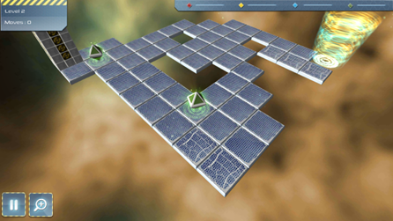
Specification of the game
Space Block – Roll the Block is a puzzle game in which the player must manage to place a block vertically in the position of the exit portal of each level. This block can roll in 4 directions (front, back, right and left) and must reach the objective without falling from the floating platform.
This project is based on the game Space Block: Roll the Block Pu. (30 de 09 de 2020).
Obtained from:
https://play.google.com/store/apps/details?id=com.zawor.spaceblock&hl=en&gl=US

Slide 3
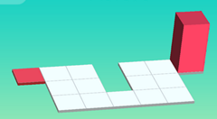
Problem formulation
State representation:
Representation of the map : This representation doesn’t take into account the position of the piece being this fundamental for states where the piece occupies an exit block;
Representation of the piece: One variable representing the state the piece is in (laying down along the y axis (Vertically), laying down along the x axis (Horizontally) or Up. Additionally, a tuple containing the position of the piece. This position always stores the position occupied by the prism that has the lowest y coordinate if the piece is in a Vertical position, or the lowest x coordinate if the piece is in a Horizontal position. This convention allows us to store less information;
Initial State:
Depends on the map and will be stored in files that will load when the game starts.
For example, in this case:
Board: [2,1,1,0,1,1,1],
[0,1,1,1,1,1,0]
Piece: ((6,0), U)
Heuristic:
Distance between the piece and the exit block.
Objective Test:
If the coordinate of the piece corresponds to the exit position and the piece is in the Up position.

Slide 4
Problem formulation: Operators
Vertical:
Move the block up (verticalMoveUp)
V -> U
pos(x, y) -> (x, y-1)
Move the block down (verticalMoveDown)
V -> U
pos(x,y)->(x,y+2)
Move the block left (verticalMoveLeft)
pos(x,y) -> (x-1, y)
Move the block right (verticalMoveRight)
pos(x,y)->(x+1, y)
Precondition: Piece: ((x,y),V)
Horizontal:
Move the block up (horizontalMoveUp)
pos(x, y) -> (x, y-1)
Move the block down (horizontalMoveDown)
pos(x,y)->(x,y+1)
Move the block left (horizontalMoveLeft)
H->U
pos(x,y) -> (x-1, y)
Move the block right (horiontalMoveRight)
H -> U
pos(x,y)->(x+2, y)
Precondition: Piece: ((x,y),H)
Up:
Move the block up (upMoveUp)
U -> V
pos(x, y) -> (x, y-2)
Move the block down (upMoveDown)
U -> V
pos(x,y)->(x,y+1)
Move the block left (upMoveLeft)
U -> H
pos(x,y) -> (x-2, y)
Move the block right (upMoveRight)
U -> H
pos(x,y)->(x+1, y)
Precondition: Piece: ((x,y),U)
Operations that lead to defeat are accepted and this possibility is verified in the loop along with the one that leads to a win.
All the operators have a cost of 1.

Slide 5
Code implementation

