Slide 1

High-Dimensional Cancer
Classification Using Statistical
Learning Methods on the ARCENE Dataset
Massogona Cisse
April 30, 2026 | Data Mining Project
10,000 Predictors
ARCENE Dataset

Slide 2


Introduction & Research Problem
Background
Research Question
Cancer classification from molecular data is critical for early detection and biomarker discovery.
The ARCENE dataset provides mass-spectrometry measurements with:
• 200 observations
(160 train + 40 test)
• 10,000 continuous predictors (p > n)
• Binary response: Cancer (1) vs Normal (0)
Which statistical learning method provides the most accurate and stable classification of cancer vs. normal in a high-dimensional setting to improve SENSITIVITY?
Key Challenges:
Large p, small n (10,000 >> 200)
Multicollinearity among predictors
Risk of overfitting
Need for interpretable biomarkers

Slide 3
Dataset & Model Selection
200
10K
2
Observations
Predictors (p)
Classes
160 train + 40 test
Continuous, p > n
Cancer vs. Normal
Model Pipeline
PCA + Logistic
Bagging
Random Forest
GRRF
LDA
Dimension Reduction
Random Forest
Variable Importance
Guided Regularized
Random Forest
Linear Discriminant
Analysis
Objective: Accurate SENSITIVITY
Source: UCI Machine Learning Repository — ARCENE Dataset (ID 167)

Slide 4
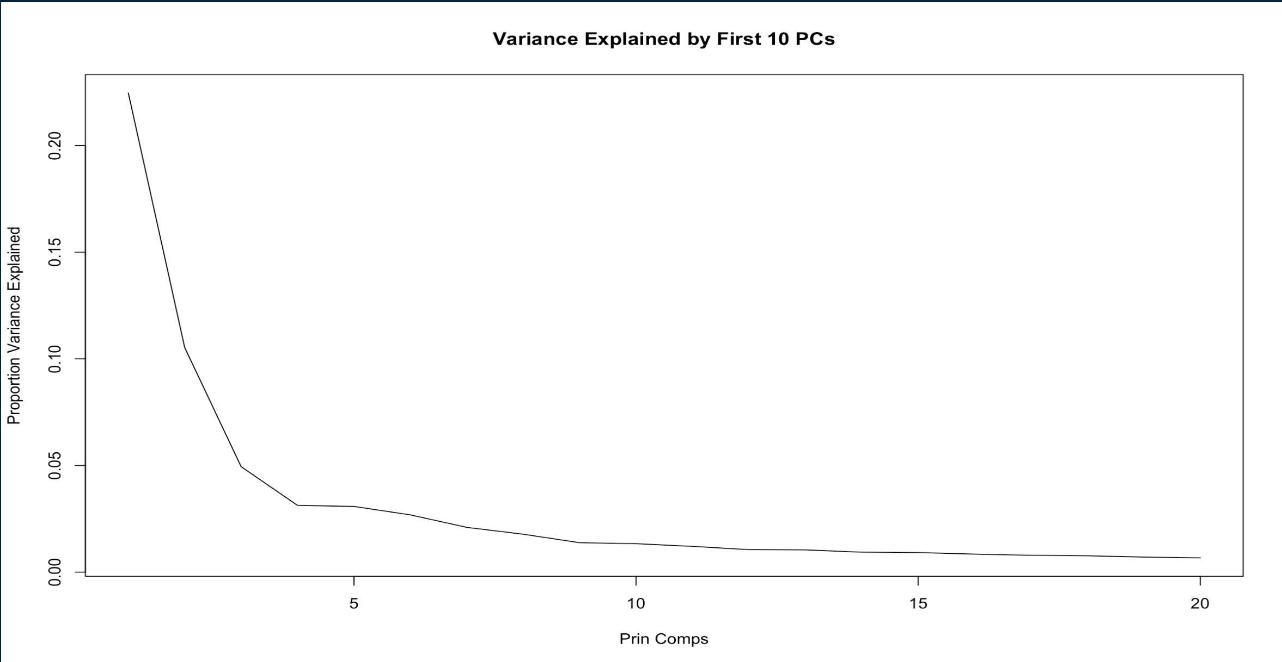
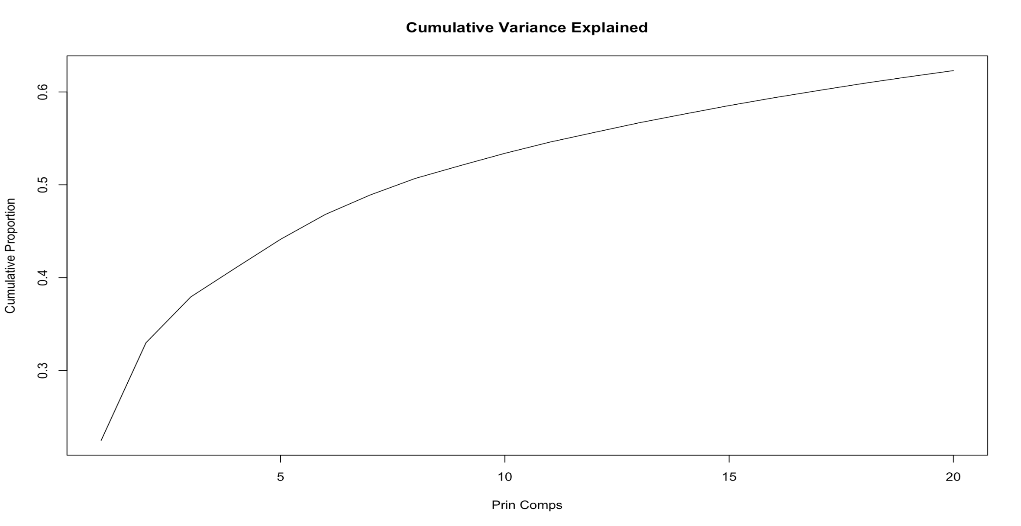
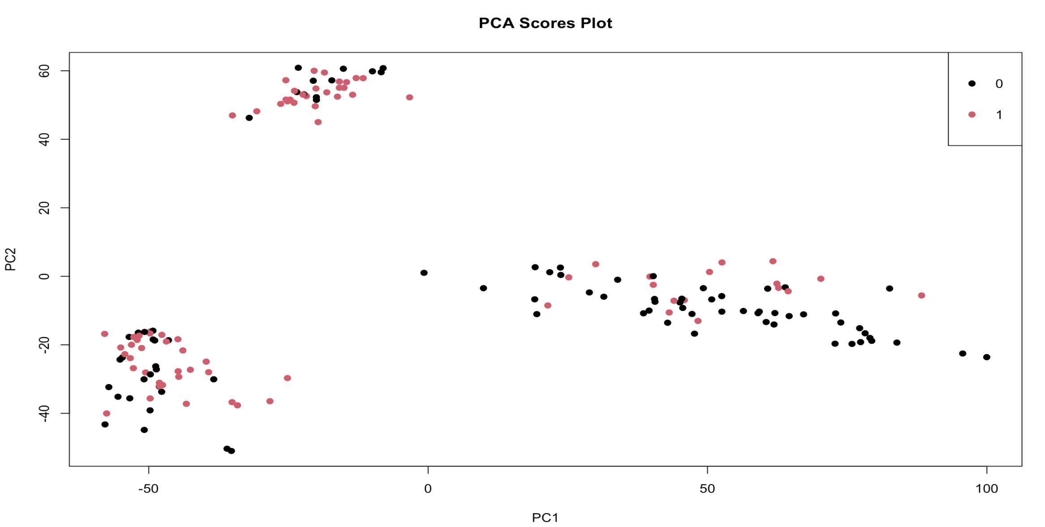
PCA

Slide 5
01
PCA + Lgistic
Predicted | Actual | Actual
 |  | 0 | 1
 | 0 | 21 | 7
 | 1 | 7 | 12
Sensitivity: 0.92 Specificity: 0.74 Error: 0.20
PCA + Logistic
Benefits
Creates smaller set of principal components
Reduces noise and multicollinearity
Fitted Logistic Regression Classifer

Slide 6
Bagging
Predicted | Actual | Actual
 |  | 0 | 1
 | 0 | 23 | 3
 | 1 | 4 | 10
Sensitivity: 0.77 Specificity: 0.85 Error: 0.17
02
Bagging with RF & mtry = p
Benefits
Variance reduction
Bagging stabilizes trees → crucial for small n
Handles nonlinearity + interactions
Robust to noise features
Drawbacks
No feature selection
Uses all 10,000 variables
Computationally expensive
Influenced by irrelevant features

Slide 7
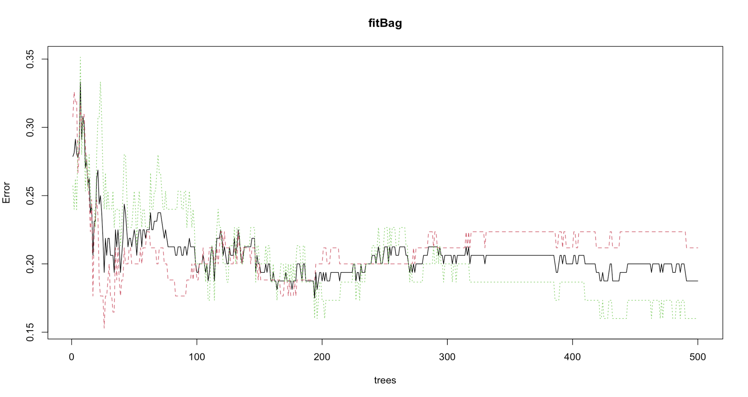
Bagging with RF & mtry = p

Slide 8
Variable Importance
Predicted | Actual | Actual
 |  | 0 | 1
 | 0 | 22 | 1
 | 1 | 5 | 12
Sensitivity: 0.92 Specificity: 0.81 Error: 0.15
03
RF with Variable Importance
Benefits
Implicit feature ranking
Handles high dimension better than single trees
Nonlinear + interaction modeling
Drawbacks
Biased toward variables with more variability.
Doesn’t reduce dimension explicitly.
Interpretability still limited

Slide 9
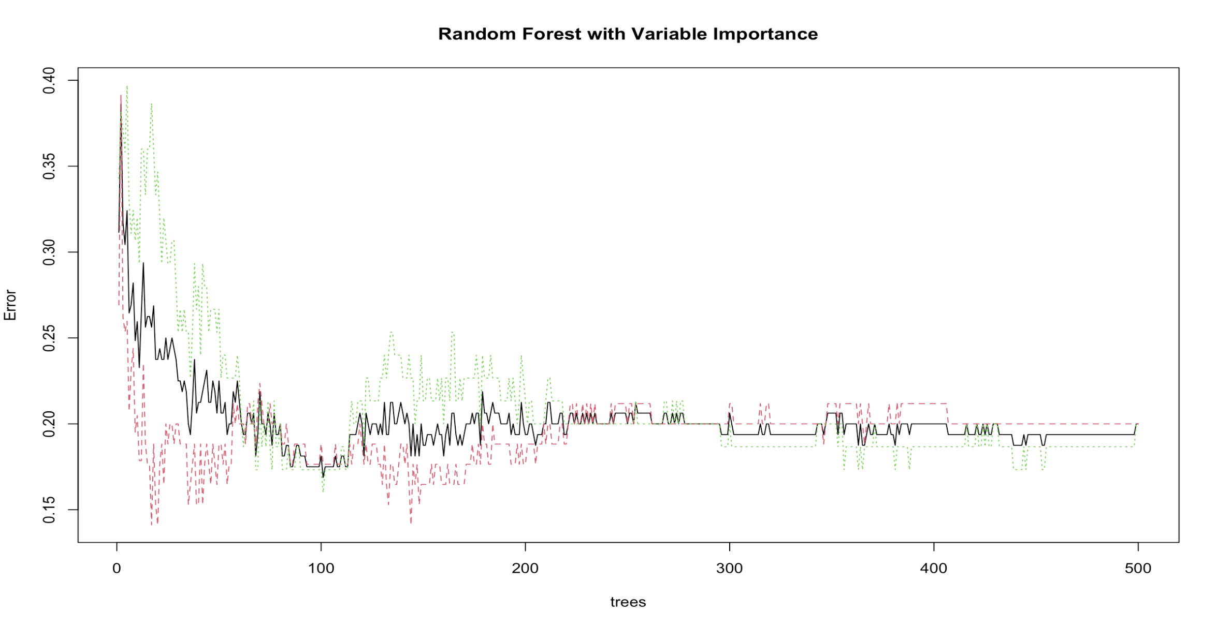
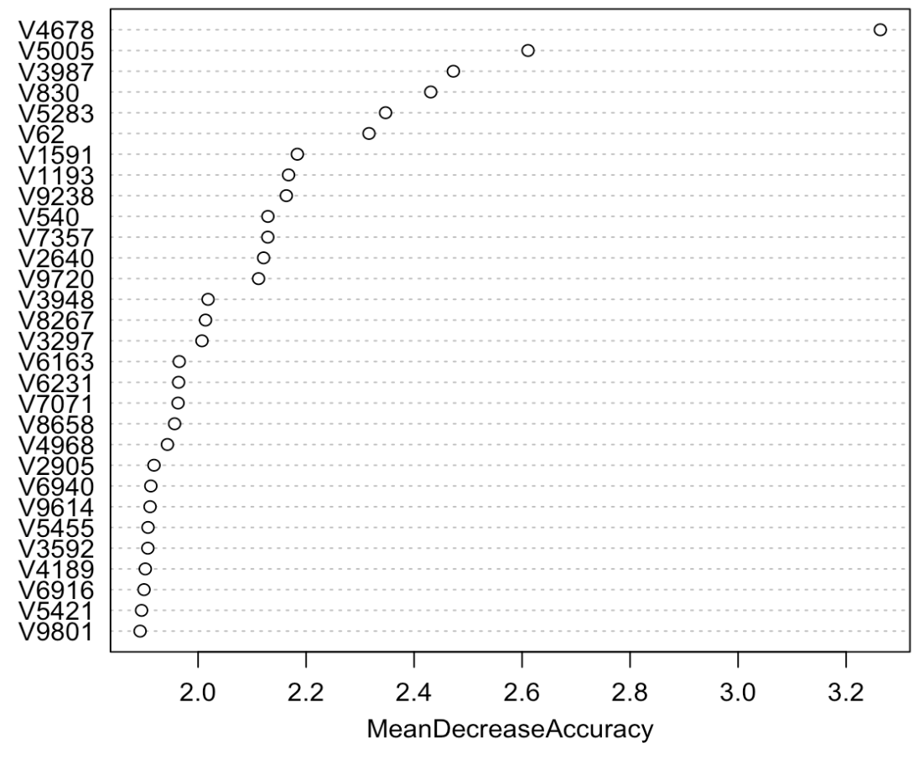
RF with Variable Importance

Slide 10
GRRF
Predicted | Actual | Actual
 |  | 0 | 1
 | 0 | 25 | 0
 | 1 | 2 | 13
Sensitivity: 1.00 Specificity: 0.93 Error: 0.05
04
Guided Regularized Random Forest
Benefits
Handles high dimension better than single trees
Implicit feature ranking
Nonlinear + interaction modeling
Compact informative feature subset
Bridges interpretability of Lasso
with ensemble power.
Drawbacks
Biased toward variables with more variability.
Doesn’t reduce dimension explicitly.
Interpretability still limited

Slide 11
GRRF: Guided Regularized Random Forest
1
Initial RRF
Why GRRF?
Train unguided RRF (flagReg=0) to get feature importances across all 10,000 predictors.
🔬 Feature Sparsity
Selects only informative features from 10K+
2
Compute Guided Coefficients
coefGRRF = (1−γ) + γ × (importance / max_importance)
γ = 0.75 balances regularization & importance.
⚡ Guided by Importance
Uses RF importances to direct regularization
3
Guided RRF Training
🧩 Interpretable
Train with flagReg=1 and coefGRRF to penalize feature selection by importance-adjusted weights.
Bridges gap: Lasso interpretability + RF power
📈 High Accuracy
4
Feature Selection
Competitive sensitivity & specificity
Extract feaSet — a compact informative subset used for final classification.

Slide 12
Bagging
Predicted | Actual | Actual
 |  | 0 | 1
 | 0 | 23 | 3
 | 1 | 4 | 10
Sensitivity: 0.77 Specificity: 0.85 Error: 0.17
GRRF
Predicted | Actual | Actual
 |  | 0 | 1
 | 0 | 25 | 0
 | 1 | 2 | 13
Sensitivity: 1.00 Specificity: 0.93 Error: 0.05
PCA + Logistic
Predicted | Actual | Actual
 |  | 0 | 1
 | 0 | 21 | 7
 | 1 | 7 | 12
Sensitivity: 0.92 Specificity: 0.74 Error: 0.20
Variable Importance
Predicted | Actual | Actual
 |  | 0 | 1
 | 0 | 22 | 1
 | 1 | 5 | 12
Sensitivity: 0.92 Specificity: 0.81 Error: 0.15
PCA + LDA
Predicted | Actual | Actual
 |  | 0 | 1
 | 0 | 23 | 0
 | 1 | 4 | 13
Sensitivity: 1.00 Specificity: 0.85 Error: 0.10

Slide 13
05
PCA + LDA
Predicted | Actual | Actual
 |  | 0 | 1
 | 0 | 23 | 0
 | 1 | 4 | 13
Sensitivity: 1.00 Specificity: 0.85 Error: 0.10
PCA + LDA
Benefits
Shared covariance acts as regularization for small n
PCA reduces 10,000 to 130 components (95% variance)
Linear boundary: stable estimates with limited data
Perfect sensitivity: every cancer case detected
AUC measures how well the model ranks cancer vs. normal across all thresholds — 1.0 is perfect, 0.5 is random. PCA + LDA achieves AUC = 0.972, indicating near-perfect ranking.

Slide 14
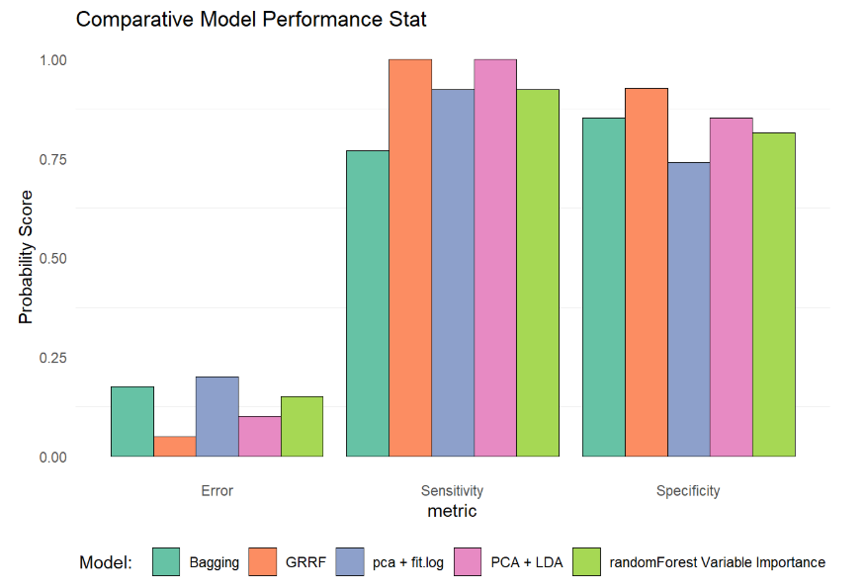
Model Performance Comparison

Slide 15
Conclusion
Clinical Priority: Sensitivity
In cancer screening, a false negative — a cancer patient sent home undiagnosed — carries far greater consequences than a false positive. Sensitivity is therefore the primary metric for model selection.
Clinical Priority: Sensitivity
In cancer screening, a false negative — a cancer patient sent home undiagnosed — carries far greater consequences than a false positive. Sensitivity is therefore the primary metric for model selection.
Our Performance Metrics
Primary: PCA + LDA: perfect sensitivity (1.00), error 0.10, specificity 0.10. Every cancer case in the test set was correctly identified through a stable linear boundary on PCA components.
Strong alternative: GRRF also achieves perfect sensitivity (1.00), with the highest specificity (0.93), lowest error rate (0.05), and selects only 12 features from 10,000 a candidate biomarker shortlist for follow-up biological investigation.
Backup: Bagging and Random Forest with Variable Importance, competitive accuracy through variance reduction in the high-dimensional setting.
Our Recommendation
Primary: PCA + LDA — perfect sensitivity (1.00), error 0.10, AUC 0.972. Every cancer case in the test set was correctly identified.
Strong alternative: GRRF — lowest error rate (0.07) and selects only 11 features from 10,000, providing a candidate biomarker shortlist for follow-up biological investigation.
Backup: Bagging and Random Forest — competitive accuracy through variance reduction in high-dimensional setting.
Key Takeaway
In high-dimensional settings, structural assumptions like LDA's shared covariance regularize effectively when n is small, while feature-selection methods like GRRF deliver compact interpretable models. Both win under p >> n for different reasons.
Key Takeaway
In high-dimensional settings, structural assumptions like LDA's share

Slide 16
Thank You
Data Mining Project | April 2026
ARCENE
200
10,000
GRRF
5%
Dataset
Samples
Features
Best Model
Best Error
Source: UCI ML Repository — https://archive.ics.uci.edu/dataset/167/arcene

