Slide 1

Microsoft Prompt Flow

Slide 2
Prompt Flow
Prompt flow is a development tool designed to streamline the entire development cycle of AI applications powered by Large Language Models (LLMs). Prompt flow provides a comprehensive solution that simplifies the process of prototyping, experimenting, iterating, and deploying your AI applications.
The flow Is exposed as API which can be consumed in your AI applications.
With prompt flow in Azure AI Studio, you can:
Orchestrate executable flows with LLMs, prompts, and Python tools through a visualized graph.
2) Debug, share, and iterate your flows with ease through team collaboration.
3) Create prompt variants and compare their performance.

Slide 3
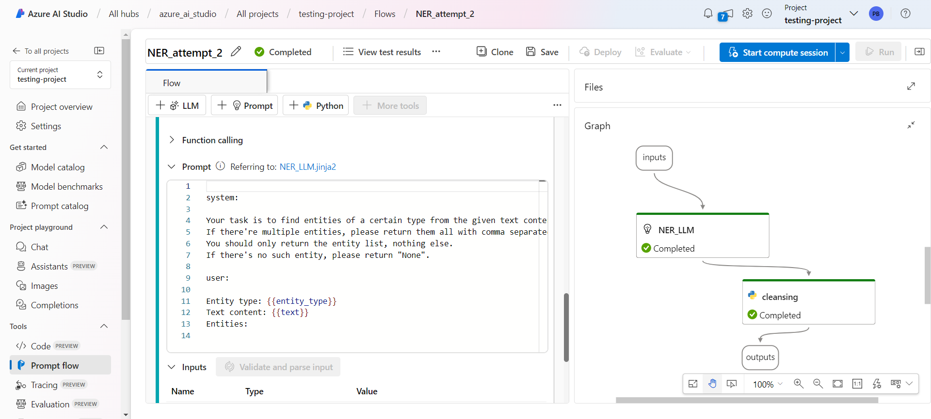

Slide 4
Prompt Engineering + Python Skills = Most AI Applications in the future!!!!
Named Entity Recognition
AI Application 1
Prompt Flow
Web URL Classification
AI Application 2
Q&A On Your Data (RAG)

Slide 5

Compute Sessions
You need to configure a compute instance to deploy your flow as a real-time managed endpoint for the purpose of inferencing.
These Compute instances are charged on an hourly basis.
Compute instances can run jobs securely in a virtual network environment, without requiring enterprises to open up SSH ports.

