Slide 1


PII Protection Prompt Flow

Slide 2
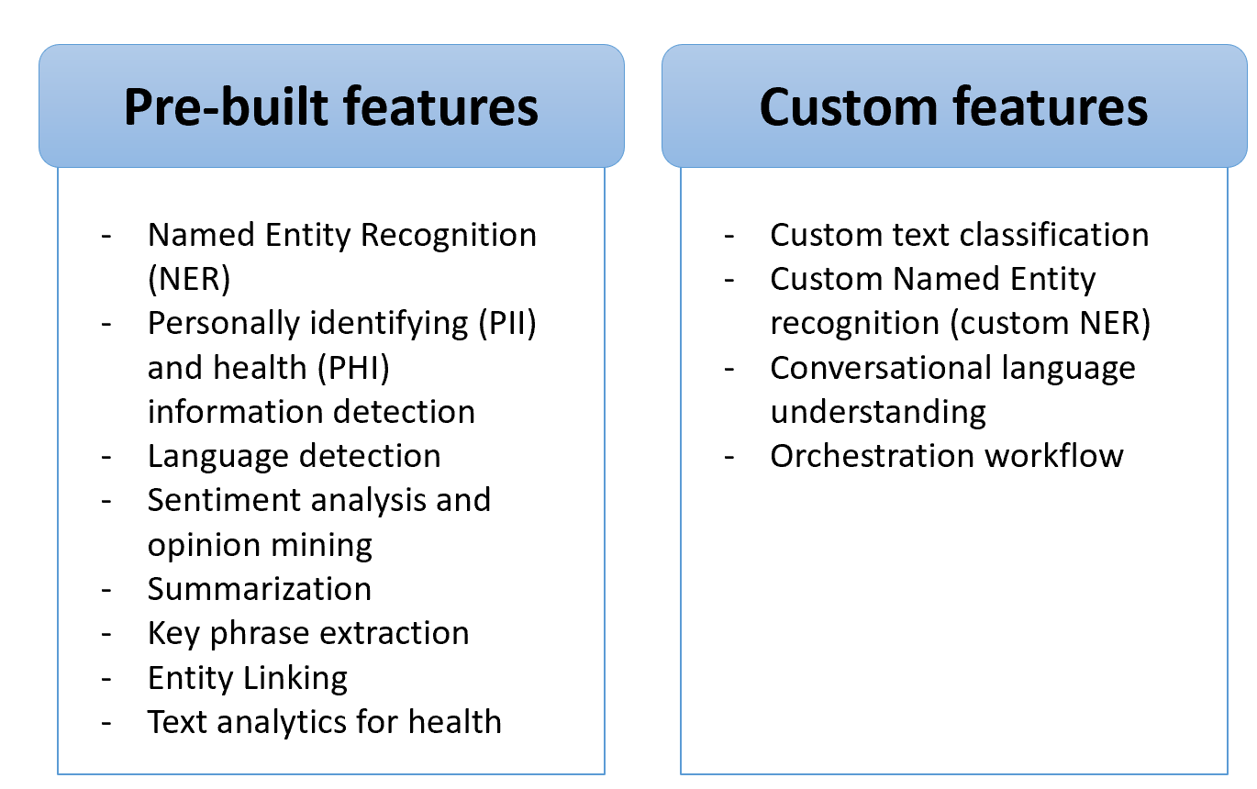
Azure Language Service

Slide 3
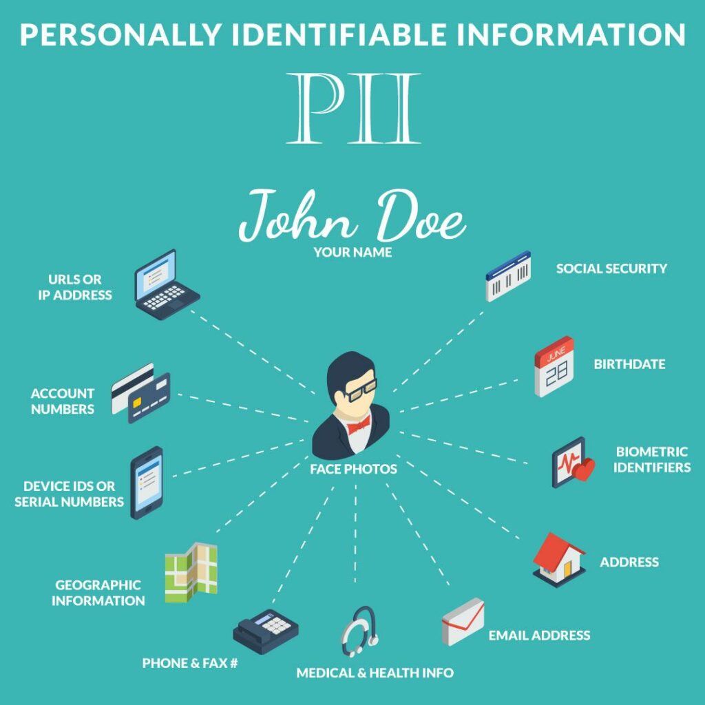

Slide 4
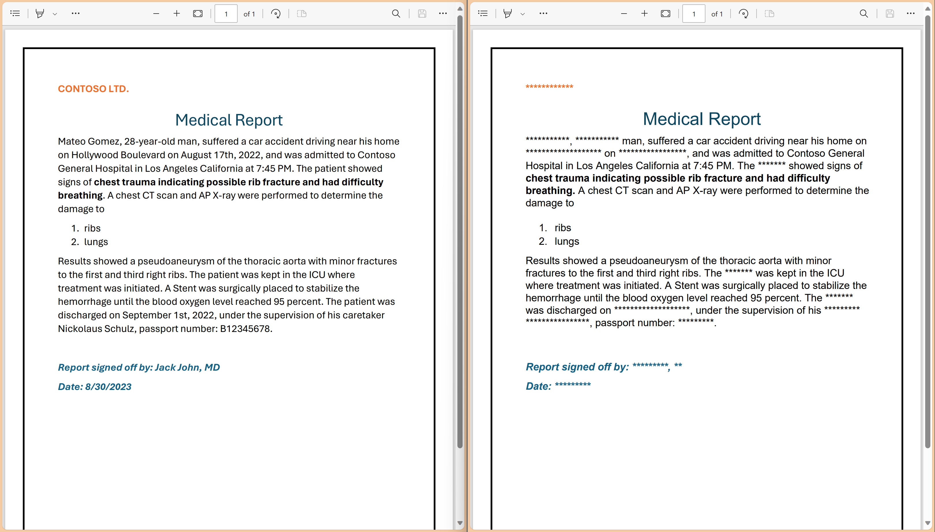

Slide 5


PII protection Prompt Flow
Hospital Documents indexed in Azure AI Search
GPT-engine
Call made to “PII” API
Filtered response send back to the user
Give me various symptoms seen in patients with this disease according to hospital records
Redacted text contains sensitive/PII entities replace with combination of asterisk (*) symbol

