Slide 1

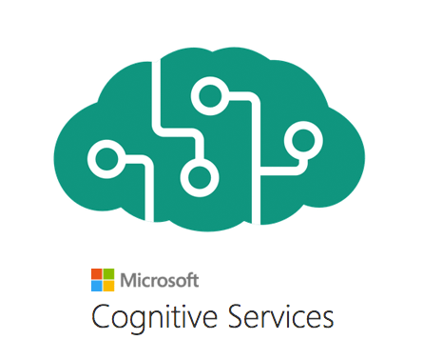
Multi-Modal Gen AI Applications
(Predictive AI + Gen AI = Unlocking Wonders!)

Slide 2
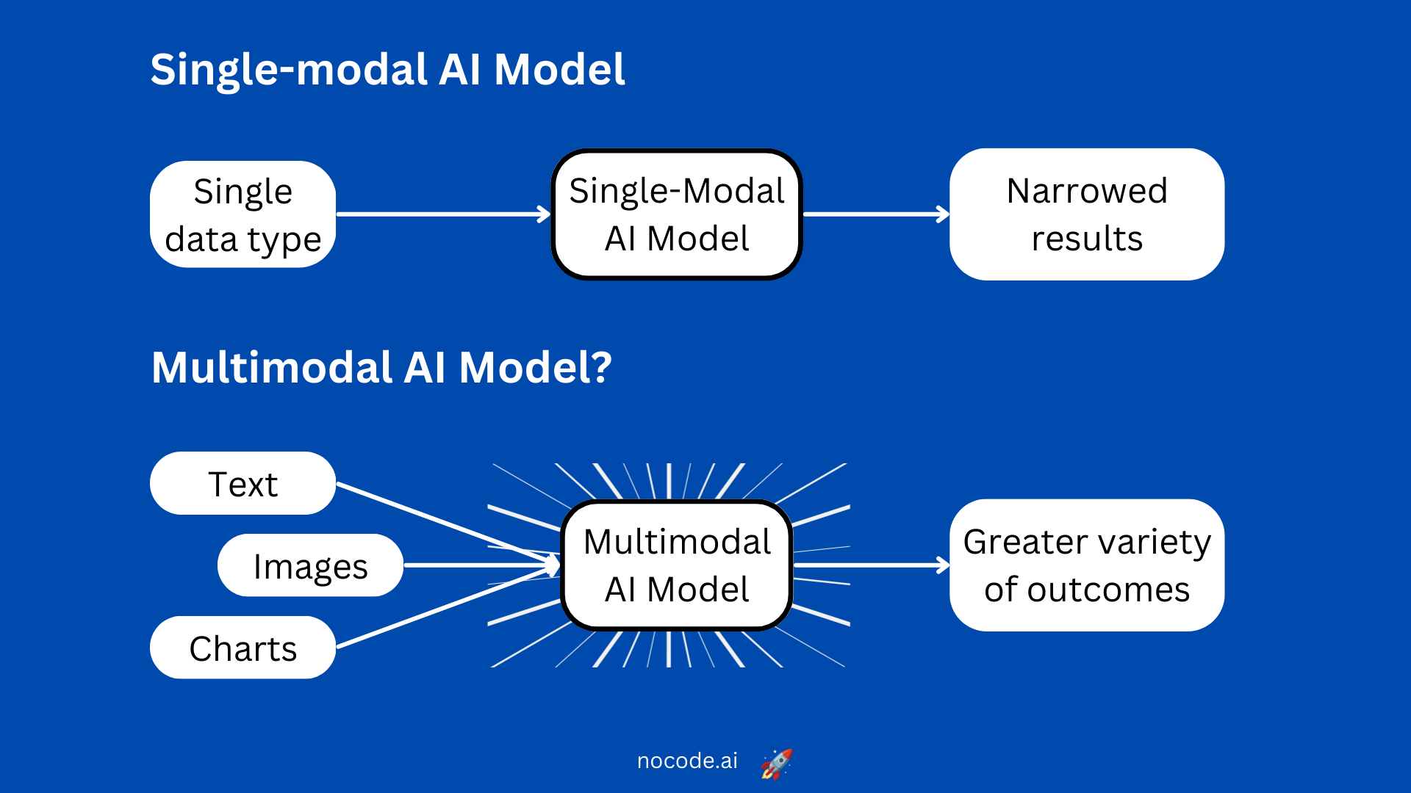
What Are Multi-Modal Applications?

Slide 3
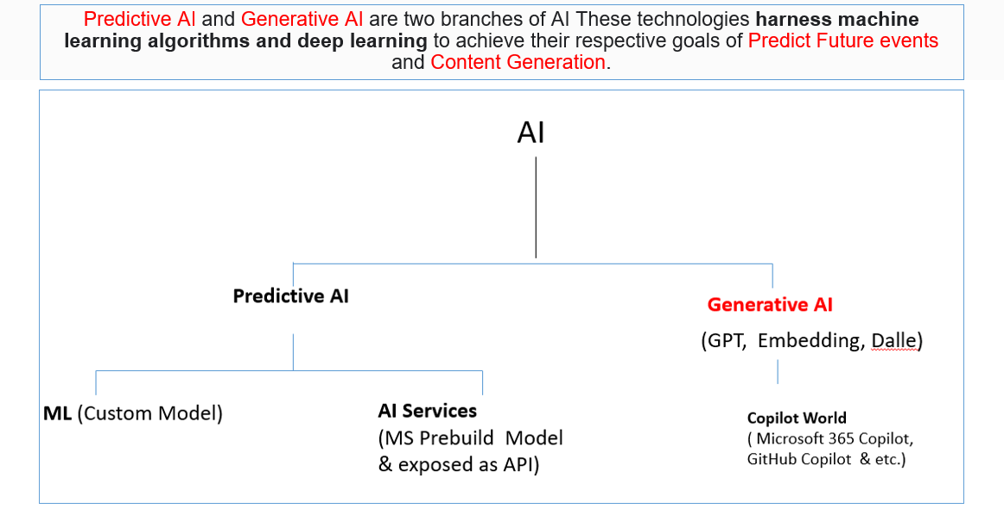

Slide 4
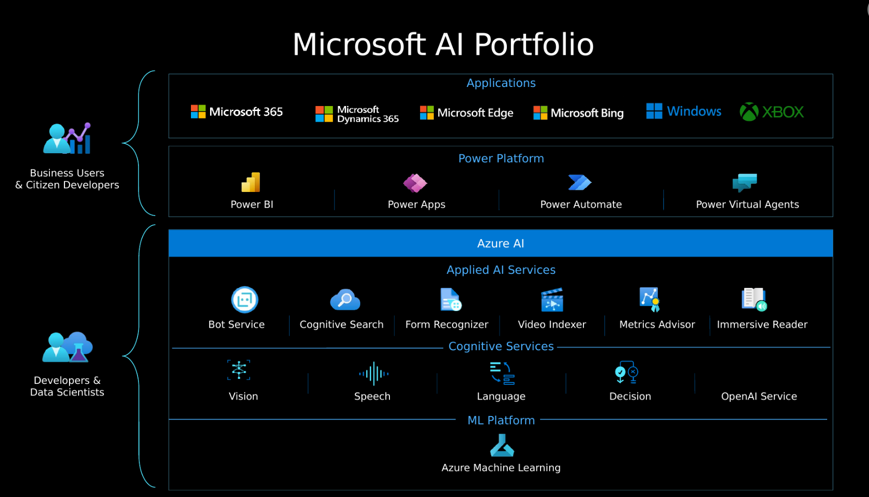

Slide 5
Some Multi-Modal Business Use-Cases
Use-Case | Technologies Used
Creating a Chat Bot that can take in image as an input. | Computer Vision (image analysis API) + OpenAI.
Creating a Chat Bot that can talk on your invoices, forms, receipts and tax forms. | Document Intelligence + OpenAI.
Creating a Chat Bot for healthcare analytics that can filter out PII (Personally Identifiable Information) entities in its response. | Language Service (text analysis API) + OpenAI.

