Slide 1
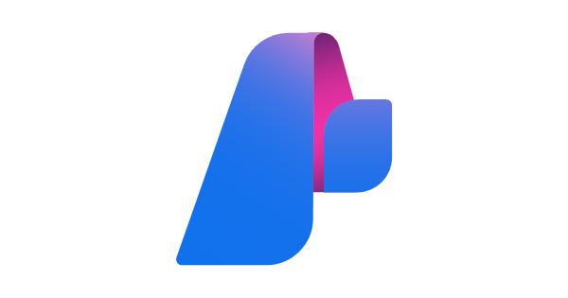
Understanding Evaluation With AI Studio
(Identity, Measure, Mitigate And Operate)

Slide 2
Evaluation in Azure AI Studio
Automated/Assisted Evaluation
Manual Evaluation
Suitable for large-scale/heavy volume dataset testing.
Done via a SDK (promptflow-evals) for python.
Suitable for small-scale/ less volume dataset testing.
Done via the “Chat Playground” in Azure AI Studio

Slide 3



Traditional Evaluation Concepts
Ground truth - refers to data that we believe to be true and therefore use as a baseline for comparisons.
Expected answers - are the outcomes that we believe should occur based on our ground truth data.
Precision – Measures true positives among all instances predicted as positives.
Recall – Assesses the proportion of actual positive instances that were correctly predicted.
F1 Score – Harmonic mean of Precision and Recall.

Slide 4

AI Assisted Evaluations
Large language models (LLM) such as GPT-4 can be used to evaluate the output of generative AI language systems.
This is achieved by instructing an LLM to annotate certain aspects of the AI-generated output. For instance, you can provide GPT-4 with a relevance severity scale (for example, provide criteria for relevance annotation on a 1-5 scale) and then ask GPT-4 to annotate the relevance of an AI system’s response to a given question.
AI-assisted evaluations can be beneficial in scenarios where ground truth and expected answers aren't available.

Slide 5
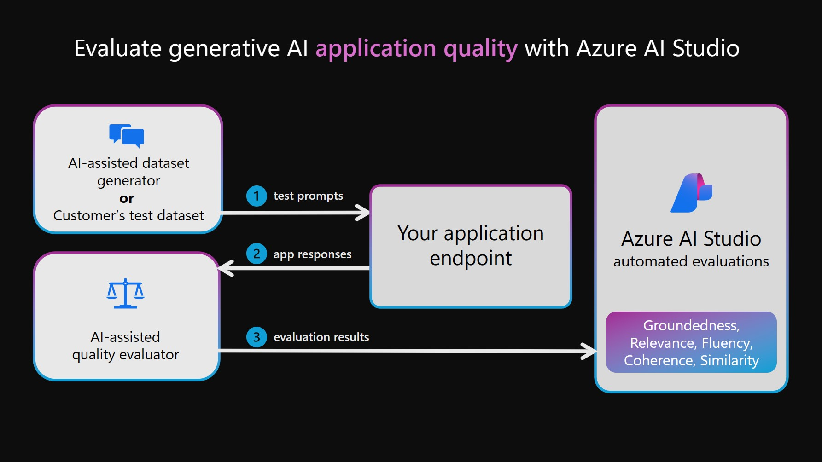

Slide 6
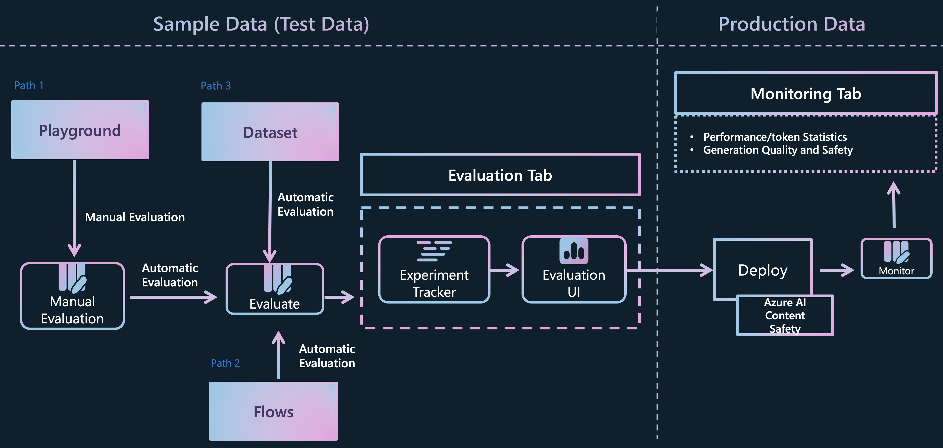
Evaluation Architecture Using Azure AI Studio

