Slide 1


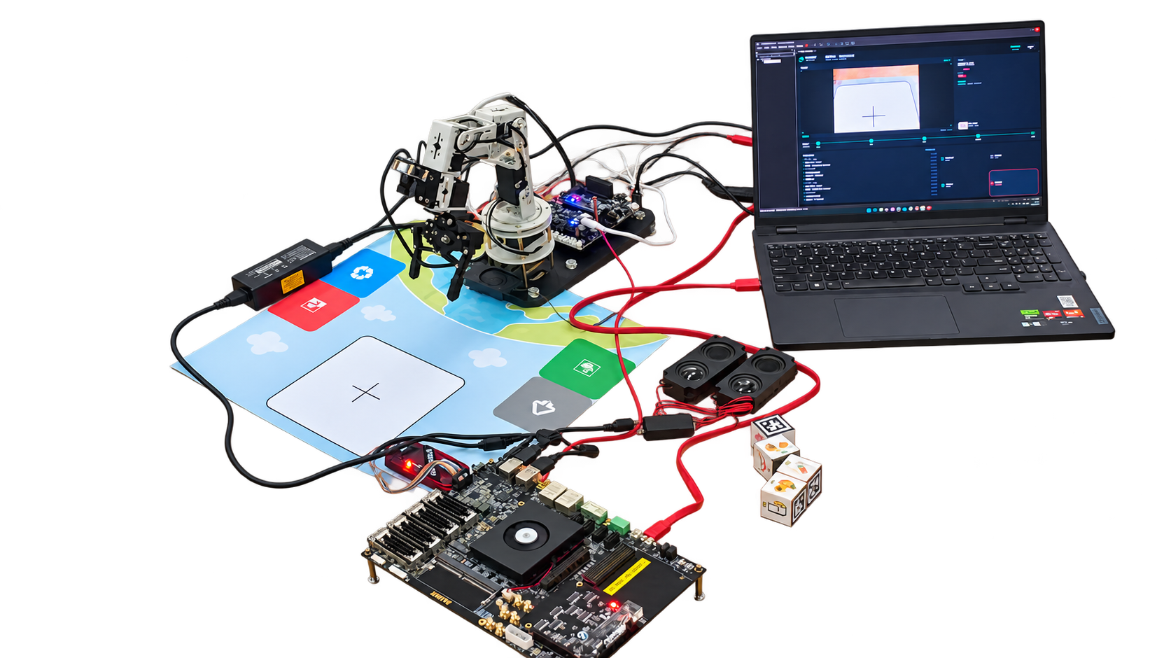
芯语智分
Xinyu SmartSort
CHONGQING
UNIVERSITY
A Voice-Visual Waste Sorting System
重庆大学
Based on Zynq Hardware-Software Co-Design
Z19 / Zynq UltraScale+ MPSoC
01
WHY IT MATTERS
02
ZYNQ CO-DESIGN
03
FROM IDEA TO ACTION
Hear. See. Sort.
Four-function source architecture · functional roles
Turn waste sorting into a visible experience.
PS | Visual intelligence
PS | Speech intelligence
A voice command starts recognition, spoken
Camera capture · YOLO on CPU
USB audio capture · Vosk ASR
feedback and a robotic sorting action.
Category + coordinate recovery
Wake and task command events
ONE COMMAND, ONE TASK
PL | Video + candidate rules
PL | Audio frontend
RGB / HSV · ROI statistics
DC suppression · 63-tap FIR
1
Wake Xiaoya
First moments · candidate checks
Filtering before speech recognition
“你好小亚”
2
Start sorting
PS TASK SERVICE | Coordinates · categories · commands
DOFBOT · sorting station · Z19 · laptop host
“开始垃圾分拣”
3
Prepare and capture
VM / HOST | Task, voice and motion
PLATFORM AT A GLANCE
Camera view
4
Recognize the category
Task management · announcement · SDK actions · visualization
Core
ALINX Z19 · Zynq UltraScale+ MPSoC
Visual detection
DESIGNED TO WORK TOGETHER
Compute
PS + PL + Ubuntu VM
5
Announce the result
Devices
Camera · voice input · DOFBOT
Spoken feedback
Natural interaction
Stack
Linux · Python · YOLO · Vosk
6
Pick and place
One wake-and-start cycle links recognition, feedback and action.
Fixed pickup station
Clear hardware-software roles
DEMONSTRATED & DELIVERED
7
Return to waiting
PS runs models and services; PL processes pixel and audio streams.
Fixed-station VM / DOFBOT demonstration.
Ready for the next task
Modular engineering
Z19 PS/PL source modules with clear interfaces.
Four functions support reuse, teaching and further integration.
Next: joint board integration and wider object coverage.
Make sorting visible. Make engineering tangible.
Campus sustainability / Community outreach / Embedded education
Notes:
Content baseline: Citlali6/VisionGrasp-Z19 main 4e51e5b60daccccb38af0b4bd327502668d9ef72.
Sources: README.md; docs/overview.md; docs/architecture.md; docs/CONFIGURATIONS.md; report/design_report.md; report/poster_copy_en.md; docs/competition/requirements_map.md; docs/competition/EVIDENCE_MATRIX.md; skill/README.md; report/ai_collaboration.md.
01: Existing VM/DOFBOT demonstration uses fixed pickup coordinates, a serial voice command module, one wake/start cycle and classification audio before grasp. This flow does not claim feedback-controlled grasping or arbitrary-position picking.
02: Four-function source profile, not a combined on-board measurement. PS owns CPU YOLO, Vosk, capture, coordinates and task service. PL owns RGB/HSV/ROI/first moments, candidate rules and DC/63-tap FIR. Diagram shows responsibility and communication, not time order: PS captures inputs for PL, reads processed data for semantic inference; PS service mediates VM integration. Existing demo does not use new PL candidate rules or Vosk.
03: Prototype artwork reuses a previously background-cleaned image of user-supplied project equipment (AI-assisted cutout). Hardware details are evidenced by the original project materials, not by the retouched visual. No new accuracy/FPS/power or end-to-end hardware result is claimed.
No current team-member names were confirmed; no names invented. Identity is included per current user request. This is a branded English exhibition poster; a formally anonymous competition copy would need identifying content removed.
Original template supplies canvas/theme/AMD asset; three-column structure reworked for the new content. Body text, workflow nodes and connections are native editable PPT objects.

