Slide 1

Capstone II 2023
The Factors that drive house prices
by Chaitra K

Slide 2
Factors driving the house prices
External Factors that affect the House prices
One of the most important factor that impacts house prices are the supply and demand and economic growth.
But also, they are hugely driven by the some of the following factors
Overall quality of the house
Total Square Footage of the house
Number of garage cars
Number of fireplaces

Slide 3
About the Data
The data set contains of 1460 houses in Ames, Iowa that were sold between 2006-2010.
Data has 81 columns and data comes from Kaggle https://www.kaggle.com/c/house-prices-advanced-regression-techniques/data

Slide 4

Method
The project was done using excel pivot tables and Excel’s Data Analysis Tool Pak
First used correlation to find top correlated variables
Based on correlation and some research t-test was conducted on selected Categorical variables.

Slide 5
Top Factors driving the house price
Overall Quality
Greater living area
Total Basement Sq.ft
Garage Cars
Fireplace
Year built
Year remodel added
Month sold

Slide 6
Overall Quality of the house is the primary driver of the sale price
Correlation of 0.79
H₀: p = 0 there is no significant effect ; H₁: p <0.05 there is significant effect
House with overall quality score 10 Vs 5 0r less p-value is 2.18711E-07which is less than 0.05

Slide 7
Does overall condition trump overall quality to determine sale price?
Although Overall quality is the top predictor for sale price same is not true for the over all condition of the house.
Overall condition is negatively correlated to sale price with Correlation of -0.0778

Slide 8
Greater the living Area, greater is the sale price of the house
Correlation of 0.708
H₀ : p=0 ; the null hypothesis state that there is no significant difference in the house sale prices between the two groups ( greater than or less than 1000 sq.ft)
p-value is 4.42E-133

Slide 9
Total Basement Square footage
Correlation is 0.61
H₀ : p=0 ; the null hypothesis state that there is no significant difference in the house sale prices between the two groups ( greater than or less than 1000 sq.ft)
p-value is 2.47551090401422E-74

Slide 10
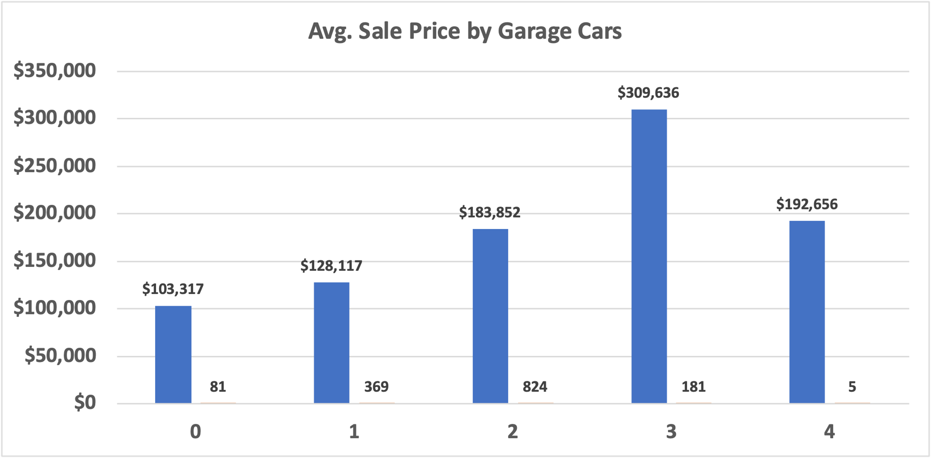
Number of cars in garage has high significance for sale price
Correlation is 0.64
p-value of 4.99E-4 for a house with no garage vs with garage cars(1,2,3,4)

Slide 11

Is having a fireplace an important factor?
Correlation is 0.46
Houses with fireplaces are likely to have higher sale price than houses with no fireplaces

Slide 12
Year Remodeled and Year Built are also significant
Year the house was remodeled, and year built both hold a lot of predictive value
From the data we can incur that the house prices have dramatically increased after the turn of the century

Slide 13
Month Sold
September is the month with highest average sale price

Slide 14

Recommendations
To allocate dollars earmarked for investment into mortgage-backed securities. Below are the factors that drive home prices in Ames, Iowa
Overall Quality
Greater living area
Total Basement Sq.ft
Garage Cars
Fireplace
Year built
Year remodeled
Month sold

Slide 15

Thank you

