Slide 1
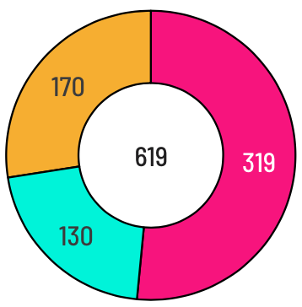
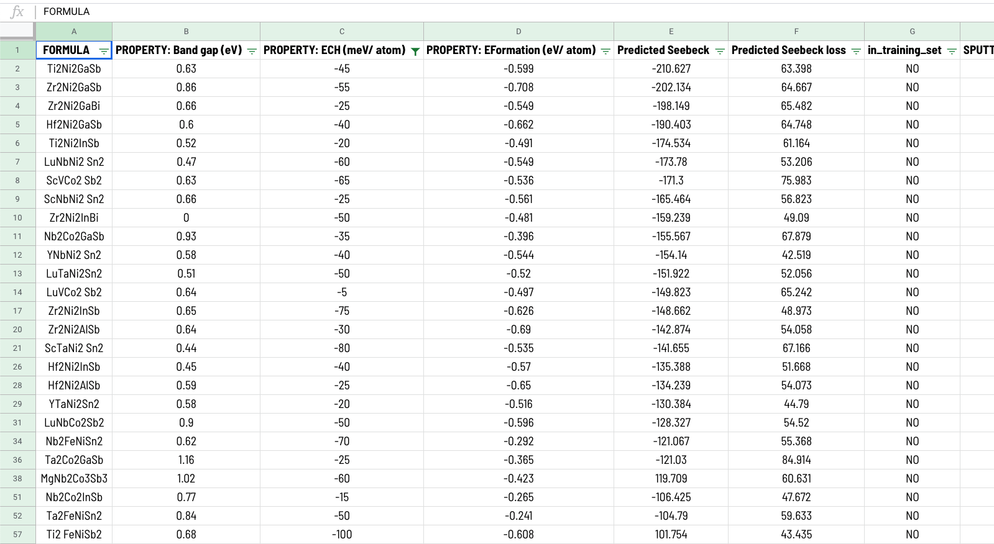
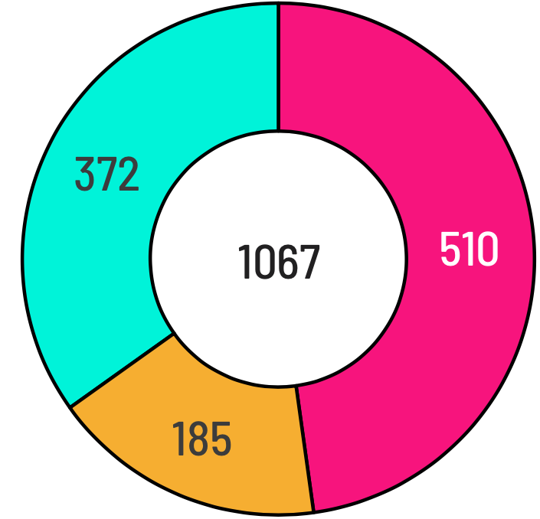
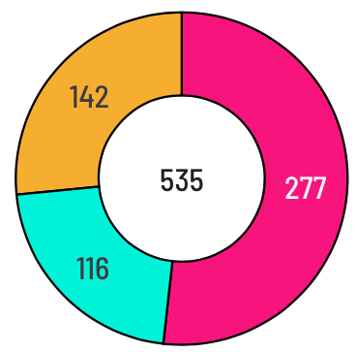
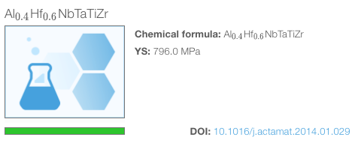
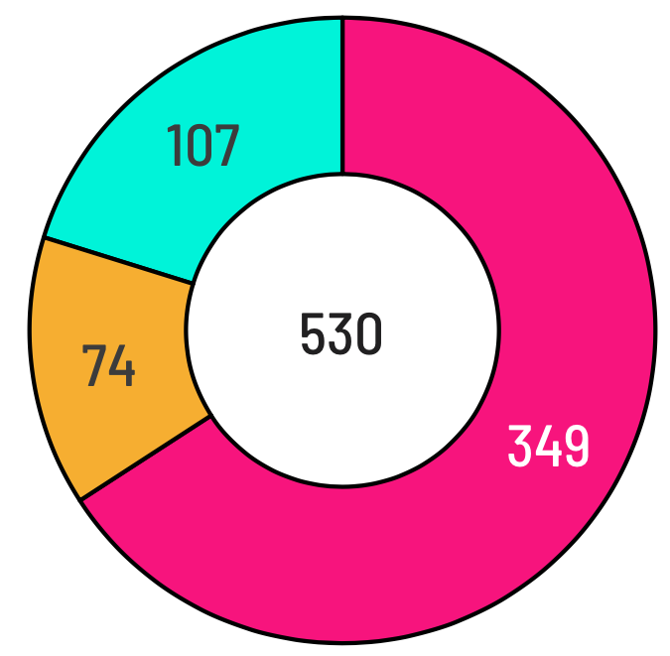
Db workflow
Structured data template
Elongation
Yield strength
Relevant articles published since 2004. (200+)
Ultimate strength
Hardness
Web-based data infrastructure
100s of mechanical properties
New MPEA publication

Slide 2
YS scatterplot

Slide 3
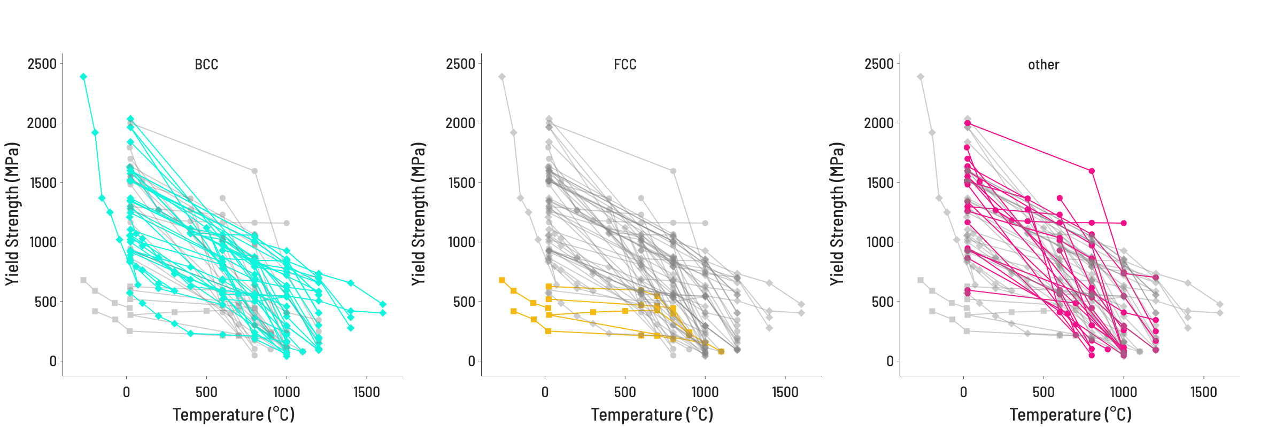
YS temperature

Slide 4
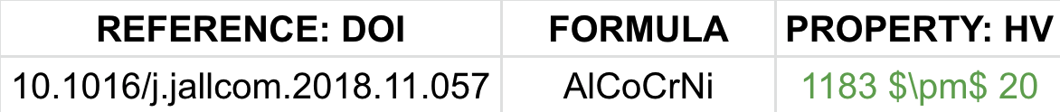
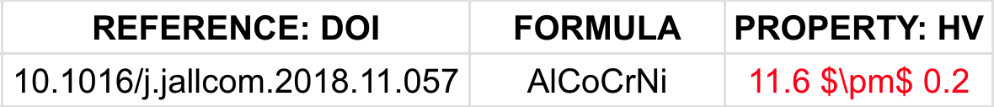
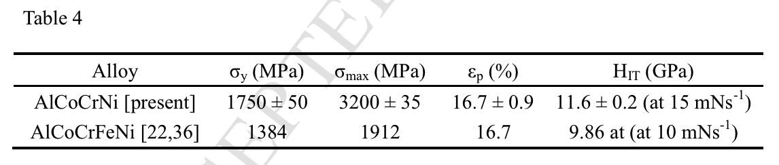
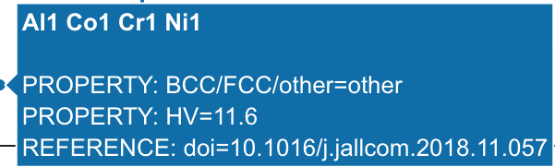
Outlier detection
3
Correct inaccuracy
Identify source
2
Identify inaccuracy type
1

Slide 5
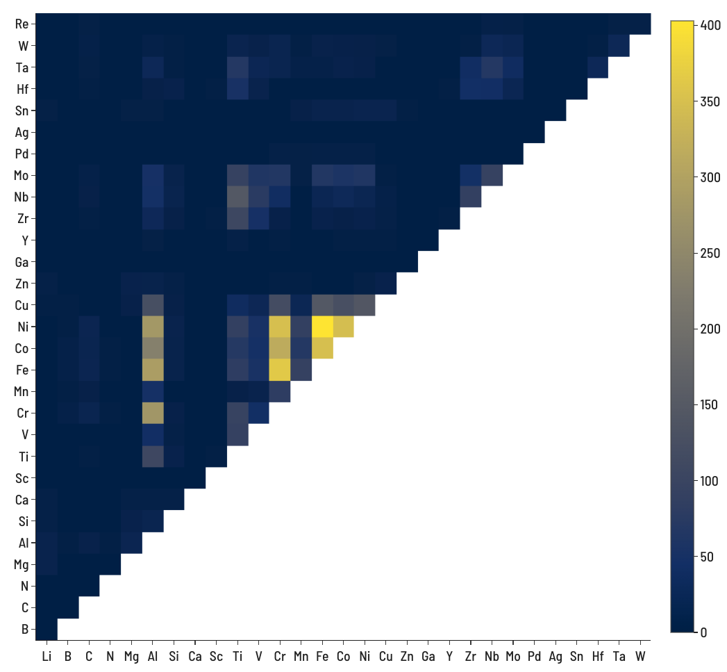
Number of records containing both elements
4-element (ABCD) systems = 27,405
5-element (ABCDE) systems = 142,506

