Slide 1

Version Control (Git, GitHub)
Notes:
By Ajit Singh (CSYS)

Slide 2
Version Control
Version Control System (VCS) is “a set of programs that manage changes to computer files (such as documents, images, source code and other collections of information) over time”.
Also known as:
Revision control
Source control management (SCM) software
Version control manages changes to a set of data over time.
VCS also allows you to restore data from a previous time point.
Notes:
You can think of a version control system (short: "VCS") as a kind of "database".
It lets you save a snapshot of your complete project at any time you want.
When you later take a look at an older snapshot (let's start calling it "version"), your VCS shows you exactly how it differed from the previous one.

Slide 3
Types of VCS
Divided into 2 groups:
Centralized version control:
Based on a client-server model.
All contributors use a shared single repository to “pull” files from and later to “push” changes.
Distributed version control:
Do not necessarily rely on a central server to store all the versions of a project’s files.
Instead, every developer “clones” a copy of a repository and has the full history of the project on their own hard drive as a local copy.
This copy (or “clone”) has all of the metadata of the original.
Notes:
The group of files that a VCS tracks is called a “repository”.
The basic idea behind a VCS is that you could use it to “roll back” to an earlier version of any file (or group of files) in the repository in the event that the current version isn’t working or isn’t optimal.
Almost all version control systems, including Git, support multiple repositories, and typically each repository would represent a particular project, component, or function

Slide 4
Centralized VCS
Based on the idea that there is a single “central” copy of your project somewhere (probably on a server), and contributors will “commit” their changes to this central copy.
“Committing” a change simply means recording the change in the central system.
Others can then see this change. They can also pull down the change, and the VCS will automatically update the contents of any files that were changed.
Contributors no longer have to keep many copies of files on their hard drives manually, because the version control tool can talk to the central copy and retrieve any version they need on the fly.

Slide 5
Centralized VCS
Most modern VCS deal with “changesets,” which simply are a groups of changes (possibly to many files) that should be treated as a cohesive whole.
Typical usage workflow (for adding a new feature or fixing a bug):
Pull down any changes other people have made from the central server.
Make your changes, and make sure they work properly.
Commit your changes to the central server, so other contributors can see them as well.
Some of the most common centralized Version Control systems include:
Concurrent Versions System (CVS)
Subversion (SVN)
Perforce
Notes:
Subversion (SVN): inspired by CVS (Concurrent Versions System).
Main Drawback: Being a centralized VCS, SVN stores additional copies of data on the local machine, which can become an issue with very large projects or files, or if developers work on multiple branches simultaneously.

Slide 6
Distributed VCS (DVCS)
DVCS do not necessarily rely on a central server to store all the versions of a project’s files.
Instead, every developer “clones” a copy of a repository and has the full history of the project on their own hard drive.
This copy (or “clone”) has all of the metadata of the original.
Does not pose storage space problems, as most programming projects consist mostly of plain text files (and a few images).
Modern DVCS also compress the files to use even less space.
Notes:
A distributed version control system (sometimes called a DVCS) allows multiple systems to host entire copies of the repository, and allows the users on those systems to collaborate on changes to the repository.
Git is a distributed version control system. Git’s architecture as a DVCS is what drives many of the concepts around how to use (and collaborate with) Git.

Slide 7
Distributed VCS (DVCS)
The act of getting new changes from a repository is called “pulling” and the act of moving your own changes to a repository is called “pushing”.
In both cases, you move changesets (changes to files groups as a coherent whole), not single-file diffs.
Some of the most common DVCS include:
Git
Mercurial
SVK
Bazaar
Notes:
Git: created by Linus Torvalds and his team in 2005 for development of the Linux kernel.
It’s development began in April 2005, after many developers of the Linux kernel gave up access to BitKeeper, a proprietary SCM system (by Larry McVoy and team) that they had previously used to maintain the project.
42.9% of professional software developers, as of 2014, use Git.
Mercurial: high performance and scalability, decentralized, fully distributed collaborative development, robust handling of both plain text and binary files, and advanced branching and merging capabilities, while remaining conceptually simple; used by Facebook.

Slide 8
DVCS advantages
The act of cloning an entire repository gives DVCS many advantages over centralized VCS:
Performing actions other than pushing and pulling changesets is extremely fast because the tool only needs to access the hard drive, not a remote server.
Committing new changesets can be done locally without anyone else seeing them. Once you have a group of changesets ready, you can push all of them at once.
Everything but pushing and pulling can be done without an internet connection. So you can work on a plane and won’t be forced to commit several bugfixes as one big changeset.
Since each programmer has a full copy of the repository, they can share changes with one or two other people at a time if they want to get feedback before showing the changes to everyone.

Slide 9
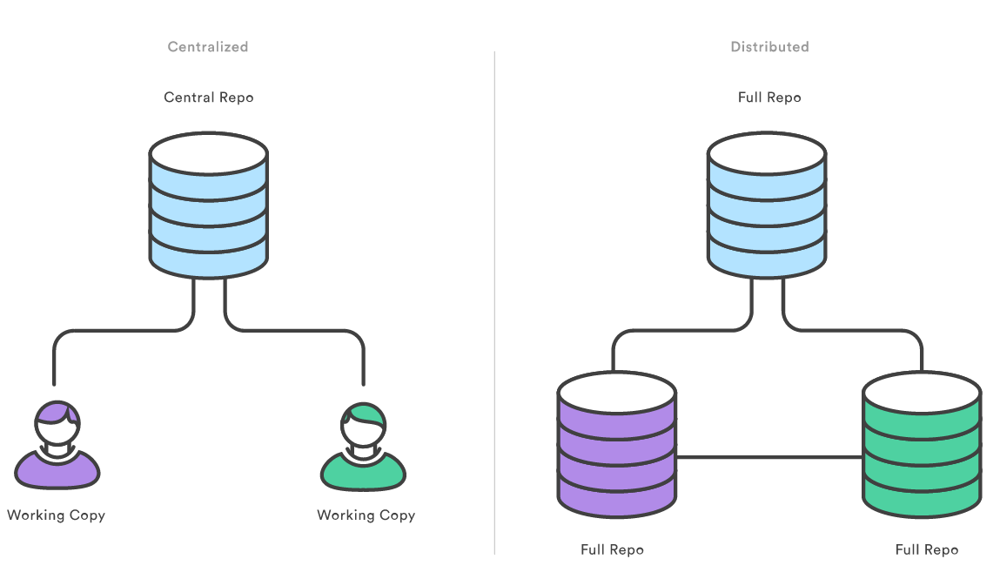
Centralized v Distributed VCS (DVCS)
Notes:
In SVN, each developer gets a working copy that points back to a single central repository.
Git, however, is a distributed version control system.
Instead of a working copy, each developer gets their own local repository, complete with a full history of commits.
Having a full local history makes Git fast, since it means you don’t need a network connection to create commits, inspect previous versions of a file, or perform diffs between commits.
Distributed development also makes it easier to scale your engineering team. If someone breaks the production branch in SVN, other developers can’t check in their changes until it’s fixed.
With Git, this kind of blocking doesn’t exist. Everybody can continue going about their business in their own local repositories. And, similar to feature branches, distributed development creates a more reliable environment.
Even if a developer obliterates their own repository, they can simply clone someone else’s and start afresh.

Slide 10
DVCS disadvantages
None, in most cases.
DVCS do not prevent you from having a single “central” repository, they just provide more options on top of that.
There are however, 2 potential disadvantages:
If your project contains many large, binary files that cannot be easily compressed, the space needed to store all versions of these files can accumulate quickly.
If your project has a very long history (100,000+ changesets or more), downloading the entire history can take an impractical amount of time and disk space.
DVCS tools and platform developers are working on solving these problems, but at the moment, no “out of the box” features solve them.

Slide 11
Git
The most popular VCS today. Open source, mature, actively maintained.
Created by Linus Torvalds and his team in 2005 for development of the Linux kernel
Has a distributed architecture (DVCS)
Rather than have only one single place for the full version history of the software, as is common in once-popular VCS like CVS or SVN, in Git, every developer's working copy of the code is also a repository that can contain the full history of all changes.
Their own working copy can be further distributed as well, by using branching.
Notes:
Git supports rapid branching and merging. A core assumption in Git is that a change will be merged more often than it is written, as it is passed around various reviewers.
Branches in Git are very lightweight. A branch in Git is only a reference to a single commit. With its parental commits, the full branch structure can be constructed.
[Note: the readme file of the Git source code elaborates on the name further: “The name "git" was given by Linus Torvalds when he wrote the very first version. He described the tool as "the stupid content tracker" and the name as (depending on your mood):
random three-letter combination that is pronounceable, and not actually used by any common UNIX command.
The fact that it is a mispronunciation of "get" may or may not be relevant.
Git: stupid. contemptible and despicable. simple. Take your pick from the dictionary of slang (when Git shows errors).
"global information tracker": you're in a good mood, and it actually works for you]

Slide 12
Git performance
Git has been designed with performance, security and flexibility in mind.
The raw performance characteristics of Git are very strong when compared to many alternatives.
Committing new changes, branching, merging and comparing past versions are all optimized for performance.
The algorithms implemented inside Git take advantage of deep knowledge about common attributes of real source code file trees, how they are usually modified over time and what the access patterns are.
Notes:
Git performance: Unlike some VCS, Git is not fooled by the names of the files when determining what the storage and version history of the file tree should be, instead, Git focuses on the file content itself. After all, source code files are frequently renamed, split, and rearranged.
The object format of Git's repository files uses a combination of delta encoding (storing content differences), compression and explicitly stores directory contents and version metadata objects.
Being distributed enables significant performance benefits as well.
For example, a developer makes changes to source code, adding a feature for the upcoming 2.0 release, then commits those changes with descriptive messages. They then work on a second feature and commits those changes too. Naturally these are stored as separate pieces of work in the version history. They then switch to the version 1.3 branch of the same software to fix a bug that affects only that older version. The purpose of this is to enable the team to ship a bug fix release, version 1.3.1, before version 2.0 is ready. They can then return to the 2.0 branch to continue working on new features for 2.0 and all of this can occur without any network access and is therefore fast and reliable. They could even do it on an airplane. When they are ready to send all of the individually committed changes to the remote repository, they can “push” them in one command.

Slide 13
Git features
Git Memory limits:
Rule of thumb: 1GB per repository, 100MB per file.
For best performance, Git recommend repositories be kept under 1GB each.
This limit is easy to stay within if large files (typically, binaries) are kept out of the repository.
In addition, Git places a strict limit of files exceeding 100 MB in size.
Security:
Designed with the integrity of managed source code as a top priority.
The content of the files as well as the true relationships between files and directories, versions, tags and commits, all of these objects in the Git repository are secured with a cryptographically secure hashing algorithm called SHA1.
This protects the code and the change history against both accidental and malicious change and ensures that the history is fully traceable. With Git, you can be sure you have an authentic content history of your source code.
Notes:
Note: Git-LFS extension for GitHub can be installed and setup to handle larger files but it does have performance (and scalability) issues.
Git security: Some other version control systems have no protections against secret alteration at a later date. This can be a serious information security vulnerability for any organization that relies on software development.

Slide 14
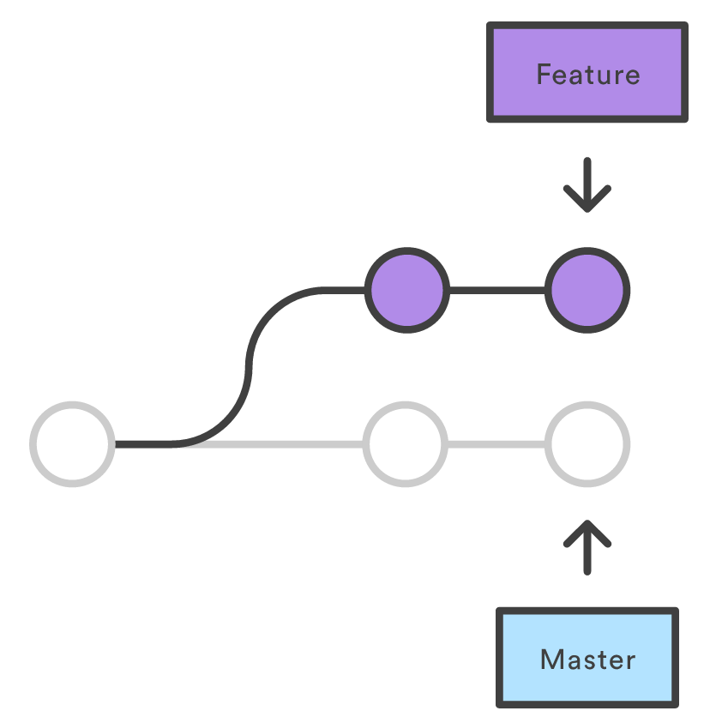
Git usage for Developers
Notes:
One of the biggest advantages of Git is its branching capabilities.
Unlike centralized version control systems, Git branches are cheap and easy to merge. This facilitates the feature branch workflow popular with many Git users.
Feature branches provide an isolated environment for every change to your codebase.
When a developer wants to start working on something—no matter how big or small—they create a new branch. This ensures that the master branch always contains production-quality code.
Using feature branches is not only more reliable than directly editing production code, but it also provides organizational benefits. They let you represent development work at the same granularity as the your agile backlog.
For example, you might implement a policy where each JIRA ticket is addressed in its own feature branch.

Slide 15
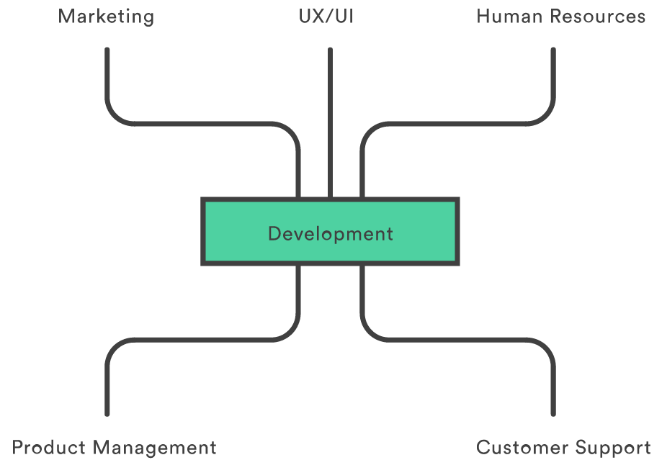
Git usage for Organizations
Git isn’t just for agile software development—it’s for agile business.
Notes:
Switching from a centralized version control system to Git changes the way your development team creates software.
And, if you’re a company that relies on its software for mission-critical applications, altering your development workflow impacts your entire business.
Git benefits each aspect of your organization, from your development team to your marketing team, and everything in between.

Slide 16
Git usage tools
Git command line (Git Bash, Git Shell, TortoiseGit: Windows shell interface, Posh-git: a PowerShell module with Git integration).
GUI clients:
GitHub Desktop (free, for Windows and Mac): https://desktop.github.com/
Tower (paid, Mac and Windows [beta stage]): https://www.git-tower.com/
SmartGit (free/ paid, Windows, Mac and Linux): http://www.syntevo.com/smartgit/
Git-cola (free, Linux)
SourceTree (free, Windows and Mac)
Others:
Gitbox (paid, Mac)
Gitg (free, Linux)
Giggle (free, Linux)
GitKraken (free, Windows, Mac and Linux)
Notes:
Posh-git: http://dahlbyk.github.io/posh-git/
For more GUI clients, see:
https://git-scm.com/downloads/guis
https://www.maketecheasier.com/6-useful-graphical-git-client-for-linux/
Git is an open source program for tracking changes in text files. It was written by the author of the Linux operating system, and is the core technology that GitHub, the social and user interface, is built on top of.

Slide 17
Installing Git
You can download installers for Git from the official Git website.
On Linux systems, you can also install Git using that distribution’s package manager (apt-get on Debian/Ubuntu systems or yum on RedHat/CentOS systems).
On OS X systems (recent releases), you can install Git by installing the “XCode command-line tools”.
Windows systems require the installer from the Git web site. https://git-scm.com/downloads
Notes:
You can download the latest version for Windows from https://git-scm.com/downloads .
If you’re running on Linux platforms, your integrated package manager (apt, yum, rpm, etc) can help you out.
OSX users can download or brew.
You will also need to have a GitHub account to use GitHub: can be a personal or an organizational account.

Slide 18
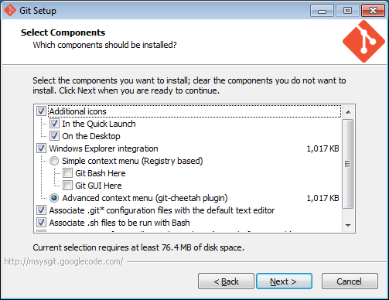
Git Installation (Windows installer)
Notes:
Defaults are fine here.

Slide 19
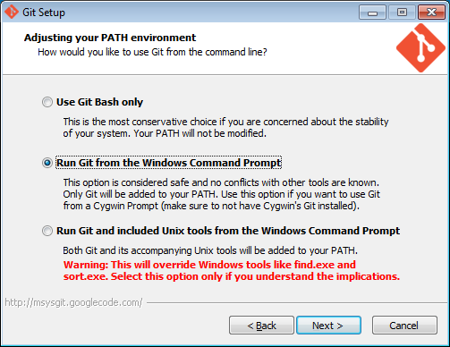
Adjust your PATH
Notes:
It’s handy to have Git in your path for all sorts of tools, so you might as well add it from the start.
The third option is also unlikely to cause you any drama, so if you’re a Unix fan, it might be handy to have awk/curl/vim around too.

Slide 20
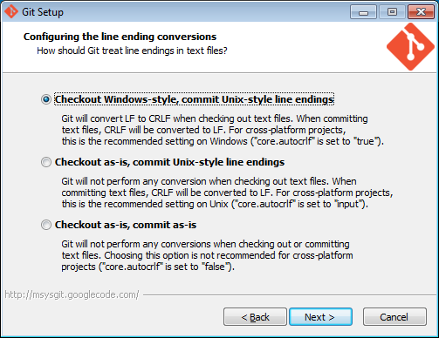
Git: Handle Line endings
Notes:
This one is really only a concern in cross-platform environments. If you’re all on the same platform, then 3 is the option for you. For now, let’s run with option 1.
This setting can always be changed later using git config --global core.autocrlf false
Now go forth & install Git!

Slide 21
Command line one-off settings
Configure your username and email address for Git:
git config --global user.name “John Smith”
git config --global user.email “john_smith@xyz.com”
git config -l [--global]
git help config
Notes:
Before you start using Git, it’s best to setup your username and email address.
Git won’t email you, but these details will appear at metadata in the commit history of your repository later on.
If you’re sharing a repo, it’s good to know who’s doing the committing.
This has nothing to do with authentication, it’s just about attribution.
That --global is required since Git supports Global configs (which affect all Git repos for the current user), and local config which operate on a repo-by-repo basis.
If you’re curious what these commands do, you can always “git help config” to find out the details.

Slide 22
Git usage basics and Workflows

Slide 23
Basic terminology & usage steps
Repository: In Git, the repository is just a simple hidden folder named ".git" in the root directory of your project.
Knowing that this folder exists is more than enough. You don't have to (and, moreover, should not) touch anything inside this folder.
Getting such a repository on your local machine can be done in two ways:
If you have a project locally on your computer that is not yet under version control, you can initialize a new repository for this project.
If you're getting on board a project that's already running, chances are there is a repository on a remote server (on the internet or on your local network). You'll then probably be provided with a URL to this repository that you will then "clone" (download/ copy) to your local computer.
Notes:
Think of a repository as a kind of database where your VCS stores all the versions and metadata that accumulate in the course of your project.

Slide 24
Git usage steps
As soon as you have a local repository, you can start working on your files (modify/ delete/ add/ rename/ move/ copy) in whatever application (editor, a file browser, programming IDE) you prefer.
In this step, you don't have to watch out for anything. Just make any changes necessary to move your project forward.
Once you've reached a noteworthy, it's time to wrap up your changes in a commit, i.e., a snapshot of your complete project at that certain point in time.
Before you commit in Git, you can get an overview of what you've changed so far via the "status" command, to get a list of all the changes you performed since the last commit.
Next, you explicitly tell Git which of your local changes you want to wrap up in the commit. To do this, you add them to the so-called "Staging Area“.
Notes:
A commit is a wrapper for a specific set of changes. The author of a commit has to comment what he did in a short "commit message". This helps other people (and himself) to understand later what his intention was when making these changes.
Every set of changes implicitly creates a new, different version of your project. Therefore, every commit also marks a specific version. It's a snapshot of your complete project at that certain point in time (but saved in a much more efficient way than simply duplicating the whole project...). The commit knows exactly how all of your files and directories looked and can therefore be used, e.g., to restore the project to that certain state.

Slide 25
Git usage steps
Now, having added some changes to the Staging Area, it's time to actually commit these changes. The commit will then be recorded in your local Git repository, marking a new version of your project.
From time to time, you'll want to have a look at what happened in the project, especially if you're working together with other people. The "log" command lists all the commits that were saved in chronological order. This allows you to see which changes were made in detail and helps you comprehend how the project evolved.
When collaborating with others, you'll want to share (some of) your changes with them and receive the changes they made. A remote repository on a server is used to make this exchange possible.
Notes:
There are two kinds of repositories:
A "local" repository resides on your local computer, as a ".git" folder inside your project's root folder. You are the only person that can work with this repository, by committing changes to it.
A "remote" repository, in contrast, is typically located on a remote server on the internet or in your local network. No actual working files are associated with a remote repository: it has no working directory but it exclusively consists of the ".git" repository folder. Teams are using remote repositories to share & exchange data: they serve as a common base where everybody can publish their own changes and receive changes from their teammates.

Slide 26
Git usage Workflow 1 (most common)
Using your own new repository:
Navigate to an existing project folder (on your PC), e.g., cd D:\MyProject
Initialize it as a local Git repository via git init.
Create a (free) remote repository on GitHub by signing in your GitHub account and creating a new, empty repository (e.g, “MyProject”).
Work on your local repository (on the default “master” branch) or create new branches as you continue working on various features. (Switch between branches as and when needed).
Commit your work to your local Git repository.
Link your local repository to the remote origin via git remote add https://github.com/user/MyProject.git
Push your changes from your local repository to the remote repository on GitHub, via git push origin master
Notes:
Repository: A repository is the most basic element of GitHub. They're easiest to imagine as a project's folder. A repository contains all of the project files (including documentation), and stores each file's revision history. Repositories can have multiple collaborators and can be either public or private.
Branch: A branch is a parallel version of a repository. It is contained within the repository, but does not affect the primary or master branch allowing you to work freely without disrupting the "live" version. When you've made the changes you want to make, you can merge your branch back into the master branch to publish your changes.
Master: The default development branch. Whenever you create a git repository, a branch named "master" is created, and becomes the active branch.
Commit: A commit, or "revision", is an individual change to a file (or set of files). It's like when you save a file, except with Git, every time you save it creates a unique ID (a.k.a. the "SHA" or "hash") that allows you to keep record of what changes were made when and by who. Commits usually contain a commit message which is a brief description of what changes were made.
Push: Pushing refers to sending your committed changes to a remote repository such as GitHub.com. For instance, if you change something locally, you'd want to then push those changes so that others may access them.

Slide 27

Creating a new local Git repository
For an existing project that is not yet under version control. Change into the project's root folder on the command line and use "git init" to start versioning this project:
Now take a moment to look at the files in that directory (including any hidden files) via: ls -la
You'll see that a new, hidden folder was added, named ".git". All that happened is that Git created an empty local repository for us.
Git did not add the current content of your working copy as something like an "initial version". The repository contains not a single version of your project, yet.
Notes:
Working Copy: The root folder of your project is often called the "working copy" (or "working directory"). It's the directory on your local computer that contains your project's files. You can always ask the version control system to populate your working copy with any version of your project.
But you always only have one working copy with one specific version on your disk, not multiple in parallel.

Slide 28
Git Workflow
Working Directory
Staging Area (Index)
Repository
Checkout
Add
Commit
Notes:
Everything in Git workflows is designed around these three stages.

Slide 29
What’s this “Commit” thing?
File1.txt
File2.txt
File3.txt
File1.txt
File4.txt
7ef7ab
ef3ad2
22e4ff
Notes:
The basic unit of git is a commit.
If you’re into the scary details, commits are stored in a Directed Acyclic Graph (so each commit keeps a record of its parent commit).

Slide 30

Commit changes
After making some changes to some files (or adding/ deleting some files in the project), you can commit your changes by executing the following:
These commands will add your changes to the Staging Area and then commit them to your local repository (on your PC).
For including all your changes in the commit, i.e., moving them all to the Staging Area, use git add .)

Slide 31
Git usage Workflow 2
The “cloning” approach:
Clone an existing Git repository (from GitHub). This will give you a local copy of that remote repository on your PC.
Work on your local repository (on the default “master” branch) or in another existing repository branch or create your own new branch. (Switch between branches as and when needed).
Commit your work to your local Git repository in the appropriate branch.
Push changes to the remote GitHub remote repository. This will create a “pull request” for the repository owner/ moderators to review and approve before pulling your changes.
Usually used to fetch tools/ functionality from 3rd party repositories but not necessarily to make future changes to those repositories.
Notes:
Clone: A clone is a copy of a repository that lives on your computer instead of on a website's server somewhere, or the act of making that copy. With your clone you can edit the files in your preferred editor and use Git to keep track of your changes without having to be online. It is, however, connected to the remote version so that changes can be synced between the two. You can push your local changes to the remote to keep them synced when you're online.
e.g, git clone https://github.com/AjitPS/testRepo.git
Remote: This is the version of something that is hosted on a server, most likely GitHub.com. It can be connected to local clones so that changes can be synced.
Pull Request: Pull requests are proposed changes to a repository submitted by a user and accepted or rejected by a repository's collaborators. Like issues, pull requests each have their own discussion forum.

Slide 32

Cloning an existing Git repository
When starting with an existing project on a server, you can clone it via its Git repository URL.
This URL can take many forms:
ssh://user@server/git-repo.git
user@server:git-repo.git
http://example.com/git-repo.git
https://example.com/git-repo.git
git://example.com/git-repo.git
No matter what format the URL is, you can use it with the "git clone" command. However, you should first make sure that you are inside the folder where you want this project to be downloaded to:

Slide 33
Cloning a repository
Git will now download a complete copy of this repository to your local disk - on condition that you're allowed to access this repository.
For the "http" and "git" protocols, no access rights are necessary.
For "https" URLs, you might need a username and a password.
For "ssh" URLs (either with a leading "ssh://" or, with the shorter form, "user@server..."), you'll have to use "SSH Public Key" authentication. While being very safe, efficient, and widely used, it's also a little bit of work to set up.
You now have a local copy of the repository on your PC to work on.
Once you have finished making changes, stage the changes that you want to package as a version.
Then, commit the changes from your staging area, as shown previously.

Slide 34
Git usage Workflow 3 (advanced)
The “fork and clone” approach:
Fork an existing repository (on GitHub). This creates a copy (fork) of the original remote (upstream) repository in your GitHub account as well and this Fork can act as an intermediary between your local repository (on your PC) and the upstream repository.
Clone your fork to get a local repository on your PC (which points to your remote fork, use git remote add to set your fork as the remote).
Work on your local repository (on the default “master” branch) or on a new new local feature branch. (Switch between branches as and when needed).
Commit your work to your local Git repository.
Add a Git remote for the original (upstream) repository as well.
Push features/ bug fixes/ branches to your GitHub (remote) fork.
To eventually push those changes to the upstream repository as well, send a “pull request” from your fork for that repository’s owner/ moderators to review.
Notes:
Fork: A fork is a personal copy of another user's repository that lives on your account. Forks allow you to freely make changes to a project without affecting the original. Forks remain attached to the original, allowing you to submit a pull request to the original's author to update with your changes. You can also keep your fork up to date by pulling in updates from the original.
Upstream: When talking about a branch or a fork, the primary branch on the original repository is often referred to as the "upstream", since that is the main place that other changes will come in from. The branch/fork you are working on is then called the "downstream"
Pull: Pull refers to when you are fetching in changes and merging them. For instance, if someone has edited the remote file you're both working on, you'll want to pull in those changes to your local copy so that it's up to date.
Adding a Git remote: git remote add https://github.com/AjitPS/testRepo.git

Slide 35
Other commonly used Git commands

Slide 36
Git Diff & Blame commands
You can use git diff when you need to see what’s changed in a file.
git diff
You can also use git blame to see what’s changed in a file over time (and who changed it).
git blame /path/to/my/file.txt
The git gui blame version gives you a nice hover over each change (so you can see the commit comments too).
git gui blame /path/to/my/file.txt
If you just want to see the commits that changed a file from the command line, use git whatchanged to list them newest to oldest, or use gitk for the GUI version.
git whatchanged /path/to/my/file.txt
gitk /path/to/my/file.txt

Slide 37
Viewing History and changing files
To view logs of commits and changes: git log
git log --oneline
To remove a file:
git rm badfile.txt
Git tracks “blobs” of data via hashing, so you can comfortably move files around and Git will (mostly) work out what’s happening. Using git mv means you can avoid doing a git remove/add combo, so it’s the way to go:
git mv oldname.txt newname.txt
Git clean will get rid of files that you haven’t staged:
git clean -n (dry run)
git clean -f (force)
Notes:
Gitk provides the most convenient GUI tool for viewing history, albeit with a fairly hideous UI.
If you’re more commandline, then git log --oneline is the way to go. We’ll teach you how to setup an alias for common commands shortly.
Exercise:
Using your sample repo, experiment using commandline git log arguments
Try and display the recent 3 commits
Experiement with “2 days ago”, “last week”, “today”, and “yesterday” as arguments to log
Compare with the gitk version to see a GUI representation

Slide 38
Ignoring Files
Ignore file(s), directories, patterns (one per line) by using a gitignore file
Great for ignoring files and directories in your project
Specially good for build artefacts and generated binaries
A trailing slash means treat it as a dir right here, otherwise it will ignore it everywhere.
You can have .gitignore files in subdirectories (and even ignore .gitignore)
Notes:
For example:
Create a .gitignore file in the root directory of your project
Add a line to ignore *.log files.
Then add a tester.log file to the directory
Confirm you are ignoring!
Commit your .gitignore file to your project
Do the same for a “bin” subdirectory

Slide 39
Modifying Staged files & Commits
To unstage a file:
git reset HEAD myfile.txt
git checkout myfile.txt
git rm –cached myfile (only pre first commit)
To amend a commit: In case you forgot a file in your last commit, just add it to staging and run “git commit --amend” and you’ll be prompted for a new commit message!
(stage the files you want)
git commit --amend
Notes:
git status will give you lots of good help about how to get out of sticky situations or move forward.

Slide 40
Modifying Staged files & Commits
Note: Amending a commit doesn’t actually change a commit; commits are immutable. It creates a new commit (with both sets of changes) and “throws out” the old one (which just has the first set of changes).
By “throws out”, Git means that it puts it in the reflog. Every few weeks, orphaned commits like this are cleaned up. But users have ample time to find and recover them if needed.
git reflog
git checkout <your-commit-sha1>
git checkout master

Slide 41
Git Branching & Tagging

Slide 42
Our very linear story so far…
7ef7ab
ef3ad2
24e4ff

Slide 43
In Reality…
Developer branches for an experimental feature..
Merges changes back to the “master”
ab4efg
6e3fc1
7ef7ab
ef3ad2
24e4ff
et7jh7
Notes:
Git makes branching very lightweight (40 bytes).
Branch early, branch often!

Slide 44
Uses of branches
Experimental features
Bug fixes
Release branches
Integration Branches (CI)

Slide 45
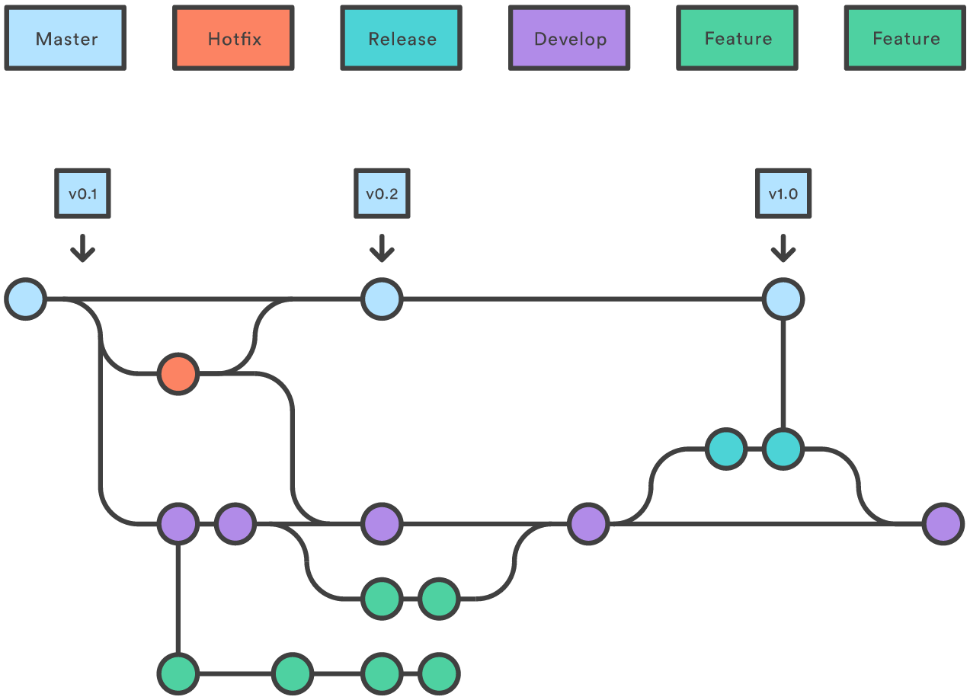
Branching in enterprise projects

Slide 46
Branching in Git
To list the branches in your repo (git’s default branch is called “master”).
git branch
Note: There is a * against your current branch.
To create a new branch (won’t switch to it automatically though). You then need to checkout to change to it.
git branch mynewbranch
git checkout mynewbranch

Slide 47
Branching
The above can be done as a single operation, i.e., to create a new branch and switch to it, use:
git checkout -b newBranch (creates a new branch, and checks it out).
Branches are very lightweight in Git (40 bytes), and developers are encouraged to create them frequently.
You can create branches of branches of branches if you like!
To delete the new branch:
git branch -d newBranch

Slide 48
Stash changes
If you have some files in progress, but want to move between branches, git stash let’s you put them away for a rainy day.
git stash
List stashed changes:
git stash list
The stash is a stack, which you can either pop (pull off the top element, removing from stack) or apply (pull off and apply without removing from stack). As a safety measure, always apply.
git stash apply
git stash pop
Clear the stash:
git stash clear
Notes:
The stash is a stack, which you can either pop (pull off the top element, removing from stack) or apply (pull off and apply without removing from stack). As a safety measure, you should almost always apply.

Slide 49
Merging branches
Merging creates a commit with two parents (for example, the master and development branch).
In fact, you can merge any number of changes at once (several feature branches in master) which is called an octopus merge.
Merge creates a new commit with two parents
6e3fd1
22e4ff
ee7ee7
Notes:
e.g:
git checkout master
Switched to branch 'master‘
git merge branch1
Merge made by the 'recursive' strategy.
index.html | 1 + 1 file changed, 1 insertion(+)

Slide 50
Handling Conflicts
When a file has been modified by “both sides”, it’s sometimes easier to just accept our changes or their changes (in case they include the other contributor’s changes), and not resolve the issues.
git status
git checkout --ours myfile.txt
git checkout --theirs theirfile.txt
Alternatively, the file with the conflict can be opened (in your preferred text editor, file browser or software development IDE [e.g., Netbeans, Eclipse, IntelliJ, etc.]) to resolve the error manually.
Git highlights the conflict with the appropriate sub-section of the file in question and it can be review and then committed by the user.

Slide 51
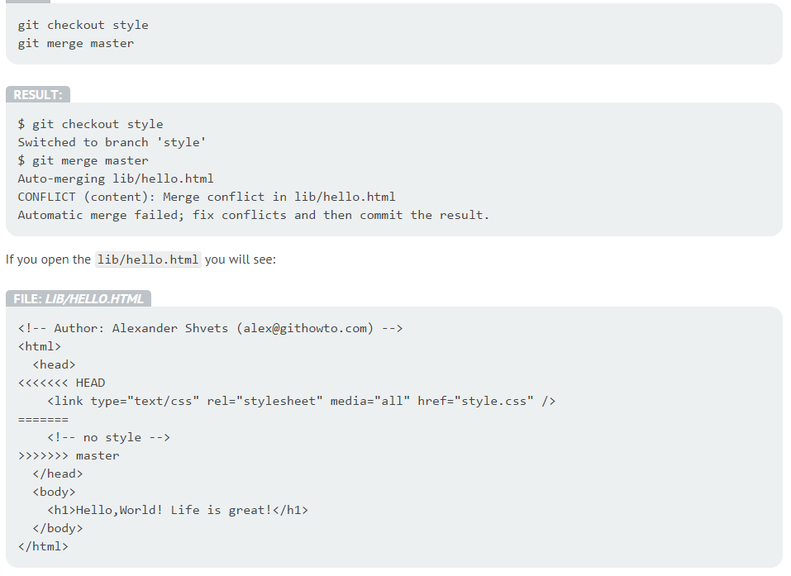
Handling Conflicts

Slide 52
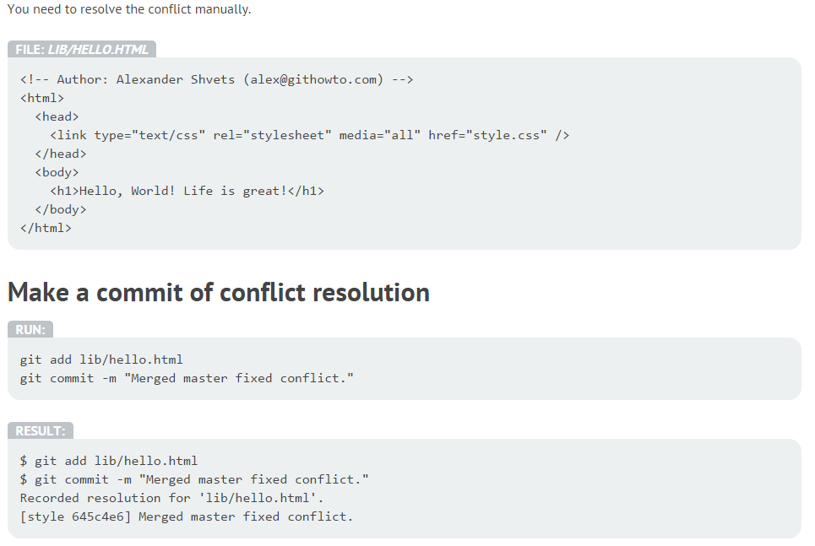
Resolving Conflicts

Slide 53
Tagging
Like most VCSs, Git has the ability to tag specific points in history as being important.
Typically people use this functionality to mark release points (v1.0, and so on).
To see a list of tags:
git tag
Creating Tags: Git supports two types of tags: lightweight tags (just a pointer to a commit), and annotated tags (contain metadata about who made the tag).
git tag 1.0 (lightweight tag)
git tag -a 1.0 (annotated tag)
All tags are local to your repo, until you push them (This process is just like sharing remote branches –run git push origin [tagname])
Notes:
Git supports two types of tags: lightweight tags (which are just a pointer to a commit), and annotated tags (which contain metadata about who made the tag).
You can move tags about using the -f option.
Use git tag to see a list of tags.
All tags are local to your repo, until you push them. That gives us a good chance to talk about remotes.

Slide 54
Working with Remotes

Slide 55
Pushing, Fetching, Pulling
You can pull changes from a remote repository via git fetch. In this case, the changes are fetched, but your current HEAD is not rolled forward to the next changes. You need to issue a git merge to apply the changes.
Doing a git pull is the equivalent of doing git fetch followed by git merge.
To push changes to the remote repository:
git push
To push tags:
git push --tags
To view logs:
git log master..origin/master

Slide 56
Sharing & deleting Remote Branches
To share a branch to the remote repository:
git push origin mybranch
To only push changes on all local branches that already have matching remote branches:
git push origin
To delete a branch:
git push origin :mybranch
git push origin --delete mybranch
git remote prune
Notes:
If you want to push changes on all local branches that have matching remote branches, use git push origin. (if your push.default is matching, if it’s simple, it will only push if the branch name matches a remote branch)

Slide 57
Merging and Rebasing

Slide 58
Back in the Day..
Developer branches for an experimental feature..
Merges changes back to the “master”
ab4efc
6e3fd1
7ef7ab
ef3ad2
23e4ff
ej7fd7
Notes:
This was cool, but if you’ve modified lots of the same files, someone is going to have to resolve those.

Slide 59
Rebase
If you’ve modified lots of the same files as other collaborators over time, someone is going to have to resolve changes/ issues.
When working on open source projects, you’re encouraged to rebase before you issue a pull request (so there is less pain for the merger).
fbd3e1
ab23d6
7ef7ab
ef3ad2
23e4ff
ej7fd7
Notes:
Notice that when rebasing, the commit ids will change since the parents of those commits have changed (the red squares)

Slide 60
Rebase essentials
Checkout a branch and use rebase to fetch newest updates from master:
git checkout mybranch
git rebase master
Then switch to master and merge updated branch:
git checkout master
git merge mybranch
Note: Only rebase on a local repo, never rewrite shared history
When there are conflicts:
git rebase --abort
git rebase --skip
git rebase --continue
Notes:
To rewrite Git History with Rebase: git rebase -i <parent-of-the-commit-to-start-from>
(entries will appear from oldest to newest)
You want to pick the first one, then squash the second and third ones.
You can use fixup to discard the log message in those commits.

Slide 61
Git Tools: Submodules
It often happens that while working on one project, you need to use another project from within it.
Perhaps it’s a library that a third party developed or that you’re developing separately and using in multiple parent projects.
A common issue arises in these scenarios: you want to be able to treat the two projects as separate yet still be able to use one from within the other.
Adding an existing Git repository as a submodule of our current repository:
git submodule add <your-git-submodule-repo>
Cloning an existing project with submodules:
git submodule init
git submodule update (to fetch all the submodule data from that project)
Notes:
Handling a multi-part project (core, db, web, etc).
For more, see https://git-scm.com/book/en/v2/Git-Tools-Submodules

Slide 62
Useful Sites
Book: http://git-scm.com/book
Training: https://services.github.com/kit/courses/github-for-everyone.html
Useful tutorial: https://ru.atlassian.com/git/tutorials/setting-up-a-repository/
Interactive tutorial challenges: http://try.github.com
Git terminology: https://www.atlassian.com/git/glossary/terminology/

