Slide 1

Silver Claims ODS — Data Model
A canonical, multi-source claims integration model — unified across ACO FHIR and Non-ACO proprietary sources. Designed for structural fidelity, pipeline idempotency, and clean Medallion layer boundaries.
SILVER ODS LAYER

Slide 2
AGENDA
What We'll Cover
1. Problem Statement Two source worlds, one model needed
2. Architecture Overview Bronze → Silver Raw → Silver ODS → Gold
3. Silver Raw Layer What it does and does not do
4. Silver Raw ER Diagram Source-aligned entity relationships
5. Core Transformations Keys, mapping, CDC, normalization
6. Silver ODS ER Diagram Member-centric entity relationships
7. Gold Layer Reporting & analytics (placeholder)
8. Summary Key takeaways (placeholder)

Slide 3
PROBLEM STATEMENT
Problem Statement: Two Source Worlds, One Model Needed
Claims data arrives from two structurally different source systems. Without a unified integration layer, downstream analytics are fragmented, inconsistent, and unreliable.
Non-ACO — Proprietary Format
ACO — FHIR Source
Claim type drives separate header/line table pairs with no unified grain:
FHIR v4 ExplanationOfBenefit (EOB) resources via BCDA
Nested JSON structure — requires flattening at ingest
Bundles can be inconsistent; source_claim_id is the reliable anchor
IP Header / IP Line
OP Header / OP Line
Pharmacy Header / Pharmacy Line
Dental Header / Dental Line
Vision Header / Vision Line
FHIR IDs alone are not reliable. source_claim_id is always the anchor.

Slide 4
ARCHITECTURE OVERVIEW
Medallion Architecture: Four Layers, One Purpose
Each layer has a distinct, non-overlapping responsibility. Business logic does not leak downward. Raw noise does not leak upward.
🟫 Bronze
🥉 Silver Raw
Raw landing zone. Exact copy of source files. No transformation. Append-only. No dedup. No schema enforcement.
Standardized ingestion layer. Technical dedup via ROW_NUMBER(). record_hash for CDC. Source-aligned keys. ACO + Non-ACO preserved as-is. No business logic.
🥈 Silver ODS
🥇 Gold
Canonical integration layer. Surrogate keys. Member-centric. Structural transformations only: patient→member mapping, adjudication scope, bridge normalization. Source traceability preserved.
Reporting and analytics layer. Conformed dimensions. Flattened models. CCLF export mapping. NOT part of this model.

Slide 5
BRONZE → SILVER RAW
From Bronze to Silver Raw — Unifying Two Worlds
Two structurally different sources. One normalized, source-aligned output.
ACO Source
Non-ACO Source
Ingest & Normalize
Output Tables
FHIR
FLAT FILE
EXPLODE — flatten FHIR arrays into rows
UNPIVOT — normalize repeated columns into rows
STANDARDIZE — unify keys: claim_id, patient_id, line_number
claim_header
claim_line
claim_adjudication
claim_diagnosis
claim_procedure
claim_provider
FHIR ExplanationOfBenefit
Nested JSON
item[], adjudication[], diagnosis[]
source_claim_id anchor
Proprietary flat files
Wide table structure
diagnosis_1..n, procedure_1..n
paid_amt, copay_amt, deductible_amt

Slide 6
SILVER RAW — INGESTION
Column-Level Source Mapping
Concept
ACO Source
Non-ACO Source
Silver Raw
Claim ID
eob.id / identifier[].value
claim_id (header table)
source_claim_id
Patient ID
eob.patient.reference
member_id / patient_id
patient_id
Claim Line
eob.item[].sequence
claim_line_number
line_number
Diagnosis
eob.diagnosis[].diagnosisCodeableConcept
diagnosis_1..n
claim_diagnosis (rows)
Procedure
eob.procedure[].procedureCodeableConcept
procedure_1..n
claim_procedure (rows)
Adjudication
eob.item[].adjudication[]
paid_amt, copay_amt, deductible_amt
claim_adjudication (rows)

Slide 7
SILVER RAW LAYER
Silver Raw: Standardize Without Transforming
Silver Raw is the first layer where data gets a shape. It does not interpret data — it preserves it safely.
✅ What Silver Raw DOES
🚫 What Silver Raw Does NOT Do
Enforces schema per source type (CSV, FHIR JSON)
Technical dedup via ROW_NUMBER() on source_claim_id
Generates record_hash for downstream CDC
Stamps ingestion_timestamp, batch_id, source_file_id on every row
Carries patient_id as-is from source
Preserves all source field names and raw values
No patient → member resolution
No surrogate key generation
No cross-source joins
No business deduplication
No code standardization
No analytical logic of any kind

Slide 8
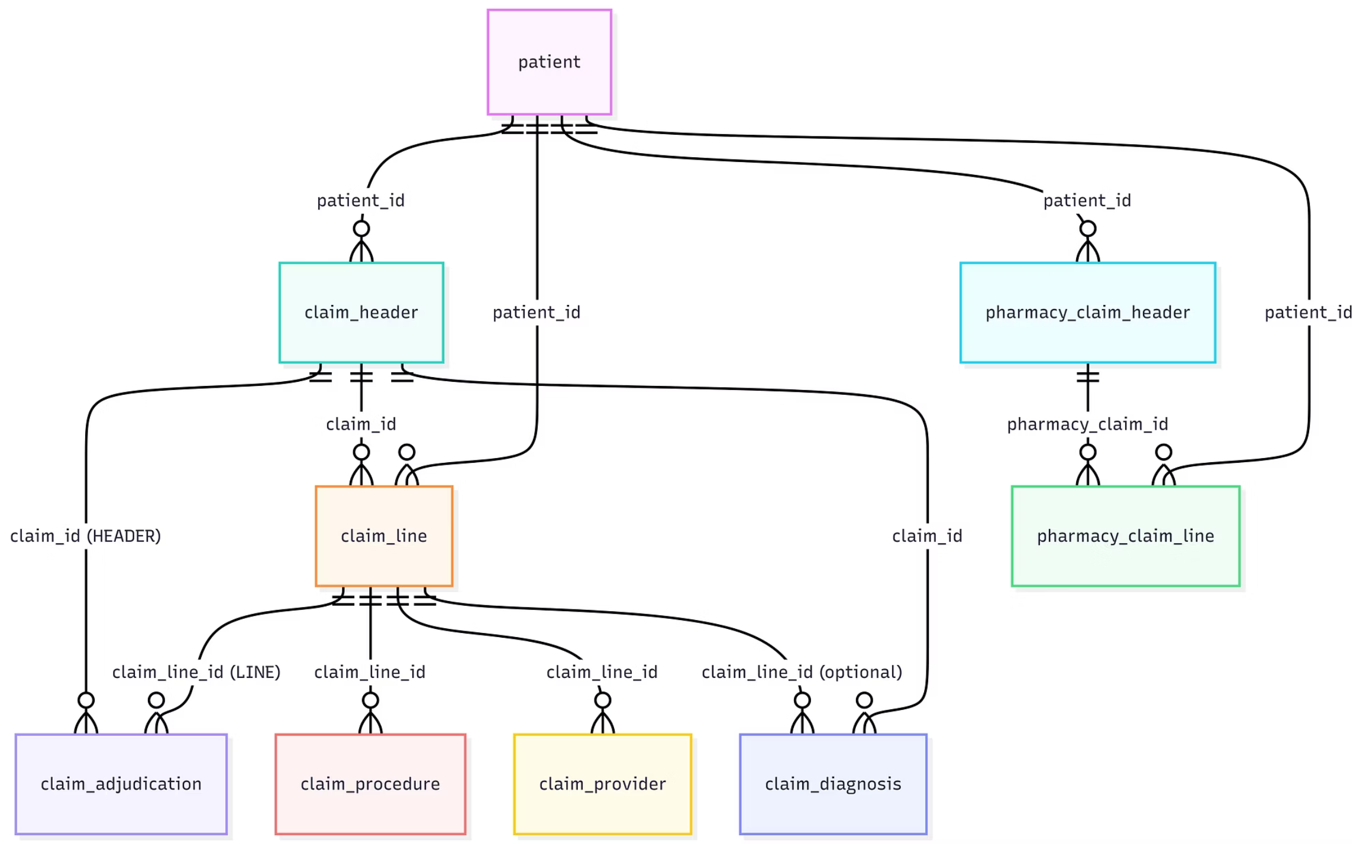
SILVER RAW — ER DIAGRAM
Silver Raw: Entity Relationships

Slide 9
SILVER RAW → SILVER ODS
Core Transformations: Silver Raw to Silver ODS
Six structural transformations at this boundary. None are analytical — all are integration-layer responsibilities.
Surrogate Key Generation
Patient → Member Mapping
Business Dedup + CDC
Generated PKs on every fact table. source_claim_id is always retained alongside.
patient_id resolves to member_wid via patient_member_map. dim_member is the central entity.
Full CDC/Merge replaces Raw's ROW_NUMBER() dedup. record_hash drives change detection.
Bridge Table Normalization
Adjudication Scope Enforcement
Code Standardization
Flat repeated columns become bridge tables: diagnosis, procedure, provider — each with a FK back to the parent claim.
Raw codes preserved as-is. Standardized columns are added alongside; Silver ODS never overwrites source values.
adjudication_scope = LINE or HEADER. Exactly one FK populated per row — never both.

Slide 10
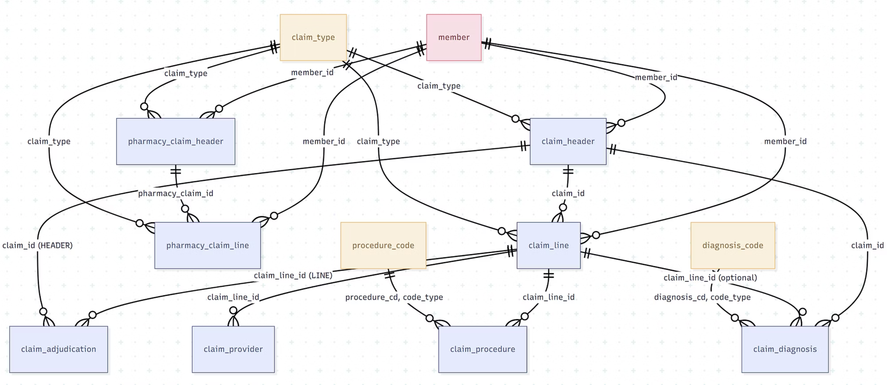
SILVER ODS — ER DIAGRAM
Silver ODS: Entity Relationships
Member-centric, surrogate-keyed relational model. Bridge tables for diagnosis, procedure, and provider. All relationships are logical — no DB REFERENCES enforced.

Slide 11

GOLD LAYER
Gold Layer — Reporting & Analytics
[ Placeholder — Gold layer content to be added ]
What Goes Here
Key Principles
Conformed dimensions (dim_member, dim_provider, dim_date)
Flattened, denormalized models for reporting
CCLF export mapping
Aggregated financial summaries (allowed, paid, billed)
ACO performance metrics
Built on top of Silver ODS — never directly on Bronze or Silver Raw
Analytical logic lives here, not in Silver
Conformed keys replace surrogate keys
Optimized for query performance
⚠️ This slide is a placeholder. Gold layer design is out of scope for this model — content to be completed separately.

Slide 12

SUMMARY
Summary & Key Takeaways
[ Placeholder — Summary content to be added ]
[ Takeaway 1 ] Placeholder — e.g. Silver ODS is the canonical integration layer, not a reporting layer.
[ Takeaway 2 ] Placeholder — e.g. source_system + source_claim_id is the universal natural key across all sources.
[ Takeaway 3 ] Placeholder — e.g. Adjudication table is the source of truth for financial adjustments.
[ Takeaway 4 ] Placeholder — e.g. All analytical logic belongs in Gold — never in Silver.
⚠️ This slide is a placeholder. Add final takeaways and next steps before presenting.

