Slide 1
CINQ Silver ODS (Enrollment)
“OurId” Strategy During Transition

Slide 2
Current State
OurID generated via SQL Server sequence
Challenge: OurId cannot be fully moved until all sources are migrated

Slide 3
Migration Challenge
Need consistent OurId generation across historical, parallel, and new loads
Risk: Duplicate or misaligned OurId if not carefully managed, current HIE integrations (ADTS), Downstream
Goal: Seamless transition without breaking referential integrity
Note: If we had used UUIDs, the migration would have been simpler.

Slide 4

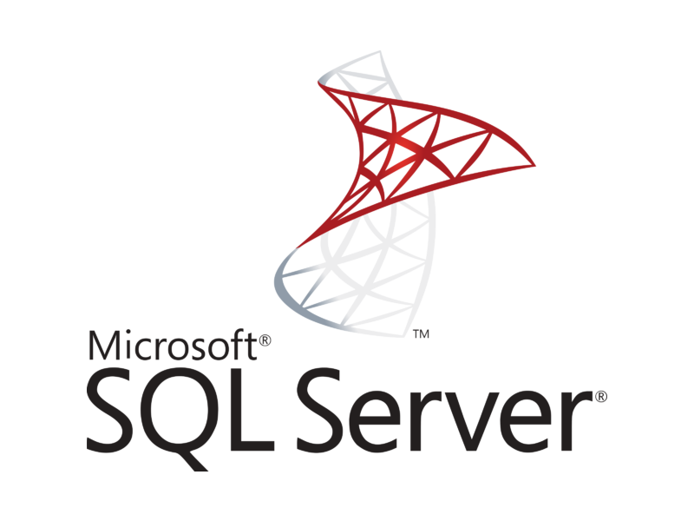
Proposed Solution [Historical Data]
CinqDataLake [LinkId]
CINQDB [LinkId, OURID]

Slide 5
Proposed Solution (Stepwise)
1. Historical Load (One-time)
a. OurID fetched from existing SQL Server DB using Federated queries
2. Parallel Loads (Interim Phase)
a. OurId’s still generated in SQL Server
3. Decommission from CINQDB
a. Once SQL Server pipeline stops for a source (Fidelis) in CINQDB
4. Full Migration (Final Phase)
a. All sources migrated
b. Loaded into Lake DB with OurID for members in Identity Table
b. Once Jobs complete in CinqDB → keys synced into Lake DB
b. Lake will check OurId for the LinkId received in existing CINQDB
c. If not found, Lake calls federated query to fetch sequence numbers for new members
b. OurId generation fully handled within Lake

Slide 6
Member Identity Resolution
Column Name | Data Type | Example | Primary Key | Partition By | Comments
LinkId | UUID |  | True
SourceSystem | STRING | Fidelis, ACOREACH | True | True | Payor
OurId | INT |  |  |  | Populated from CinqDB
SourceSystemId | STRING | FidelisId, MBI_ID | True |  | Source Unique Identifier
InsuranceId | STRING |  | True |  | For non CMS/ CMS it will be same
IsActive | BOOLEAN | TRUE/FALSE |  |  | For given member_id, sourcesystem only one unique is allowed
BatchId | INT | 101 |  | True | For lineage tracking
Date Columns

Slide 7
Benefits
Ensures continuity of OurId
Avoids duplication/conflicts
Smooth transition with minimal disruption
Clear roadmap for eventual Databricks-only key generation

Slide 8
Next Steps
POC on Federated queries from databricks

