Slide 1


CINQCARE Data Platform
Technical Design
April 8th, 2026

Slide 2
CINQ Data Platform – Project Scope
Conceptual Architecture
Infra Architecture
Digital Urth – Data Platform Framework & AI
About DU Framework + AI Agents
AI Data Engineer
Business Context IQ
CINQ Data Platform + AI
Infra Components
CINQ Business Capabilities
LLM Guardrails
HITRUST
Agenda

Slide 3
Data Platform - Current Scope: Phase 1 and 2
From Daily Struggles to Data Success: Empowering Stakeholders by Fixing the Core
Onboarding of remaining 41 sources
Consumer data from TransUnion, Quality data, EMR data, and other data sources
Infrastructure Set up
Phase 1
Phase 2
Azure Infrastructure set up
Databricks config & set up
Azure Services config & set up
Self-service ingestion solution (design and implement)
Onboard sources - 14 files
Four (4) Enrolment sources (Centene GA, Centene GA - Risk , D0284, MSSP)
Two (2) claims sources (Centene GA Risk, CMS Claims)
Four (4) daily census sources (TBD)
DQ Rules Engine - Ability to configure rules
Healthcare Industry Standard Data Model for Enrolments, Claims, & Daily Census
Dashboard (4)
Mapping data sources to CINQ Canonical Model
Historical data loading from existing CINQ DB (1 year data)
Automated operations
File Processing SLA tracking
Data Quality Report
Verato integration
Focus Areas
Next Gen Architecture: Data Platform with ability to scale and grow with future demand
Self Service: Business users have capability to onboard and govern data and track data operations
AI Foundation: Development of Infra, and Data Platform architecture to support future build of CINQ Business AI Agents
Data Observability: Ability to track data lineage, usage, and quality in real time
Architecture & Design
Azure Infra Design & Architecture
CINQ Data Platform – Design & Architecture
Data Lake House Architecture & Design (Medallion Architecture)
Data Model/Schema Design
Data Operations Design

Slide 4
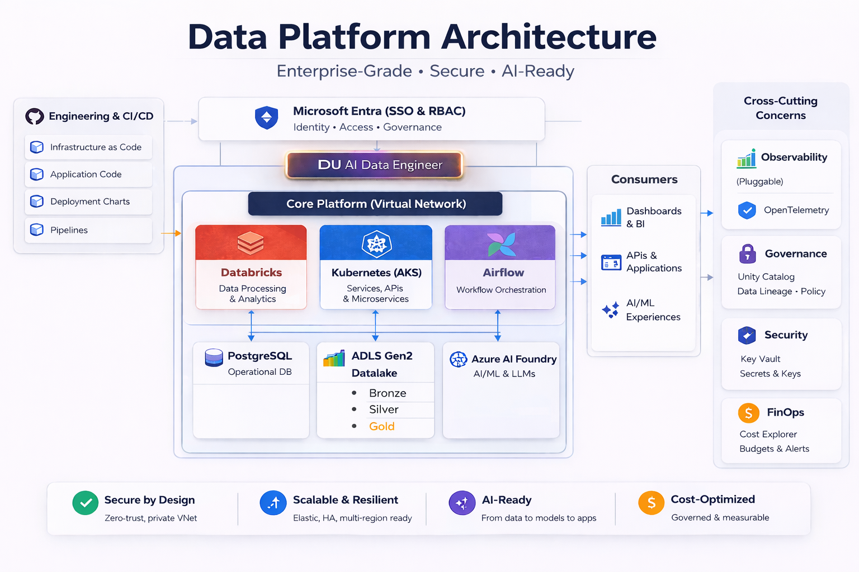
Infra Architecture

Slide 5
Conceptual Architecture – Building Blocks
Data Governance
(Data Catalog, Data Quality, Ownership, Data Profiling, Usage)
Landing Zone
Data Transformation
(Data processing based on business requirements)
Analytics
Enrollment
Models & Scores
ADT
Bronze > Silver > Gold
(Data Lake House)
Data Delivery
Claims
Data Observability
(Track Lineage, Quality & Costs)
Ops
Data DWH

Slide 6
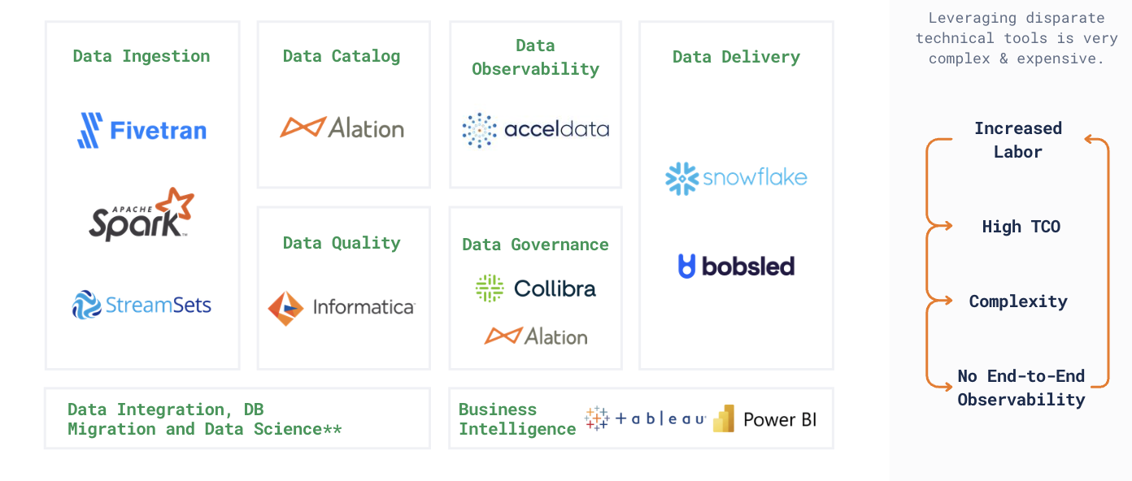
Data Platform – Tools & Capabilities
Typical Enterprises are adopting multiple niche point solutions on top of existing public cloud services which will increase overall TCO, and labor intensive

Slide 7
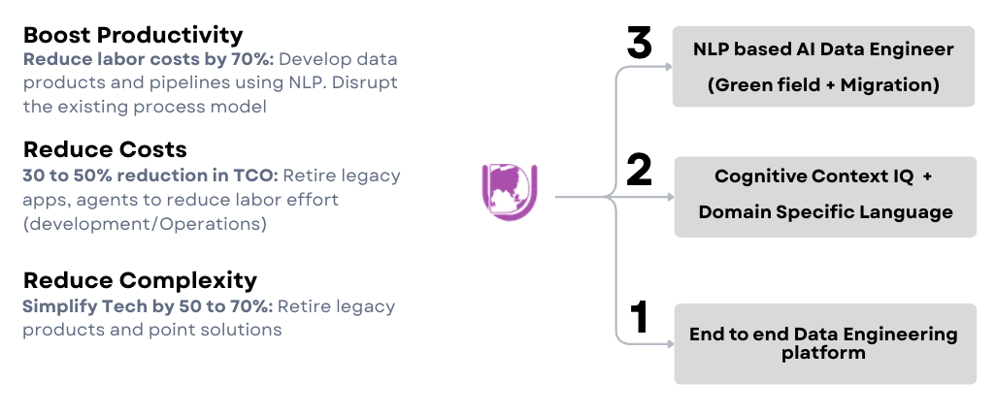
Digital Urth Framework + AI Agents
The Trinity of Transformation: Platform, Context, and AI Engineer

Slide 8
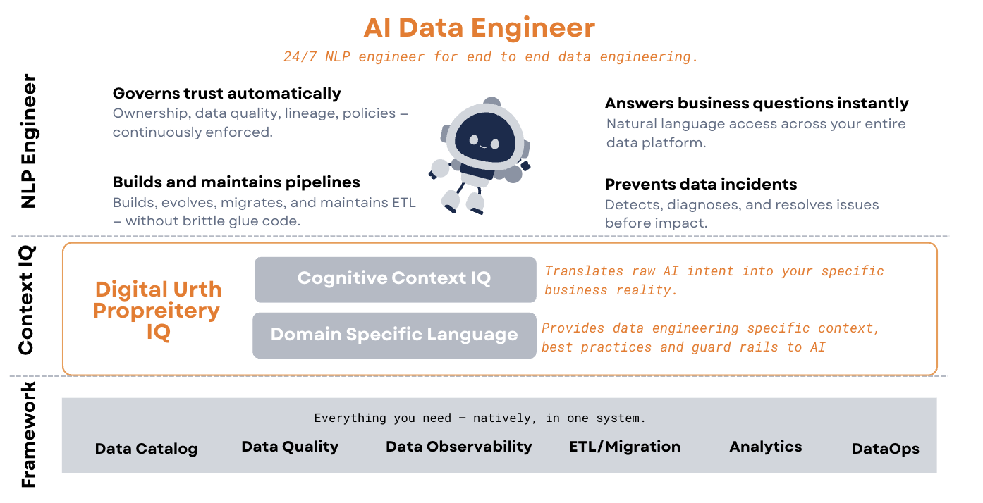
Digital Urth: AI Acceleration

Slide 9
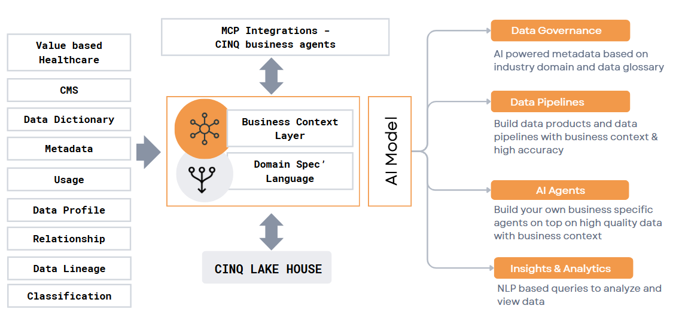
Digital Urth: Business Context IQ
Mapping of CINQ data to enterprise glossary, Health care domain, and other metadata to enable Context Engine

Slide 10
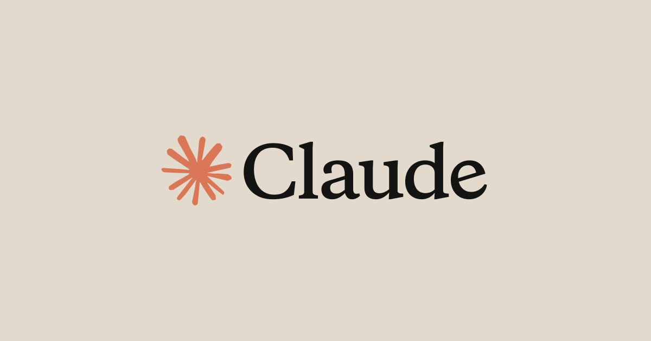





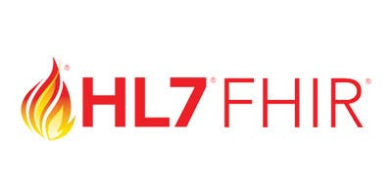
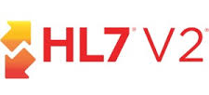
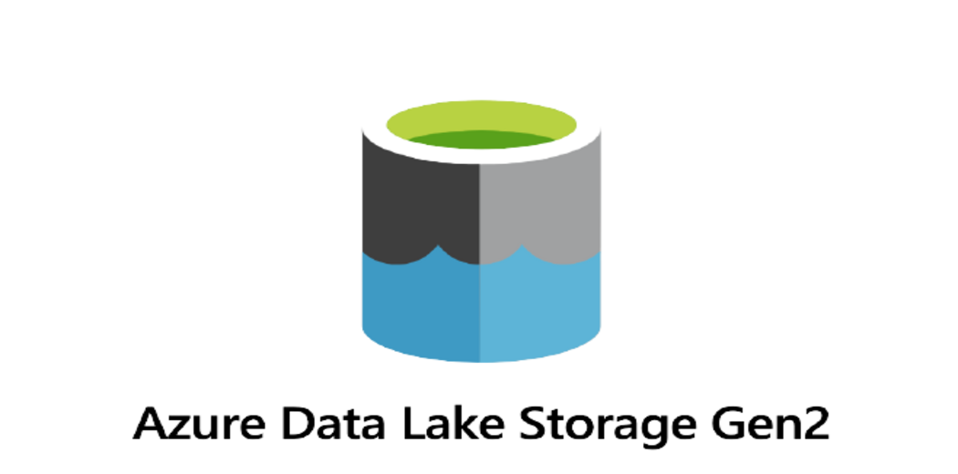
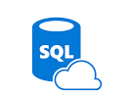
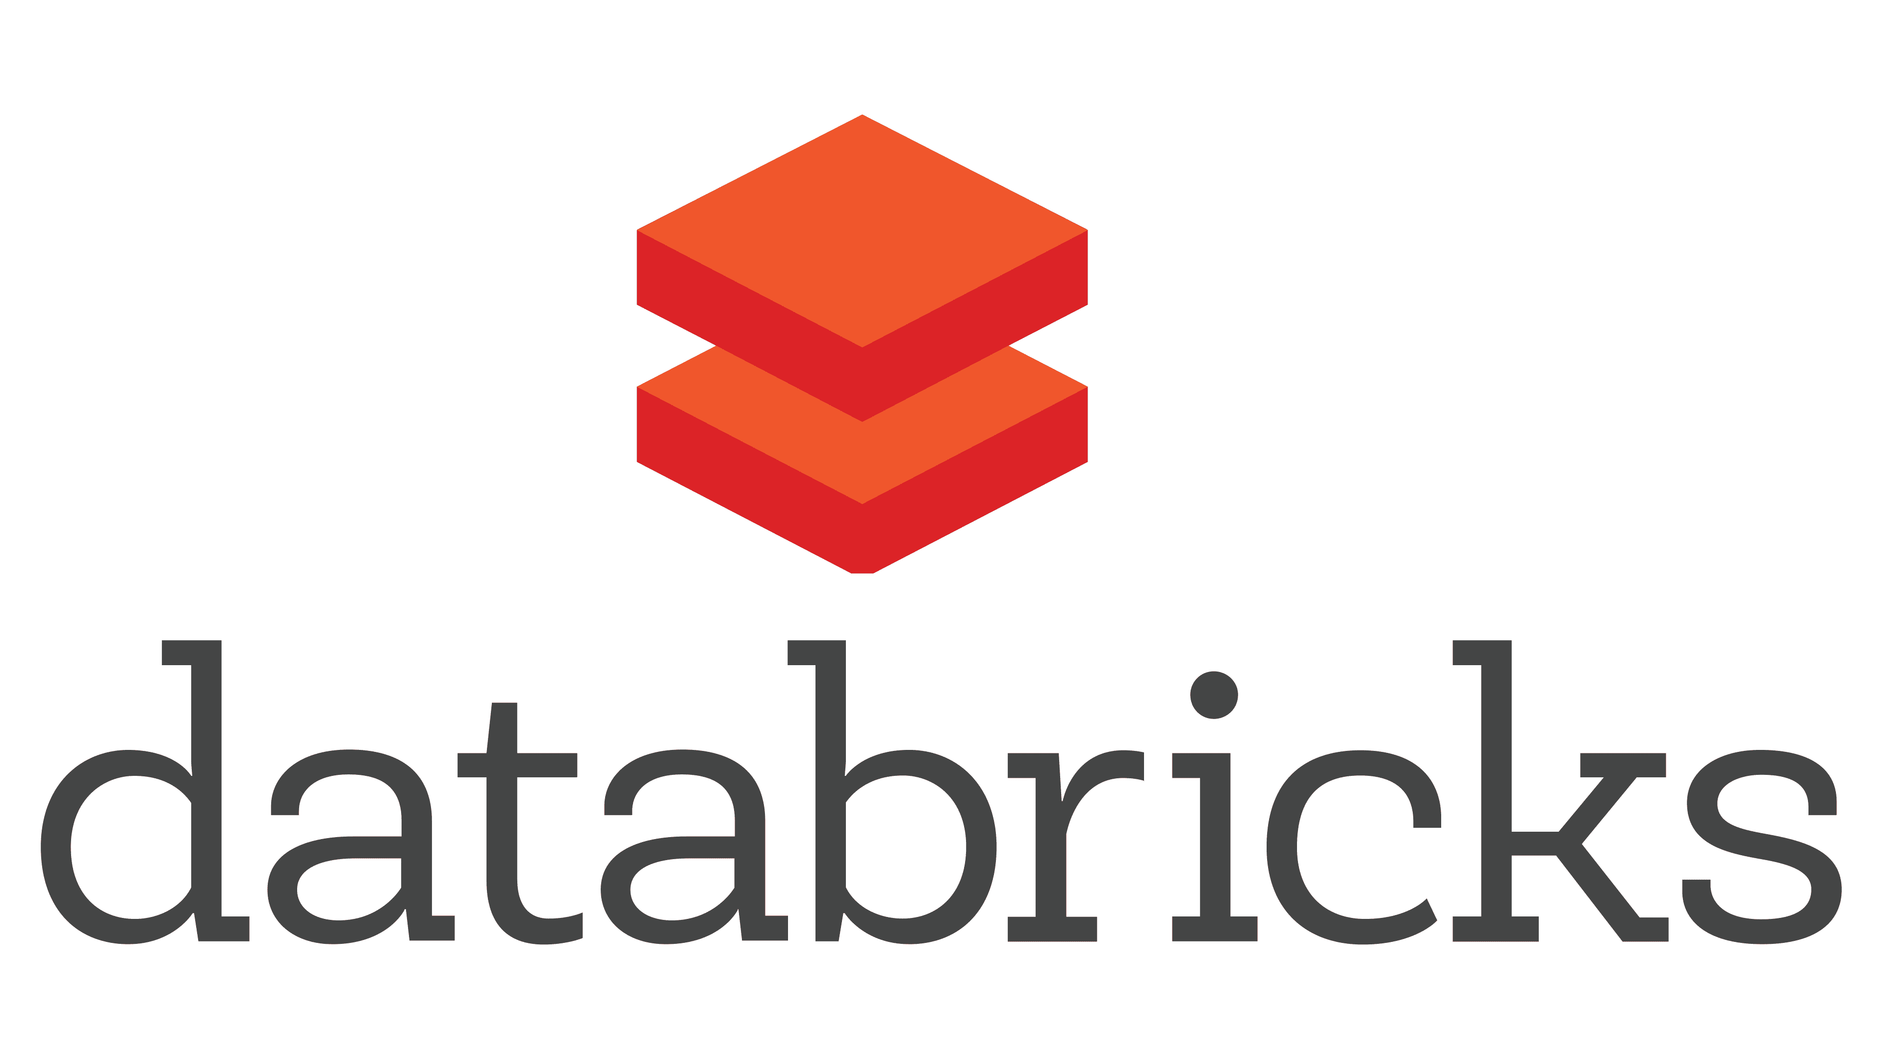


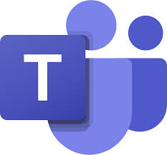
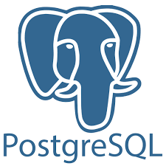

CINQ Data Platform + AI: High Level Architecture
We will be leveraging AI for rapid development, adoption and operations of CINQ Data Platform. Our NLP based AI Data Engineer will governs data, builds data pipelines, manages data platform and answers data related questions.
Digital Urth - NLP Layer for all user input
Digital Urth Business Context IQ + Domain Specific Language
AI DATA ENGINEER
Data Governance
Data Quality
Data Pipelines
Data Observability
Platform Operations
Data Delivery
Source Data
Data Lake
Data Consumption
Bronze
Silver
Gold
Roster
ADT
Claims
RBAC/Audit
Delivery
Analysis
DevOps (CI/CD)
Data Observability
SLA
Monitor
Alerts
Channels
Operational
Data Store

Slide 11
Infra Components
Layer | Capability | Technology | Business Value
Orchestration | Automated pipelines | Apache Airflow | Reduce manual effort, faster data delivery
Processing | Scalable Spark compute | Azure Databricks | Handle large healthcare datasets efficiently
Storage | Raw + curated zones | ADLS Gen2, Blob Storage | Enable audit, replay, and trusted analytics
Governance | Unity Catalog | Unity Catalog | Ensure compliance and controlled data access
Control Tier | Catalog and Operations | AKS, PostgreSQL Flexible Server | Single plane view for Operations and Automation
Foundation models | AI Foundation | Azure AI Foundry | Scalable and secure AI adaptation and acceleration
Security | Private endpoints | Key Vault, Private Endpoints, Managed Identity | Reduce breach risk and regulatory exposure

Slide 12
CINQ Business Components
Component | Capability | Tech ( Aligned)
Context Engine | Semantic understanding of data (schema + business meaning) Mapping of data to Healthcare domain, and other key items Maps business terms to physical data (FHIR, Claims, ADT, etc.) Powers AI-driven query generation & recommendations Enables Context IQ for smarter decisions | LLM-powered Context Engine - Vector store (metadata + embeddings) - Azure AI Foundry (LLMs)
Self Service – Data Onboarding | Rapid onboarding of new data sources (FHIR, CCLF, APIs, files) Auto schema inference & mapping Guided ingestion workflows Minimal engineering dependency | Databricks (ingestion pipelines) - Airflow (orchestration) - ADLS Gen2 (landing / bronze)
Business Rules Engine | Define and manage transformation rules (SQL / no-code) Supports complex joins, aggregations, validations Rule versioning & reusability AI-assisted rule generation (NLP → SQL) | Rules Engine (LLM-assisted) - Databricks (execution layer) - SQL / PySpark
Data Catalog | Central metadata repository (tables, columns, lineage) - Business glossary & semantic layer Search & discovery of datasets - Enables governance & reuse | Unity Catalog (Databricks) - Metadata store (Postgres) - Context Layer
Data Observability | End-to-end pipeline monitoring (freshness, failures) - Data lineage tracking Anomaly detection (volume, schema, patterns) - Alerting & root cause insights | Open Telemetry - Airflow + Databricks logs - Observability tools (pluggable)

Slide 13
LLM Guardrails
By combining AI guardrails, governance, security, and cost control, DU allows organizations to confidently deploy AI agents, LLM applications and automated workflows all within a secure and compliant enterprise environment.
Guardrail Layer | What It Enforces
LLM Guardrails | Content filters (violence, hate, self-harm), PII detection & masking, topic deny-lists, prompt & response filtering. Client owns and manages Guardrail configs; DU references them via IAM-scoped policy.
Safety Settings | Built-in toxicity & prompt-injection filters, DLP integration with Workspace labels, tunable safety tiers per use-case ( relaxed for internal code-gen).
DU Policy Engine | Per-agent allowed-intent lists. Jailbreak & prompt-injection pattern detection before tool execution.
PII Protection (Presidio) | Configurable recognizers: SSN, email, credit cards + custom regex. Auto-detection and masking/redaction before prompts reach the LLM. Tenant-testable before deployment. Differential privacy for training (DP-SGD).
Environment & Tool Isolation | LLM inference runs in isolated containers. All agent tools are whitelisted — no arbitrary SQL or shell execution. Write actions require human-in-the-loop approval. Sandboxed API gateways for all tool calls.
Key Points:
100% On Prem: DU will host their AI Data Engineer in CINQ Azure environment (container)
Data Isolation: CINQ data will be hosted in it’s own Azure infra
DU Solution at a foundation level provides ability to classify and tag all CINQ data with HIPAA
LLM: CINQ will implement and manage it’s own LLM, tokens, u sage, budget, etc.,

Slide 14

HITRUST Focus
AI with Guardrails
LLM usage via Azure AI Foundry
Enterprise controls:
Data isolation
No training on customer data
Secure prompt handling
Built-in Secure Architecture
Zero-trust design (private VNet)
Integration with Microsoft Entra ID (SSO, RBAC)
Secure secrets via Azure Key Vault
Accelerators for HITRUST Readiness
Data Lake provides:
Pre-defined security architecture patterns
Control mapping to HITRUST domains
Audit-ready logging & lineage
Faster implementation vs building from scratch
Auditability & Observability
End-to-end logging across:
Pipelines (Airflow, Databricks)
APIs (AKS)
Integrated with Open Telemetry
Enables:
Full lineage tracking
Audit trails for compliance
Data Quality & Compliance Controls
DQ engine ensures:
Clinical correctness
Financial accuracy
Data completeness
Helps meet regulatory reporting requirements
Data Protection & Governance
Data stored in secure Lake House
(ADLS + Delta) with fine-grained access
Supports:
Encryption at rest & in transit
PHI access controls
Data masking strategies

Slide 16
Appendix

Slide 17
Agentic AI Framework
Digital Urth “AI Data Engineer” leverages LangGraph for Agent Orchestration which is ideal for all complex agents or data pipelines
What is the value add or automation enabled?
Or what is the productivity gain?
Our proprietary model:
Multi-Agent (Orchestration) & Hierarchical Agentic System: Our “AI Data Engineer” is a super agent which delegates tasks to specialized "Worker" agents (ex: DQ, Profiling, etc.,)

Slide 18
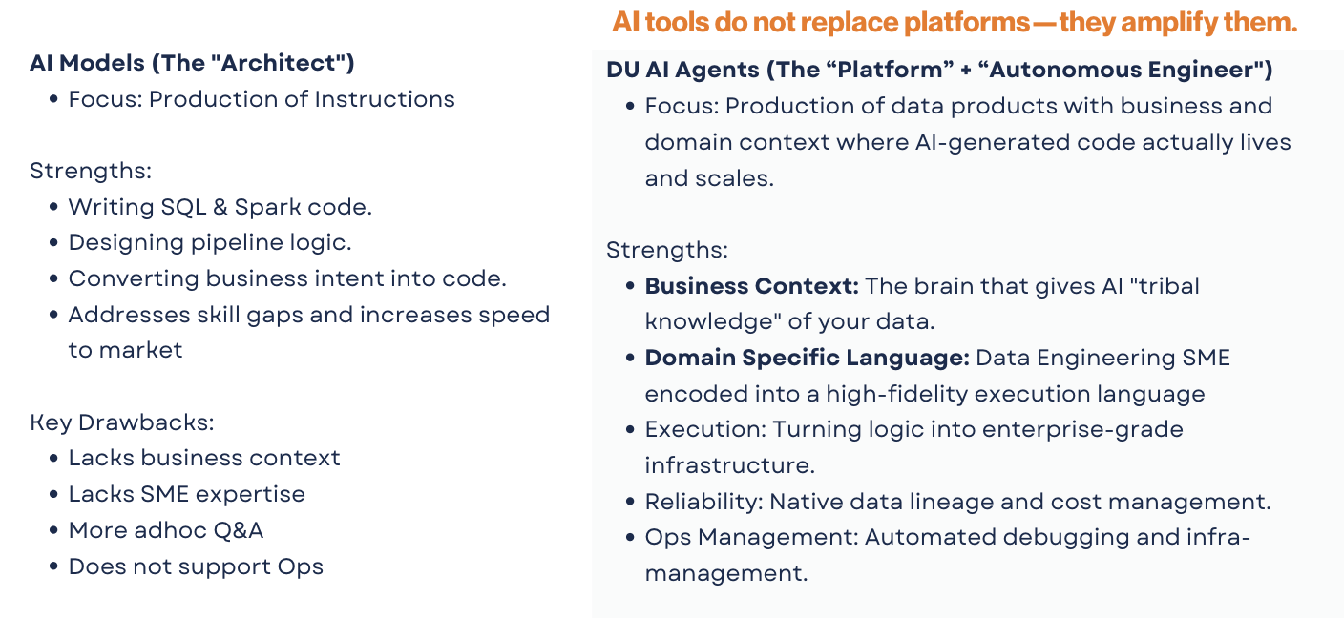
LLM’s and DU AI Data Engineer

Slide 19
How our Context IQ will help for future use cases
AI-Powered Data Development
Intelligent Impact Analysis
Convert business intent → SQL / pipelines using rich context
Auto-suggest transformations based on historical patterns
Predict downstream impact before changes
Safer releases with proactive risk detection
Self-Service Analytics
Business users explore data using natural language
Context-driven recommendations for datasets & dashboards
Automated Data Quality & Governance
Auto-generate DQ rules from historical data behaviour
Enforce policies using lineage + usage insights
Smart Observability & RCA
AI-driven anomaly detection
Faster root cause analysis using full context graph
Data Product Enablement
Discover, trust, and reuse curated datasets
Accelerate creation of domain-specific data product
Notes:
6.

Slide 20
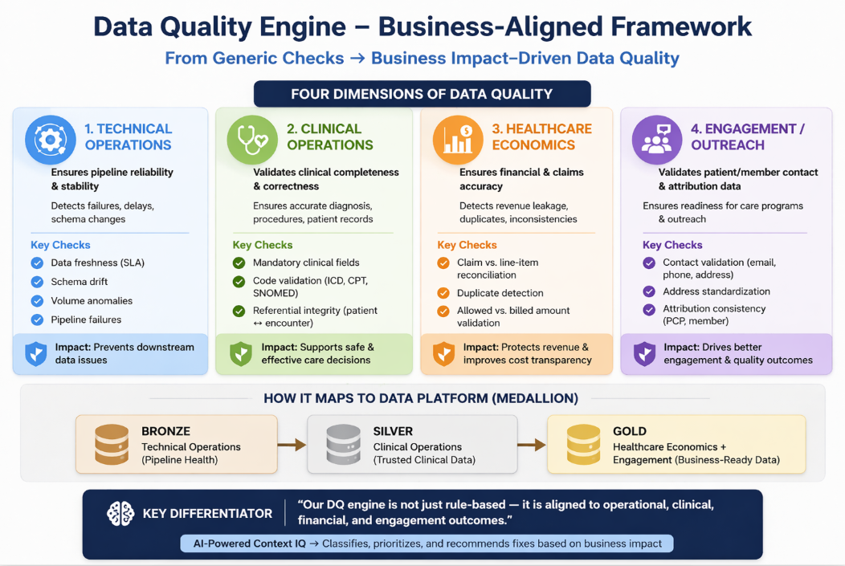

Slide 21
How we will solve data lineage, DQ and observability
Data Lineage
Data Quality
Observability
End-to-end visibility: Source → RAW → Curated → Consumption
Column-level traceability for transformations
Visual lineage graph for impact analysis
Version-aware lineage for safe changes
Rule-based validation (nulls, uniqueness, referential integrity)
Business rule checks (domain-specific validations)
Schema drift detection
Data quality scorecards & trend tracking
Pipeline monitoring (failures, retries, SLA tracking)
Data freshness & latency tracking
Volume anomaly detection (spikes/drops)
Root cause analysis across pipelines & datasets

Slide 22
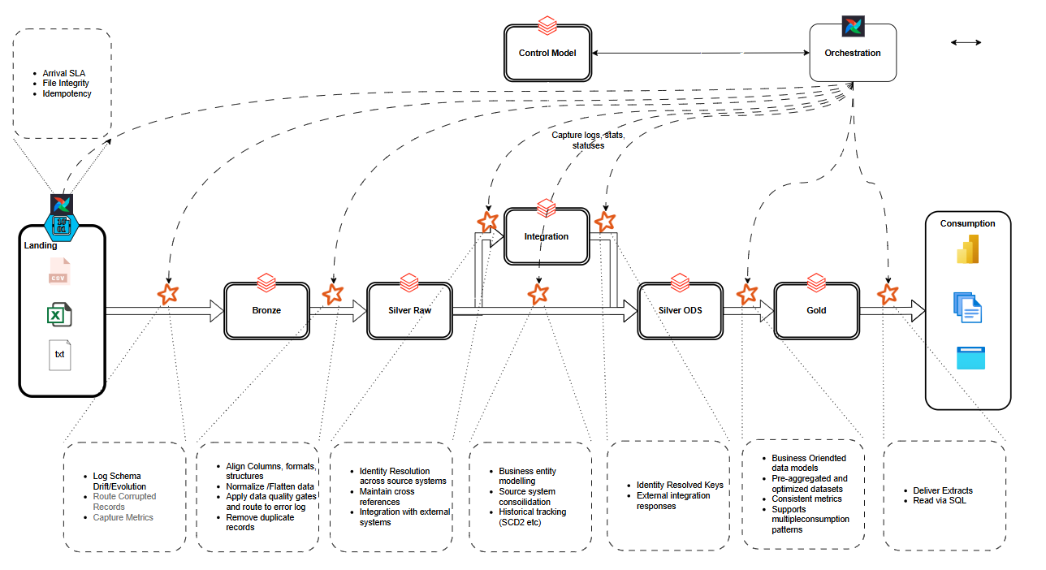
Lakehouse Data Flow

Slide 23
Goals & Objectives
Challenge | Benefit | Business Value
All data ingestion requires engineering support | Self-service data ingestion platform with pre-built connectors, schema inference, and validation templates | Reduce onboarding time from weeks to hours, freeing engineering bandwidth by 40–60%
Silent record failures result in customer issues and lost revenue | End-to-end data observability with reject tracking, lineage, and alerting | Reduce revenue leakage; improve trust with 100% transparency of failed records and faster root cause analysis
Data processing for ADT is done once a day, resulting in delays | Near real-time / micro-batch processing with incremental pipelines | Reduce latency from 24 hours to minutes, enabling faster faster following and transition care (enabling < 48hrs SLA adherence and enabling PCP discharge in 7 days)
Data quality rules are hardcoded and not scalable | Configurable rule engine (no-code / low-code) for DQ checks and transformations | Business users can define rules → reduces dependency on engineering and accelerates change cycles

