Slide 1
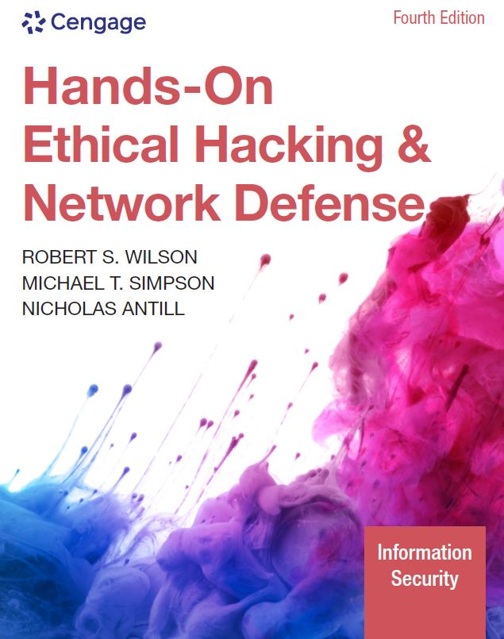
Hands-On Ethical Hacking and Network Defense,
Edition 4
Module 3: Network and Computer Attacks
Simpson, Antill, Wilson, Hands-On Ethical Hacking and Network Defense, 4th Edition. © 2023 Cengage. All Rights Reserved. May not be scanned, copied or duplicated, or posted to a publicly accessible website, in whole or in part.

Slide 2
Malicious Software (Malware)
Network attacks are initiated to steal data that can be used or sold for financial gain or to carry out a sociopolitical agenda
Malicious software (malware)
  Virus
  Worm
  Trojan program
Main goal
  To make money
Malware was once targeted specifically at Windows, Linux, and other traditional OSs
  Now, it is written to target tablets, smartphones, and other Internet-connected devices

Slide 3
Viruses (1 of 4)
Virus: A program that attaches itself to a file or another program, often sent via email
  Can’t replicate itself or operate without the presence of a host
  Does not stand on its own
Examples
  Phishing: Sender of a phishing email uses social engineering to lure a user into following a malicious link to a fake website
  Ransomware: A type of virus that locks a target system until a ransom is paid
Bad news about viruses
  No foolproof prevention method

Slide 4
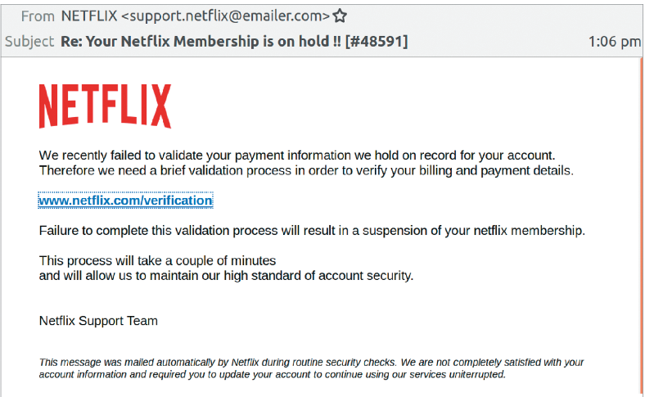
Viruses (2 of 4)
Figure 3-1 Phishing email message

Slide 5
Viruses (3 of 4)
Antivirus software
  Compares signatures and common malicious programmatic behaviors of known viruses against every file on a computer
    Signatures are kept in a virus signature file
      Must update regularly
    Many antivirus software packages offer automatic updates
Network security devices
  Can monitor entire networks and intercept malware before it reaches users
Sandboxing
  Allows users to run programs in a secure, isolated operating area that prevents malicious files from being written to the hard drive

Slide 6
Common Computer Viruses (1 of 3)
Virus | Description
Ryuk | The Ryuk ransomware virus was responsible for more than one-third of all ransomware attacks in 2020. Ryuk is used in attacks targeting companies, hospitals, and government municipalities. Ryuk encrypts critical files and typically demands a multimillion-dollar ransom.
FormBook | FormBook is a malware family of data stealers and form grabbers. It attempts to steal the contents of the Windows Clipboard, log what you type on the keyboard, and steal data while you browse the web. It is sold as “malware-as-a-service” on hacking forums. Hackers can purchase a subscription and use the FormBook tool. FormBook is usually distributed through spam email containing malicious attachments.
CryptoLocker | CryptoLocker is less prevalent now but is considered the father of many ransomware viruses. CryptoLocker has become a term referring to families of ransomware viruses. In 2016, it was estimated to have infected more than 250,000 computers. This malware locks the user’s files in an encrypted container and requires the victim to pay ransom for their decryption. Like most malware, it is delivered through an email message that is designed to trick users into clicking a malicious link or attachment. Once a machine is infected, victims have a set amount of time to pay the ransom if they want to retrieve their files.

Slide 7
Common Computer Viruses (2 of 3)
Virus | Description
MalumPOS | Malware has targeted devices responsible for processing payments, referred to as POS (point of sale) systems. The MalumPOS virus was used in mid-2015 to attack POS devices at hotel chains. This virus was programmed to find, intercept, copy, and exfiltrate payment card information (e.g., credit/debit card numbers and other information stored on the magnetic strip of a credit card). POS attacks were rare in 2020, but a new strain seems to target personally identifying information only instead of full payment card information.
Carbanak | This virus is spread via phishing emails that almost always target financial institutions. These phishing emails contain a Word document and a malicious .cpl file. (Keep this in mind for the upcoming base-64 decoding exercise.) When it first accesses a system, the malware runs a number of checks to ensure it can gain the proper privileges to further its attack. When proper privileges are obtained or verified, the malware opens a backdoor to a few remote servers under the control of an unknown (to this point) malicious actor. This malware has been used to facilitate fraudulent transactions in financial institutions’ funds transfer systems and ATM machines.

Slide 8
Common Computer Viruses (3 of 3)
Virus | Description
Gumblar | First detected in March 2009, this malware spread by mass-hacking hundreds of thousands of websites, which then exploited visiting browsers via Adobe PDF and Flash vulnerabilities. It has made a resurgence in 2020, crashing thousands of blogs and websites that use WordPress, Drupal, Joomla, and other PHP-based constructs. The malware steals FTP credentials and uses them to further compromise websites that the victim maintains. It also hijacks Google searches and blocks access to antivirus update sites to prevent removal. Recent variations install a backdoor that attempts to connect to a botnet.
Gpcode or PGPCoder | This ransomware virus was detected in 2008 and was still active in 2020. Although not widespread, it is unique because it uses practically unbreakable 1024-bit asymmetric key encryption to hide a user’s documents on the computer and hold them for ransom until the victim pays for the encryption key.

Slide 9
Viruses (4 of 4)
Some viruses contained in email attachments were encoded in base 64
Running a base-64 decoder on suspicious email attachments can help determine if malware or viruses are detected
Examples of what to look for:
  Hidden computer programs
  Executable pieces of programming code known as shell
    Creates an interface to an OS for issuing system commands
    Should not appear in an email attachment

Slide 10
Macro Viruses
Macro virus
  A virus coded as a macro in programs that support a macro programming language (e.g., Visual Basic for Applications)
  Macro: Basically, a list of commands
    Can be coded to carry out several malicious actions
    Example
      Melissa: Appeared in 1999
Viruses were created by programmers in the past
  Today, even nonprogrammers can create viruses easily
  Instructions on how to create a virus step by step are posted on websites
    Security professionals learn from thinking like attackers

Slide 11
Worms
Worm: A program that replicates and propagates itself without having to attach itself to a host
Infamous examples:
  Stuxnet
  Code Red
  Conficker
Theoretically, a worm that replicates itself multiple times to every user it infects can infect every computer in the world over a short period
Some infamous worms have cost businesses billions of dollars because of:
  Lost productivity caused by computer downtime and time spent recovering lost data
  Reinstalling programs and operating systems
  Hiring or contracting IT personnel

Slide 12
Common Computer Worms (1 of 2)
Worm | Description
WannaCry | WannaCry is a ransomware cryptoworm that began its attack in 2017. It targeted vulnerabilities in the Microsoft Windows file-sharing protocol server message block (SMB), which allowed it to spread from system to system. Once on a system, it would then release its ransomware attack. Within a day, WannaCry had infected more than 230,000 computers in about 150 countries.
Flame (also called KyWiper) | Often touted as the most complex malware ever created, Flame was discovered in May 2012. It used advanced techniques to infect both local and remote computers. Its capabilities included microphone/webcam spying, keystroke logging, and screen capturing.
Stuxnet | In 2010, this malicious code was found on the industrial control systems (ICSs) in a nuclear production facility in Iran. Believed to have been delivered via USB drive, the worm may have used newly discovered Windows exploits to propagate itself, according to later analysis. Once the malware spread to a system that was running specific control software, the malware took control of the attached uranium refinement equipment, causing centrifuges to spin erratically and then fail. This is analogous to making a washing machine spin so fast that the motor burns out.

Slide 13
Common Computer Worms (2 of 2)
Worm | Description
Duqu | Detected in October of 2011, Duqu had design features similar to Stuxnet but with a different objective. Instead of causing damage to uranium refinement equipment, its goal was to steal data from users. This malware targeted government agencies in Europe and the Middle East, where the majority of infections occurred.
Storm | Detected in January 2007, this worm spread through automatically generated email messages. It is estimated that this botnet Trojan program and its variants infected millions of systems.
Waledac | This email worm harvests and forwards passwords and spreads itself in an email attachment called eCard.exe. It has many variants that can be controlled remotely. A recent variant used a geographic IP address lookup to customize the email message so that it looked like a Reuters news story about a dirty bomb that exploded in a city near the victim.
Conficker | Detected in late 2008, this botnet worm and its variants propagated through the Internet by using a Microsoft network service vulnerability. It updates itself dynamically but can be detected remotely with a standard port scanner, such as Nmap, and a special Conficker signature plug-in.
Slammer | Detected in 2003, this worm was purported to have shut down more than 13,000 ATMs of one of the largest banks in America by infecting database servers located on the same network.

Slide 14
Trojan Programs
Responsible for the most insidious attacks against networks and computers worldwide
  Disguise themselves as useful programs
  Can install backdoors or rootkits on a computer
    Backdoors or rootkits give attackers a means of regaining access to the attacked computer later
    A rootkit is created after an attack and usually hides itself in the OS tools
A good software or hardware firewall
  Identifies traffic using unfamiliar ports
Common ports used by Trojans
  TCP port 80 (HTTP) or UDP port 53 (DNS)

Slide 15
Trojan Programs and Ports
Trojan program | TCP ports used
Agobot, Backdoor.Hacarmy.C, Linux.Backdoor.Kaitenh, Backdoor.Clt, Backdoor.IRC.Flood.E, Backdoor.Spigot.C, Backdoor.IrcContact, Backdoor.DarkFtp, Backdoor.Slackbot.B | 6667
Backdoor.Danton | 6969
Backdoor.Nemog.C | 4661, 4242, 8080, 4646, 6565, and 3306
Backdoor.Rtkit.B | 445
Backdoor.Systsec, Backdoor.Zincite.A | 1034
Emotet | 20, 22, 80, 443, 7080, and 50000
Trickbot | 447, 8082
W32.Beagle.Y@mm | 1234
W32.Korgo.A | 13, 2041, and 3067
W32.Mytob.MX@mm | 7000

Slide 16
Spyware (1 of 2)
Sends information from the infected computer to the initiator of the spyware program on your computer
  Confidential financial data
  Passwords
  PINs
  Any other stored data
Can register each keystroke entered
  Prevalent technology
Records and sends everything a user enters to an unknown person located halfway around the world
Educate users about spyware

Slide 17
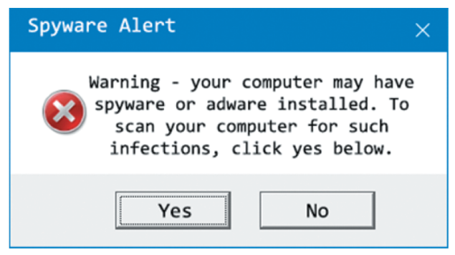
Spyware (2 of 2)
Figure 3-2 Spyware initiation program

Slide 18
Adware
Similar to spyware
  Installed without users being aware of their presence
Sometimes displays a banner that notifies users of its presence
Main purpose
  Determine a user’s purchasing habits
    Web browsers can then display advertisements tailored to the user
Security and privacy violation
  Gathers your purchasing habits
    Information is likely being sent back to the hackers that deployed the adware

Slide 19
Protecting against Malware Attacks (1 of 2)
Difficult task
  New viruses, worms, and Trojan programs appear daily
Antivirus programs
  Can detect many malware programs
Educate users about these attacks
  Users who aren’t trained thoroughly can open holes into a network that no technology can protect against

Slide 20
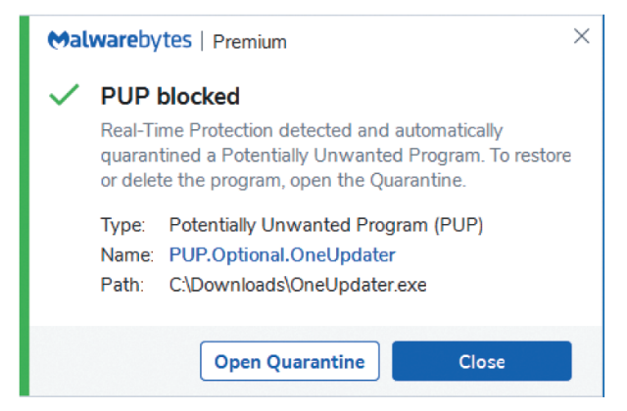
Protecting against Malware Attacks (2 of 2)
Figure 3-3 Detecting a virus

Slide 21
Educating Your Users (1 of 2)
Conducting structured training
  Includes all employees and management
  Email monthly security updates to all employees
  Recommend virus signature database updating
    Activate automatic updates
Actively phishing employees and sending them to training content if they click a link they should not click
White-listing
  Allows only approved programs to run on computers
Another recommendation to make is to update virus signature files as soon as they are available from the vendor

Slide 22
Educating Your Users (2 of 2)
Two popular spyware and adware removal programs:
  HitmanPro
  Malwarebytes Anti-Malware (MBAM)
Training employees on safe email practices and how to recognize and avoid phishing messages
Installing firewalls
  Software firewalls (for home and small-business users)
    For those who don’t have a hardware firewall or an intrusion detection system (IDS)

Slide 23
Avoiding Fear Tactics
Avoid scaring users into complying with security measures
  Sometimes used by unethical security testers
    Against the Open Source Security Testing Methodology Manual’s (OSSTMM) Rules of Engagement
Promote awareness rather than instill fear
  Users should be aware of potential threats, not terrified by them
  Build on the users’ existing knowledge
    Makes training easier

Slide 24
Intruder Attacks on Networks and Computers
Attack
  Any attempt by an unauthorized person to access, damage, or use network resources
  Usually happens when a weakness or a vulnerability is exploited
Exploit
  A specially crafted string of data intended to take advantage of a vulnerability
Network security
  Concerned with the security of computers or devices that are part of a network infrastructure
Computer security
  Concerned with the security of a stand-alone computing device that is not part of a network infrastructure
Computer crime
  Fastest growing type of crime worldwide

Slide 25
Denial-of-Service (DoS) Attack (1 of 2)
Prevents legitimate users from accessing network resources
Attackers do not attempt to access the information on a remote computer
  May just want to cripple the network
Conducting a DoS attack yourself is not wise
  Only explain how the attack could be carried out

Slide 26
Denial-of-Service (DoS) Attack (2 of 2)
Ping of Death attack
  Causes the victim computer to freeze and malfunction
  Not as common as it was during the late 1990s
  How it works
    Attacker creates a large ICMP packet
      More than the allowed 65,535 bytes
      Large packet is fragmented into smaller packets
      Reassembled at its destination
      User’s system at the destination point cannot handle the reassembled oversize packet
      Causes it to crash or freeze

Slide 27
Distributed Denial-of-Service Attacks
Distributed denial-of-service (DDoS) attack
  Attack on the host is launched from multiple servers or workstations
  Network could be flooded with billions of packets
    Available network bandwidth could drop
    Legitimate users may notice a performance degradation
  Often, participants are not aware their computers are part of the attack
    They, too, have been attacked
A Dark DDoS attack
  A smoke screen to distract network defenders while another, more damaging attack is occurring

Slide 28
Buffer Overflow Attacks
Attacker finds a vulnerability in poorly written code that doesn’t check for a defined amount of memory space use
Attacker writes code that overflows buffer
  Fills buffer with executable program code
  OS runs this code, and the attacker’s program does something harmful
  Code elevates the attacker’s permissions to an administrator’s level
    Or creates a service that allows an attacker to remotely access the target system
Ensure programmers are aware of how their code might be vulnerable to attack
DevSecOps
  Addresses the need for programmers to develop code with security in mind

Slide 29
Buffer Overflow Vulnerabilities (1 of 2)
Buffer overflow | Description
Cisco ASA Internet Key Exchange | Cisco Security Advisory for CVE-2016-1287 discusses a serious buffer overflow vulnerability in the Cisco ASA product line. Attackers could send a specially crafted packet to the affected device, allowing them to gain full administrative privileges. This attack could be carried out from anywhere on the Internet if ASAs are used on a company’s perimeter.
GHOST | This vulnerability made headlines across the globe when it was discovered by security researchers at Qualys. Community. Under the right conditions, GHOST could be exploited to gain administrative access to a remote system with no credentials. The vulnerability resulted from a weakness with the “glibc” library, a central component of Linux operating systems.
PAN-OS | In 2020, Palo Alto Networks released a fix for a buffer overflow vulnerability in its PAN-OS operating system found in many of its next-generation firewalls. A remote, unauthenticated attacker could use this vulnerability to disrupt system processes or to execute code.

Slide 30
Buffer Overflow Vulnerabilities (2 of 2)
Buffer overflow | Description
StageFright Android Overflow Vulnerability | Buffer overflows not only affect traditional operating systems but mobile devices as well. This vulnerability, CVE-2015-1538, was found in Android’s media playback libraries. Researchers found that a special MMS (Multimedia Messaging Service) message sent to a target Android device could cause an overflow, which allows for remote code execution without any user interaction.
VPN Product | In 2020, the NSA alerted administrators about buffer overflow vulnerabilities in three popular VPN products, namely Pulse Secure, Palo Alto GlobalProtect, and Fortinet FortiGate. The vulnerability allowed for arbitrary file downloads and remote code execution on some of these products.
Windows Server Service | Microsoft Security Bulletin MS08-067 discusses this buffer overflow vulnerability, which makes it possible for attackers to run arbitrary code placed in memory. This vulnerability allowed the infamous Conficker worm to spread.

Slide 31
Eavesdropping
An attacker can listen to unencrypted network communications
  To intercept confidential information or gather credentials that can be used to extend the attack
Accomplished with sniffing tools
  Sniffing tools are designed to capture copies of packets being sent across a network
To defend against the threat of eavesdropping
  Network equipment and applications should be forced to communicate only over encrypted protocols
    Use only valid, trusted certificates

Slide 32
Man-in-the-Middle Attacks
Attackers can inject themselves between two parties or systems communicating with one another
  To manipulate messages being passed back and forth

Slide 33
Network Session Hijacking
Enables an attacker to join a TCP session
  Attacker makes both parties think he or she is the other party
Complex attack beyond the scope of this book

Slide 34
Polling Activity 3-2
An exploit that attacks computer systems by inserting executable code in areas of memory because of poorly written code is called which of the following?
a. Buffer overflow
b. Trojan program
c. Virus
d. Worm
Notes:
Instructions:
1. Use this activity to solicit student opinions about concepts in the module or to play a game.
2. Go to kahoot.com, or the platform of your preference, and log in or sign up.
3. Create the challenge.
4. Teacher Tip: Turn off the timer to prioritize accuracy or turn on the nickname generator to avoid inappropriate nicknames.
5. Invite players by sharing the link or PIN.
6. This can be done synchronously during class or asynchronously for review or homework.

Slide 35
Polling Activity 3-2: Answer
An exploit that attacks computer systems by inserting executable code in areas of memory because of poorly written code is called which of the following?
Answer: a. Buffer overflow
In a buffer overflow attack, an attacker finds a vulnerability in poorly written code that doesn’t check for a defined amount of memory space use.

Slide 36
Addressing Physical Security
Protecting a network requires some basic skills
  Must secure servers and computers from an attack from within the organization
  Higher chance that an attacker who breaks into the network is from inside the company rather than outside

Slide 37
Keyloggers (1 of 2)
Hardware devices or software used to capture keystrokes on a computer
  Software
    Behaves like viruses or Trojans
  Hardware
    Small device that is easy to install
    Examples: KeyGrabber and KeyGhost
Can be used by organizations to monitor the activity of users on their computer systems
Available as software (spyware) loaded on a computer
  Retrieved information can be emailed or transferred to a remote location

Slide 38
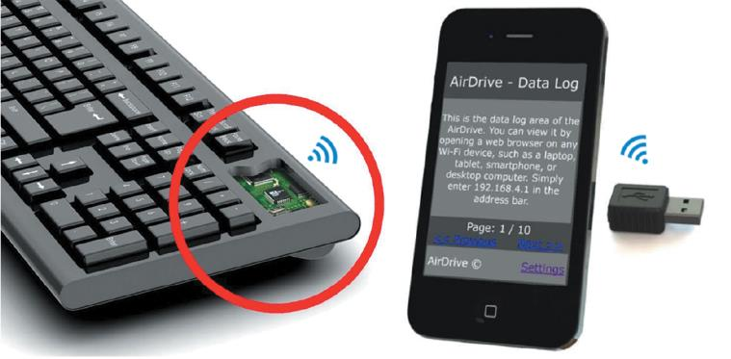
Keyloggers (2 of 2)
Figure 3-4 Wi-Fi USB keylogger, keylogger keyboard, and keylogger phone app

Slide 39
Behind Locked Doors
Lock up your servers
  Average person
    Can pick an American home lock in less than five minutes
    Those who have more time on their hands
      Can pick a deadbolt lock in under 30 seconds
Rotary locks are more difficult to crack than deadbolt locks
  Require pushing in a sequence of numbered bars
  Neither lock type keeps a record of who entered the locked room
  Security cards can be used for better security
Biometric security devices
  Read fingerprints or retinal scans and are used to restrict access to secure areas
  Provide a second authentication factor

