Slide 1
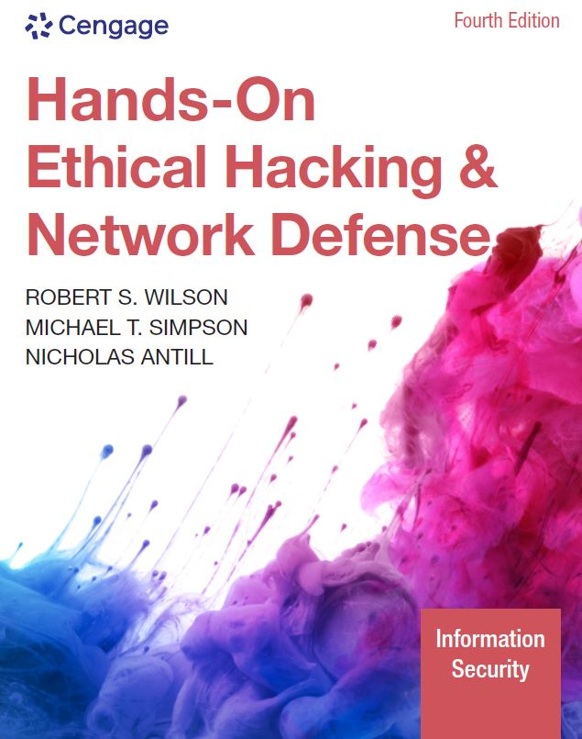
Hands-On Ethical Hacking and Network Defense,
Edition 4
Module 1: Ethical Hacking Overview
Simpson, Antill, Wilson, Hands-On Ethical Hacking and Network Defense, 4th Edition. © 2023 Cengage. All Rights Reserved. May not be scanned, copied or duplicated, or posted to a publicly accessible website, in whole or in part.

Slide 2
Introduction to Ethical Hacking
Ethical hackers
  Hired by companies to perform penetration tests
Penetration test
  Attempt to break into a company’s network to find the weak links
Vulnerability assessment
  Tester attempts to enumerate all vulnerabilities found in an application or on a system
Security test
  Tester analyzes a company’s security policy and procedures
  Reports any vulnerabilities to management

Slide 3
The Role of Security and Penetration Testers (1 of 5)
Hackers access computer system or network
  Without the authorization of the systems owner
    Considered as breaking the law; can go to prison
Crackers
  Break into systems to steal or destroy data
  The U.S. Department of Justice
    Labels all illegal access to a computer or network systems as hacking
Ethical hacker
  Performs most of the same activities a hacker does
    With the permission of the owner or company

Slide 4
The Role of Security and Penetration Testers (2 of 5)
Script kiddies or packet monkeys
  Derogatory terms to refer to younger, inexperienced people
  They copy code or use tools created by knowledgeable programmers without understanding how they work
Programs or scripts used by experienced penetration testers
  To carry out attacks
  Python, Ruby, Perl, or C
  Script
    A set of instructions
    Runs in sequence to perform tasks on a computer system

Slide 5
The Role of Security and Penetration Testers (3 of 5)
Hacktivist
  A person who hacks computer systems for political or social reasons
Penetration testers
  Usually have a laptop computer with multiple OSs and hacking tools

Slide 6
The Role of Security and Penetration Testers (4 of 5)
Job requirements for a penetration tester might include:
  Perform vulnerability, attack, and penetration assessments
    In Internet, Intranet, and wireless environments
  Perform discovery and scanning
    For open ports and services
  Apply appropriate exploits
    To gain access and expand access as necessary

Slide 7
The Role of Security and Penetration Testers (5 of 5)
  Participate in activities
    Involving application penetration testing and application source code review
  Interact with the client as required throughout the engagement
  Produce reports documenting discoveries during the engagement
  Debrief with the client at the conclusion of each engagement
  Participate in research and provide recommendations
    For continuous improvement
  Participate in knowledge sharing
  Demonstrate a good understanding of current country, state, and city cyber laws

Slide 8
Penetration-Testing Methodologies (1 of 3)
White box model
  The tester is told what network topology and technology the company is using
    May be given a floor plan
  Tester is permitted to interview IT personnel and company employees
    Makes the penetration tester’s job easier
Black box model
  Staff is not aware of the test
  Tester is not given any diagrams or details about the technologies used
    Burden is on the tester to find details using different techniques
  Tests security personnel’s ability to detect an attack

Slide 9
Penetration-Testing Methodologies (2 of 3)
Gray box model
  Hybrid of the white and black box models
  Company gives tester only partial information
    Example: OSs are used, but no network diagrams

Slide 10
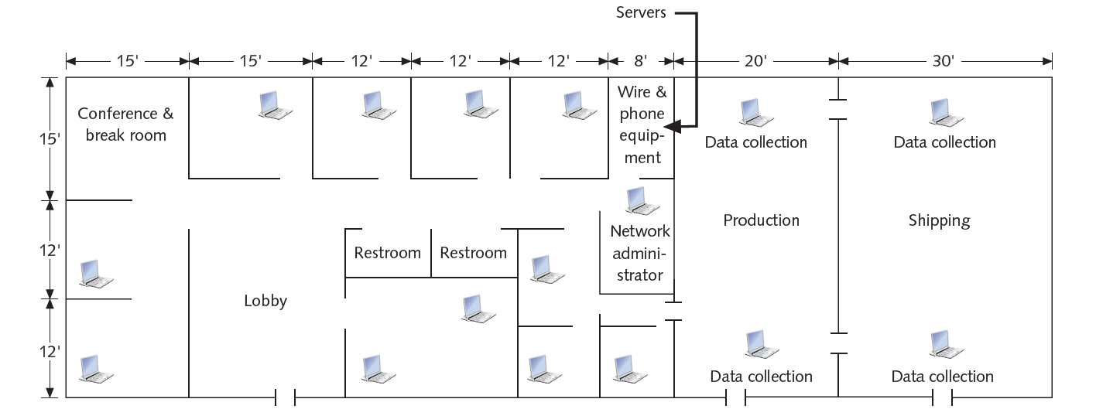
Penetration-Testing Methodologies (3 of 3)
Figure 1-1 A sample floor plan

Slide 11
Certification Programs for Network Security Personnel
Certification programs
  Available in almost every area of network security
Minimum certification
  CompTIA Security+ certification or have equivalent knowledge
    Prerequisite for Security+ certification is CompTIA Network+ level of knowledge

Slide 12
CompTIA PenTest+
Advanced certification that verifies successful candidates have the knowledge and skills required to:
  Plan and scope an assessment
  Understand legal and compliance requirements
  Perform vulnerability scanning and penetration testing
  Analyze data
  Effectively report and communicate results

Slide 13
Offensive Security Certified Professional (OSCP)
OSCP
  An advanced certification that requires students to demonstrate hands-on abilities to earn their certificates
  Covers network and application exploits
  Gives students experience in:
    Developing rudimentary buffer overflows
    Writing scripts to collect and manipulate data
    Trying exploits on vulnerable systems

Slide 14
Certified Ethical Hacker
Developed by the International Council of Electronic Commerce Consultants (EC-Council)
  The multiple-choice Certified Ethical Hacker (CEH) exam is based on 22 domains the tester must be familiar with
  EC-Council website
Most likely to be placed on a team that conducts penetration tests
  Called a Red team
    Composed of people with varied skills who perform the tests
    Unlikely that one person will perform all tests

Slide 15
O S S T M M Professional Security Tester (OPST)
Open Source Security Testing Methodology Manual (O S S T M M) Professional Security Tester
  Designated by the Institute for Security and Open Methodologies (ISECOM)
  The OPST certification uses the O S S T M M as its standardized methodology
  Written by Peter Herzog
  Five main topics (i.e., professional, enumeration, assessments, application, and verification)
  ISECOM website

Slide 16
Certified Information Systems Security Professional (C I S S P)
C I S S P
  Issued by the International Information Systems Security Certification Consortium (ISC²)
  Not geared toward technical IT professionals
  Tests security-related managerial skills
    Usually more concerned with policies and procedures
  Consists of questions from ten domains
  ISECOM website

Slide 17
SANS Institute
SysAdmin, Audit, Network, Security (SANS) Institute
  Offers training and IT security certifications through Global Information Assurance Certification (GIAC)
Top 25 Software Errors list
  One of the most popular SANS Institute documents
  Details most common network exploits
  Suggests ways of correcting vulnerabilities
  SANS website

Slide 18
Which Certification Is Best?
Penetration testers and security testers
  Need technical skills to perform duties effectively
  Must also have:
    A good understanding of networks and the role of management in an organization
    Skills in writing and verbal communication
    Desire to continue learning
Danger of certification exams
  Some participants simply memorize terminology
    Don’t have a good grasp of subject matter or complex concepts

Slide 19
What You Can Do Legally
Laws involving technology change as rapidly as technology itself:
  As a security tester, you should:
    Keep abreast of what’s happening in your area
      Find out what is legal for you locally
    Be aware of what is allowed and what you should not or cannot do
      Laws vary from state to state and country to country
    Example: In some states, the possession of lockpicking tools constitutes a crime

Slide 20
Laws of the Land
Having hacking tools on your computer might be illegal
  Contact local law enforcement agencies before installing hacking tools
Laws are written to protect society
  Written words are open to interpretation
  Example: In Hawaii, the state must prove that the person charged with committing a crime on a computer had the “intent to commit a crime”
Make sure you’re aware of the dangers of being a security tester

Slide 21
Overview of Recent Hacking Cases (1 of 3)
State and Year | Description
Kansas, 2021 | A resident of Ellsworth County, Kansas, was charged with one count of tampering with a public water system and one count of reckless damage to a protected computer during unauthorized access. The indictment alleged that a former employee knowingly accessed the Ellsworth County Rural Water District’s protected computer system without authorization. During this unauthorized access, the accused allegedly performed activities that shut down the processes at the facility, which affected cleaning and disinfecting procedures, with the intention of harming the public drinking water system. If found guilty, the accused faces up to 25 years in prison and a fine of up to $500,000 for illegally accessing the protected computer and tampering with the water system.
California, 2021 | A former employee of an IT consulting firm accessed the server of a company in Carlsbad, California, and deleted more than 1,200 of the company’s 1,500 Microsoft user accounts. The employee was apparently retaliating for being fired. The attack affected most of the Carlsbad company’s employees so that they could not access email or other network services, effectively shutting down the company for days and causing continuous IT problems for three months. The former contractor was sentenced in federal court to two years in prison and ordered to pay the company more than $560,000.

Slide 22
Overview of Recent Hacking Cases (2 of 3)
State and Year | Description
Nevada, 2021 | A Russian national offered $1 million to an employee of Tesla’s electric battery plant in Nevada in a scheme to have the insider introduce malicious software into the company’s computer network. The malware attack was designed to extract data from the company’s network and then demand a ransom for its return. The ransomware case is considered unusual because it involves face-to-face bribery rather than anonymous hacking via the Internet. Such an attack typically carries a penalty of up to five years in prison and a $250,000 fine.
Atlanta, 2021 | A Cypriot national hacked into major websites as a teenager and threatened that he would release stolen user information unless the websites paid a ransom. The hacker identified vulnerable websites, including those for sports news and online games, and then stole personally identifiable information from user and customer databases. He became the first Cypriot national extradited from Cyprus to the United States, and paid nearly $600,000 in restitution to his victims. In addition, he has been sentenced to federal prison for at least three years.

Slide 23
Overview of Recent Hacking Cases (3 of 3)
State and Year | Description
New Jersey, 2021 | While employed at a data analytics and risk assessment firm based in New Jersey, a resident of Moorefield, Nebraska, obtained confidential information that belonged to the firm—including names, passwords, email addresses, and telephone numbers of clients—and then attempted to sell the information. Nearly two years after his arrest, the hacker was sentenced to three years of supervised release and ordered to pay restitution of more than $290,000.
Florida, 2021 | A Florida high school conducted online voting to select a homecoming queen but found out that an assistant principal in the school district manipulated the vote electronically. She accessed a network database storing confidential student information—including grades, medical history, and credentials—and then used the credentials to cast ballots in favor of her daughter. The pair were arrested and charged with fraudulently accessing confidential student information. The daughter was expelled from the high school, and her mother was suspended from her job as they awaited sentencing.

Slide 24
Is Port Scanning Legal? (1 of 3)
Some states consider it noninvasive or nondestructive in nature and deem it legal
  Not always the case
  Be prudent before using penetration-testing tools
Federal government does not see infringements, such as port scanning, as a violation of the U.S. Constitution
  Allows each state to address them separately
    Research your state laws before using what you learn
Read your ISP’s “Acceptable Use Policy”

Slide 25
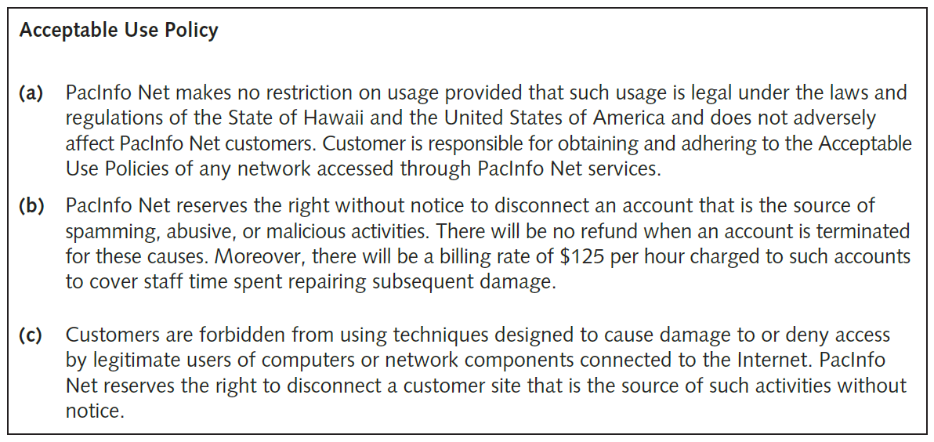
Is Port Scanning Legal? (2 of 3)
Figure 1-3 Sample acceptable use policy

Slide 26
Is Port Scanning Legal? (3 of 3)
Internet Relay Chat (IRC) bot
  Program that sends automatic responses to users
  Gives the appearance of a person on the other side of a connection
Virtual private network (VPN)
  Consider whether your computer is connected to your business network by a VPN
    Many people work from home using a VPN to connect to their work network
    May end up scanning work computers, which could be problematic

Slide 27
Federal Computer Crime Laws (1 of 4)
Federal law | Description
The No Electronic Theft Act (P.L. 105 to 147) | Extends the reach of criminal copyright law to specifically include electronic means as one method for committing the crime (17 U.S.C. § 501(a)(1)). The act also expands the scope of the criminal conduct covered under this crime, allowing for prosecutions without showing that the distributor of the copyrighted material profited from the activity.
The Economic Espionage Act (EEA) | The EEA offers trade secret protection to both businesses and the government. The significance of information to society and the problems that are attached to protecting this information make the EEA an important step in how the law can provide protection from computer crime.
The Computer Fraud and Abuse Act (CFAA). Title 18, Crimes and Criminal Procedure. Part I: Crimes, Chapter 47, Fraud and False Statements, Sec. 1030: Fraud and related activity in connection with computers | This law makes it a federal crime to access classified information or financial information without authorization.

Slide 28
Federal Computer Crime Laws (2 of 4)
Federal law | Description
The Identity Theft and Assumption Deterrence Act (ITADA) [18 U.S.C. Section 1028(a)(7)] | This act criminalizes identity theft and allows courts to assess the losses suffered by individual consumers. While the CFAA covers certain aspects of identity theft, the ITADA addresses restitution and relief for the victims.
Electronic Communication Privacy Act. Title 18, Crimes and Criminal Procedure. Part I: Crimes, Chapter 119, Wire and Electronic Communications Interception and Interception of Oral Communications, Sec. 2510: Definitions and Sec. 2511: Interception and disclosure of wire, oral, or electronic communications prohibited | These laws make it illegal to intercept any communication, regardless of how it was transmitted.
U.S. PATRIOT Act, Sec. 217. Interception of Computer Trespasser Communications | This act largely seeks to amend previous privacy and surveillance laws and fund government surveillance programs. It also specifies ways for the government to monitor individuals and allows victims of cybercrimes to monitor the activity of trespassers on their systems.

Slide 29
Federal Computer Crime Laws (3 of 4)
Federal law | Description
Homeland Security Act of 2002, H.R. 5710, Sec. 225: Cyber Security Enhancement Act of 2002 | This amendment to the Homeland Security Act of 2002 specifies sentencing guidelines for certain types of computer crimes.
The Computer Fraud and Abuse Act. Title 18, Crimes and Criminal Procedure, Sec. 1029: Fraud and related activity in connection with access devices | This law makes it a federal offense to manufacture, program, use, or possess any device or software that can be used for unauthorized use of telecommunications services.

Slide 30
Federal Computer Crime Laws (4 of 4)
Federal law | Description
Stored Wire and Electronic Communications and Transactional Records Act. Title 18, Crimes and Criminal Procedure. Part I: Crimes, Chapter 121, Stored Wire and Electronic Communications and Transactional Records Act, Sec. 2701: Unlawful access to stored communications (a) Offense. Except as provided in subsection of this section whoever (1) intentionally accesses without authorization a facility through which an electronic communication service is provided; or (2) intentionally exceeds an authorization to access that facility; Sec. 2702: Disclosure of contents | This law defines unauthorized access to computers that store classified information.

Slide 31
What You Cannot Do Legally
Illegal actions:
  Accessing a computer without permission
  Destroying data without permission
  Copying information without the owner’s permission
  Installing viruses on a network
  Denying users access to network resources
Be careful that your actions do not prevent client’s employees from doing their jobs

Slide 32
Get It in Writing
Using a contract is good business
  May be useful in court
Books on working as an independent contractor
  Getting Started in Consulting by Alan Weiss
  The Consulting Bible: Everything You Need to Know to Create and Expand a Seven-Figure Consulting Practice by Alan Weiss
Internet can also be a helpful resource
  Will find free modifiable contract templates
Have an attorney read your contract before signing

Slide 33
Ethical Hacking in a Nutshell
Skills needed to be a security tester
  Knowledge of network and computer technology
  Ability to communicate with management and IT personnel
  An understanding of the laws applicable in your location
  Ability to apply necessary tools to perform your tasks

