Slide 1
Chapter 5 – Protecting Security of Assets

Slide 2
Defining Sensitive Data
Personally Identifiable Information (PII)
  NIST SP 800-122
Protected Health Information (PHI)
  HIPAA and makes it broad
Proprietary Data
  Think about the previous chapter

Slide 3
Defining Data Classifications
Top Secret
Secret
Confidential
Unclassified

Slide 4
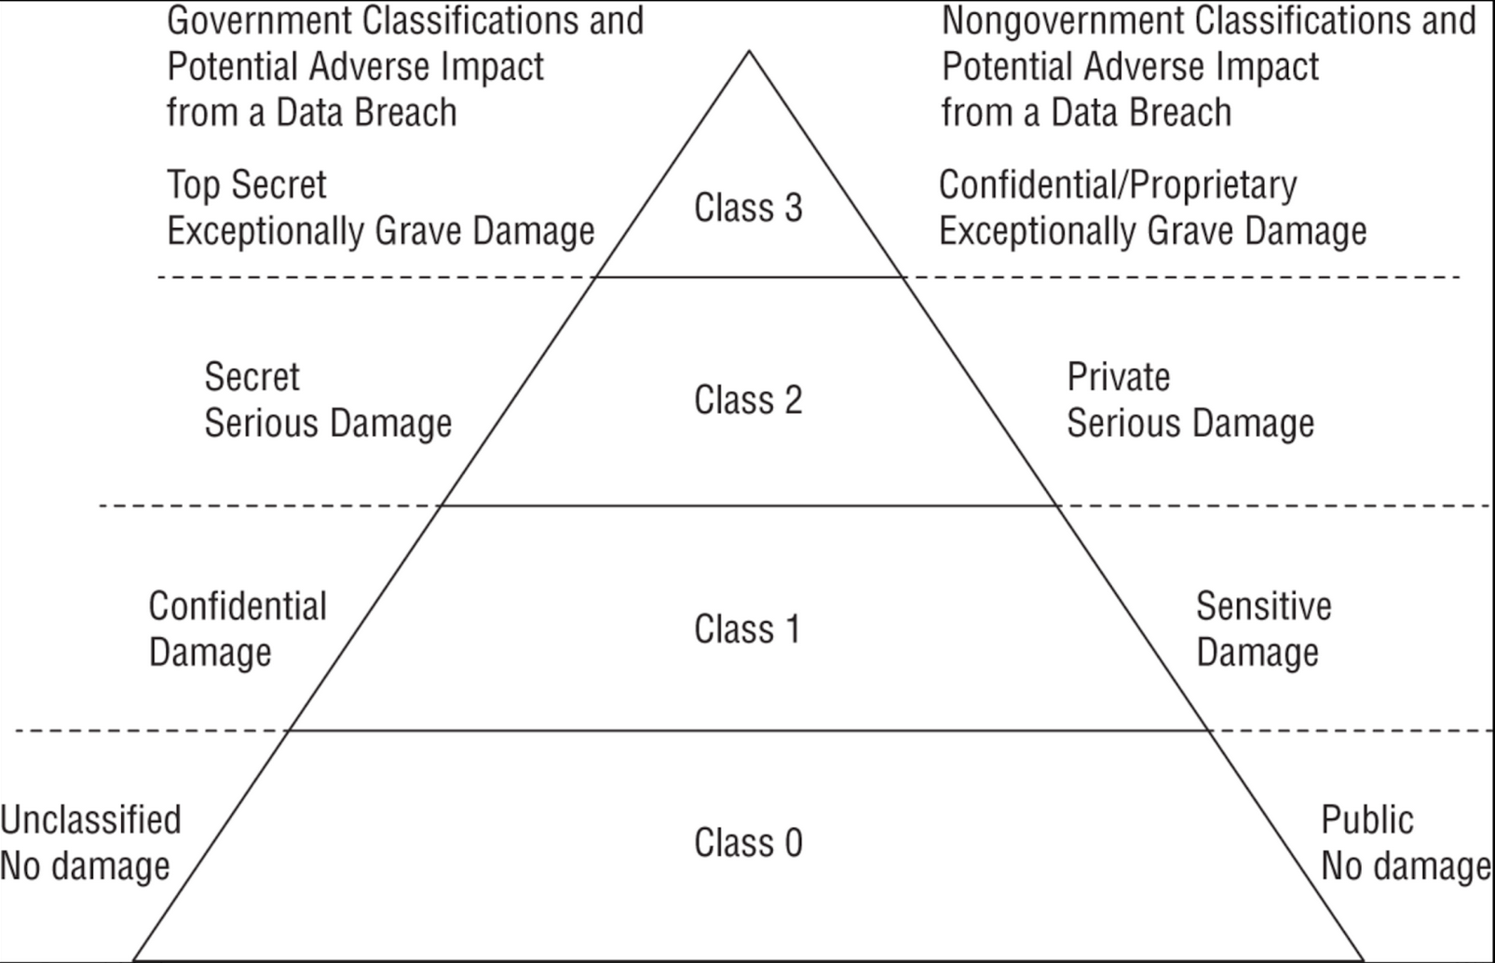
Defining Data Classifications

Slide 5
Defining Asset Classifications
Asset classification should match the data classifications
For example: A computer that process top secret data, then the computer is considered a top secret asset

Slide 6
Understanding Data States
Data at Rest
Data in Transit
Data in Use

Slide 7
Compliance Requirements
Type of data matters
This relates back to Chapter 4

Slide 8
Determining Data Security Controls
How would you put controls on the following:
  Confidential/Proprietary
  Private
  Sensitive
  Public

Slide 9
Information Handling Requirements
Data Maintenance
Data Loss Prevention
  Network DLP, Cloud DLP, Endpoint DLP
Labeling Sensitive Data and Assets

Slide 10
Handling Sensitive Information/Assets
Data Collection Limitation
Data Location
Storing Sensitive Data

Slide 11
Data Destruction
Eliminating Data Remanence
Common Data Destruction Methods
  Erasing, Purging, Degaussing, Destruction
Cryptographic Erasure

Slide 12
Appropriate Data & Asset Retention
Record Retention
EOL (End of Life)
EOS (End of Support)

Slide 13
Data Protection Methods
We talked about DLP
Digital Rights Management
  DRM License
  Persistent Online Authentication
  Continuous Audit Trail
  Automatic Expiration

Slide 14
Cloud Access Security Broker (CASB)
Software between users and cloud based resources
Authentication and Authorization
Detects shadow IT

Slide 15
Pseudonyminzation
Pseudonym for different data sets
Prevents data from identifying an entity or person
You can still reverse the data

Slide 16
Tokenization
Registration
Usage
Validation
Completing a Sale
Even if someone took a token, it’s extremely difficult to use unless at the time

Slide 17
Anonymization
If you don’t need personal data, another option is to remove all relevant data
You can’t detect the original subject or person
Randomized
You can’t get the data back

Slide 18
Understanding Data Roles
Data Owners (CEO, President, Department Head, etc.)
Data Controllers and Processors (persons collection and use of data)
Data Custodians (Properly stored/protected)
Users and Subjects (Personal Information)

Slide 19
Using Security Baselines
Low-Impact Systems
Moderate-Impact Systems
High-Impact Systems
Privacy Control Baseline

Slide 20
Comparing Tailoring and Scoping
After selecting a control baseline, we need to fine-tune it
Tailoring is to modify your baseline
NIST SP 800-53B
Standards Selection
  PCI DSS, GDPR, NIST CSF, CIS, CMMC, etc.

