Slide 1
Chapter 11: Secure Network Architecture and Components

Slide 2
OSI Model
Communication is only possible between protocols
OSI History
OSI Functionality

Slide 3
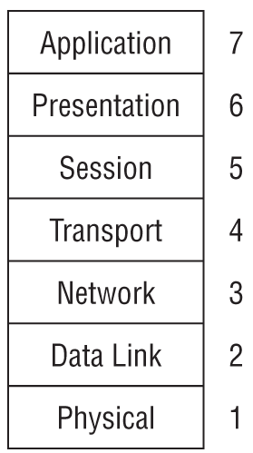
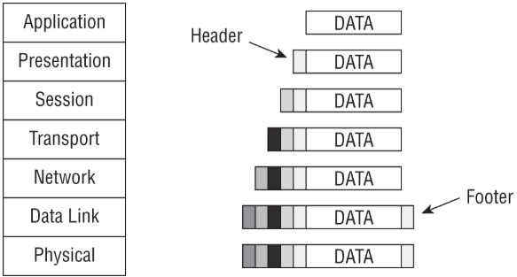
OSI Model

Slide 4
Analyzing Network Traffic
Protocol Analyzer
Any tools you can think of?

Slide 5
Common Application Layer Protocols
Telnet, FTP, TFTP, SMTP, POP3, IMAP4, DHCP, HTTP, HTTPS, LPD, X Window, NFS, SNMP

Slide 6
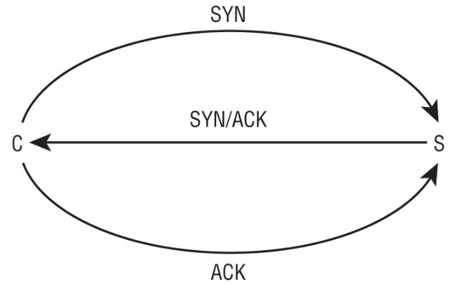
Transport Layer Protocols
Transmission Control Protocol (TCP)
User Datagram Protocol (UDP)

Slide 7
Domain Name System
Domain Name
IP Address
MAC Address
DNS, what does it do exactly?

Slide 8
Domain Name System
Top-level domain (TLD) — The com in www.google.com
Registered domain name —The google in www.google.com
Subdomain(s) or hostname — The www in www.google.com

Slide 9
Domain Name System
DNSSEC
DNS Poisoning
Rougue DNS Server
DNS Cache Poisoning
DNS Pharming
Altering the Hosts File

Slide 10
Domain Name System
Corrupt the IP Configuration
DNS Query Spoofing
Use Proxy Falsification
Defenses to DNS Poisoning?

Slide 11
Domain Name System
Corrupt the IP Configuration
DNS Query Spoofing
Use Proxy Falsification
Defenses to DNS Poisoning?

Slide 12
Internet Protocol (IP) Networking
IPv4 vs. IPv6
IP Classes
Class A = /8
Class B = /16
Class C = /24

Slide 13
Internet Protocol (IP) Networking
Internet Control Message Protocol (ICMP)
Internet Group Management Protocol (IGMP)

Slide 14
ARP Concerns
Address Resolution Protocol (ARP)
ARP Spoofing
Unsolicited ARP

Slide 15
Secure Communication
IPSec
Kerberos
SSH
Single Protocol
Secure RPC
TLS/SSL

Slide 16
Implications of Multiplayer Protocols
TCP/IP is a multilayer protocol
[ Ethernet [ IP [ TCP [ HTTP [Payload] ] ] ] ]
[ Ethernet [ IP [ TCP [ TLS [ HTTP [Payload] ] ] ] ] ]
[ Ethernet [ IPSec [ IP [ TCP [ TLS [ HTTP [Payload] ] ] ] ] ] ]

Slide 17
Convereged Protocols
Storage Area Network (SAN)
Internet Small Computer Systems Interface (iSCSI)
InfiniBand over Ethernet (IBoE)
Voice over Internet Protocol (VoIP)
Software-Defined Networking (SDN)

Slide 18
Segmentation
Bosting Network Performance
Reducing Communication Problems
Providing Security
Edge Networks

Slide 19
Wireless Networks
802.11 is the IEEE standard
Ad hoc mode
Wireless Access Point (WAP)
Extended Service Set Identified (ESSID)

Slide 20
Securing the SSID
Service Set Identifier (SSID)
Disable SSID broadcasting, not really securing it entirely.
Use WPA2 or WPA3 to have encrypted channels

Slide 21
Wireless Channels
2.4GHz
5 GHz

Slide 22
Wireless Security
Service Set Identifier (SSID)
Disable SSID broadcasting, not really securing it entirely.
Use WPA2 or WPA3 to have encrypted channels
Wi-Fi Protected Setup (WPS)

Slide 23
Wireless Security
Wireless MAC Filter
Wireless Antenna Management
Captive Portals

Slide 24
Wireless Communications
Bluetooth
Bluesniffing
Bluejacking
Bluesnarfing
Bluebugging

Slide 25
Wireless Communications
Radio Frequency Identification (RFID)
Near-Field Communication (NFC)
War-Driving
Rouge Access Points
Evil Twin
Disassociation

Slide 26
Wireless Communications
Jamming
Initialization Vector (IV) Abuse
Replay Attack
Satellite Communications
Cellular Networks
Content Distribution Networks (CDNs)

Slide 27
Common Network Equipment
Repeaters/Amplifiers
Multiplexer
Hubs
Modems
Bridges
Switches

Slide 28
Common Network Equipment
Routers
LAN Extenders
Jumpbox
Sensor
Collector
Aggregators

Slide 29
Common Network Equipment
Network Access Control (NAC)
Firewalls
Static Packet-Filtering Firewalls
Application-Level Firewalls
Circuit-Level Firewalls
Stateful Inspection Firewalls

Slide 30
Common Network Equipment
Next-Gen Firewalls (NGFWs)
Internal Segmentation Firewall (ISFW)
Proxy
Content/URL Filter

Slide 31
Endpoint Security
Transmission Media
Coaxial Cable
Baseband and Broadband Cables
Twisted Pair
Conductors
Fiber-Optic Cables

Slide 32
Endpoint Security
Transport Architecture
Network Topologies
  Ring Topology
  Bus Topology
  Star Topology
  Mesh Topology

