Slide 1
Chapter 14: Controlling and Monitoring Access

Slide 2
Comparing Access Control Models
Subject?
Object?
What was the last chapter about?

Slide 3
Comparing Access Control Models
Subject – active entity that accesses a passive object
Object – passive entity that provides information to active subjects
After authenticating subjects, now we need to focus on access

Slide 4
Permissions, Rights, & Privileges
Permissions?
Rights?
Privileges?

Slide 5
Understanding Authorization
Implicit Deny
Access Control Matrix
Capability List
Constrained Interface
Content-Dependent Control
Context-Dependent Control

Slide 6
Understanding Authorization
Need to Know
Least Privilege
Separation of Duties and Responsibilities

Slide 7
Defining Requirements – Security
What is a security policy?

Slide 8
Introducing Access Control Models
Discretionary Access Control
Role-Based Access Control (RBAC)
Rule-Based Access Control
Attribute-Based Access Control (ABAC)
Mandatory Access Control (MAC)
Risk-Based Access Control

Slide 9
Discretionary Access Control
What is it?
Is there something you can see this being used in?

Slide 10
Nondiscretionary Access Control
What is it?
Why is this different from discretionary access control?

Slide 11
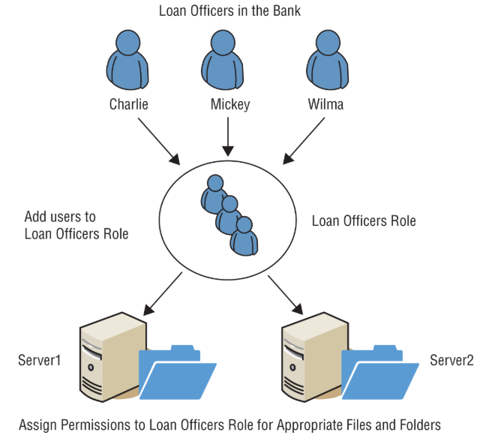
Role-Based Access Control
Pros?
Any Issues?

Slide 12
Rule-Based Access Control
Rules, restriction, and filters
Any idea what this is used in?

Slide 13
Attribute-Based Access Control
Characteristic of users, the network, and devices
Any idea what this is used in?

Slide 14
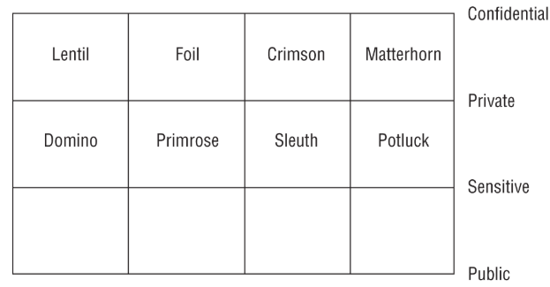
Mandatory Access Control (MAC)
Classification labels

Slide 15
Mandatory Access Control (MAC)
Hierarchical Environment
Compartmentalized Environment
Hybrid Environment

Slide 16
Risk-Based Access Control
Relatively New
  Environment
  Situation
  Security policies
Multifactor Authentication
Compliant Mobile Devices

Slide 17
Implementing Authentication Systems
Implementing SSO on the Internet
  XML
  SAML
  OAuth
  OpenID Connect

Slide 18
Comparing SAML, OAuth, OpenID
SAML
  SAML 2.0 is an open XML-based standard
  OASIS adopted it as a standard in 2005
  It utilizes three entities: a principal (such as a user), a service provider (such as a website), and an identity provider (a third party that holds the authentication and authorization information)
  It can provide authentication, authorization, and attribute information on the principal.

Slide 19
Comparing SAML, OAuth, OpenID
OAuth
  It's an authorization framework, not an authentication protocol
  RFC 6749 describes OAuth 2.0
  It exchanges information using APIs
  An app obtains an access token from an identity provider
  Later, the app includes the access token for authorization

Slide 20
Comparing SAML, OAuth, OpenID
OpenID Connect
  OIDC is an authentication layer using OAuth 2.0
  It provides both authentication and authorization
  It builds on OpenID (a deprecated standard) but uses a JSON Web Token

Slide 21
Implementing SSO Internal Networks
AAA Protocols
VPNs
NASs
Etc

Slide 22
Implementing SSO Internal Networks
Kerberos
  Key Distribution Center
  Kerberos Authentication Server
  Ticket
  Ticket-Granting Ticket
  Kerberos Principal
  Kerberos Realm

Slide 23
Implementing SSO Internal Networks
Remote Authentication Dial-In User Service (RADIUS)
TACACS+

Slide 24
Zero-Trust Access Policy Enforcement
What is Zero-Trust?

Slide 25
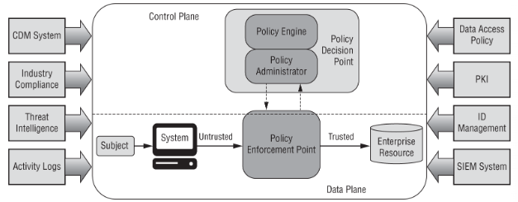
Zero-Trust Access Policy Enforcement

Slide 26
Understanding Access Control Attacks
Privilege Escalation
Using the su and sudo commands
PowerShell
Password Attacks
Dictionary Attacks
Brute-Force Attacks

Slide 27
Understanding Access Control Attacks
Spraying Attacks
Credential Stuffing Attacks
Birthday Attacks
Rainbow Table Attacks
Mimikatz
Pass-the-Hash Attacks

Slide 28
Understanding Access Control Attacks
Overpass the Hash
Pass the Ticket
Silver Ticket
Golden Ticket
Kerberos Brute Force
ASREPRoast

Slide 29
Understanding Access Control Attacks
Kerberoasting
Sniffer Attacks
Spoofing Attacks

Slide 30
Core Protection Methods
Control Physical Access to Systems
Control Electronic Access to Files
Hash and Salt Passwords
Use Password Masking
Deploy MFA
Account Lockout

Slide 31
Core Protection Methods
Use Last Logon Notification
Educate Users about Security

