Slide 1
Chapter 16: Managing Security Operations

Slide 2
Managing Security Operations
What does that mean to you?

Slide 3
Applying Sec Ops Concepts
Whose job is security?
IT?
Security?
What does it look like?

Slide 4
Need-to-Know & Least Privilege
Need-to-Know
The Principle of Least Privilege

Slide 5
Other Sec Ops Concepts
Segregation of Duties (SoD)
Two-Person Control
Job Rotation
Mandatory Vacations

Slide 6
Other Sec Ops Concepts
Privileged Account Management (PAM)
Detecting APTs
Service-Level Agreements (SLAs)

Slide 7
Address Personnel Safety & Security
Duress
Travel
Emergency Management
Security Training and Awareness

Slide 8
Provision Info & Asset Securely
Information and Asset Ownership
Asset Management
  Hardware
  Software
  Intangible

Slide 9
Media Management
Media Protection Techniques
Controlling USB Flash Drives
Tape Media
Mobile Device
Managing Media Life Cycle

Slide 10
Managed Services in the Cloud
What is the cloud?
Shared Responsibility with Cloud Service Models

Slide 11
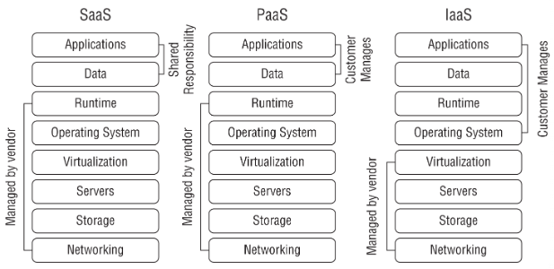
Managed Services in the Cloud

Slide 12
Managed Services in the Cloud
XaaS (Anything as a Service)
Scalability and Elasticity
Service Integration
Servless Architecture

Slide 13
Perform Configuration Management
Configuration Management (CM)
Provisioning
Baselining
Using Images for Baselining
Automation

Slide 14
Manage Change
How would you do it?

Slide 15
Manage Change
Request the Change
Review the Change
Approve/Reject the Change
Test the Change
Schedule and Implement the Change
Document the Change

Slide 16
Manage Change
Versioning
Configuration Documentation

Slide 17
Manage Patches and Reduce Risk
System to Manage
Patch Management
  Evaluate patches
  Test patches
  Approve the patches
  Deploy the patches
  Verify that patches are deployed
  Patch Tuesday and Exploit Wednesday!

Slide 18
Manage Patches and Reduce Risk
Vulnerability Management
Vulnerability Scans
Common Vulnerabilities and Exposures (CVE)

