Slide 1
Chapter 17: Preventing and Responding to Incidents

Slide 2
Conducting Incident Management
Defining an Incident

Slide 3
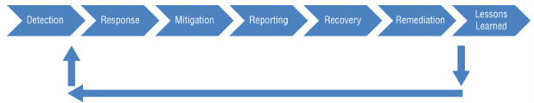
Incident Management Steps

Slide 4
Implementing Detecting & Preventive
Preventive Controls
Detection Controls

Slide 5
Basic Preventive Measures
Keep Systems and Applications Up-to-Date
Remove or Disable Unneeded Services and Protocols
Use IDS/IPS Systems
Use Up-to-Date Anti-Malware Software
Use Firewalls
Implement Config and System Process

Slide 6
Understanding Attacks
Botnets
Denial-of-Service
SYN Flood Attack
Smurf and Fraggle Attacks
Ping Flood
Zero-Day Exploit

Slide 7
Understanding Attacks
Man-in-the-Middle/On-Path Attacks
Sabotage

Slide 8
IDS/IPS
Intrusion?
Knowledge Based Detection
Behavior Based Detection
False Positive or True Negatives?

Slide 9
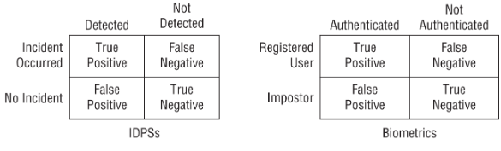
IDS/IPS

Slide 10
IDS/IPS
IDS Response
Host-Based IDS
Network Based IDS
What’s the difference between IDS and IPS?

Slide 11
Specific Preventive Measures
Honeypots and Honeynets
Warning Banners
Anti-Malware
Whitelisting and Blacklisting
Firewalls
Sandboxing

Slide 12
Logging and Monitoring
Security Logs
Systems Logs
Application Logs
Firewall Logs
Proxy Logs
Change Logs
Protecting Log Data

Slide 13
Role of Monitoring
Audit Trails
Accountability
Investigations
Problem Identification
Tuning Techniques
SIEMs

Slide 14
Automating Incident Response
Understanding SOAR
Machine Learning and AI Tools
Threat Intelligence
Understanding the Kill Chain Model
MITRE ATT&CK Framework
Threat Feeds
Threat Hunting

Slide 15
SOAR, ML, AI, and Threat Feeds
Is there a use case?

