Slide 1
Chapter 2 – Personnel Security and Risk Management Concepts

Slide 2
Personnel Security
What is the weakest link and why?

Slide 3
Personnel Security
To apply security governance, we must address the weakest link in this chain – people
On the flip side, this is our greatest security asset when properly trained
Users, developers, managers, vendors, consultants, etc.

Slide 4
Job Descriptions and Responsibilities
Job Description
Job Responsibilities
Candidate Screening

Slide 5
Onboarding
Security-focused organization, the process of onboarding will be heavily on security policies
Identity and Access Management (IAM)
Principle of Least Privilege
Employment Agreement
Acceptable Use Policy (AUP), Nondisclosure Agreement (NDA), Non-Compete (CNC)

Slide 6
Employee Oversight
Mandatory Vacations
Collusion – Several people working to commit a crime
User Behavior Analytics (UBA) and User and Entity Behavior Analytics (UEBA)

Slide 7
Offboarding, Transfers, Termination
Offboarding is the removal of an employee’s identity from the IAM system once that person left
Transfers is when there’s a position, department, or organizational change
A strong relationship between the security and HR department is highly needed

Slide 8
Offboarding, Transfers, Termination
Termination is to reduce the risk while treating the person with respect
Exit interview is to understand why an employee is leaving and their experience

Slide 9
Risk Management Concepts
Risk management is the process of identifying factors that could damage or disclose assets, evaluate those factors in light of asset value and countermeasure cost, and implement cost effective solutions for mitigating or reducing risk.

Slide 10
Risk Management Concepts
There are two primary elements:
  Risk Assessment
  Risk Response
Risk Awareness

Slide 11
Risk Terminology and Concepts
Asset
Asset Valuation
Threats
Threat Agent/Actors
Threat Events
Threat Vector

Slide 12
Risk Terminology and Concepts
Vulnerability
Exposure
Risk
Safeguards
Attack
Breach

Slide 13
Risk Terminology and Concepts
Hazard

Slide 14
Risk Terminology and Concepts
Assets → which are endangered by → Threats → exploit → Vulnerabilities → which results in → Exposure → which is → Risk → which is mitigated by → Safeguards → which protects → Assets

Slide 15
Asset Valuation
Asset based risk analysis
Think about it?
Is this easy to do?

Slide 16
Identify Threats and Vulnerabilities
NIST SP 800-30r1 Appendix D (Threat Sources) and Appendix E (Threat Events)
The Consultant Cavalry

Slide 17
Risk Assessment/Analysis
Risk is all relative and there’s no way to eliminate 100% of all risk
Quantitative Risk Analysis
Qualitative Risk Analysis
Both are needed in cybersecurity

Slide 18
Qualitative Risk Analysis
Scenario-based, perception-based, gut reaction-based
Judgment, intuition, and experience
NIST SP 800-30 rev 1 (Tables D-3, D-4, D-5, D-6, and E-4) csrc.nist.gov/pubs/sp/800/30/r1/final
Delphi Technique aka anonymous surveys

Slide 19
Quantitative Risk Analysis
Probability indication or a numeric indication
Asset valuation and threat identification
There are six major steps but can vary from organization to organization

Slide 20
Quantitative Risk Analysis
Assign asset value (AV)
Calculate exposure factor (EF)
Calculate single loss expectancy (SLE)
Asses the annualized rate of occurrence (ARO)
Derive the annualized loss of expectancy (ALE)
Perform cost/benefits analysis of countermeasures

Slide 21
Exposure Factor (EF)
The percentage of loss that an organization would experience if a specific asset were violated by a realized risk
Also know as loss potential

Slide 22
Single-Loss Expectancy (SLE)
The potential loss associated with a single realized threat against a specific asset
SLE = AV * EF
SLE sometimes is skipped over as ALEs are the most commonly needed value for criticality prioritization

Slide 23
Annulized Rate of Occurrence (ARO)
Expected frequency with which a specific threat or risk will occur within a single year
Very complicated to calculate and is known to be probabilistic determination

Slide 24
Annulized Loss Expectancy (ALE)
The possible yearly loss of all instances of a specific realized threat against a specific asset
ALE = SLE * ARO
ALE = AV * EF * ARO
This is for EACH asset, largest to smallest
Cost vs Benefit of Security Control

Slide 25
Risk Responses
Mitigation or Reduction
Assignment or Transfer
Deterrence
Avoidance
Acceptance
Reject or Ignore

Slide 26
Risk Responses
Risk Appetite: total amount of risk that an organization is willing to shoulder across all assets
Risk Capacity: the level of risk an organization is able to shoulder
Risk Tolerance: the level of risk that an organization will accept
Risk Limit: the max level that can be tolerated

Slide 27
Risk Mitigation
Reducing Risk
Risk Mitigation
Safeguards, security controls, countermeasures
Examples: firewalls, encryptions, segmentation, etc.

Slide 28
Risk Assignment
Assigning Risk
Transferring Risk
Cybersecurity insurance, outsourcing

Slide 29
Risk Deterrence
Auditing, security cameras, warning banners, guards, etc.

Slide 30
Risk Avoidance
Alternative options
Less risky endeavors

Slide 31
Risk Acceptance
Cost of security is more than the actual loss
Management has agreed to accept it
Needs a clearly written statement why something wasn’t implemented and who is responsible for the decision

Slide 32
Risk Rejection
Reject Risk
Ignore Risk
Unacceptable Response
This is considered negligence in court

Slide 33
Risk Responses
Inherent Risk – Default risk in the environment
Residual Risk – After safeguards are in place, the risk that remains
Total Risk – Amount of risk if no safeguards were in place
Control Gap – Amount of risk reduce from safeguards

Slide 34
Risk Responses
Total Risk – Controls Gap = Residual Risk
Security must be continually maintained and monitored

Slide 35
Cybersecurity Insurance
What is this?

Slide 36
Cybersecurity Insurance
Coverage for Data Breaches
Financial Loss Protection
Legal Liabilities
Reputation Management
Business Interruption
Ransomware Protection

Slide 37
Cybersecurity Insurance
Forensic Services
Incident Response
Regulatory Compliance
Third-Party Liability

Slide 38
Countermeasure Selection
The cost of the control should be less than the value of the asset
The cost of the control should be less than the benefit of the countermeasure
The result of applied countermeasures should make the cost of an attack greater for the attacker than the derived benefit from an attack

Slide 39
Countermeasure Selection
The countermeasure should provide a solution to a real and identified problem
The benefit of the countermeasure should not be dependent on its secrecy.
The benefit of the countermeasure should be testable and verifiable

Slide 40
Countermeasure Selection
The countermeasure should provide a solution to a real and identified problem
The benefit of the countermeasure should not be dependent on its secrecy.
The benefit of the countermeasure should be testable and verifiable

Slide 41
Countermeasure Selection
The countermeasure should provide consistency protection across all users, systems, protocols, etc.
The countermeasure should have few or no dependencies to reduce cascade failures
The countermeasure should require minimal human intervention after initial deployment

Slide 42
Countermeasure Selection
The countermeasure should be tamperproof
The countermeasure should have overrides accessible to privileged operators only
The countermeaure should provide fail-safe and fail-secure options
KEEP IN MIND: security should be designed to support the business tasks and functions

Slide 43
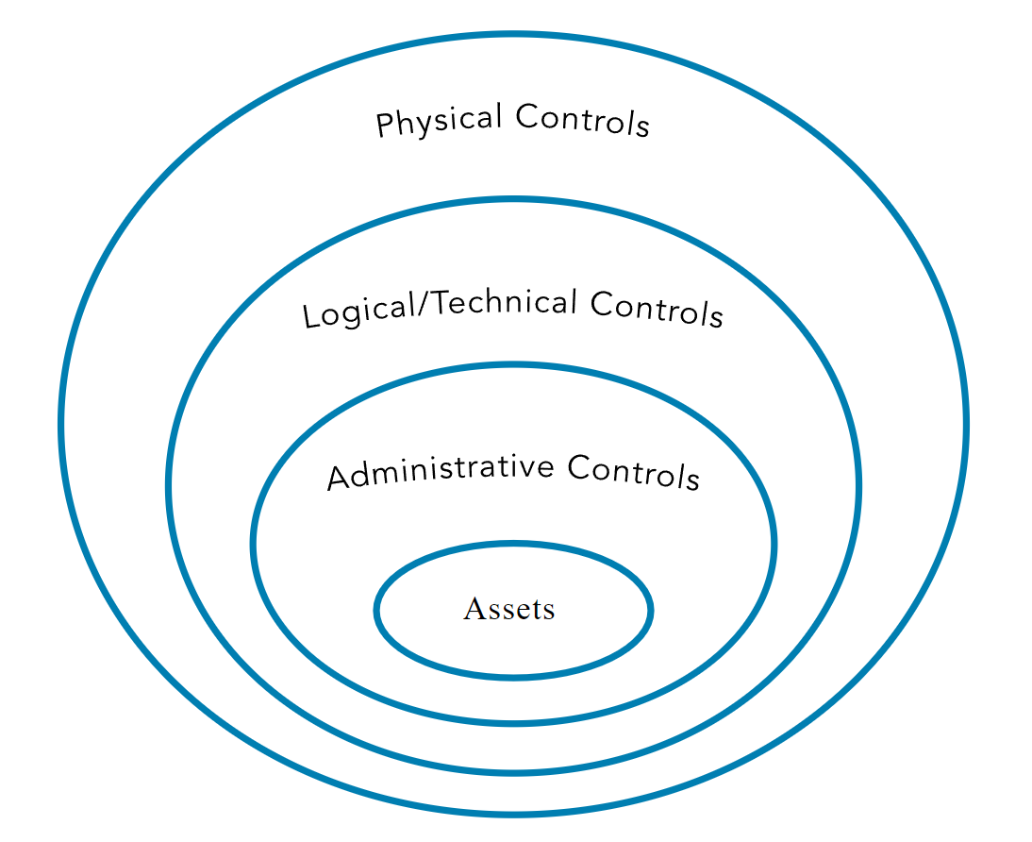
Countermeasure Selection
Defense in depth

Slide 44
Administrative Controls
Policies and procedures defined by security policy and other regulation or requirements
Management Controls, Managerial Controls, Procedural Controls
Examples: policies, procedures, hiring practices, background checks, data classifications, security training, etc.

Slide 45
Technical or Logical Controls
The hardware/software mechanisms used to manage access and protection for IT resources and system
Examples: passwords, smartcards, biometrics, encryption, IDS/IPS, firewalls, ACLs, etc.

Slide 46
Physical Controls
Providing protection to the facility and real-world objects
Examples: guards, fences, motion detection, locked doors, sealed windows, lights, cable protection, laptop locks, badges, guard dogs, cameras, alarms, etc.

Slide 47
Applicable Types of Controls
Preventive
Detection
Corrective
Recovery
Deterrent
Directive
Compensating

Slide 48
Preventive Control
Deployed to stop unwanted or unauthorized activity from occurring
Examples: fences, locks, DLP, pentesting, encryption, auditing, antimalware software, firewalls, IPSs, etc.

Slide 49
Detection Control
Deployed to discover or detect unwanted or unauthorized activity
Examples: security guards, motion detectors, CCTV, job rotation, mandatory vacations, honeypots/honeynets, IDS, incident investigation, etc.

Slide 50
Corrective Control
Modifies the environment to return systems to normal after an unwanted or unauthorized activity has occurred
Examples: installing a spring on a door so that it will close and relock, file integrity checking tools like sigverif to see boot files, etc.

Slide 51
Recovery Control
An extension of corrective controls but more advanced and complex
Examples: backups, fault-tolerant drive systems, system imaging, server clustering, antimalware software, VM shadowing, hot/warm/cold sites, etc.

Slide 52
Deterrent Control
Deployed to discourage security policy violations
Examples: security awareness training, locks, fences, security badges, guards, cameras, etc.

Slide 53
Directive Control
Deployed to direct, confine, or control the actions of subject to force or encourage compliance with security policies
Examples: policy requirements, escape route exits, monitoring, supervision, etc.

Slide 54
Compensating Control
Deployed to provide various options to other existing controls to aid in the enforcement and support of security policies
Examples: if a preventive control fails, then the compensating control takes over, DRP, etc.

Slide 55
Security Control Assessment (SCA)
Formal evaluation of a security infrastructure’s individual mechanisms against a baseline or expectation
NIST SP 800-53 Rev. 5 Security and Privacy Controls for Information Systems and Organizations

Slide 56
Monitoring and Measurement
If a security control’s benefits cannot be quantified, evaluated, or compared, then it does not actually provide any security

Slide 57
Risk Reporting and Documentation
Risk reporting is a key task to perform at the conclusion of a risk analysis
Internal Reporting
  Decision-making
  Risk Mitigation
  Management of Risk
  Risk Register, Risk Heat Maps, Key Risk Indicators

Slide 58
Risk Reporting and Documentation
External Reporting
  Transparency
  Risk Profile
  Risk Exposure
  Risk Management

Slide 59
Risk Reporting and Documentation
Risk Register/Risk Log
  Identifying risks
  Evaluating the severity of and prioritizing those risks
  Prescribing responses to reduce or eliminate the risks
  Tracking the progress of risk mitigation

Slide 60
Continuous Improvement
Security is always changing, so any implemented security solution requires updates and changes over time
Enterprise Risk Management (ERM) program can be evaluated using the Risk Maturity Model (RMM)

Slide 61
Continuous Improvement
Risk Maturity Model (RMM) Levels
  Ad Hoc
  Preliminary
  Defined
  Integrated
  Optimized

Slide 62
Legacy Risk
Often overlooked
End of Life (EOL)
End of Service Life (EOSL) or End of Support (EOS)
Example: Windows 10 EOSL as of October 14, 2025

Slide 63
Risk Frameworks
A guideline for how risk is assessed, resolved, and monitored
Risk Management Framework (RMF)
  Established mandatory requirements for federal agencies
Cybersecurity Framework (CSF)
  Critical infrastructure and commercial organizations

Slide 64
Cybersecurity Framework (CSF) 2.0
Identify: Understand and catalog assets, risks, and vulnerabilities
Protect: Implement safeguards to protect assets and data
Detect: Develop and deploy mechanisms for identifying and detecting security incidents
Respond: Define strategies and process for responding to and mitigating cybersecurity incidents
Recover: Develop and implement strategies for recovery and resilience after a cybersecurity incident
Govern: Establish, communicate, and oversee roles, responsibilities, and policies that ensure a proactive and adaptive approach to cybersecurity

Slide 65
Cybersecurity Framework (CSF) 2.0
Released in early 2024
Not a checklist but a support and improvement of security over time
More of a improvement system rather than a risk management process

Slide 66
Risk Management Framework (RMF)
NIST SP 800-37 Rev 2
Used by US federal government
Intended to be used as a risk management process
There are seven phases, six which are used cyclically

Slide 67
Risk Management Framework (RMF)
Prepare
Categorize
Select
Implement
Assess
Authorize
Monitor

Slide 68
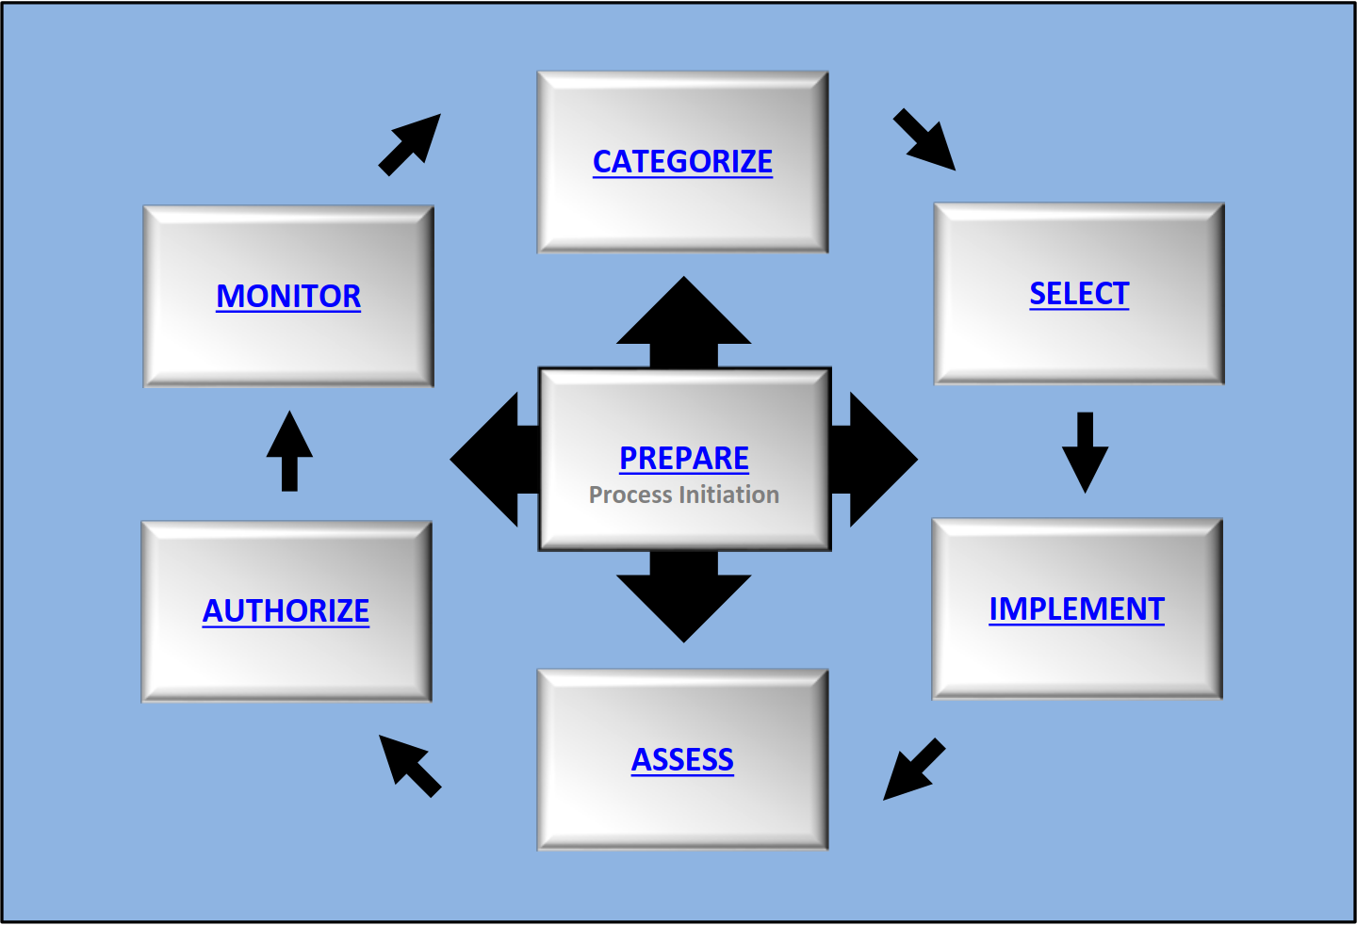
Risk Management Framework (RMF)

Slide 69
Other Risk Frameworks
ISO/IEC 31000 (Risk Management – Guidelines)
ISO/IEC 27005 (Information Security, Cybersecurity, and Privacy Protection: Guideance on Managing Information Secuirty Risks)
www.iso.org/standard/56610.html

Slide 70
Other Risk Frameworks
The Committee of Sponsoring Organizations (COSO) of Treadway Commission’s Enterprise Risk Management Integrated Framework
ISACA’s Risk IT Framework
Operationally Critical Threat, Asset, and Vulnerability Evaluation (OCTAVE)

Slide 71
Other Risk Frameworks
Factor Analysis of Information Risk (FAIR)
Threat Assessment and Remediation Analysis (TARA)

Slide 72
Other Risk Frameworks
The CISSP is focused in on NIST RMF
It is important to understand other frameworks depending on what works for an organization

Slide 73
Social Engineering
Exploiting human nature and behavior
People are always the weakest link
This works well because we’re human

Slide 74
Social Engineering Principles
Authority: Effective technique because most people are likely to respond to authority with obedience
Intimidation: Uses authority, confidence, or even the threat of harm to motivate someone to follow orders or instructions

Slide 75
Social Engineering Principles
Consensus: The act of taking advantage of a person’s natural tendency to mimic what others are doing or are perceived as having done in the past
Scarcity: Convince someone that an object has a higher value based on the object’s scarcity

Slide 76
Social Engineering Principles
Familiarity: Attempts to exploit a person’s native trust in that which is familiar
Trust: An attacker working to develop a relationship with a victim
Urgency: The need to act quickly
Eliciting Information: Collecting information from systems or people

Slide 77
Social Engineering Principles
Prepending: Adding of a term, expression, or phrase to the beginning or header of some other communication
Phishing: Focused on stealing credentials or identity information from any potential target
Smishing: SMS over text messaging services

Slide 78
Social Engineering Principles
Vishing: Phishing done over any telephony or voice communication systems
Spear Phishing: Targeted version of phishing where the message is crafted and directed specifically to a group or individual
Whaling: Spear phishing but for specific high value individuals

Slide 79
Social Engineering Principles
Spam: Any type of communication that is undesired and/or unsolicited
Shoulder Surfing: An in-peson form where someone is able to watch a user’s keyboard or their display

Slide 80
Social Engineering Principles
Invoice Scams: Attempt to steal funds from an organization or individuals through the presentation of a false invoice, often followed by strong inducements to pay
Hoax: Convince targets to perform an action that will cause problems or reduce their IT security

Slide 81
Social Engineering Principles
Impersonation: Taking on the identity of someone else
Tailgating: Unauthorized entity gains access to a facility under the authorization of a valid worker without their knowledge

Slide 82
Social Engineering Principles
Dumpster Diving: Act of digging through trash, discarded equipment, or abandoned locations in order to obtain information about a target
Identity Theft: Act of stealing someone’s identity
Identity Fraud: Falsely claim to be someone else through the use of stolen information form the victim

Slide 83
Social Engineering Principles
Typosquatting: Employed to capture and redirect traffic when a user mistypes the domain name
Influence Campaigns: Attacks that attempt to guide, adjust, or change public opinion
Hybrid Warfare: www.globalknowledge.com/us-en/resources/resource-li

Slide 84
Social Engineering Principles
Social Media: Based on nation-state actors
Hybrid Warfare: https://www.globalknowledge.com/us-en/resources/resource-library/white-papers/cyberwarfare-origins-motivations-and-what-you-can-do-in-response/

Slide 85
Security Awareness and Education
Awareness: Bring security to the forefront
Training: Teaching the people
Education: Students and users learn much more than they actually need to know to perform their work tasks
Effectiveness Evaluation

