Slide 1
Chapter 01 – Security Governance Through Principles and Policies

Slide 2
Security 101
What is IT?
Is it different or the same as security?
What is the overall goal of security?

Slide 3
Security 101
IT is the hardware/software that support the operations or functions of a business
Security is very different
Select security controls that provide the most significant protections for the lowest resource cost
Security is a journey, not a finish line

Slide 4
Pillars of Information Security
Confidentiality
Integrity
Availability
Authenticity
Nonrepudiation

Slide 5
CIA Triad
What is the CIA triad?

Slide 6
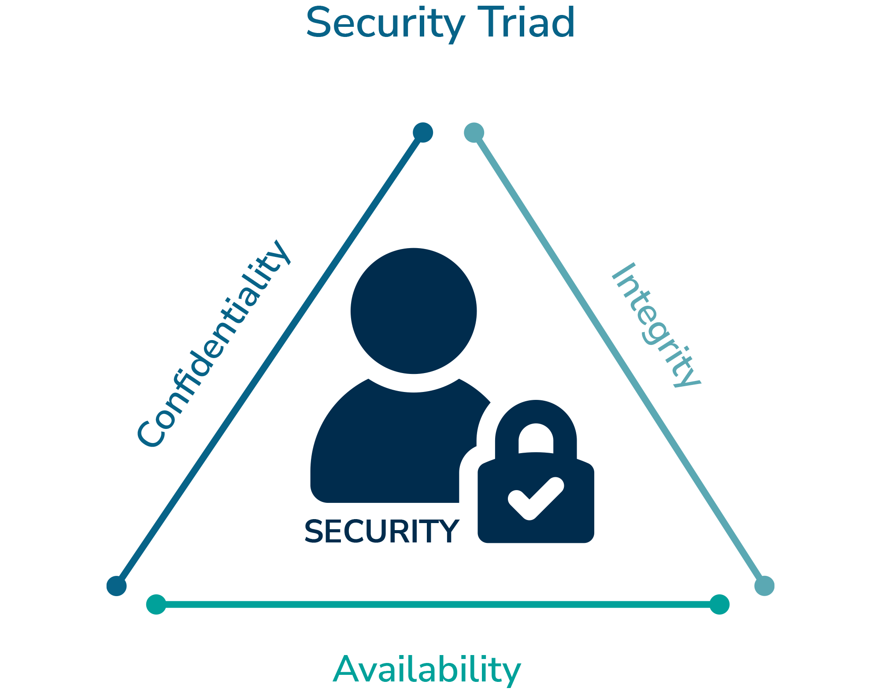
CIA Triad

Slide 7
Confidentiality
What is it?
What is the goal?
Any Violations?
Countermeasures?

Slide 8
Confidentiality
The concept of the measures used to ensure the protection of the secrecy of data, objects, or resources
The goal is to prevent or minimize unauthorized access to data

Slide 9
Confidentiality
Violations
  Human error
  End user
  System Administrator
  Security Policy
  Misconfigured Security Controls

Slide 10
Confidentiality
Countermeasures
  Encryption
  Network Traffic Padding
  Strict ACLs
  Data Classification
  Rigorous Authentication Procedures
  Extensive Personnel Training

Slide 11
Confidentiality Vocabulary (Quizable)
Sensitivity
Discretion
Criticality
Concealment
Secrecy
Privacy
Seclusion
Isolation

Slide 12
Integrity
What is it?
What is the goal?
Any Violations?
Countermeasures?

Slide 13
Integrity
The concept of protecting the reliability and correctness of data
Integrity goal is to prevent unauthorized alterations of data

Slide 14
Integrity From 3 Perspectives
Preventing unauthorized subjects from making modifications
Preventing authorized subjects from making unauthorized modifications
Maintaining the internal external consistency of objects so that their data is correct

Slide 15
Integrity
Violations
  Numerous attacks (viruses, logic bombs, unauthorized access, errors in code/applications, malicious modifications, intentional replacements, system backdoors, etc.)
  Human error

Slide 16
Integrity
Countermeasures
  Strict ACLs
  Rigorous authentication procedures
  IDS
  Object/data encryption
  Hash verfications
  Interface restrictions
  Input/function checks
  Extensive personnel training

Slide 17
Integrity Vocabulary (Quizable)
Accuracy
Truthfulness
Validity
Accountability
Responsibility
Completeness
Comprehensiveness

Slide 18
Availability
What is it?
What is the goal?
Any Violations?
Countermeasures?

Slide 19
Availability
The concept of authorized subjects are granted timely and uninterrupted access to objects
Supporting infrastructure, including but limited to network, communications, access control mechanisms, and is functional while allowing authorized users to gain access

Slide 20
Availability
Violations
  Device failure
  Software issues
  Environmental issues
  DoS attacks
  Object destruction
  Communication interruptions

Slide 21
Availability
Countermeasures
  Monitoring performance/networks
  Firewalls
  Redundancy
  Backups
  Business Continuity Planning (BCP)
  Eliminating single point of failure

Slide 22
Availability Vocabulary (Quizable)
Usability
Accessibility
Timeliness

Slide 23
DAD Triad
What is it?

Slide 24
DAD Triad
Disclosure
  Sensitive or confidential material is accessed by unauthorized entities
Alteration
  Data is either maliciously or accidently changed
Destruction
  A resource is damaged or made inaccessible to authorized users

Slide 25
Overprotecting
Is this an issue?

Slide 26
Overprotecting
Yes!
Confidentiality
  Restriction of availability
Integrity
  Restriction of availability
Availability
  Loss of confidentiality and integrity

Slide 27
Authenticity
Security concept
  Authentic
  Genuine
  Originates from its alleged source

Slide 28
Nonrepudiation
Security concept
  Logs
  Who caused what
  Accounting

Slide 29
AAA Services
Identification
Authentication
Authorization
Auditing
Accounting

Slide 30
Identification
Claiming to be an identity when attempting to access a secured area or system
This is before starting the AAA process
Username, swiping smart card, proximity device, phrases, face, fingerprint, scanning device, etc.

Slide 31
Authentication
Proving you are that claimed identity
Providing additional information that is in line with identification
Identification and authentication usually work in a single two-step process
Passwords, MFA, PIN, ID code, etc.

Slide 32
Authorization
Permission level of a resource and object access for a specific identity or subject
Allow, deny aka need to know basis
Identification and authentication are all or nothing
Authorization is a lot of gray

Slide 33
Auditing
Recording a log of the events and activities related to systems and subjects
Audit trail to recreate
  Events
  IDS/IPS
  System failure

Slide 34
Accounting
Reviewing log files to check for compliance and violations in order to hold subjects accountable for their actions, especially violations of organizational security policy
Support security decisions with legal backing

Slide 35
Protection Mechanisms
Defense in Depth
Abstraction
Data Hiding
Encryption

Slide 36
Defense in Depth
Why is this used?
You can think of it as layering

Slide 37
Abstraction
Why is this used?
You can think of it as not knowing all the details but still being able to use the security controls in place
Think of it like driving a car, do you need to know all the internal parts to be able to drive the car?

Slide 38
Data Hiding
Why is this used?
You can think of it as security through obscurity

Slide 39
Encryption
Why is this used?
You can think of it as I don’t want anyone to be able to access my data

Slide 40
Security Boundaries
Divisions between secure areas
Think LANs, Internet, public/private, open areas vs closed areas etc.
Classifications depending on the subject and what that subject can do in certain areas

Slide 41
Applying Security Governance
Supporting, evaluating, defining, and directing an organization’s security efforts
Closely related to or intertwined with corporate or IT governance
Security is never just an IT issue
NIST SP 800-53, NIST SP 800-100, etc. focused on military/gov but can be followed

Slide 42
3rd Party Governance
External entity oversight that law, regulation, industry standards, contractual obligation, or licensing requirements mandate
Outsource creates problems e.g. McDonalds, MGM, etc.
Document exchange = standards meet

Slide 43
Documentation Review
Process of reading the exchanged materials and verifying them against standards and expectations
Documents not met = loss or void of ATO (Authorization to Operate)
Managing, assessing, and addressing risk

Slide 44
Security Function
Operating a business that focuses on the task of evaluating the improving security over time
Security MUST be measurable
Align security functions to business strategy, goals, mission, and objectives

Slide 45
Security Function
Security policy
Business case
Top-down approach (effective)
Bottom-up approach (rarely used)
CIO, CISO, ISO, CSO, CTO, etc.

Slide 46
Security Management
How will security be managed?
Who will be responsible for security?
How security will be tested?
Who will be developing security policies?
Who will be performing risk analysis?
How will security education be implemented?

Slide 47
Security Management
All of the previous questions is guided through a management plan
The best security plan is useless without one key factor
  Approval by senior management

Slide 48
Sample Three Type Plan
Strategic Plan
Tactical Plan
Operational Plan

Slide 49
Strategic Plan
Long-term plan that is fairly stable
Purpose, goals, mission, and objectives of the organization
~ 5 year road map updated annually
Include an annual, bi-annual, or quarterly risk assessment

Slide 50
Tactical Plan
Midterm planning with more details
Planned or via ad hoc on events
Good for ~1 year
Projects, acquisitions, hiring, budget, maintenance, support, system development, etc.

Slide 51
Operational Plan
Short term, highly detailed plan
Must be updated often (monthly or quarterly)
Retaining compliance
Spell out how to accomplish various goals
Training, system deployment, product design, etc.

Slide 52
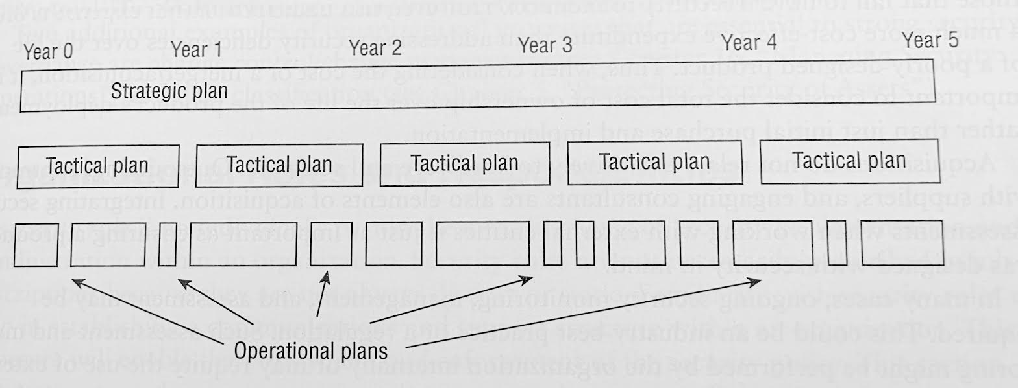
Overall Timeline

Slide 53
Organizational Process
On-Site Assessment
Document Exchange and Review
Process/Policy Review
Third-Party Audit

Slide 54
Roles & Responsibilities
What is a security role?
Can you tell me how you can put that in policy and procedure?

Slide 55
Roles & Responsibilities
Senior Manager
Security Professional
Asset Owner
Custodian
User
Auditor

Slide 56
Security Control Frameworks
ISO (International Organization for Standardization)
NIST (National Institute of Standards and Technology)
COBIT (Control Objectives for Information and Related Technologies)

Slide 57
Security Control Frameworks
SABSA (Sherwood Applied Business Security Architecture)
PCI DSS (Payment Card Industry Data Security Standard)
FedRAMP (Federal Risk and Authorization Management Program)
ITIL (IT Infrastructure Library)

Slide 58
Security Policies
Document that defines the scope of security needed by the organization and discusses the assets that require protections and the extent to which security solutions should go to provide the necessary protection.
Policies are broad overviews

Slide 59
Security Standards and Baselines
More details and specific implementation from policies
Standards define compulsory requirements for the homogeneous use of hardware, software, technology, and security controls
Baseline is a minimum level of security hat every system throughout the organization must meet

Slide 60
Security Standards and Baselines
Guidelines offer recommendations on how standards and baselines are implemented and serves as a operational guide for both security professionals and users
Guidelines are flexible and should be customized

Slide 61
Security Procedures
Procedures or Standard Operating Procedure (SOP) is a detailed, step by step how to document that describes the exact actions necessary to implement a specific security mechanism, control, or solution
Final element of the formalized security policy structure

Slide 62
Keep Them Separate Benefits
Not all users need to know the security standards, baselines, guidelines, and procedures for all security classification levels
When changes occur, it is easier to update and redistribute only the affected material rather than updating a monolithic policy and redistributing it throughout the organization

Slide 63
Keep Them Separate Benefits
Not all users need to know the security standards, baselines, guidelines, and procedures for all security classification levels
When changes occur, it is easier to update and redistribute only the affected material rather than updating a monolithic policy and redistributing it throughout the organization

Slide 64
Threat Modeling
Threat modeling is the security process where potential threats are identified, categorized, and analyzed
Potential harm
Probability of occurrence
How to eradicate or reduce threats

Slide 65
Threat Modeling
Different approaches
Defensive approach
Proactive approach
Reactive approach
IoC are involved in all cases

Slide 66
Identifying Threats
Focused on Assets
Focused on Attackers
Focused on Software

Slide 67
Identifying Threats – STRIDE Model
Spoofing
Tampering
Repudiation
Information Disclosure
Denial of Service (DoS)
Elevation of Privilege

Slide 68
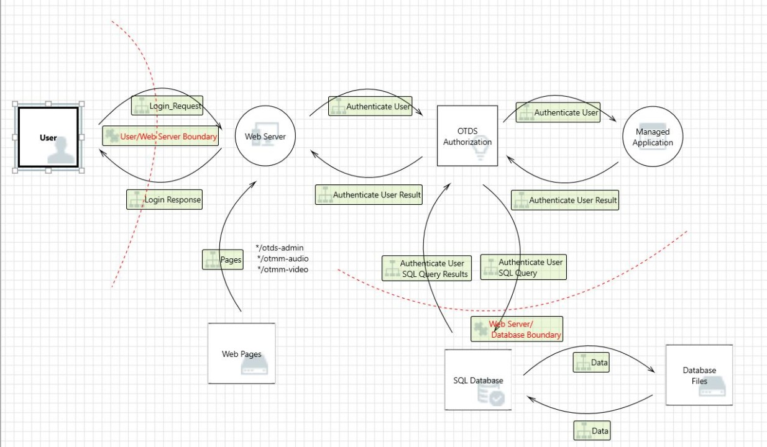
Diagramming Potential Attacks

Slide 69
Reduction Analysis
Reduction analysis is decomposing the application, system, or environment
Trust Boundaries – Any location where the level of trust or security changes
Dataflow Paths – the movement of data between locations

Slide 70
Reduction Analysis
Input Points – Location where external input is received
Privileged Operations – Any activity that requires greater privileges than a standard user account or process typically required to make system changes
Details about Security Stance and Approach – Security policy, foundation, assumptions

Slide 71
Prioritization and Response
Rank/rate the threats
Wide range of techniques
Probability x Damage Potential
Risk Matrix
DREAD Rating System

Slide 72
Supply Chain Risk Management
Supply Chain is the concept that most computers, devices, networks, systems, and even cloud services are not built by a single entity
Supply Chain Risk Management (SCRM) ensure all vendors are reliable, trustworthy, reputable organization and disclose their security requirements

