Slide 2
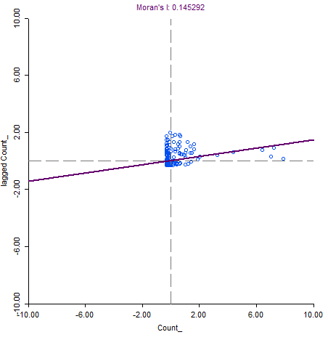
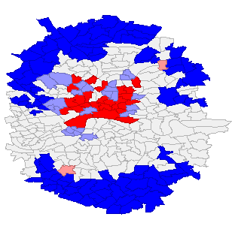
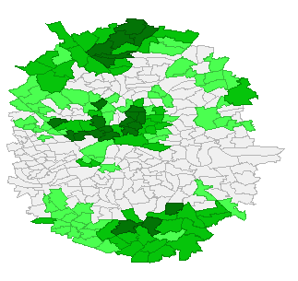
Overall

Slide 3
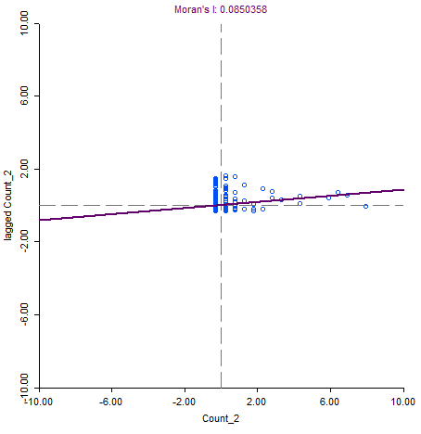
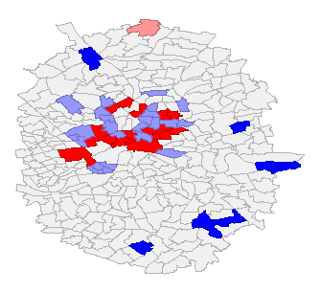
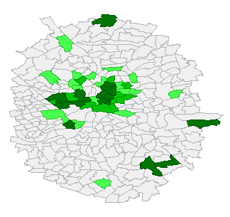
Jazz

Slide 4
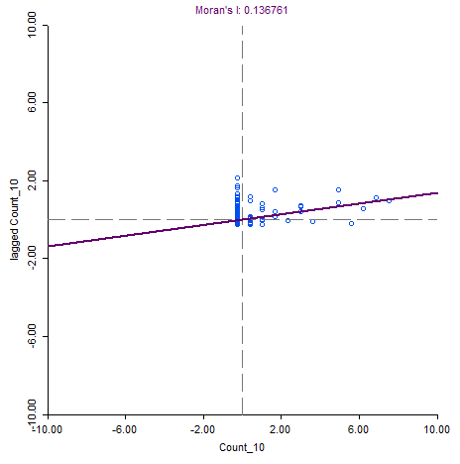
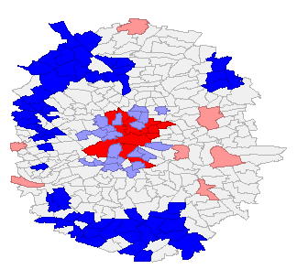
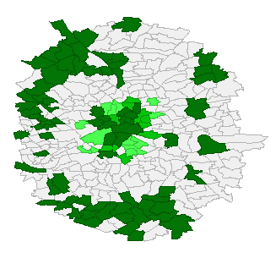
House

Slide 5
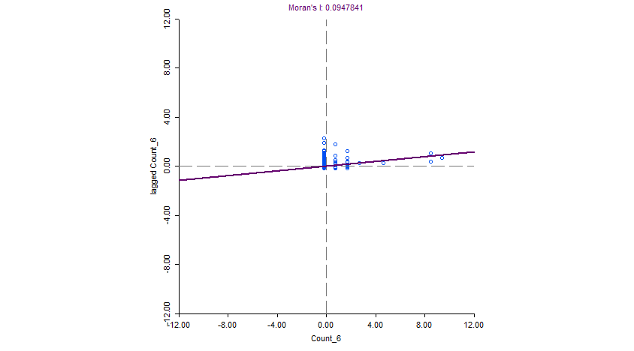
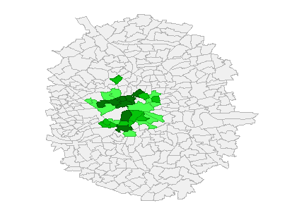
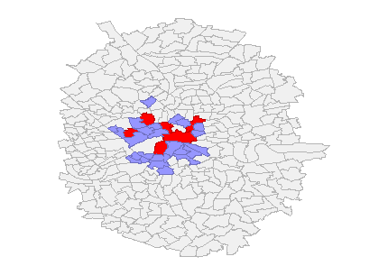
Classical

Slide 6
<div>
<a href="https://plot.ly/~cohenjota/79/?share_key=VnxAedE6nG92nfUVzYJ4Ou" target="_blank" title="BOROUGHs-bar" style="display: block; text-align: center;"><img src="https://plot.ly/~cohenjota/79.png?share_key=VnxAedE6nG92nfUVzYJ4Ou" alt="BOROUGHs-bar" style="max-width: 100%;width: 600px;" width="600" onerror="this.onerror=null;this.src='https://plot.ly/404.png';" /></a>
<script data-plotly="cohenjota:79" sharekey-plotly="VnxAedE6nG92nfUVzYJ4Ou" src="https://plot.ly/embed.js" async></script>
</div>

