Slide 1
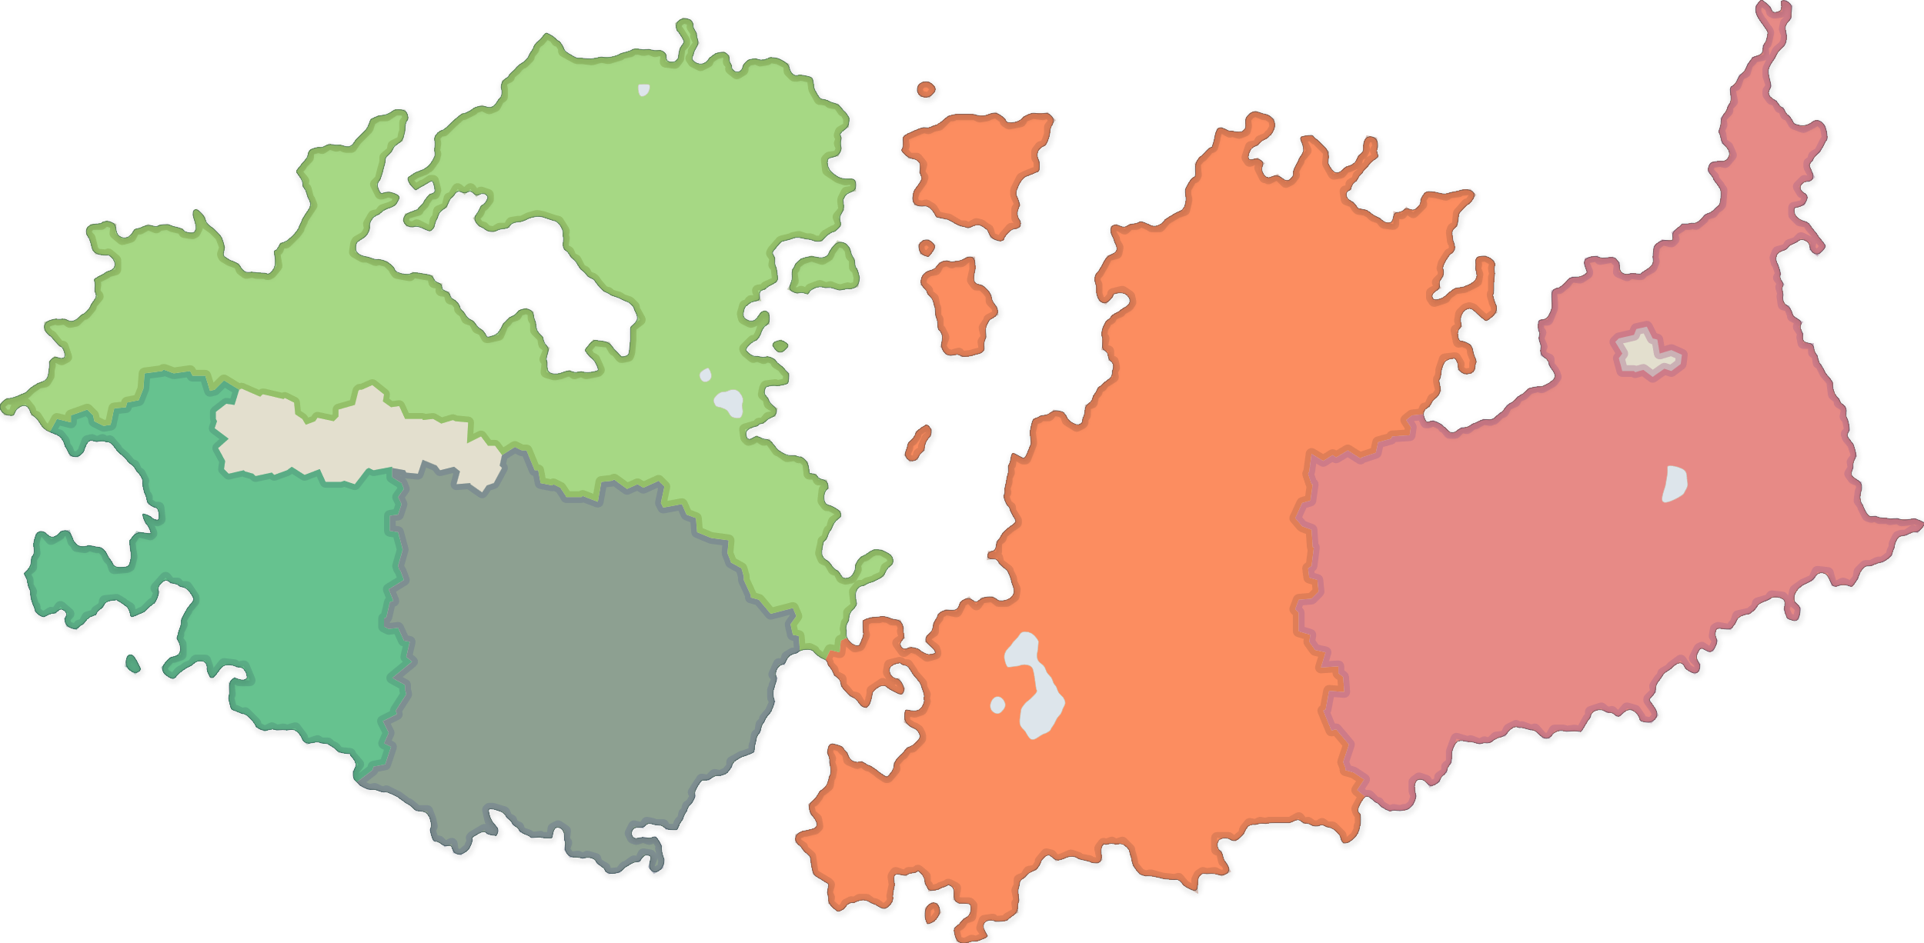
Harpazo

Slide 2
Harpazo
What the website is about
Harpazo is a website about a fantastic world which has 5 countries and fantastic creatures
You can explore the different cultures, histories and legends of each country,
and learn about the amazing animals and plants that live there.
Harpazois a place where you can let your imagination run wild and discover new wonders every day.

Slide 3
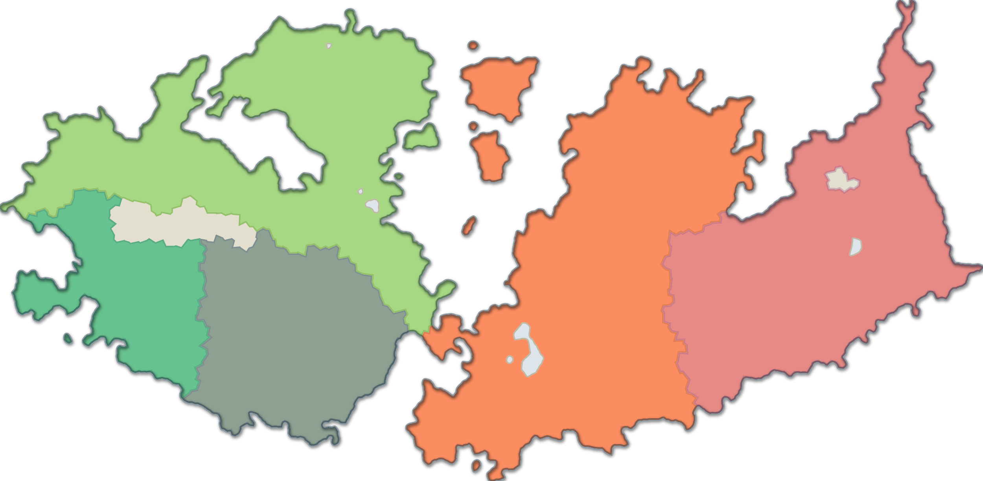
Harpazo
What the website is about
Harpazo is a website about a fantastic world which has 5 countries and fantastic creatures
You can explore the different cultures, histories and legends of each country,
and learn about the amazing animals and plants that live there.
Harpazois a place where you can let your imagination run wild and discover new wonders every day.

Slide 4
Harpazo
MOV EMPIRE
CYNOCEPHALI CONFEDERACY
DEMOCRACY OF YEK
HEADFUSSLER HIVE
ONNI COLLECTIVE
SMALL COUNTRY DESC
HISTORY AND POLITICS
RELIGION
CULTURE
LANGUAGE
ECONOMY AND TRADE

Slide 5
