Slide 1
BEEHIVE DRAFT

Slide 2
Improving the
The impact new developments have on active travel is suboptimal
Travel plans come too late in the development design process
Developer don’t have enough information or
motivation to encourage active travel in their design
Track the active travel change after development.

Slide 3
The Solution: Travel Plan Impact tool – BEEHIVE!
We help stakeholders to asses the impact of new development on active travel and reduce infrastructure cost.

Slide 4
General Accessibilty Index
By data and knowledge related with active travel and spatial design
PTLA: Access to public transport
Safety: Crime rates
Access to green space
Access to services

Slide 5
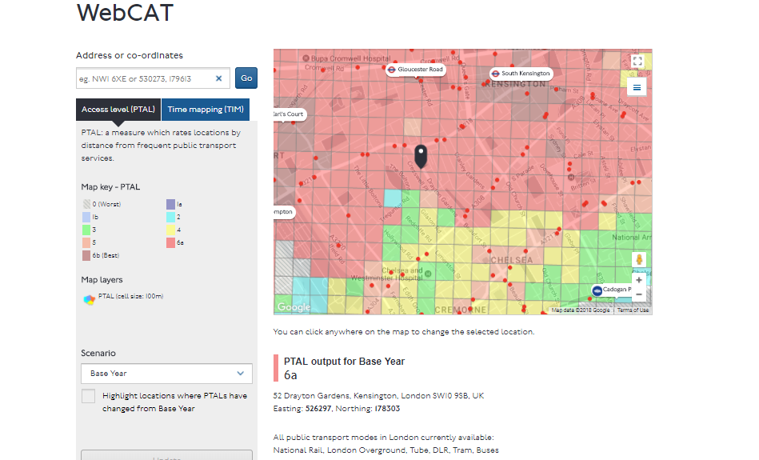
DEMO

Slide 6
Tech Diagram

Slide 7
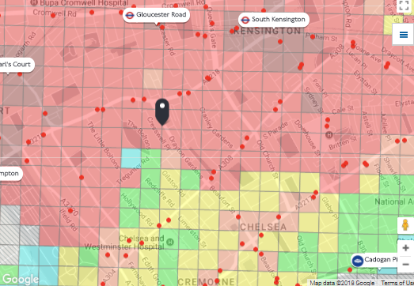
Before

Slide 8
Next steps
Standardization: access to services
Analyzing route?
Balancing weights
Define the challange parameter
Establish cost-benefit relationship.

Slide 9
