Slide 1

Part B Optimizer
End-user guide — how the benchmark tool works
Educational only — not enrollment or insurance sales
No phone, email, or login required to benchmark
You control if/when you connect with a licensed partner

Slide 2
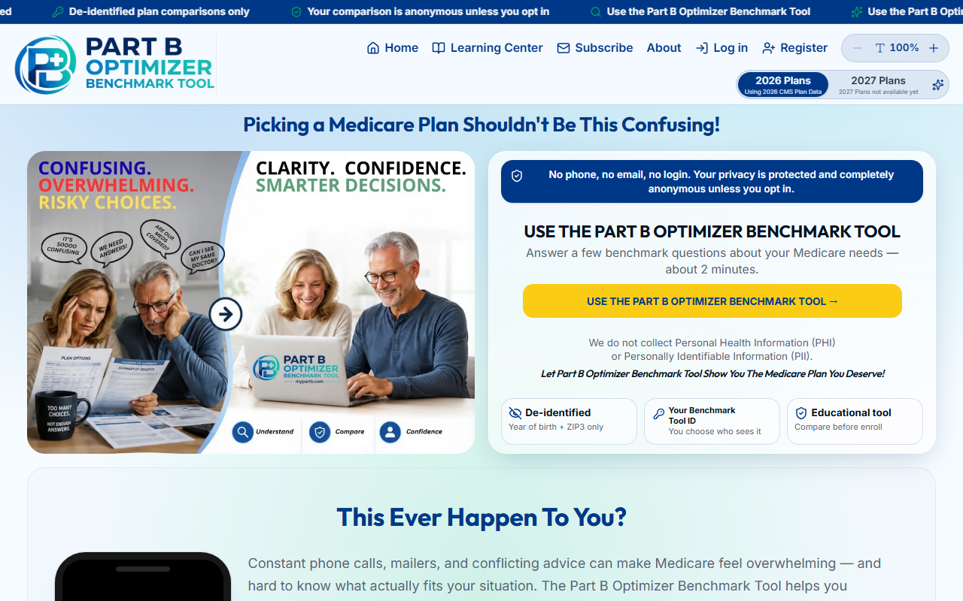
Start on the home page
Open mypartb.com and choose the Part B Optimizer Benchmark Tool
Privacy banner: de-identified inputs only (year of birth + ZIP3)

Slide 3
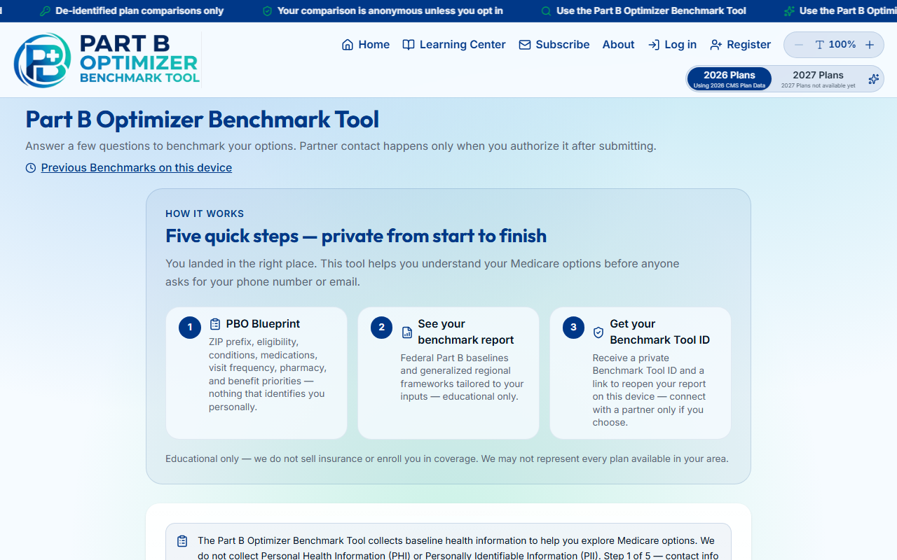
Part B Optimizer Benchmark Tool
Five quick steps: PBO Blueprint → Conditions → Medications → Utilization → Benefits
Optional: reopen a previous benchmark from this device at the bottom

Slide 4
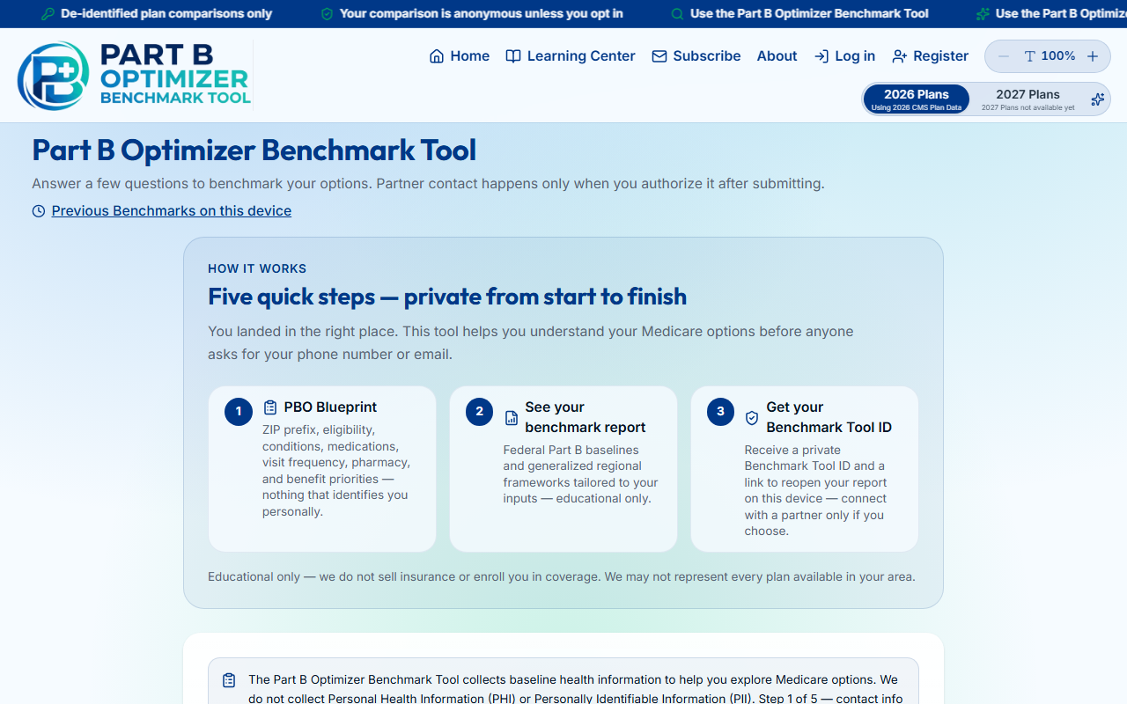
Step 1 — PBO Blueprint
Year of birth, gender, tobacco, ZIP3, county, Medicare enrollment, income band
No full ZIP, SSN, phone, or email

Slide 5
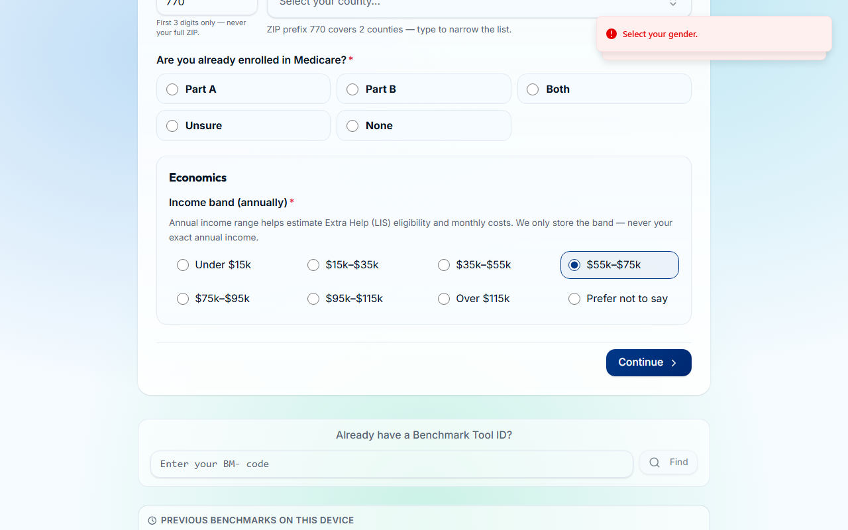
Steps 2–3 — Optional health inputs
Conditions and medications are optional but improve the educational report
Continue through each step — nothing is shared until you choose partner contact

Slide 6

Submit — get your Benchmark Tool ID
Step 5: benefit priorities, then Submit
You receive a BM-… ID stored on this device only

Slide 7
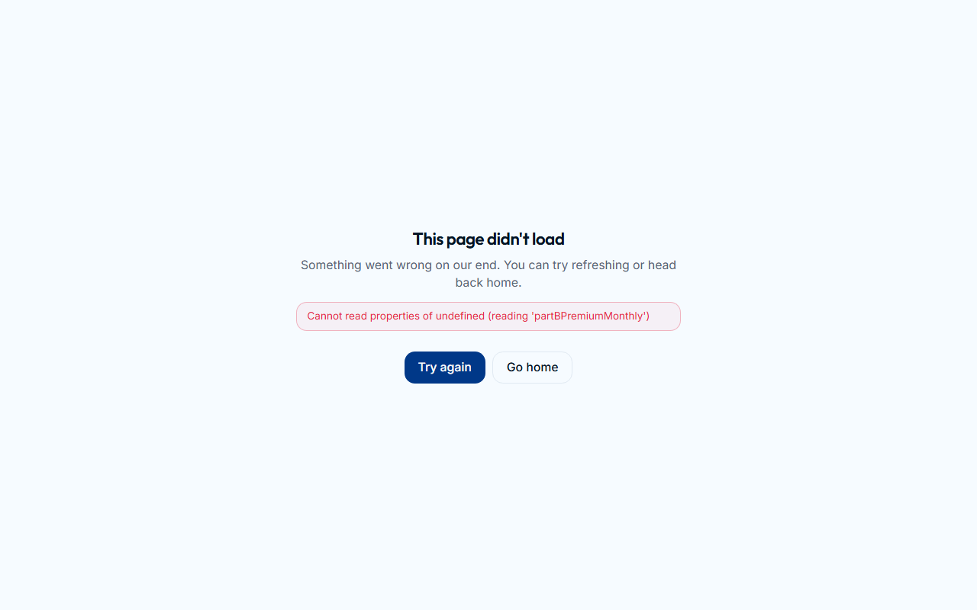
Your benchmark report
Federal Part B baselines, regional context, Top 10 framework, workbook, PDF download
Section menu scrolls to PBO Blueprint, Possible Plans, workbook, and more

Slide 8
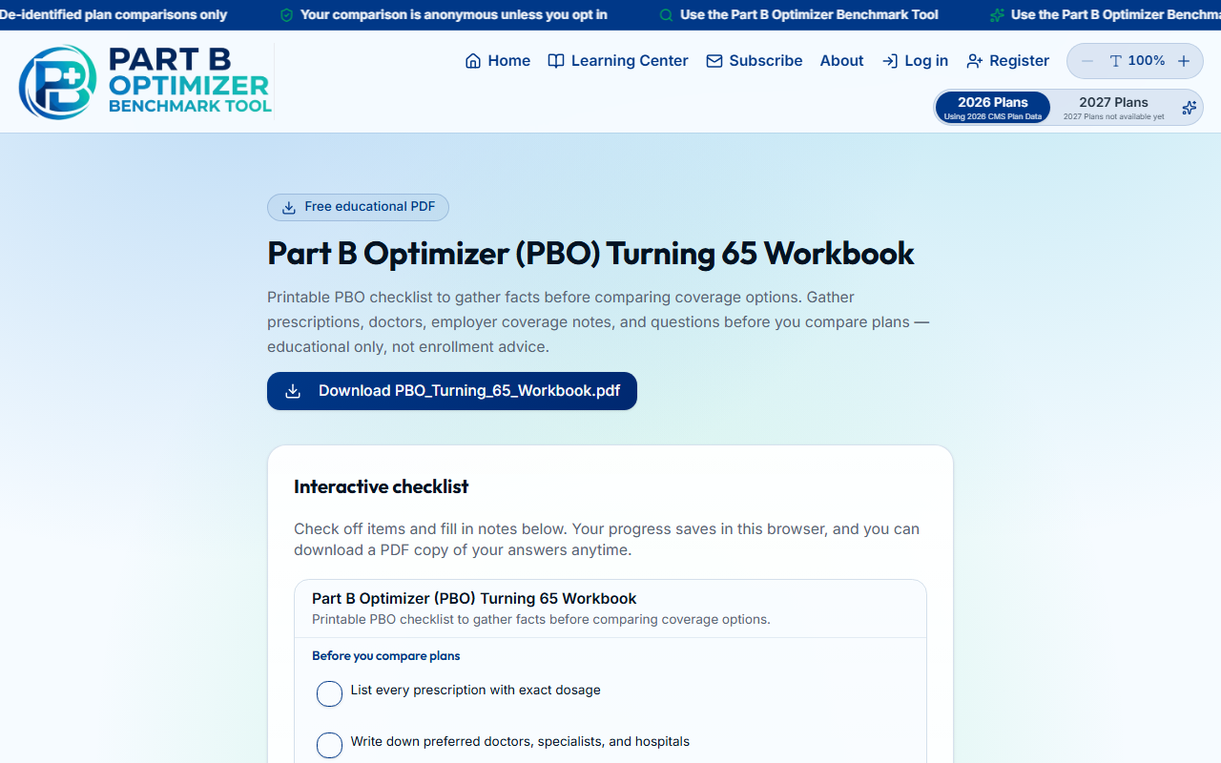
PBO Turning 65 Workbook
Interactive checklist — progress saves in your browser
Save my answers as PDF when ready

Slide 9
Partner contact is optional
After the report, you may connect with a licensed partner — only if you opt in
Benchmark Tool ID is yours to share or keep private
Educational tool — we do not sell insurance or enroll you in coverage

