Slide 1



Assignment 4
View in Power BI
City Hussen
Last data refresh:
3/6/2024 4:32:28 AM UTC
Downloaded at:
3/6/2024 4:37:37 AM UTC

Slide 2
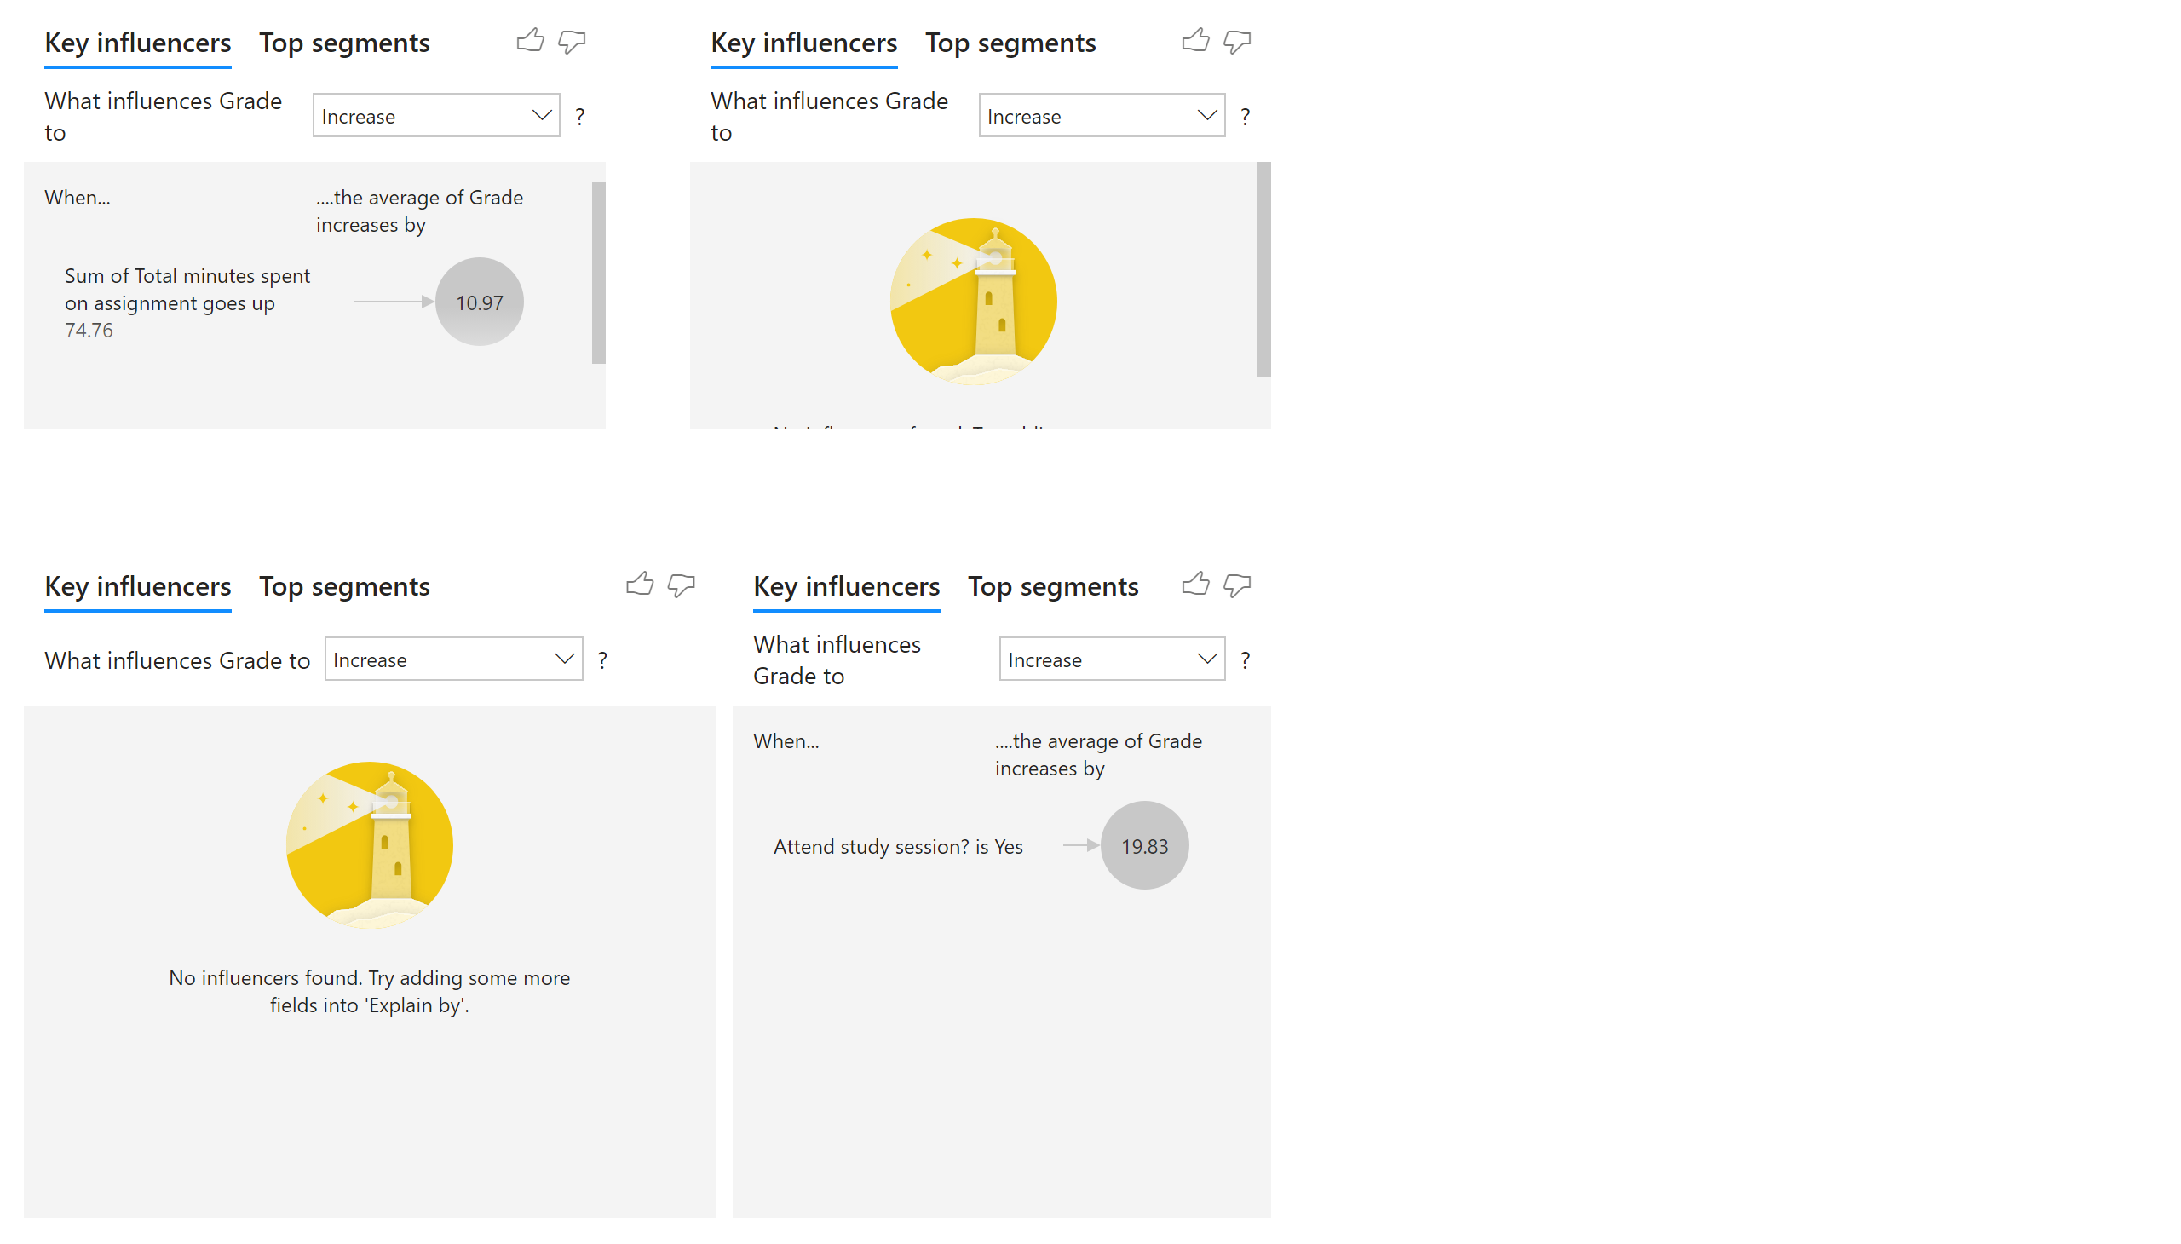
Key influncers
Notes:
keyDriversVisual
No alt text provided
keyDriversVisual
No alt text provided
keyDriversVisual
No alt text provided
keyDriversVisual
No alt text provided

Slide 3
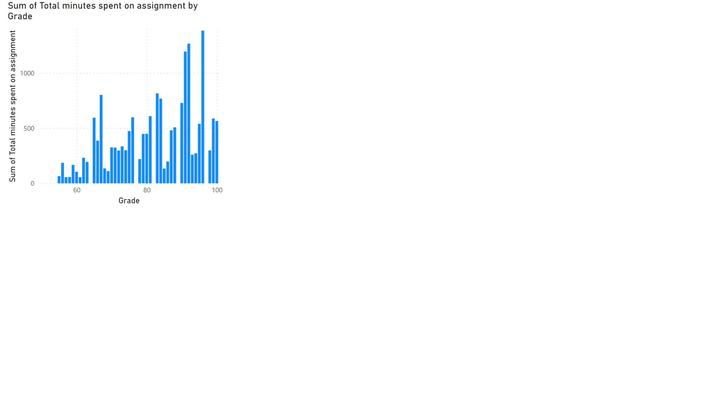
Time Spent Vs Grade
Notes:
clusteredColumnChart
No alt text provided

Slide 4
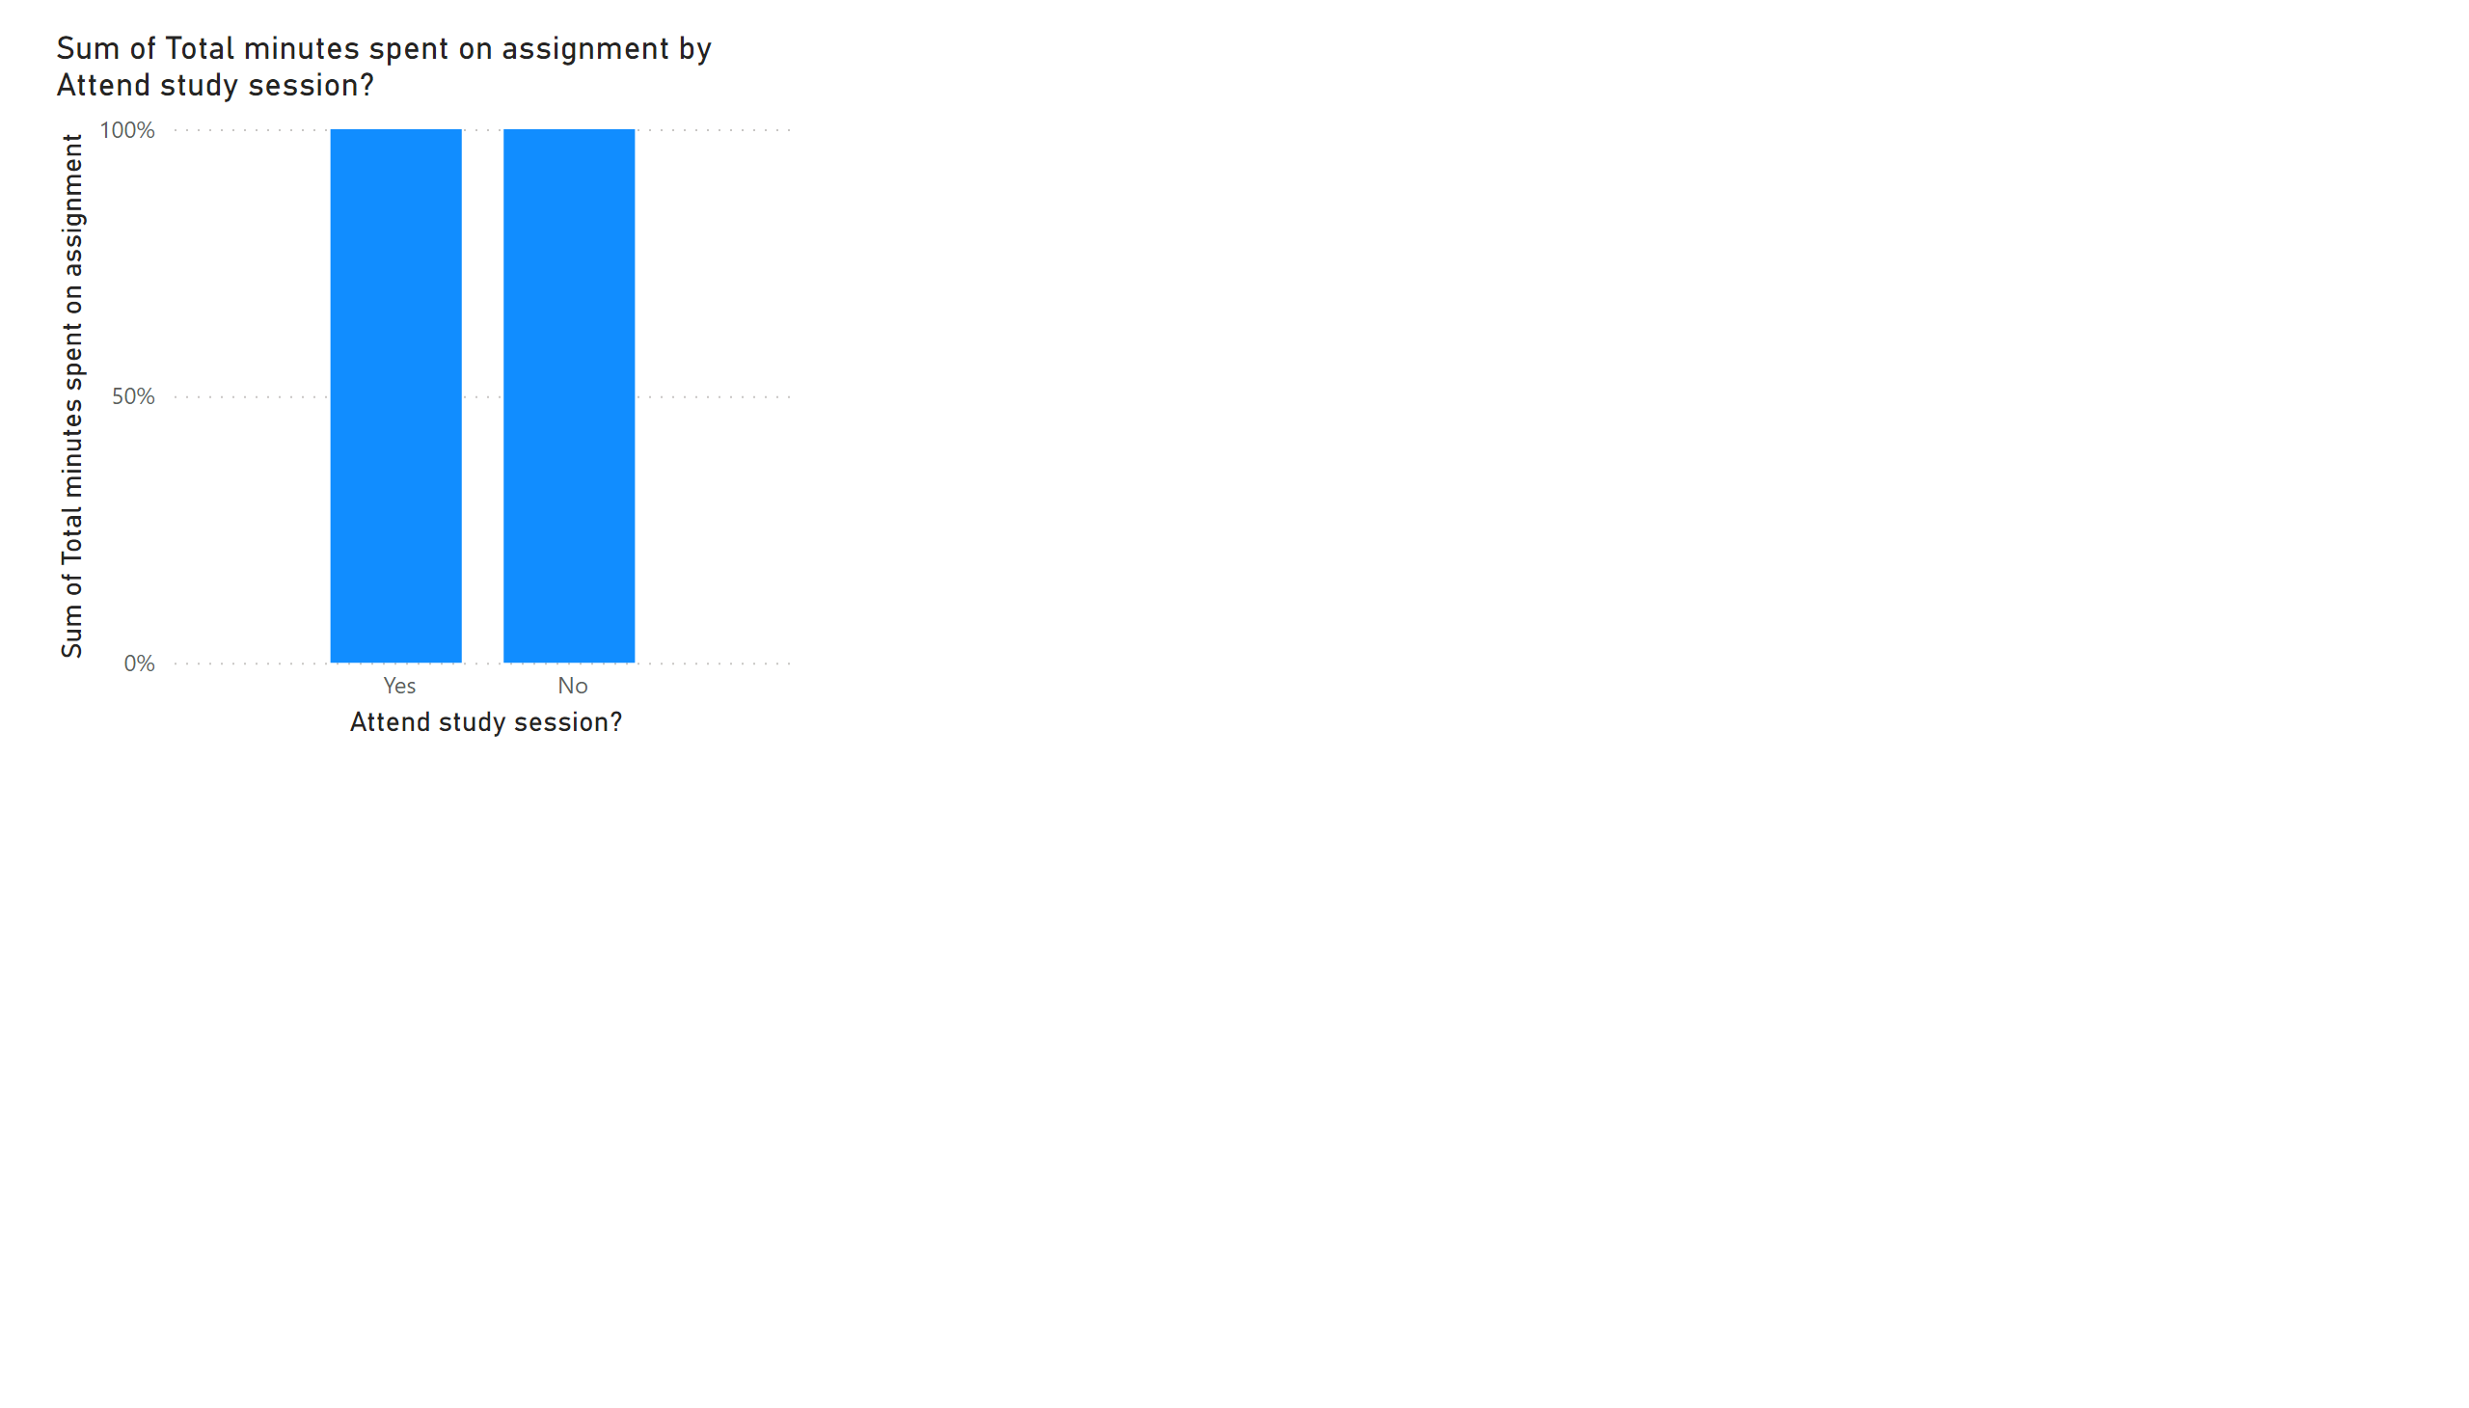
Time Spent vs study Session
Notes:
hundredPercentStackedColumnChart
No alt text provided

Slide 5
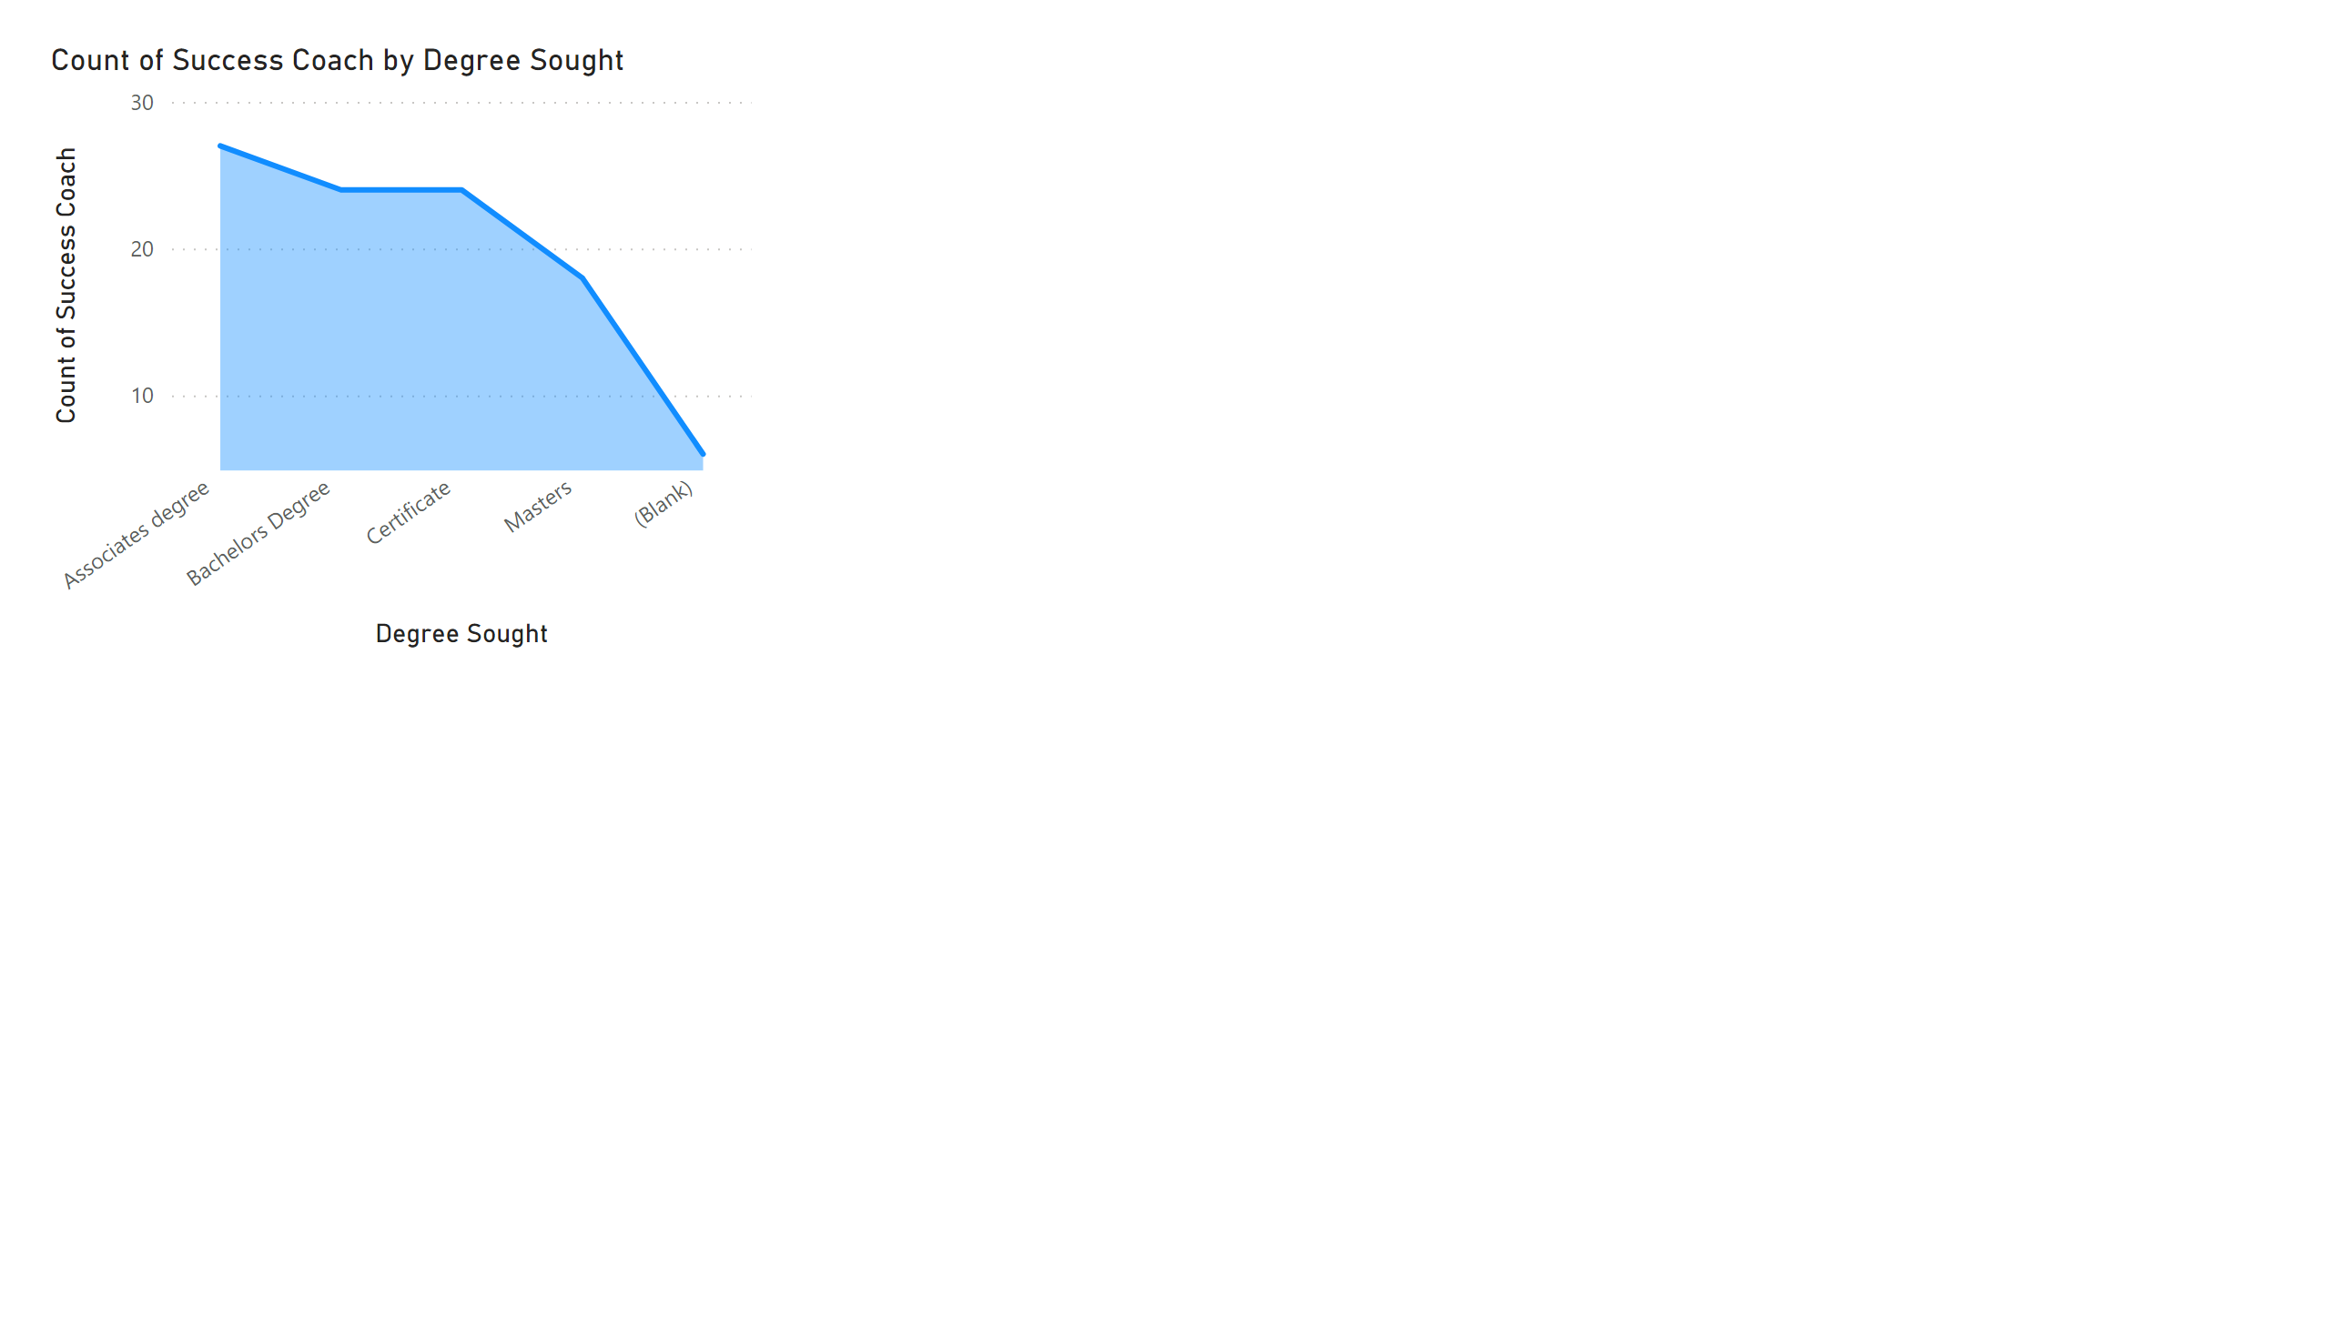
Success Coach vs Degree Sought
Notes:
stackedAreaChart
No alt text provided

Slide 6
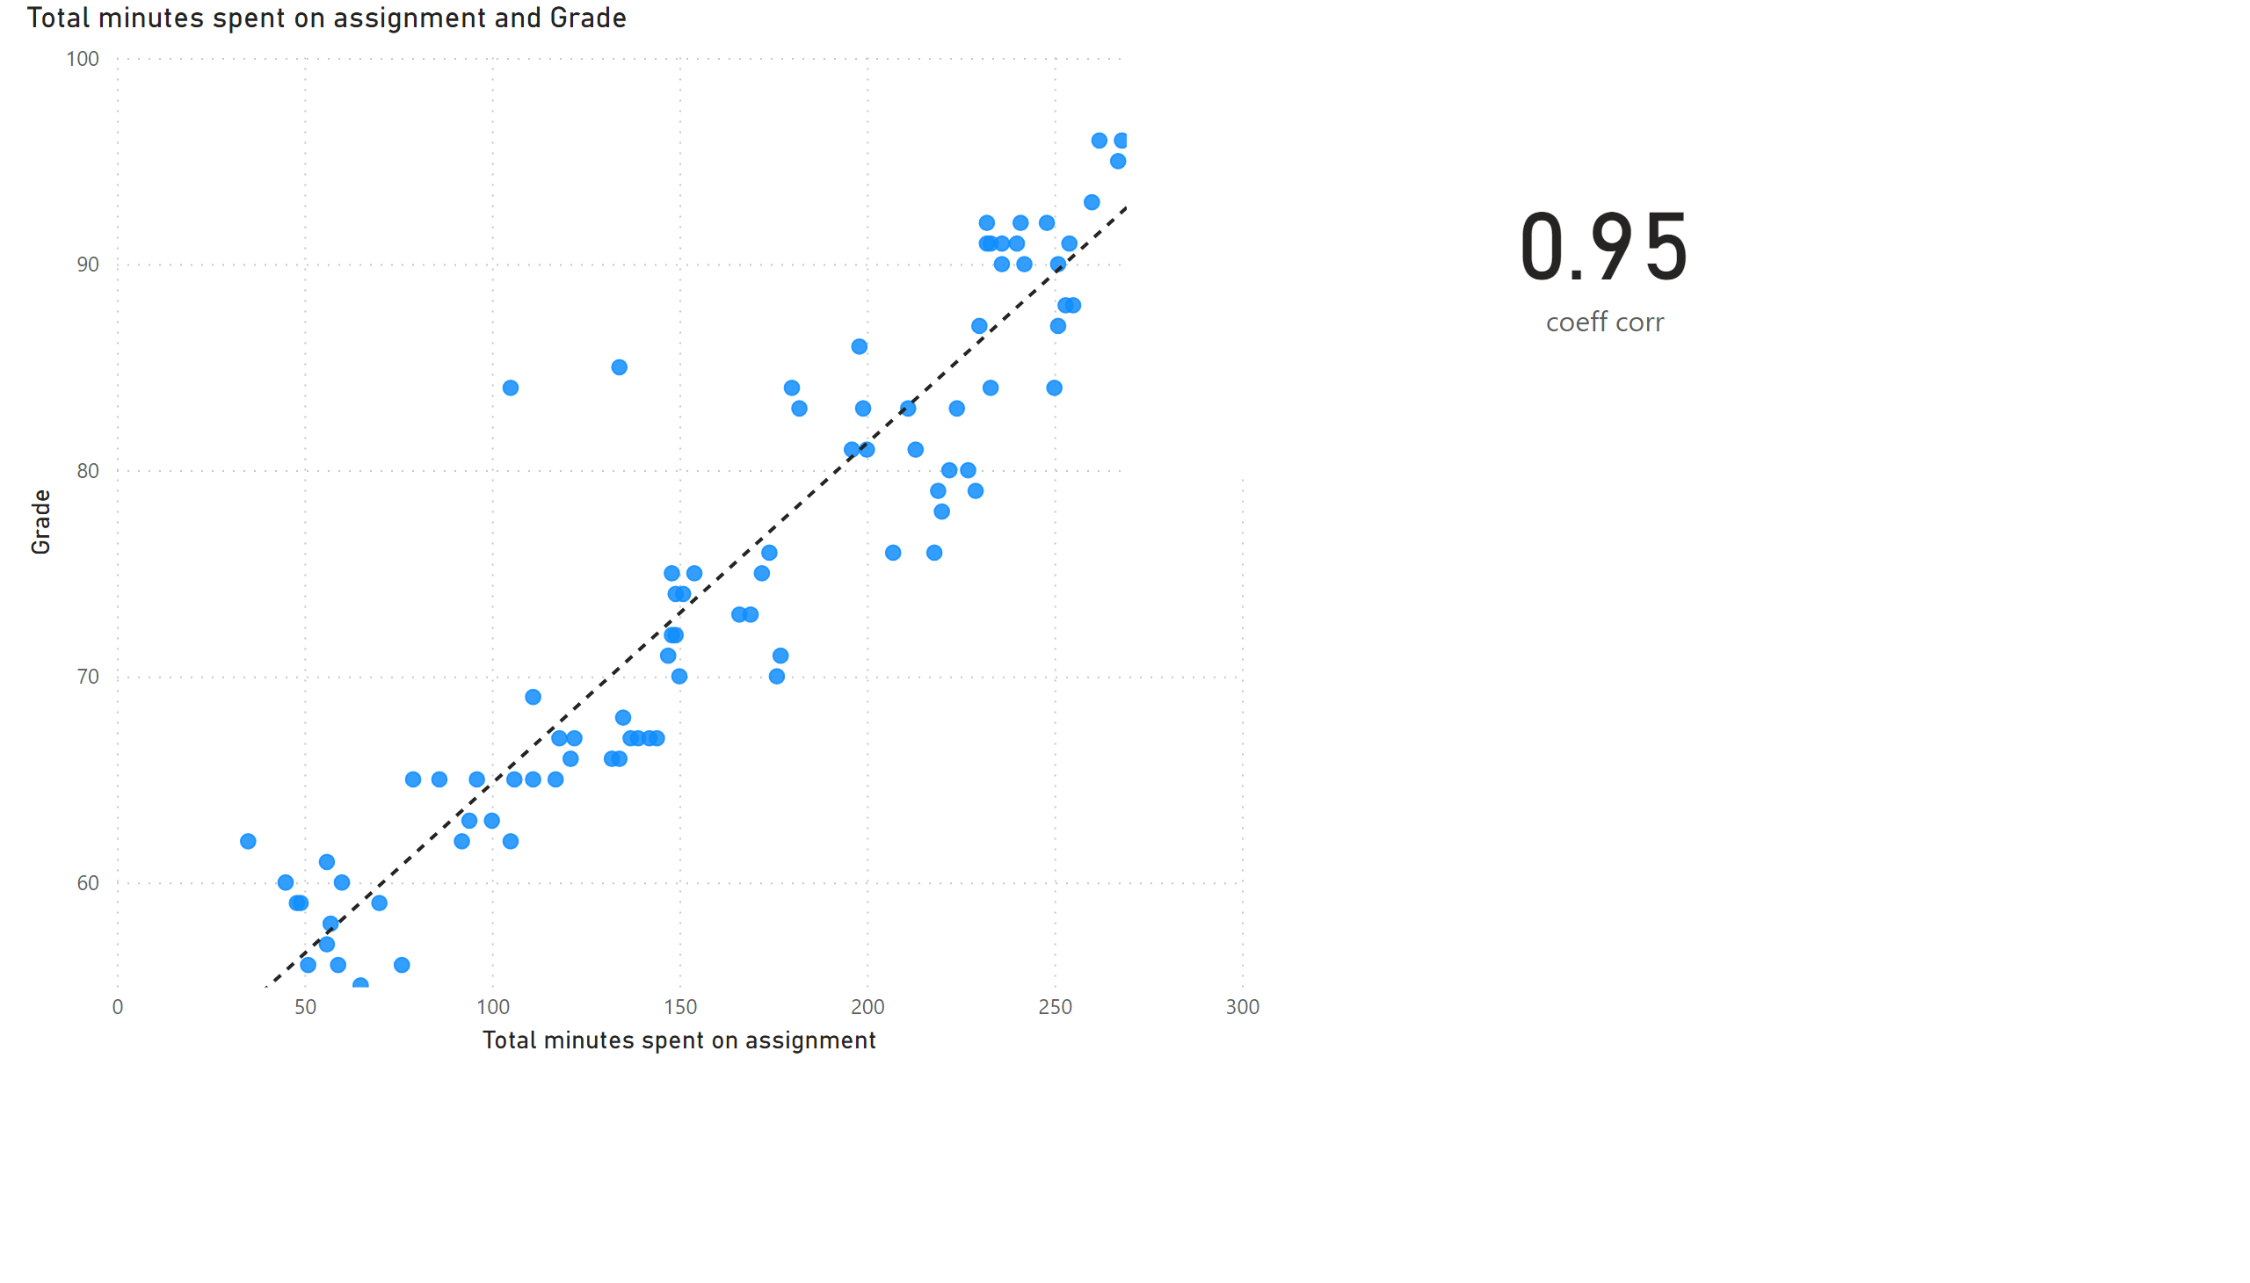
Scatter Plot
Notes:
scatterChart
No alt text provided
card
No alt text provided

