Slide 1

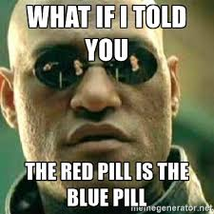
Digital Identity in a Smart Economy NEO Smart Contract Implementation
4-Nov-2018
Notes:
We are the Team 4, City of Zurich.
We will present a smart contract architecture for Digital Identity in a Smart Economy.
To quote Morpheus in the movie Matrix, identity is a key topic and a smart economy based on digital identities shall be able to deal with identity theft, fake identities

Slide 2
Identity on the NEO Blockchain for a Smart Economy
Overview: 3 Types of Smart Contracts – Identity Provider SC, Delegator SC and Identity Token
Passport Prov.
Driver Lic. Prov.
KYC / AML Prov
Citizens’ list
Car drivers’ list
Investors’ list
Identity Token IDK
Delegator (ICO Comp.)
Claims:
“I am Human”
“Over 18”
“Have Driving License”
“KYC / AML Approved”
[…]
Verify Claims
Notes:
For identity management, our smart economy requires three smart contracts:
The Identity Provider Smart Contract
The Identity Token (IDK), also the abbreviation of «I Don’t Know»
A Delegator Smart Contract, which will verify the respective claim
For example, a policeman may control your driving license. Your Identity Token claims that you have a Driving License. The Policeman using the Delegator Smart Contract will verify that claim, by making sure that the token identifier is mentioned in the resp. list of cars

Slide 3
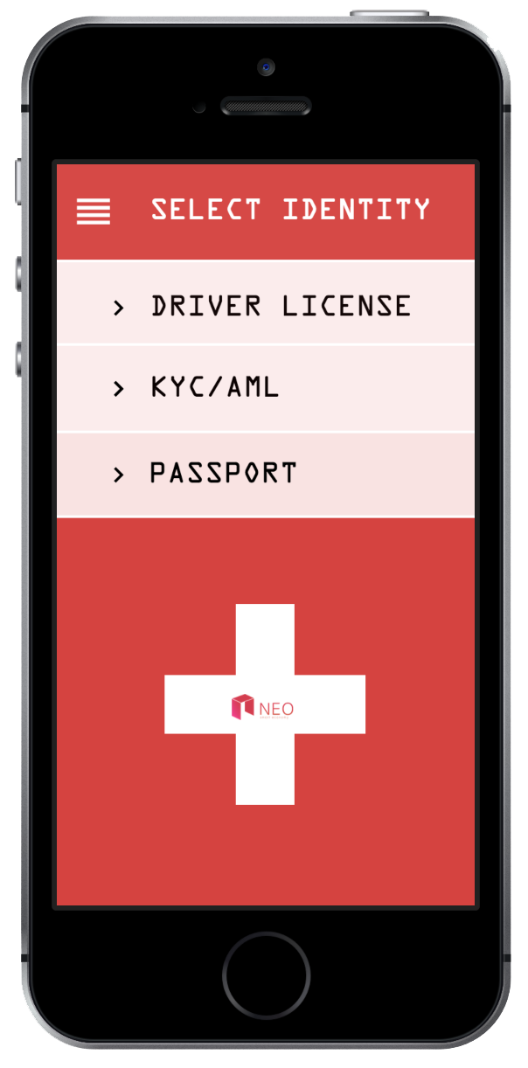
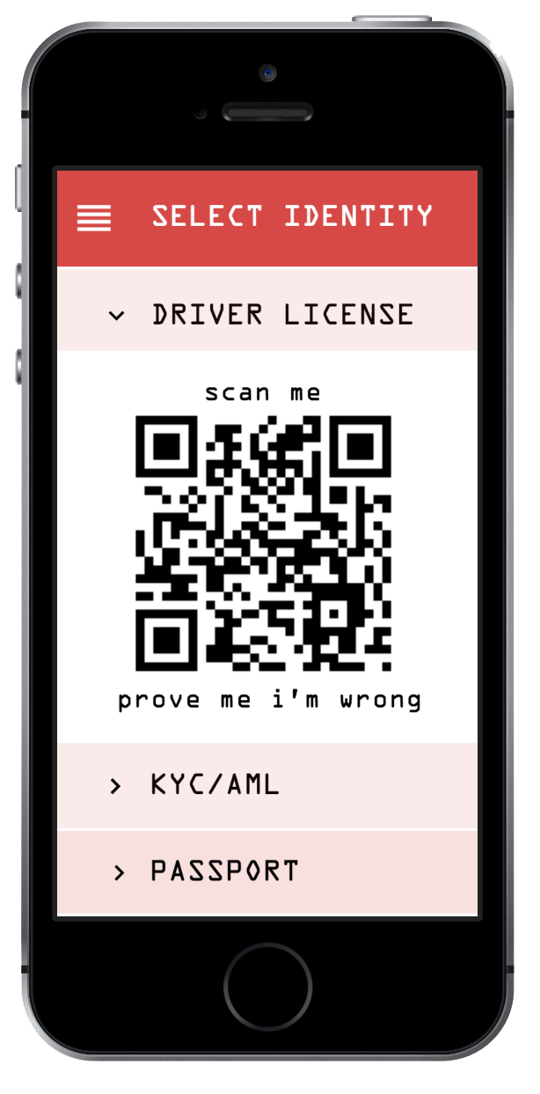
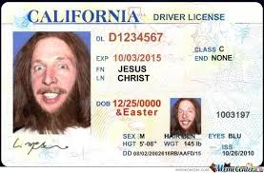
UI - Demo
Illustrative Overview
Notes:
This illustrates, how this works. The policeman would scan the resp. QR code and obtain an answer that the owner of that phone has a driving license for the relevant category
This has to be combined with a biometric check of course
In the following, we will illustrate in more details, why such a structure helps to realize a smartER economy using the example of KYC / AML processes in the context of ICOs

Slide 4
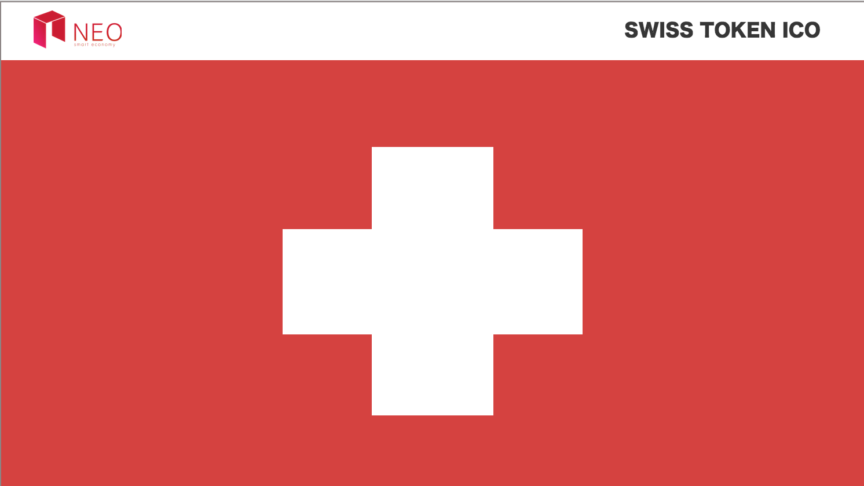
Demo
Illustrative Overview
Notes:
This illustrates, how this works. The policeman would scan the resp. QR code and obtain an answer that the owner of that phone has a driving license for the relevant category
This has to be combined with a biometric check of course
In the following, we will illustrate in more details, why such a structure helps to realize a smartER economy using the example of KYC / AML processes in the context of ICOs

Slide 5


KYC / AML Requirements
We «LOVE» Bureaucracy and Exclude Investors with less Assets – Reality of the ICO Market
Investor 1
ICO 1
Investor 2
ICO 2
Investor 3
ICO 3
Heavy KYC / AML of ALL investors at EACH ICO
3x3=9 KYC / AML Processes required
Exponential costs
Exclude investors with less assets
Less diversification potential
Notes:
Currently, KYC / AML requirements are increasing more and more and all investors have to go through a heavy KYC / AML at EACH ICO
For 3 investors and 3 ICOs, we are required to run 9 different processes
This increases the costs exponentially

Slide 6
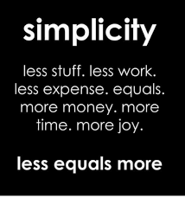
Get back the Control of your Identity
Exponential Improvement through fungible non-transferrable Identity Tokens
Investor 1
ICO 1
Investor 2
ICO 2
Investor 3
ICO 3
Step 1: Whitelist investors
Step 2: Combine whitelists of different KYC / AML providers
Step 3: N*N -> N KYC / AML Providers required
Notes:
Investors are whitelisted at the source
Instead of 9 KYC / AML processes, you have 3 processes. In the case of 10 investors and 10 ICOs, you are saving 90 KYC / AML processes. This system leads to exponential improvement, in terms of saving time & efforts

Slide 7
Data Required with the KYC / AML Provider
Illustrative Overview
Data Requirements for a specific KYC / AML Provider Smart Contract
Address KYC Provider: AV9umY6yj3DYbyEgaZqiawhFTneEWipfbR
KYC / AML Doc (Hash): ba7816bf8f01cfea414140de5dae2223b00361a396177a9cb410ff61f20015ad
Time Stamp: YYYYMMMDDHHMMSS
Address Wallet: AgaZqiawhFTneEWipV9umY6yj3DYbyEfbR
Value in Wallet at KYC: 500 NEO
INVESTMENT 1
INVESTMENT 2
INVESTMENT 3
INVESTMENT 4
Notes:
This illustrates briefly, how lean a provider smart contract will be:
One address of the provider
One hash of the KYC / AML documentation
One time stamp of the KYC / AML documentation
One address for the relevant Wallet and the value in the wallet, which was KYCed
Instead of 4 KYC processes for 4 ICOs, you just need 1 KYC for that specific investors

Slide 8
Benefits
Key Requirements
Key Features
Functional
Lean smart contract architecture and DApp
Ease of Use
Integration of a NFT with all identity claims at one place
Stability
Key Functionalities de-centralized
Performance
Strict minimum in the chain, 2nd layer channel off-chain
Originality
Bringing a simple NEO standard to Identity Providers

