Slide 2
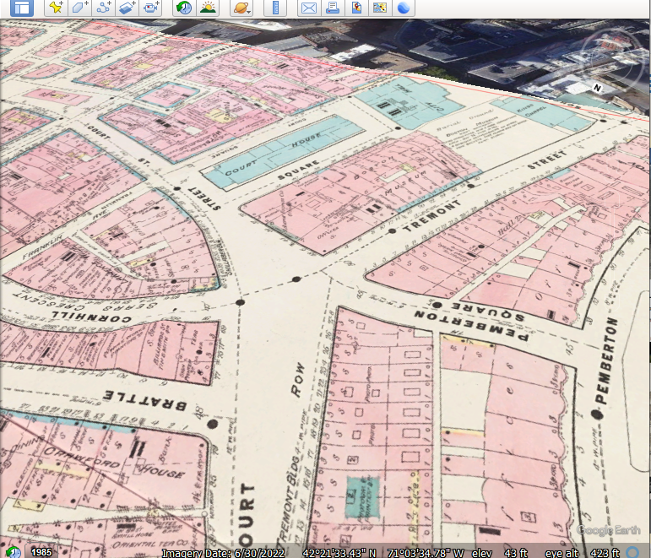
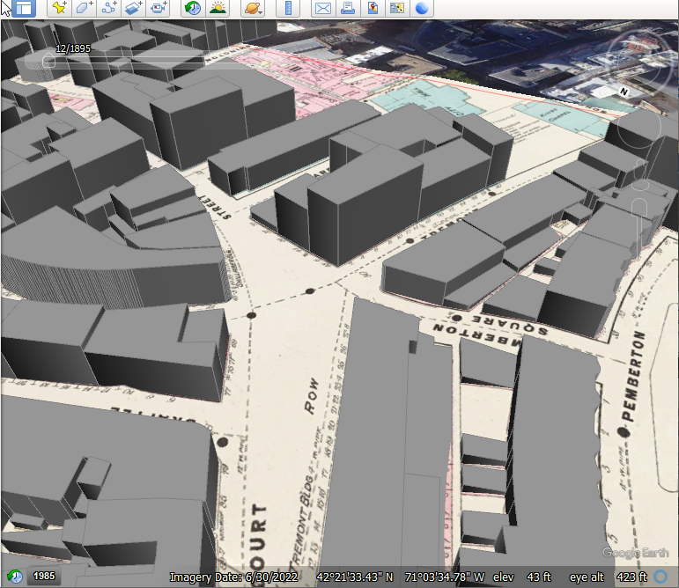
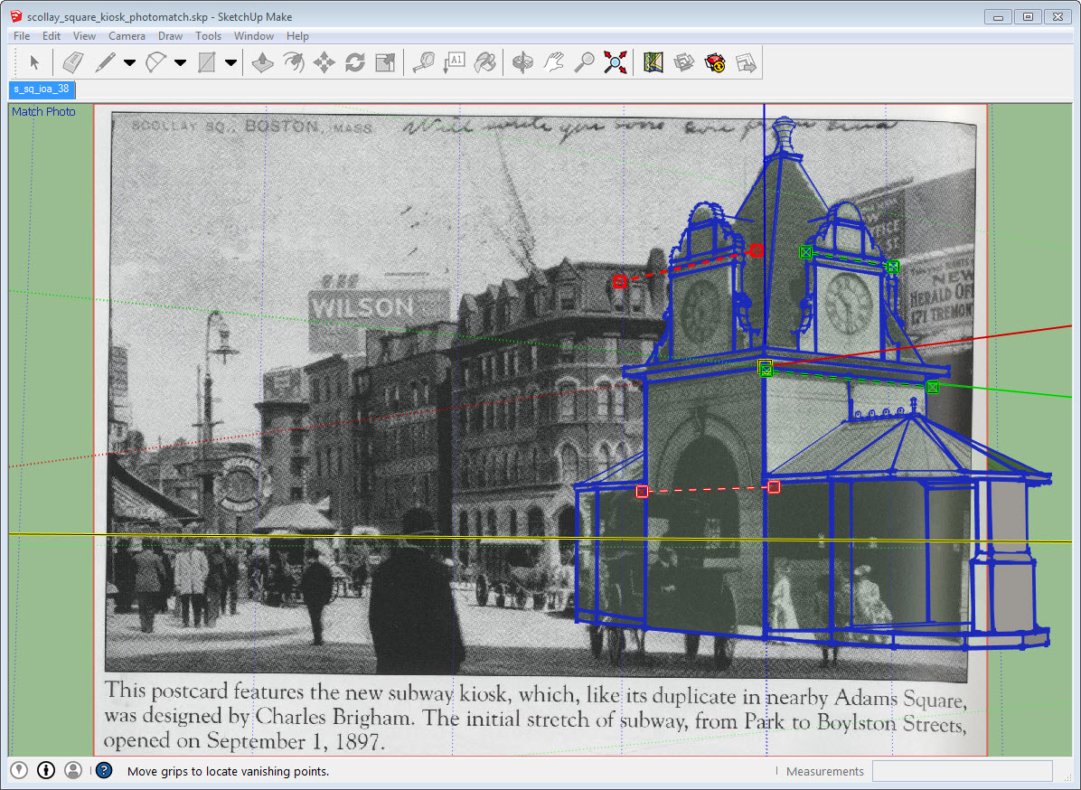
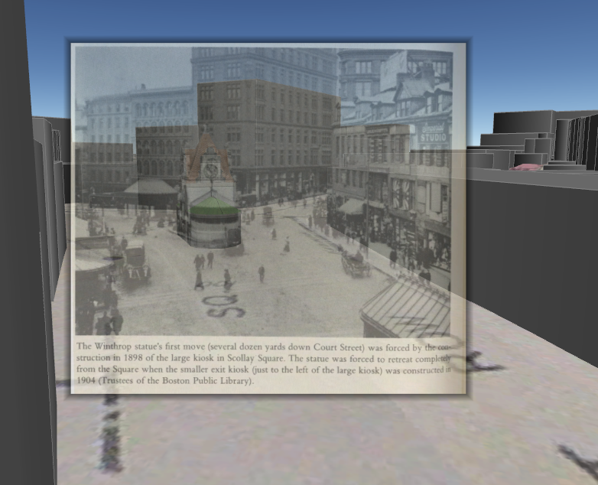
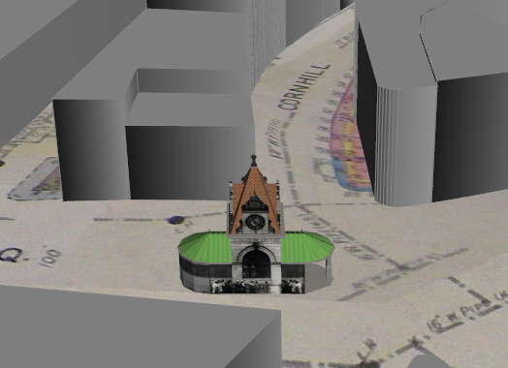
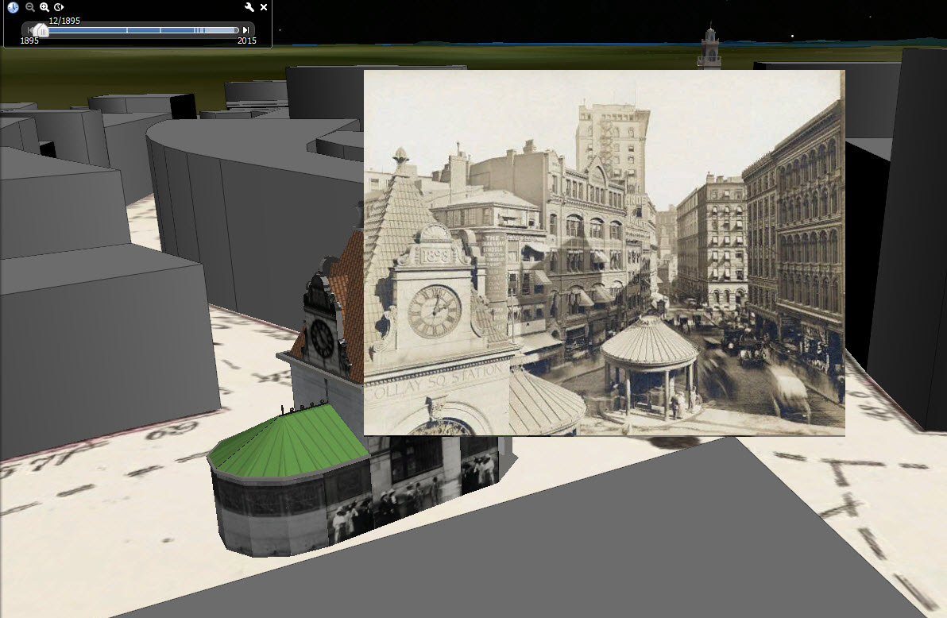
City Models demonstrate the power of 4D Referencing as a value- multiplier for Digital Historical Imagery
One term we focused on developing a 4D model of the historic Scollay square which was demolished in the early 1960s to clear the area now known as Government Center.
Georeference old fire insurance maps, trace buildings to polygons in GIS.
Extrude 2.5-D building models. Add attributes for appear and disappear dates. Export to KMZ
Use photos to create detailed 3d model of old landmark Buildings using Sketchup.
In Google Earth use rough 3d model as reference for 3D georeferencing of perspective photos.
Use more georeferenced photos to locate building geographically,
Use Building location to contextualize more photographs.
This experience proved to be a huge Aha! moment pointing out the magic of 4D georeferencing systems as an EXPLOSIVE resource multiplier for historic maps, 3D Models and perspective imagery.
1.
3.
2.
4D Georeferencing is the oldest and still the coolest demonstration of Semantically Linked Data!
4.
6.
5.

Slide 3
City Models demonstrate the power of 4D Referencing as a value- multiplier for Digital Historical Imagery
One term we focused on developing a 4D model of the historic Scollay square which was demolished in the early 1960s to clear the area now known as Government Center.
Georeference old fire insurance maps, trace buildings to polygons in GIS.
Extrude 2.5-D building models. Add attributes for appear and disappear dates. Export to KMZ
Use photos to create detailed 3d model of old landmark Buildings using Sketchup.
In Google Earth use rough 3d model as reference for 3D georeferencing of perspective photos.
Use more georeferenced photos to locate building geographically,
Use Building location to contextualize more photographs.
This experience proved to be a huge Aha! moment pointing out the magic of 4D georeferencing systems as an EXPLOSIVE resource multiplier for historic maps, 3D Models and perspective imagery.

Slide 4
City Models demonstrate the power of 4D Referencing as a value- multiplier for Digital Historical Imagery
One term we focused on developing a 4D model of the historic Scollay square which was demolished in the early 1960s to clear the area now known as Government Center.
Georeference old fire insurance maps, trace buildings to polygons in GIS.
Extrude 2.5-D building models. Add attributes for appear and disappear dates. Export to KMZ
Use photos to create detailed 3d model of old landmark Buildings using Sketchup.
In Google Earth use rough 3d model as reference for 3D georeferencing of perspective photos.
Use more georeferenced photos to locate building geographically,
Use Building location to contextualize more photographs.
This experience proved to be a huge Aha! moment pointing out the magic of 4D georeferencing systems as an EXPLOSIVE resource multiplier for historic maps, 3D Models and perspective imagery.

Slide 5
City Models demonstrate the power of 4D Referencing as a value- multiplier for Digital Historical Imagery
One term we focused on developing a 4D model of the historic Scollay square which was demolished in the early 1960s to clear the area now known as Government Center.
Georeference old fire insurance maps, trace buildings to polygons in GIS.
Extrude 2.5-D building models. Add attributes for appear and disappear dates. Export to KMZ
Use photos to create detailed 3d model of old landmark Buildings using Sketchup.
In Google Earth use rough 3d model as reference for 3D georeferencing of perspective photos.
Use more georeferenced photos to locate building geographically,
Use Building location to contextualize more photographs.
This experience proved to be a huge Aha! moment pointing out the magic of 4D georeferencing systems as an EXPLOSIVE resource multiplier for historic maps, 3D Models and perspective imagery.
1.
3.
2.
4D Georeferencing is the oldest and still the coolest demonstration of Semantically Linked Data!
4.
6.
5.

Slide 6
City Models demonstrate the power of 4D Referencing as a value- multiplier for Digital Historical Imagery
One term we focused on developing a 4D model of the historic Scollay square which was demolished in the early 1960s to clear the area now known as Government Center.
Georeference old fire insurance maps, trace buildings to polygons in GIS.
Extrude 2.5-D building models. Add attributes for appear and disappear dates. Export to KMZ
Use photos to create detailed 3d model of old landmark Buildings using Sketchup.
In Google Earth use rough 3d model as reference for 3D georeferencing of perspective photos.
Use more georeferenced photos to locate building geographically,
Use Building location to contextualize more photographs.
This experience proved to be a huge Aha! moment pointing out the magic of 4D georeferencing systems as an EXPLOSIVE resource multiplier for historic maps, 3D Models and perspective imagery.
1.
3.
2.
4D Georeferencing is the oldest and still the coolest demonstration of Semantically Linked Data!
4.
6.
5.

