Slide 1
1. Set Theory

Slide 2
What is a set?
A set is a well-defined collection of objects
No duplication, no order
Elements (∈) are members of set
Notation: { }
Eg {1,2,3,4}
Notation: ∈, ∉
Eg 1 ∈ {1,2,3,4}

Slide 3
Set comprehension
Notation: | is “such that”
Notation: U is the universal set (all possible elements)
Define sets as elements that satisfy a property.
eg {x | x is an integer and 1≤x≤5} = {1,2,3,4,5}
{x^2 | x is an integer and 1≤x≤4} = {1,4,9,16}
U = {1,2,3,4,5} : {x | x^2≤U} = {1,2}

Slide 4
Exercise
Give a set comprehension for the set of all odd numbers
Where U = {0, 1, 2, …, 10}, give all the elements of: {x | x∈U, 3x ≤ 22}
{x | x is an integer and x is odd} or {x | x is an integer and x is not divisible by 2} or {x | x is an integer and x mod 2 = 1}
{0,1,2,3,4,5,6,7}

Slide 5
Cardinality and subsets
Cardinality – number of elements in a set
Notation: |A| is the cardinality of A
A = {a,b,c,d,e} : |A| = 5
D = {1,2,2,4,4,5} : |D| = 4 (due to duplicates)
Notation: ⊆,⊂, ⊈, ⊄
eg {1,2} ⊆ {1,2,3,4} (all elements exist in subset)
⊆ - exist in subset / ⊈ - doesn’t exist in subset
⊂ - left subset is less than right / ⊄ - vice versa

Slide 6
Exercise
If A = {2, {3}, 1, {2, 3}}, which of these is true?
P
1 ∈ A
3 ∈ A
{2} ∈ A
{2,3} ∈ A
1 ⊆ A
{3} ⊆ A
{{2,3}} ⊆ A
{2} ⊆ A
What is |A|
P
✗
= 4︎
✗
P
✗
✗
P

Slide 7
Emptyset, Powerset
Emptyset Notation: ∅
|∅| = 0, ∅ ≠ {∅}, |∅| = 1
∅ ⊆ A, for my set A
Powerset Notation: P(A)
A = {1,2}, |A| = 2
B(A) = {∅,{1},{2},{1,2}}
|B(A)| = 4, |B(A)| = 2^|A|

Slide 8
Exercise
If A = {a, b, c}, what is P(A) ?
{∅, {a}, {b}, {c}, {a,b}, {a,c}, {b,c}, {a,b,c}}

Slide 9
Number systems:
Naturals: N
Integers: Z
Rationals: Q
Reals: R
Complex: C

Slide 10
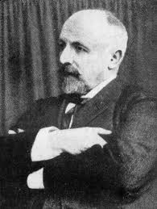
Georg Cantor
http://mathematiquexxsiecle.free.fr/Georg%20Cantor.html

Slide 11
N and Q
1/1 1/2 1/3 1/4
2/1 2/2 2/3 2/4
3/1 3/2 3/3 3/4
4/1 4/2 4/3 4/4

Slide 12
N and R
Suppose R is enumerable
Then:
r₁: 0. 1 5 4 3 7 …
r₂: 0. 4 9 8 1 4 …
r₃: 0. 7 6 3 3 6 …
r₄: 0. 2 2 3 5 2 …
etc…

Slide 13
N and R
Now build a new number by selecting the n^{th} digit of r_{n} and changing it by
0 ⟼ 2, 1 ⟼ 3, 2 ⟼ 4, 3 ⟼ 5, 4 ⟼ 6, 5 ⟼ 7, 6 ⟼ 8, 7 ⟼ 9, 8 ⟼ 0, 9 ⟼ 1
Now consider the diagonal
This must be r_{i} for some i.
But then, the i^{th} digit of r_{i} is different from itself.
A contradiction, hence R is not enumerable.

Slide 14
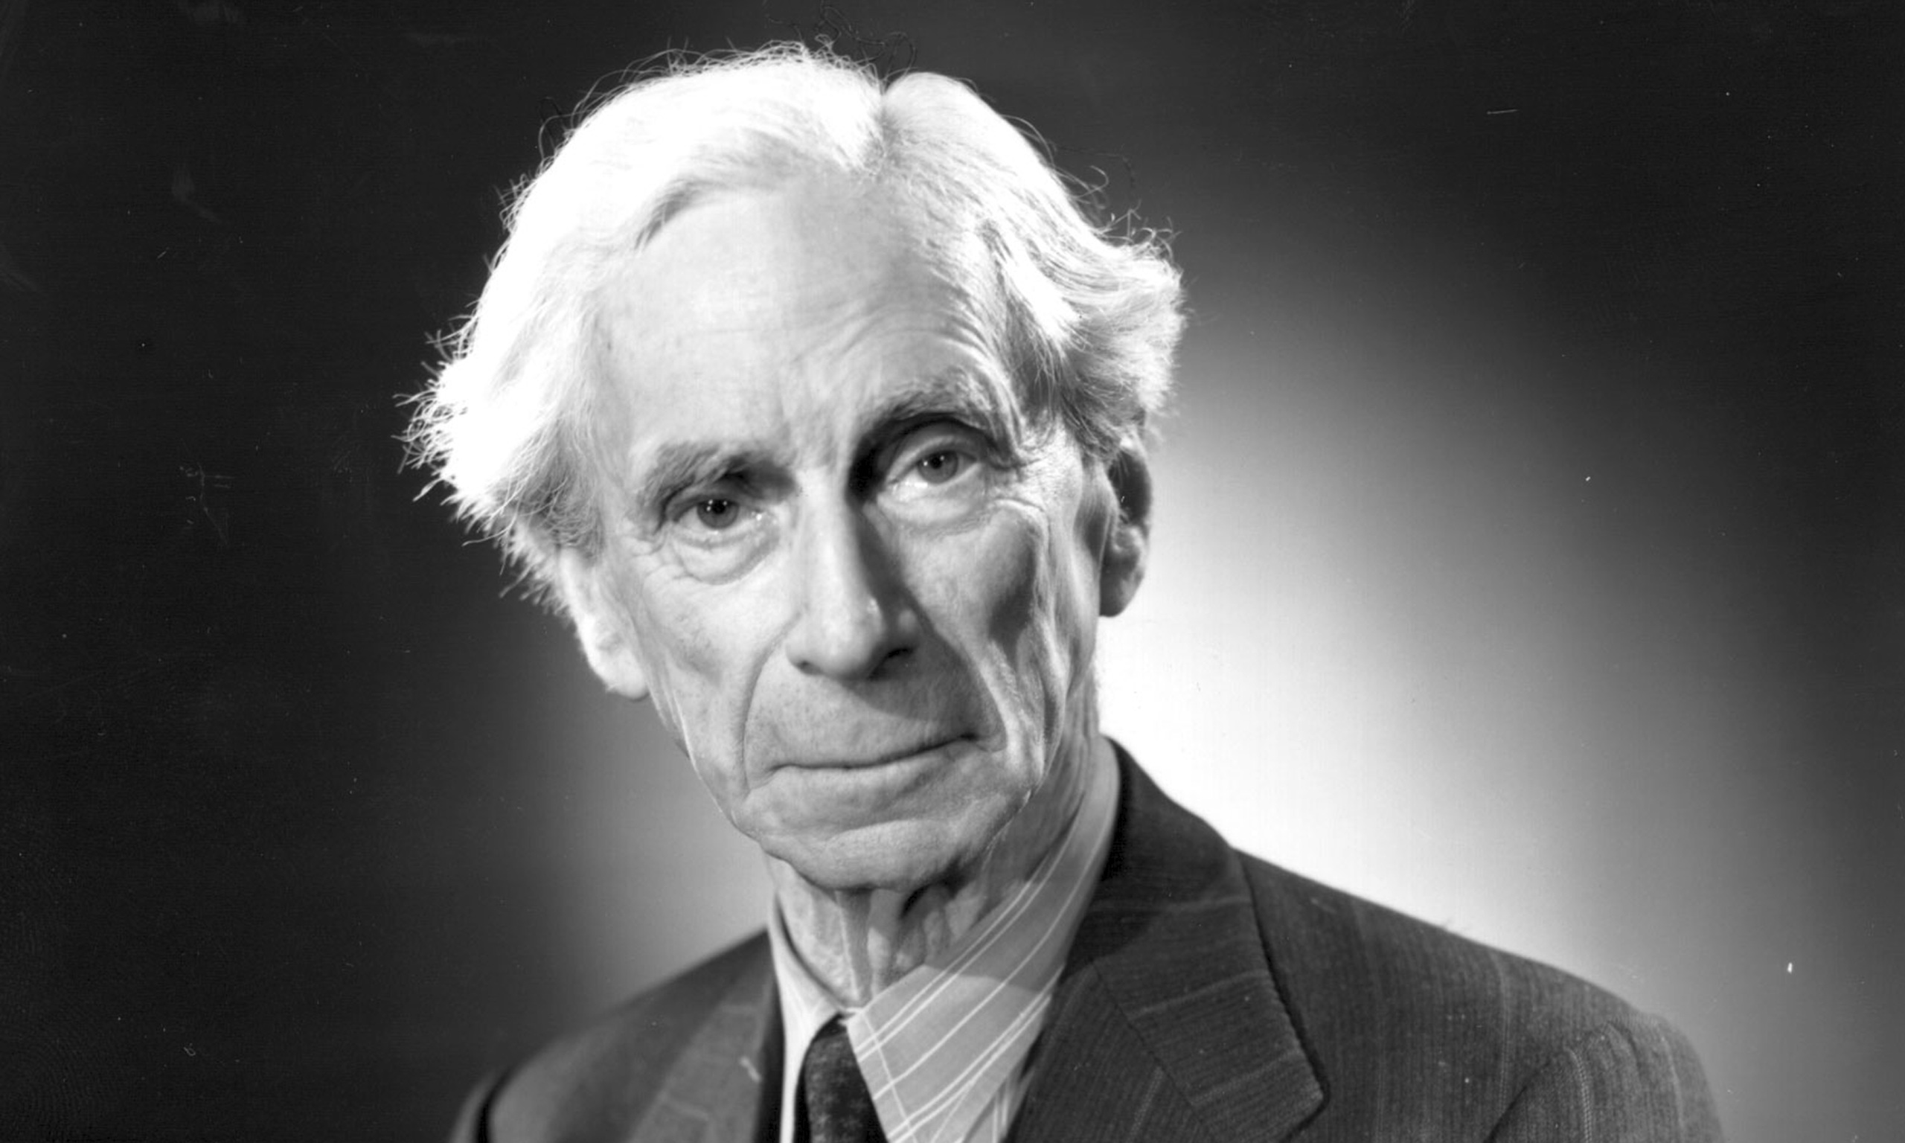
Bertrand Russell
http://www.theguardian.com/commentisfree/2014/jan/06/bertrand-russell-everyday-value-of-philosophy

Slide 15
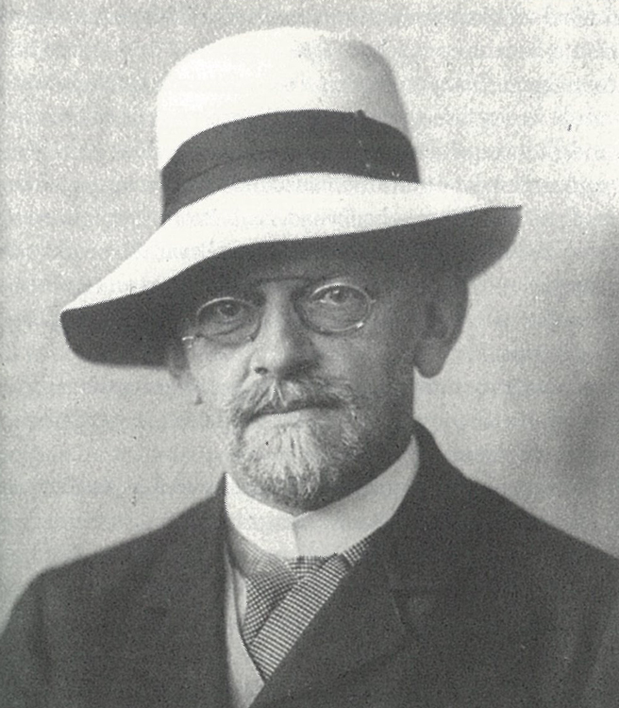
David Hilbert
http://www.aventdudomainepublic.org/2013/12/david-hilbert/

Slide 16
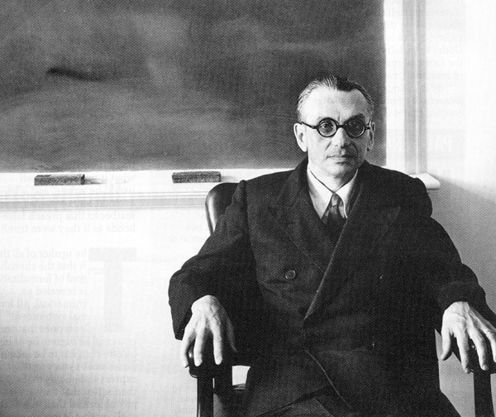
Kurt Gödel
http://www.rudyrucker.com/blog/2012/08/01/memories-of-kurt-godel/

