Slide 1
Secure Processor
True Random Number Generator
Arthur Chung

Slide 2
Outline
Target
TRNG Evaluation Platform
- Shared Folder function in Oracle VM VirtualBox
Q & A

Slide 3
Target
An FPGA-based TRNG without post-processing
- it can pass both DIEHARD and NIST Tests
Study the proposed TRNG
Figure out its best performance
Optimize the proposed TRNG to achieve the goal

Slide 4
TRNG Evaluation Platform
Virtex-6 Kit
100 MHz
PC
ASCII
Format
Data
USB
Cable
Hyper-
Terminal
(Random
Data in
Text file)
FSL Link
Xilinx
MicroBlaze
Soft Processor
USB
UART
(RS232)
TRNG
Throughput: About 200 MB Random Data per 40 mins

Slide 5
TRNG Evaluation Platform
Pass Random Data (RN data) into Linux
(Gust OS in Oracle VM VirtualBox)
Perform DIEHARD and NIST Tests
Reason of using Linux:
i) DIEHARD test program runs with bugs in Windows but it runs perfectly in Linux
ii) NIST test program is designed for running in Linux

Slide 6
Shared Folder Function in
Oracle VM VirtualBox
How to efficiently pass RN data into Linux (Gust OS in VM) ?
Ans: Use Share Folder
Use the Shared Folder Function provided by VirtualBOX
Drag and Drop the RN data into the shared folder and the Linux in VM can get it at once
Then, do the tests directly !!
Advantages:
i) everything can be done internally inside PC (convenient)
ii) no need to go through share network drive (no network, much safer)
iii) no need to use any portable device mapping (no portable device)

Slide 7
TRNG Evaluation Platform
DIEHARD Test Conditions:
- Input RN data: 11.5 MB (binary format)
- Comply with DIEHARD standard
(Use the ASCII to Binary converter provided by the test suite for data conversion)
NIST Test Conditions:
- Input RN data: 260 MB (ASCII format)
(No need to do any conversion as NIST accepts ASCII format)
- Bitstream Length: 2068480
- No. of bitstreams: 128
- Comply with NIST standard

Slide 8
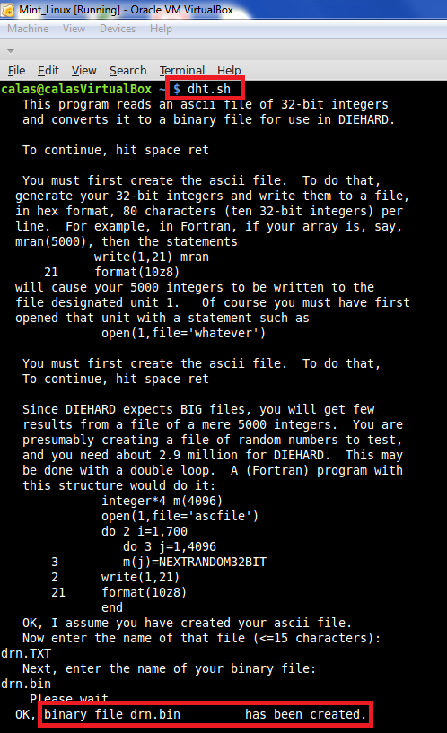
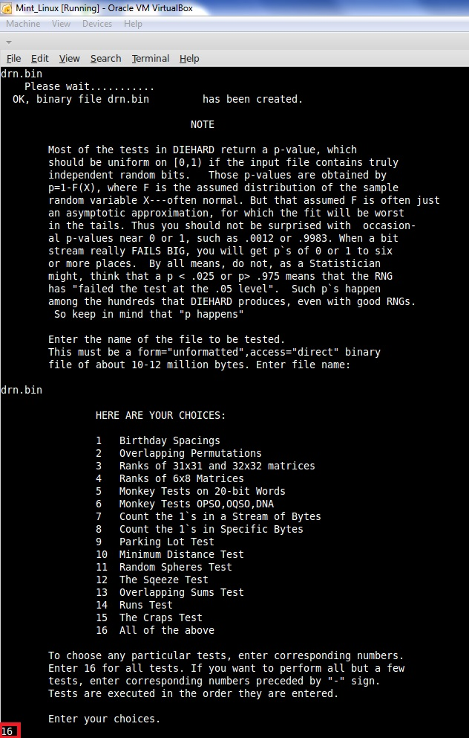
TRNG Evaluation Platform
DIEHARD Test

Slide 9
TRNG Evaluation Platform
DIEHARD Test (con’t)
- after getting the results,
execute bash script “ca.sh” (written by me)
- delete the Input RN data and the generated binary file
- prevent any confusion
- reset the Terminal
Clear Up everything !!
Start flash in the next test !!

Slide 10
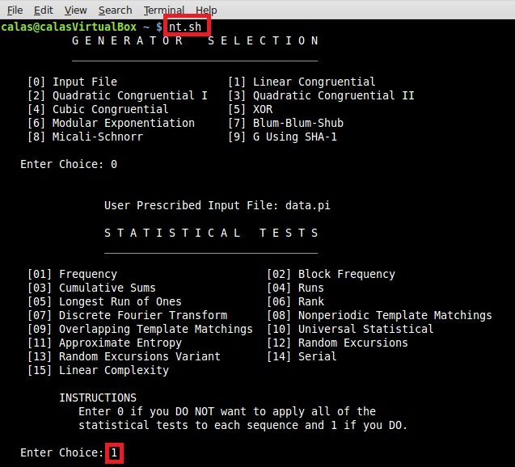
TRNG Evaluation Platform
NIST Test

Slide 11

Q & A

