Slide 1


Capstone Project - The Battle of Neighborhoods
An Entrepreneurial search to open a chain of Indian Restaurants in New York
RANJITHKUMAR PALANIAPPAN

Slide 2
Introduction
New York, The City of Dreams is known for its multicultural community of people at all facets of life known for its excellent cuisine. It's food culture includes an array of international cuisines influenced by the city's immigrant history.
In regard to that, the utilization of Data Science will help in the increase of ROI, reduction of risk while looking for expanding or venturing new businesses.

Slide 3
Business Problem
The bustling city with a growing number of New Yorkers, Indians and non-Indians, are mulling over the passage to India through spicy delicious foods. There are dozens of pricy fancier Indian restaurants across the city.
So to distinguish from them, it is not only necessary to focus on the product offerings of a new franchise, but also to select the right locations for it.
One of my Acquaintance wants to open his business in New York or in the surrounding boroughs, so I focus on developing a concrete evidence.

Slide 4
Data Selection
The objective is to find the best locations for opening the new Indian restaurant:
so we are going to analyze the dataset corresponding to New York Neighborhoods. This dataset exists for free at the NYU Spatial Data Repository. Link to the dataset is:
https://geo.nyu.edu/catalog/nyu_2451_34572
From Foursquare Venues Categories - https://developer.foursquare.com/docs/resources/categories
Category "Indian" cuisine’s id: 4bf58dd8d48988d10f941735

Slide 5
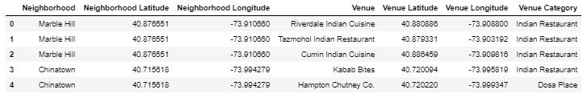
Data Selection
Next, we also used Google Map API to find the geographic coordinates of the VENUES corresponding to Indian Cuisine
Table 1: Data frame containing geographic coordinates of top 5 locations

Slide 6
Methodology
Our main goal is to get optimum location for the first branch of the chain of restaurants in New York City. Analytic Approach:
New York city neighborhood has a total of 5 boroughs and 306 neighborhoods. clustering of venues will be done as part of the following Exploratory data analysis.
Data 1- New York city Geographical Coordinates Data
In this we load the data and explore data from networks data.json file.
Transform the data of nested python dictionaries into a pandas dataframe and Addresses are converted into their equivalent latitude and longitude values.
We used geopy and folium libraries to create a map of New York city with neighborhoods superimposed on top.
.

Slide 7
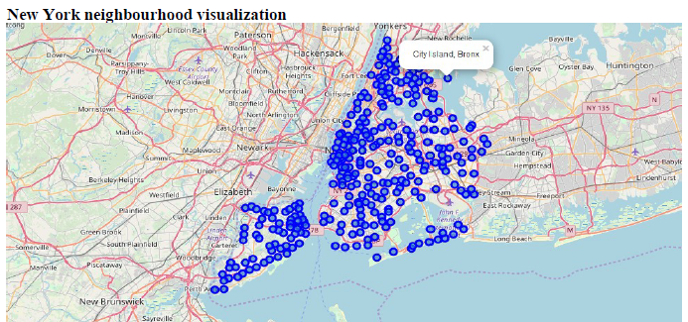
Methodology
Addresses are converted into their equivalent latitude and longitude values.
Foursquare API is used to explore neighborhoods in Manhattan, New York.

Slide 8
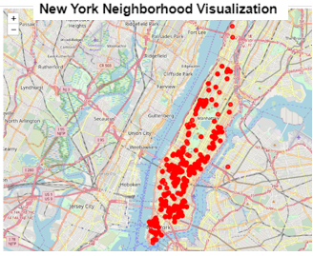
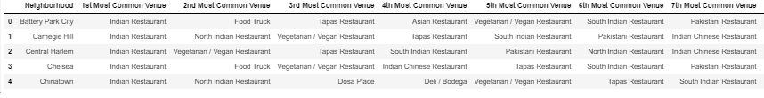
Methodology
New York city geographical coordinates data has been utilized as input for the Foursquare API with explore endpoint and mapped the Indian Restaurants
Then using this feature to group the neighborhoods into clusters K-means clustering algorithm to complete the task. And also, the Folium library to visualize the neighborhoods in Manhattan and its emerging clusters
TOP VENUES

Slide 9
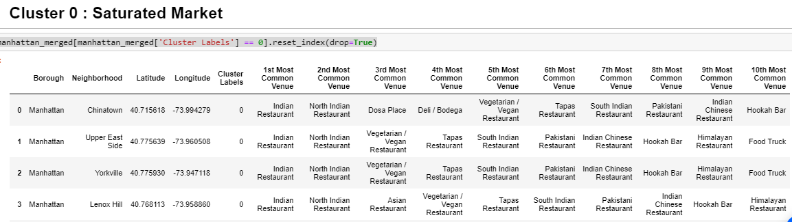
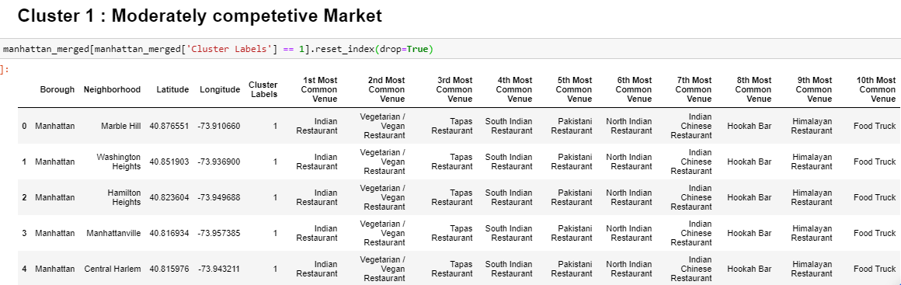
Results
Very High Competition with 16 groups
Moderate competition with 8 groups

Slide 10
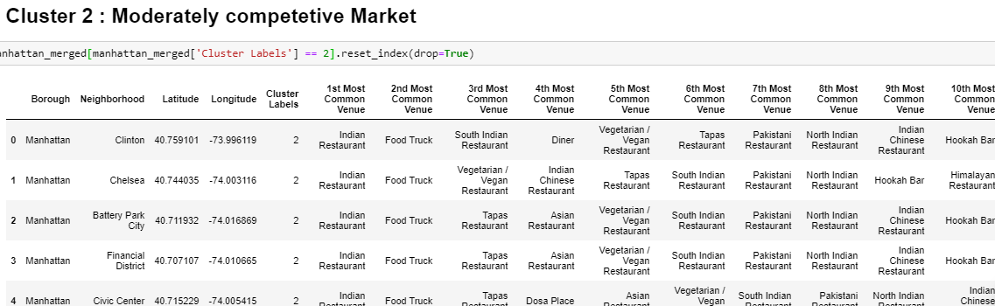
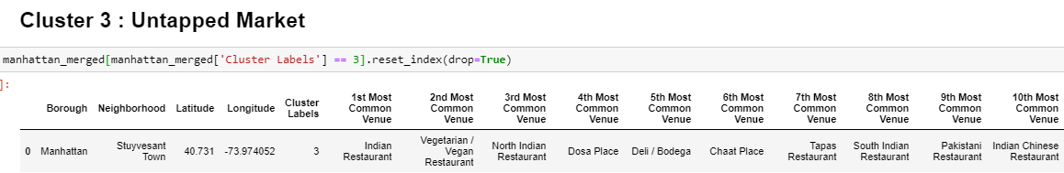
Results
Moderate Competition with 6 groups
LOW competition with 1 group

Slide 11
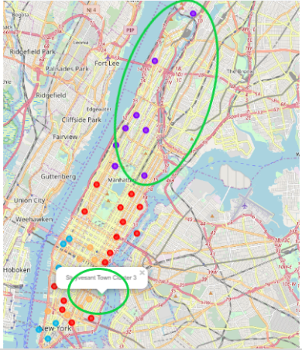
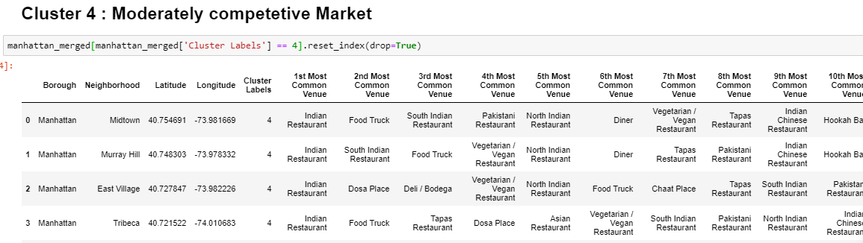
Results
We can notice that within 3 clusters can be opted for opening a new restaurant as follows:
High Competition with 9 groups
Stuyvesant Town Cluster 3
Washington heights Cluster 1
Civic center Cluster 2

Slide 12
Discussion
There is scope to include Farmers markets data analysis to optimize procurement for the restaurants.
There is scope to explore cuisines of Chinese and Japanese to leverage furthermore business opportunities.
A more detailed analysis can be done by adding other factors such as transportation, demographics of inhabitants.

Slide 13
Conclusion
This analysis is performed on limited data to explore the possibilities of analytical approach towards finding the best location for the franchise.
To conclude, this analysis proves to be a start of selecting a low risk-high yield location. On further development, it can be rendered into an efficient evidence with better accuracy and precision.

