Slide 1
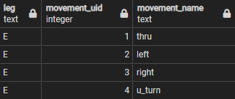
Vehicle Movement – think of it as a point
Leg = N
N
3
1
MVT
Leg = W
Leg = E
4
2
Leg = S

Slide 2

Pedestrian movement
Leg = N
ccw
cw
N
cw
ccw
cw
ccw
Leg = W
Leg = E
cw
ccw
cw
clockwise
ccw
counter- clockwise
Leg = S

Slide 3
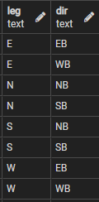
ATR – think of it as a line. you cross one line going in and one line going out of the intersection
Leg = N
SB
(in)
A T R
N
NB
(out)
A
T
R
WB
(out)
A
T
R
WB
(in)
Leg = W
Leg = E
EB
(in)
EB
(out)
SB
(out)
A T R
NB
(in)
Leg = S

Slide 4
One leg zoom in
Leg = N
Leg E, WB
All vehicles approaching the intersection from the eastern leg
N
SB
NB
Leg E In
A
T
R
Leg E In…
WB
WB
Leg = W
Leg = E
and Out!
EB
EB
(u-turn)
Leg E, EB
All vehicles exiting the intersection via the eastern leg
SB
NB
Leg = S
Leg E Out

