Slide 1
Quick Review of C Programming
Data Types
ANSI C
  Console Output: printf
  Console Input: scanf, gets, getchar
  File I/O: fopen, fclose, fprintf, fscanf, fgets, fgets, feof
  String Manipulation: sprintf, sscanf
Arithmetic Functions
Bitwise Operations

Slide 2
Data Types

Slide 3
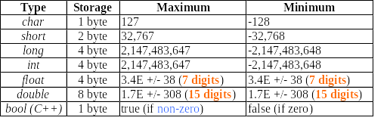
Data Types
Important for ACM questions as there are usually restrictions on memory usage and input/output number range

Slide 4
Data Types
Tips for ‘int’ type:
‘int’ is actually a type of undefined size.
For old compilers (e.g. Turbo C), it is equivalent to ‘short’ (16 bits)
For newer compilers (Visual C), it is the same as ‘long’ (32 bits)
Tips for ‘float/double’ type:
‘float’ uses 32-bit. It has at least 7-digit precision
‘double’ uses 64-bit, the range is larger and has 15-digit precision. (so we usually use ‘double’)

Slide 5
Data Types – Unsigned Version
Each integer data type (i.e. char, short, long, int) has an ‘unsigned’ version, whose positive range is doubled. The smallest value is 0.
e.g.
char = [-128 ...127]
unsigned char = [0 … 255]
A floating point data type (i.e. float, double) or bool does not have `unsigned’ version.
Tips for ‘char’ type:
‘ char’ is an 8-bit type, for storing ASCII character. Its array forms a string (e.g. char[10]).
‘char’ & ‘unsigned char’ can actually be used for storing small numbers. {-128..127} and {0..255}, respectively

Slide 6
Data Types
If the number is too large…
  Try ‘unsigned’ version
  Try larger type such as ‘long’ or ‘double’
  Some compiler has ‘long long’ and ‘long double’ type, which uses 64bits/80bits. But those types are not standard and may not be supported. (e.g. Visual C++ does not support it)
  For ACM questions, a few even requires you to write your own type. (500 digits…)

Slide 7
ANSI C

Slide 8
Why ANSI C?
Easy for formatting & parsing
Runtime efficiency
We’ll discuss
Console I/O
File I/O
Output to Strings

Slide 9
Console output: printf()
For all C I/O function, we need:
  #include <stdio.h>
To print a plain text, just place it in quotes:
printf(“This is plain text\n”);
The string in quotes is actually a template. It contains your plain text and some place-holders for variables. E.g:
printf(“This is a number: %d”,1);

Slide 10
Console output: printf()
E.g.
printf(“One: %d Two: %d Three: %d”, 1,2,3);
3 place-holders
3 parameters
Output:
One: 1 Two: 2 Three: 3
The number & types of parameters after the format string must match the number & types of place-holders in the string. Parameters can be immediate data (e.g. 1) or variables (e.g. (int) int_var);

Slide 11
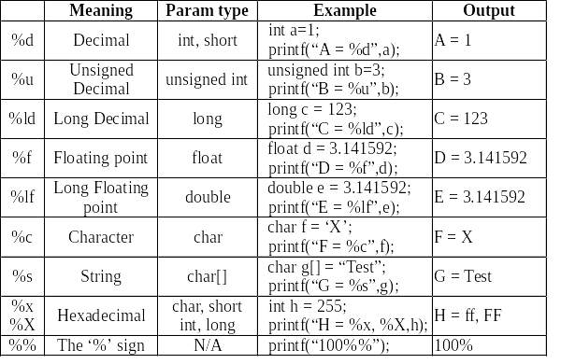
Place-holders:

Slide 12

printf Formatting - Integer
Commonly used ones: %d, %f and their long versions: %ld, %lf
It is easy to specify spacing, justification & places
Strings are enclosed in ‘*’ for easy viewing
What if
printf(“%5d\n”,123456);

Slide 13
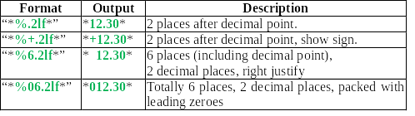
printf Formatting – Floating Point

Slide 14
Console input: scanf()
scanf() is similar to printf(), except that it’s for input from stdin.
To print integer variables a and b:
    printf(“%d %d”, a, b);
To read integer variable a and b:
    scanf(“%d %d”, &a, &b);
    scanf(“%d %d”, a, b);
You must place
address here

Slide 15
Console input: scanf()
You can use the format strings as those for printf(), except that you don’t need to take care of any formatting issue.
  there's NO such thing as: scanf(“%5d”,&a);
  the correct one should be: scanf(“%d”,&a);
scanf() can also perform some simple parsing:
  E.g. Read x,y co-ordinates: scanf(“(%d,%d)”,&x,&y);
  Input: “(123,456)”, then x=123 and y=456
  Even if the input is “ ( 123 , 456 ) ”
  You still get the correct value of x=123, y=456
scanf() returns the number of items it gets from the input or EOF if there is an error.

Slide 16
Console input: Strings and Characters
Input of string is a bit tricky.
If input string is “Hello World” and you use scanf(“%s”,Buffer); Then you get “Hello” only.
To get the whole string, you should use: gets(Buffer); The <enter> at the end of line will be replaced by NULL character.
To get a single character, use: c = getchar();
If reading of character is not successful, it will return the constant EOF

Slide 17
File I/O
To open a file to read, we use the following code:
  FILE *fp;
  fp=fopen(“Input.txt”,“r”);
FILE is a structure storing various states about a file… actually we don’t care what it is.
A FILE pointer will be returned by fopen(), we need to store it and use in further file operations
The second parameter of fopen() is used to specify the open mode of file: (“r”: read “w”: write)
To close the file we use: fclose(fp); where fp is the pointer returned by fopen()

Slide 18
File Read/Write Operations
After the file is opened, we can perform the read/write operation as usual (as stdin).
There are “file” version of printf() and scanf() with a ‘f’ prefix: fprintf() and fscanf().
To print (int) Num to file: fprintf(fp,“%d”,Num);
To read an int from file: fscanf(fp,”%d”,&Num);
To read a character from file: Ch = fgetc(fp);
To read a string from file, we use fgets();
Note that syntax and behavior of fgets() is a bit different from gets()

Slide 19
File Read/Write Operations
Syntax: fgets(Buffer, length, fp);
  need to specify the length of Buffer. Reading stops when length-1 characters are read or the newline character is reached. The string is then terminated with a null byte.
  Unlike gets(), fgets() preserves the newline character in string.
To detect whether end-of-file is reached, we use feof(). If we’ve not yet reached end-of-file, zero is returned.

Slide 20
Output to String: sprintf() & sscanf()
Apart from the ‘file’ version of fprintf() and fscanf(), printf() and scanf() have 2 more cousins!
They are the ‘string’ version: sprintf() and sscanf()
To print int N to string: sprintf(Buffer,“%d”, N);
To read an int from string: sscanf(Buffer,“%d”, &N);
Examples:
String copy ( as strcpy() ): sprintf(Dest,“%s”, Src);
String concatenation ( as strcat() ): sprintf(Dest,“%s%s”,Src1,Src2);
Number parsing ( as atoi(), atol() ):
  sscanf(Buf,“%d”,&Int_Var);
  sscanf(Buf,“%f”,&Float_Var);

Slide 21
Arithmetic Functions

Slide 22
Arithmetic Functions
Apart from +, -, *, /, C can perform many other arithmetic operations.
Modulus operator: %
  e.g. a = 11 % 3; Then a = 2;
  Only applied to integer types (char, short, int, long)
  What would be the result of a = -11 % 3 ?
Other mathematical functions (mostly for floating point) are in the math library:
#include <math.h>

Slide 23
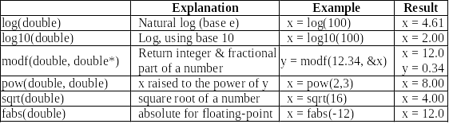
Arithmetic Functions
Other math functions:
Of course C has functions for sin(), cos() and tan()
But note that the angles are in radians

Slide 24
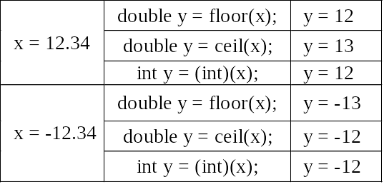
Floor and Ceilings
Two functions that worth mentioning are floor() and ceil(). (The numeric floor and ceiling)
They are different from casting:
  floor() : largest integer no greater than x
  ceil() : smallest integer no less than x
  casting is round-towards-zero

Slide 25
Bitwise Operations

Slide 26
Bitwise Operations
One powerful feature of C is that it supports bitwise operation for integer types:
  Bitwise AND (&) (Note: && is logical)
  Bitwise OR (|) (Note: || is logical)
  Bitwise NOT (~) (Note: ! is logical)
  Bitwise XOR (^)
  Left arithmetic shift (<<)
  Right arithmetic shift (>>)

Slide 27
Bitwise Operations
Bitwise operation is efficient and has lots of usage:
Checking Odd or Even:
  if (x&1) printf(“x is odd”);
Check for divisibility of 2’s power:
  if (x & 7) printf(“x not divisible by 8”);
Round down to nearest multiple of 2’s power
  x = 27; y = x & (~7); // y becomes 24 (8’s multiple)
Quick multiply by 2’s power
  x = 5; x=(x<<2); //(or simply x<<=2;) x=20 (5*4)
Quick division by 2’s power, round down
  x=27; x>>=2; // x = 6 int(27/4)

